Slide 1
Traditional dishes in Albania

Slide 2
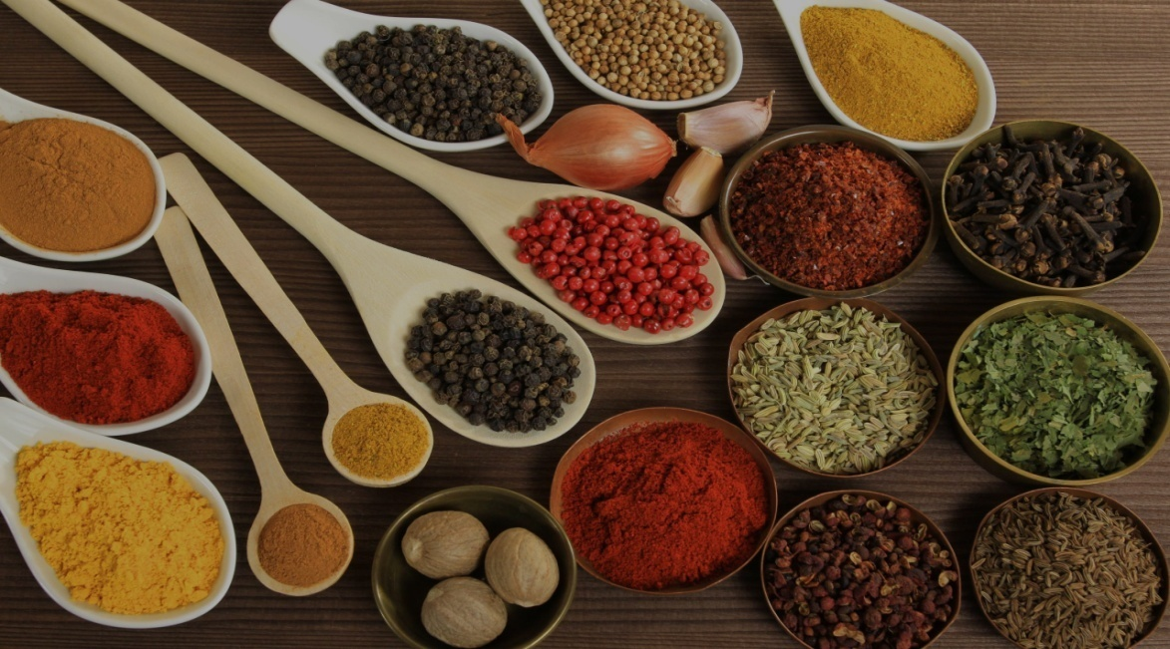
Albanian Cusine
Albanian Cuisine (Albanian: Kuzhina shqiptare) is the national cuisine of the Albanian people. Albanian cooking traditions are diverse because of geographical factors. It is influenced by many including Italian, Greek and Turkish cooking. It is characterized by the use of many herbs such as oregano, mint, basil, rosemary and more in cooking meat and fish, but also chilli pepper and garlic. Vegetables are used in almost every dish.

Slide 3
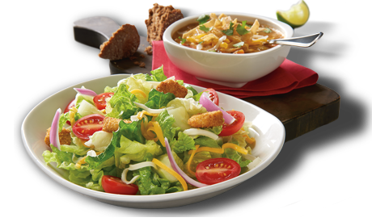
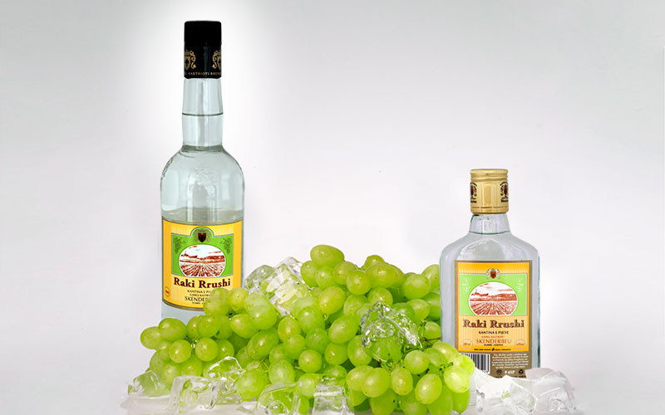
Albanian Cuisine
The main meal of the Albanians is lunch, which usually consists of gjellë (stew), the main dish of slowly cooked meat with various vegetables, and a salad of fresh vegetables, such as tomatoes, cucumbers, green peppers, and olives. The salad is dressed with salt, olive oil, vinegar or lemon juice.
In high elevation localities, smoked meat and pickled preserves are common. Dairy products are integral part of the cuisine usually accompanied with alcoholic beverages such as Raki.

Slide 4
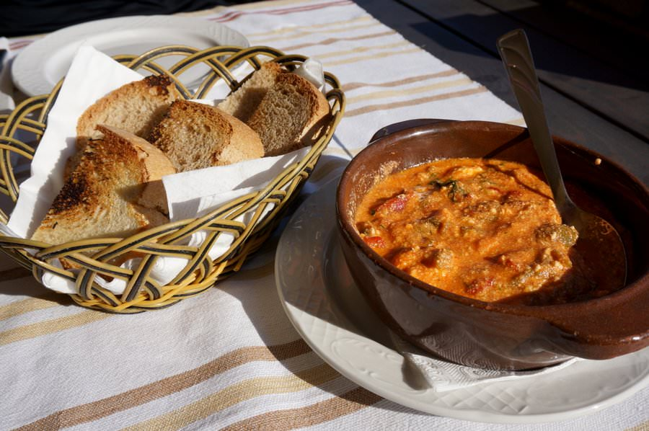
Fërgesë
This simple dish ended up being one of our go-to meals for lunch. Green and red peppers, along with skinned tomatoes and onions are cooked down with cottage cheese and spices. The end product is a thick dip, which when accompanied with some bread is actually quite filling.

Slide 5
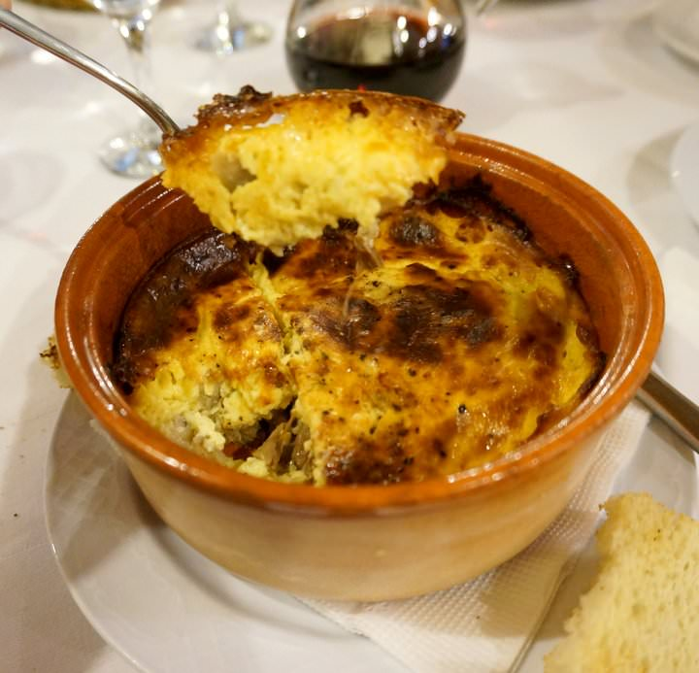
Tavë Kosi
Lamb and veal are popular meat choices in Albania, and the tavë kosi is one of the most beloved dishes in the country. Lamb is baked in an earthenware dish with eggs and yogurt. The end result is a quiche-like dish, with tender meat and a light, creamy egg topping.

Slide 6
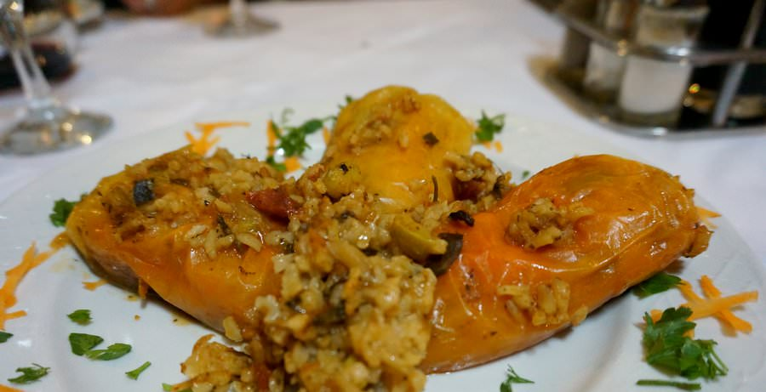
Speca te mbushura
Yellow, orange or red peppers are stuffed with rice, cottage cheese and spices, before being baked in the oven. This was one of our favourite meals, as it was bursting with flavour, and was a healthy choice.

Slide 7
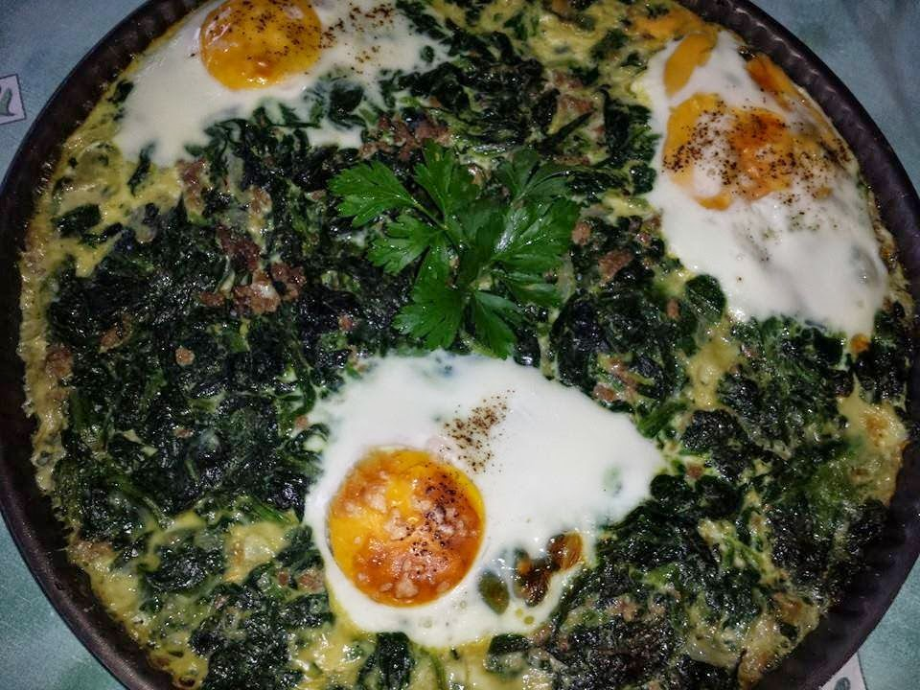
Burani
Albanian Burani is a simple great all-in-one pot spinach and rice recipe. It’s quick, easy,cheap and healthy. Flavorful white basmati rice cooked with spinach with eggs often introduced within the mixture or cooked on top.It contains rice , spinach,onions,basil, eggs and butter.

Slide 8
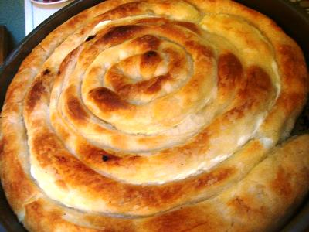
Byrek me kos
Byrek is made and eaten throughout Albania. Byrek me Kos is a yogurt and white cheese pie and is just one of the many variations you can find throughout the Balkans.
Layers of filo pastry are rolled out, within the middle of them a filing is added and then the byrek is shaped. Traditionally you can have a whole pie, spirals and also a lot of the street sellers will have triangle or horseshoes.

Slide 9
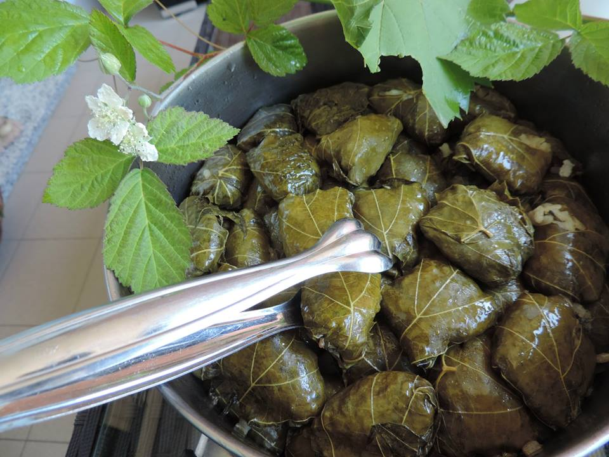
Dollma (Japrak)
These refreshing rolled vine leaves stuffed with minced lamb, onions, rice, herbs and seasonings are simmered until tender and delicious.
‘Dolma’ means stuffed vegetables and although grape vine leaves are most popular you can also stuff any form of Greens (Cabbage is most popular), Onions, Peppers, Aubergines, Squash, Tomatoes and Courgettes.

Slide 10
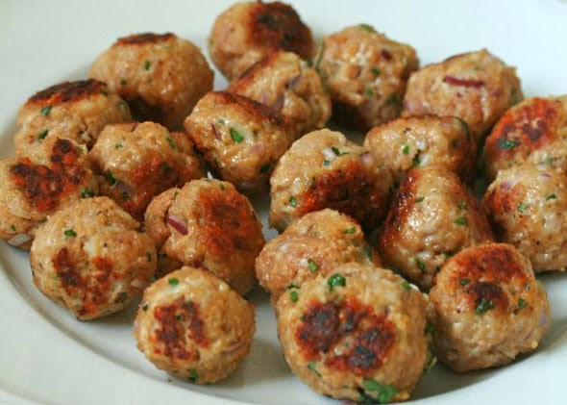
Qofte
Albanian Qofte (meatballs) are amazing and one of Albania’s national dishes as well as a part of the Middle Eastern cuisine. Commonly made and fried in all parts of Albania mean that there are many different versions of the qofte recipe including versions that use mint or feta cheese.

Slide 11
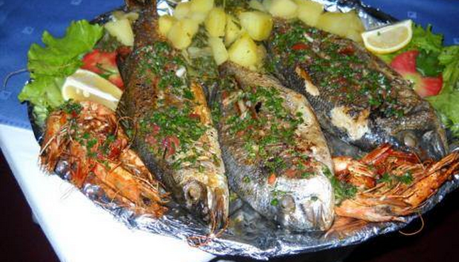
Tave me peshk Korani
Albania is known for its rivers, lakes and seas with fresh fish. The common fish in our country are the Trout and Koran.The recipe includes:koran,salt, pepper,wine,vegetables ,garlic, onions and a few bay leaves.It is cooked in a casserole.

Slide 12
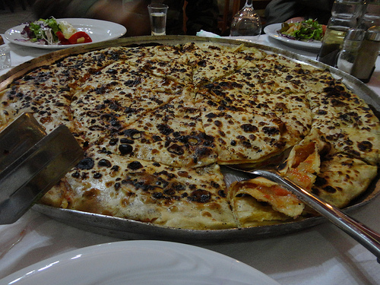
Lakror
Lakror(leek pie) is Albanian style burek, that is taught by generation to generation and is filled with a variety of fillings. Popular fillings are, spinach and cheese, leek and cheese, ground meat and onion mixture, onion, tomato and pepper like the one in this recipe and more. The dough is a thicker filo closer to yufka depending on how thin you roll it. This dough is thin and flaky as there is no yeast added to it.

Slide 13
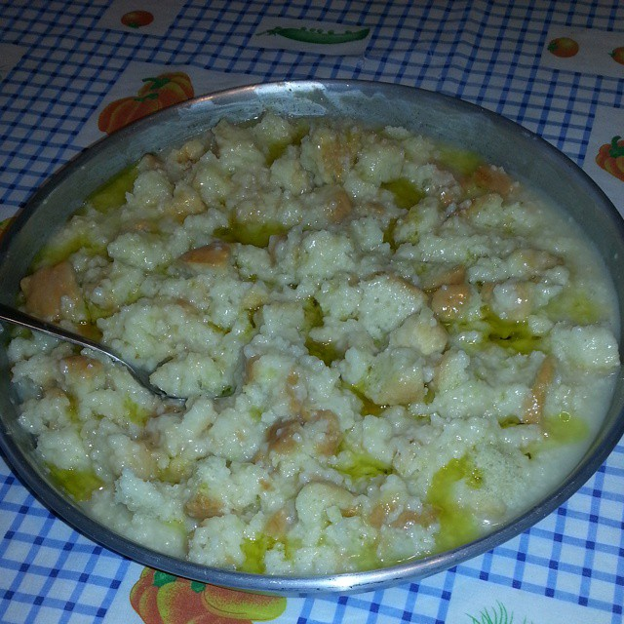
Albanian Trahana
Trahana is always made at the end of the summer when there is enough of a breeze and enough heat to dry the morsels quickly but also because the summer is a time, in the agrarian cycle, when there is an excess of milk. Once the ingredients have been combined, they are broken into chunks, dried, and then broken up into smaller pieces.
Dairy-based trahana comes in two types: sweet and sour. Sweet is made with whole milk, typically goat’s milk, and sour trahana is made with yogurt or buttermilk.

Slide 14
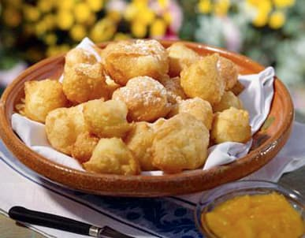
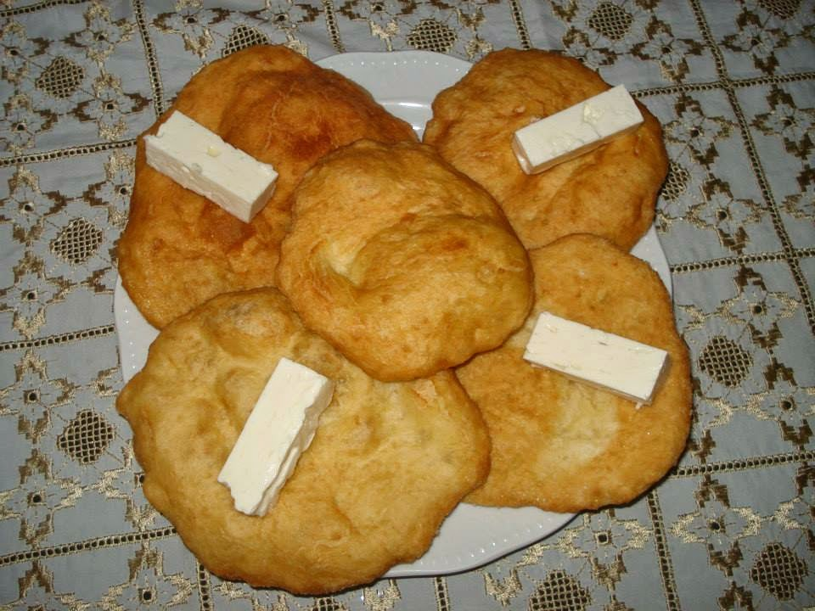
Petulla
Petulla, the Albanian version of fried dough, is a childhood favorite of albanians. You can eat it with powdered sugar, but also is with feta cheese and raspberry jam or fresh raspberries.

Slide 15
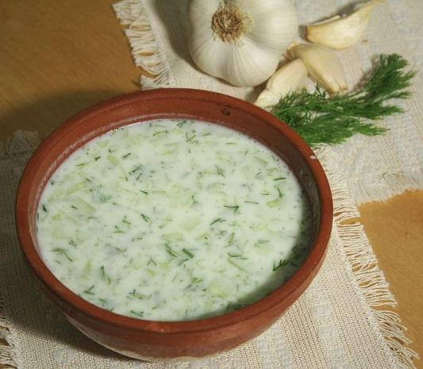
Tarator
Tarator is a chilled yogurt ,garlic and cucumber drink and is popular in the summer months.

Slide 16
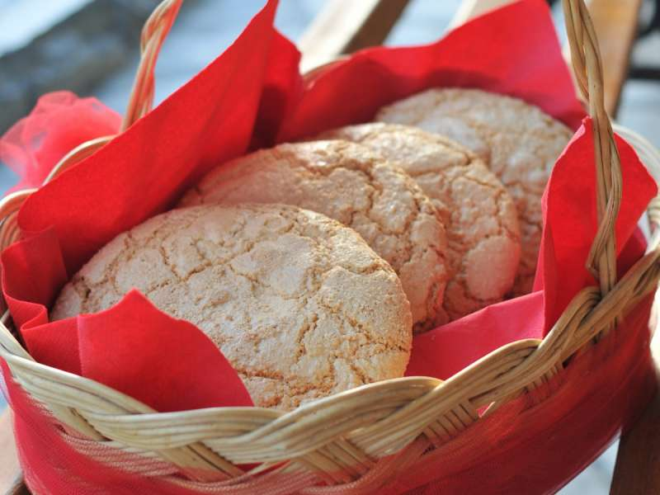
Ballokume
Ballokume is an Albanian dessert that originated in Elbasan ( a city in Albania). Ballokume is prepared every year on March 14th to celebrate “Summer Day”. Every year, when people go out to celebrate the “Summer Day”, people from Elbasan prepare the ballokume and sell it.

Slide 17
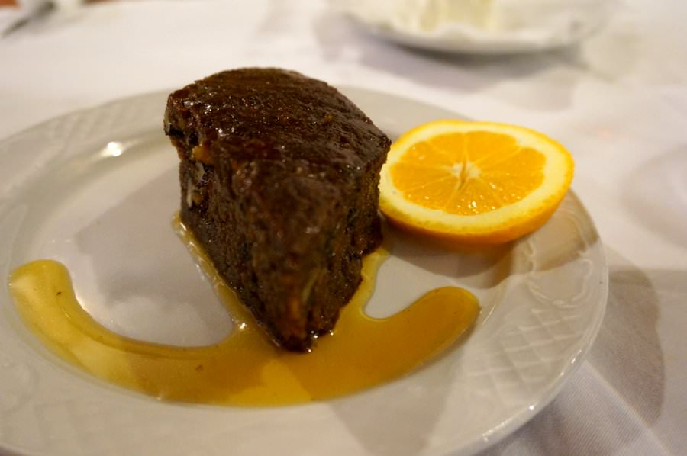
Shëndetli
This honey nut cake is a typical Albanian dessert, and is also a very popular one. It’s made with all of the usual cake suspects – baking soda, flour, sugar, eggs – but what sets it apart are the honey and walnuts.
Also, when the cake is ready, a hot syrup made with vanilla, sugar, water and cloves is poured over the cake and left to soak overnight.

