Slide 1
Polish Culture

Slide 2
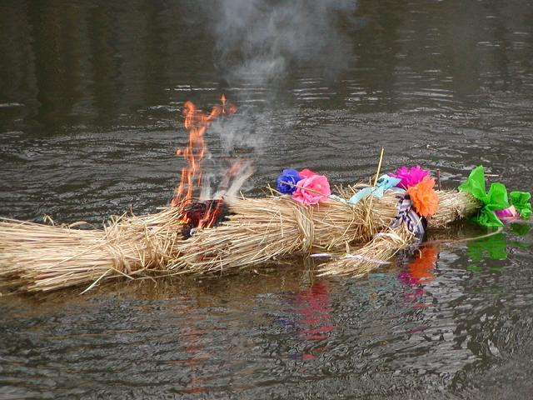
Marzanna – Burning and drowning a straw effigy
Marzanna is the Polish name for a Slavic goddess associated with death, winter and nature. Even though pagan religion was theoretically eradicated from Poland in the early 11th century, Marzanna is still alive thanks to a popular ritual. Every year, on the first day of spring, people would make an effigy, set it on fire, and then drown it in a river. The aim of the ritual is to chase off winter and encourage nature to revive.

Slide 3
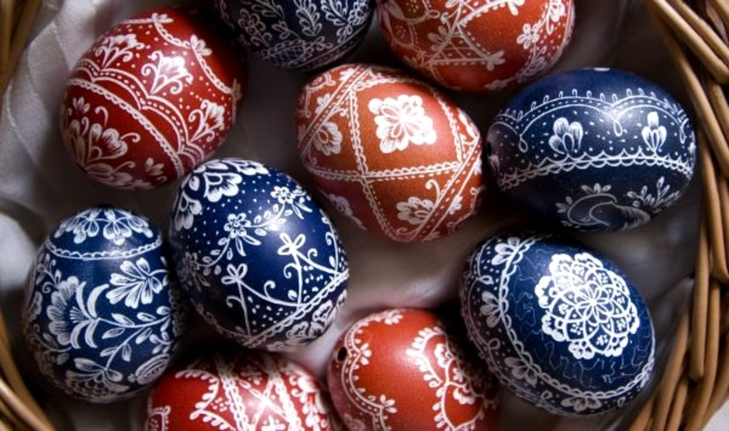
Written Eggs / Pisanki
The custom of coloring eggs for Easter is still observed in Polish custom. The eggs are decorated with many traditional Polish symbols of Easter. Most popular are lamb, cross, floral designs or Easter's greetings. On Easter Sunday, the Easter table will be covered with a white tablecloth.

Slide 4
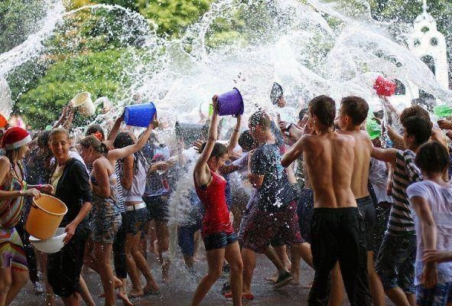
Śmigus Dyngus – Pouring buckets of water on strangers
Among the Easter code of rituals Śmigus Dyngus may be the most unexpected. What it is nowadays is a free-for-all, all-day water battle played out with water pistols, bottles, water balloons thrown from windows, plastic bags or whatever means are on hand – in some rare instances even fire trucks have been known to join in.

Slide 5
Poprawiny – Having a second wedding party after the first
Poprawiny basically means starting the wedding party all over again, in the middle of the day after the wedding party, and sometimes it is even carried on to the third day. There are even legends of week-long wedding parties organised by Gorals – the inhabitants of the Polish Tatra mountains.

Slide 6
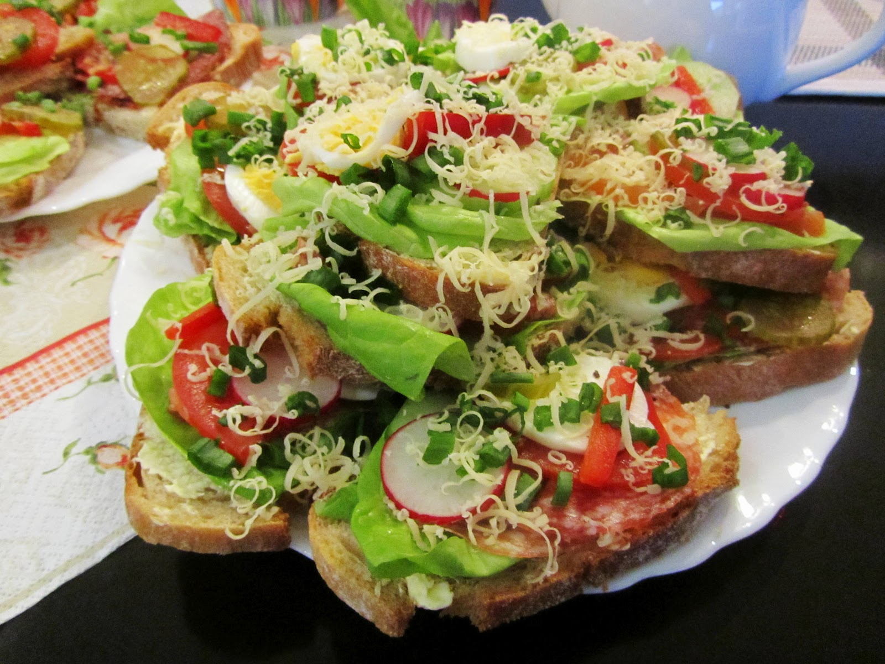
Kanapki – Sliced bread instead of sandwiches
Kanapka is the Polish word for most types of snacks that have a slice (or slices) of bread as a base component. It refers to all types of sandwiches but, above all else, to the Poles, it means the beloved open sandwich. Kanapka is the first choice for breakfast, lunch and supper, and doesn’t really differ depending on time of the day.

Slide 7
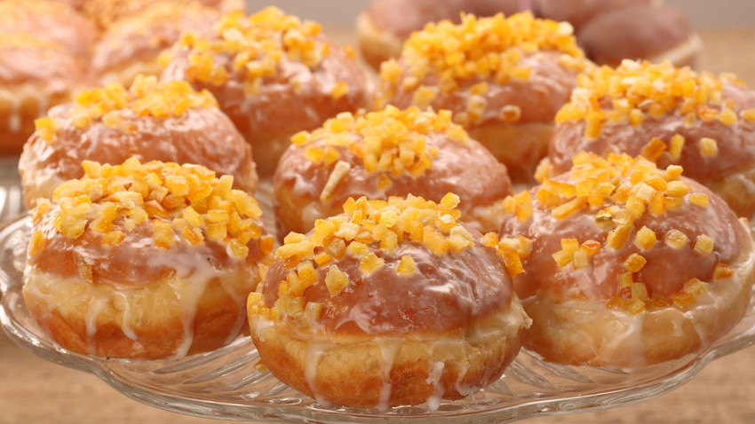
Fat Thursday
The last one before the Ash Wednesday, is a festival of overeating when every Pole devours the Fat Thursday's specials: ‘favorki’ crunch cakes and the Polish doughnuts (balls with rose-petals jam filling) which are a must-eat treat on that day.

Slide 8
The prefix Pan (Mr) or Pani (Ms) is the safest way to address someone who is Polish. This should be accompanied by the first name, of course. Taking the surname of a person is seen as a slight even when a Pan/Pani is placed before. "Ty" is polish for "you". If one is allowed to call the other "Ty", it means that the relationship is a lot informal

Slide 9
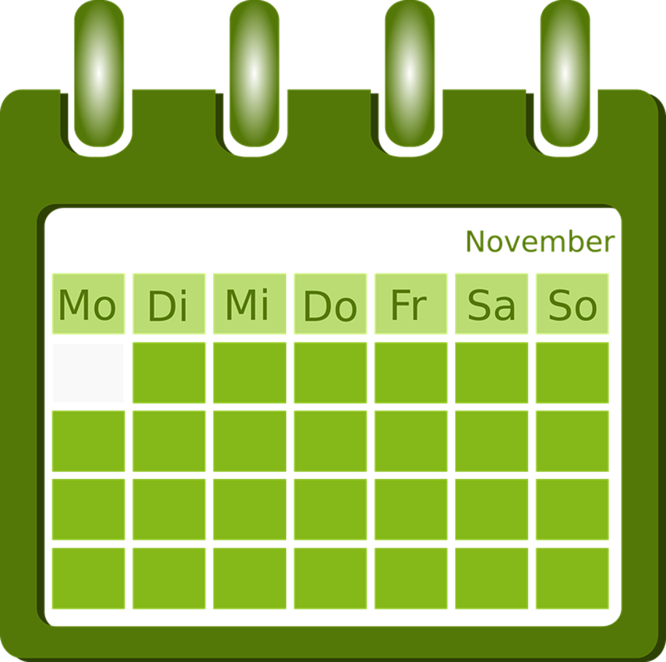
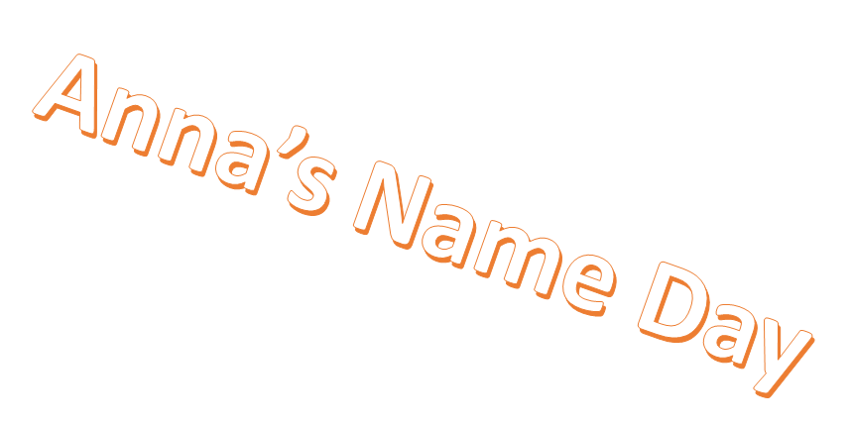
It is important to remember name days (a patron saint's day - rather than birthdays). This anniversary is important for Poles and in no other culture, it is celebrated with equal fanfare. In order to avoid awkward situations, it is worthwhile checking the calendar and marking the appropriate date.

