Slide 1
Lifestyle!
*Or at least, the teenager part of it*
Cosmin Negoita

Slide 2
Basics
As it is already familiar with more than 90% percent of our population, we, teenagers, are quite different when compared to adults.
So that leads us to many weird activities, most of them ending in sleep. A lot of sleep.
If it wasn’t obvious enough, I present you :

Slide 3
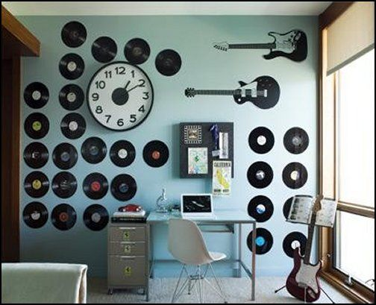
Music tastes
In this department, we kinda enjoy the boom-boom and the message of the song itself, rather than the musicality as a whole.
But, that doesn’t mean we are completely lost, we do enjoy the ol’ classy’ songs that Bon Jovi used to sing to impress the ladies.
When sincerity is key..
Grab a guitar, or, 2 , 3.

Slide 4
GO ON A DIET. JUST DO IT
As expected, ‘lifestyle’ had to have a food chart.
As it is, our food intake isn’t that wow. In fact, it’s mostly chips, chocolate and fastfood.
But, we do eat soup, ..sometimes..kinda…maybe..
HIDE!!!!!!!

Slide 5
Things to wear, always trending
In a teenager’s life, the clothing is the most important element, followed by the second and third most vital things, likes on facebook and having at least a mohawk.
Nontheless, we do enjoy to have a variate wardrobe, and tend to dress in vivid colors, and funny designs and cool shapes.
Less material = more $$$
It’s logic, isn’t it?

