Slide 1
Visit to the sorting centre in Juankoski 3 June 2022
Classes 3-4 and 5-6

Slide 2
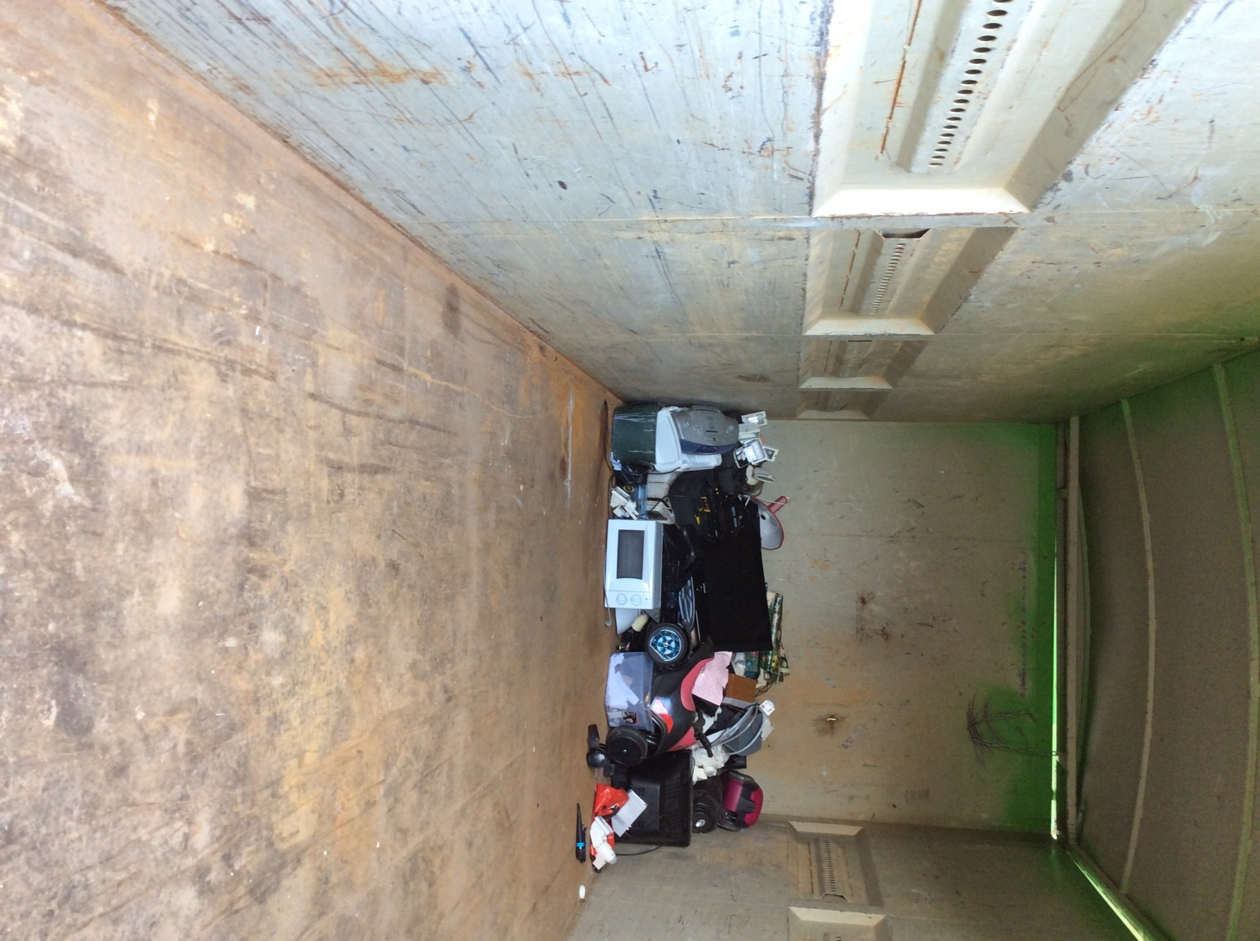
Electrical waste

Slide 3
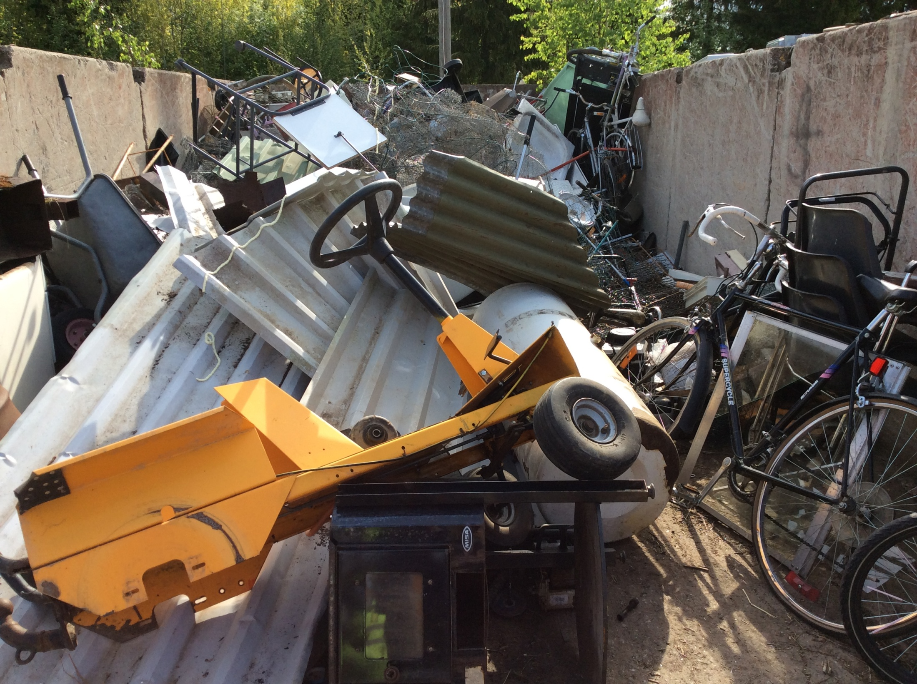
Metal

Slide 4
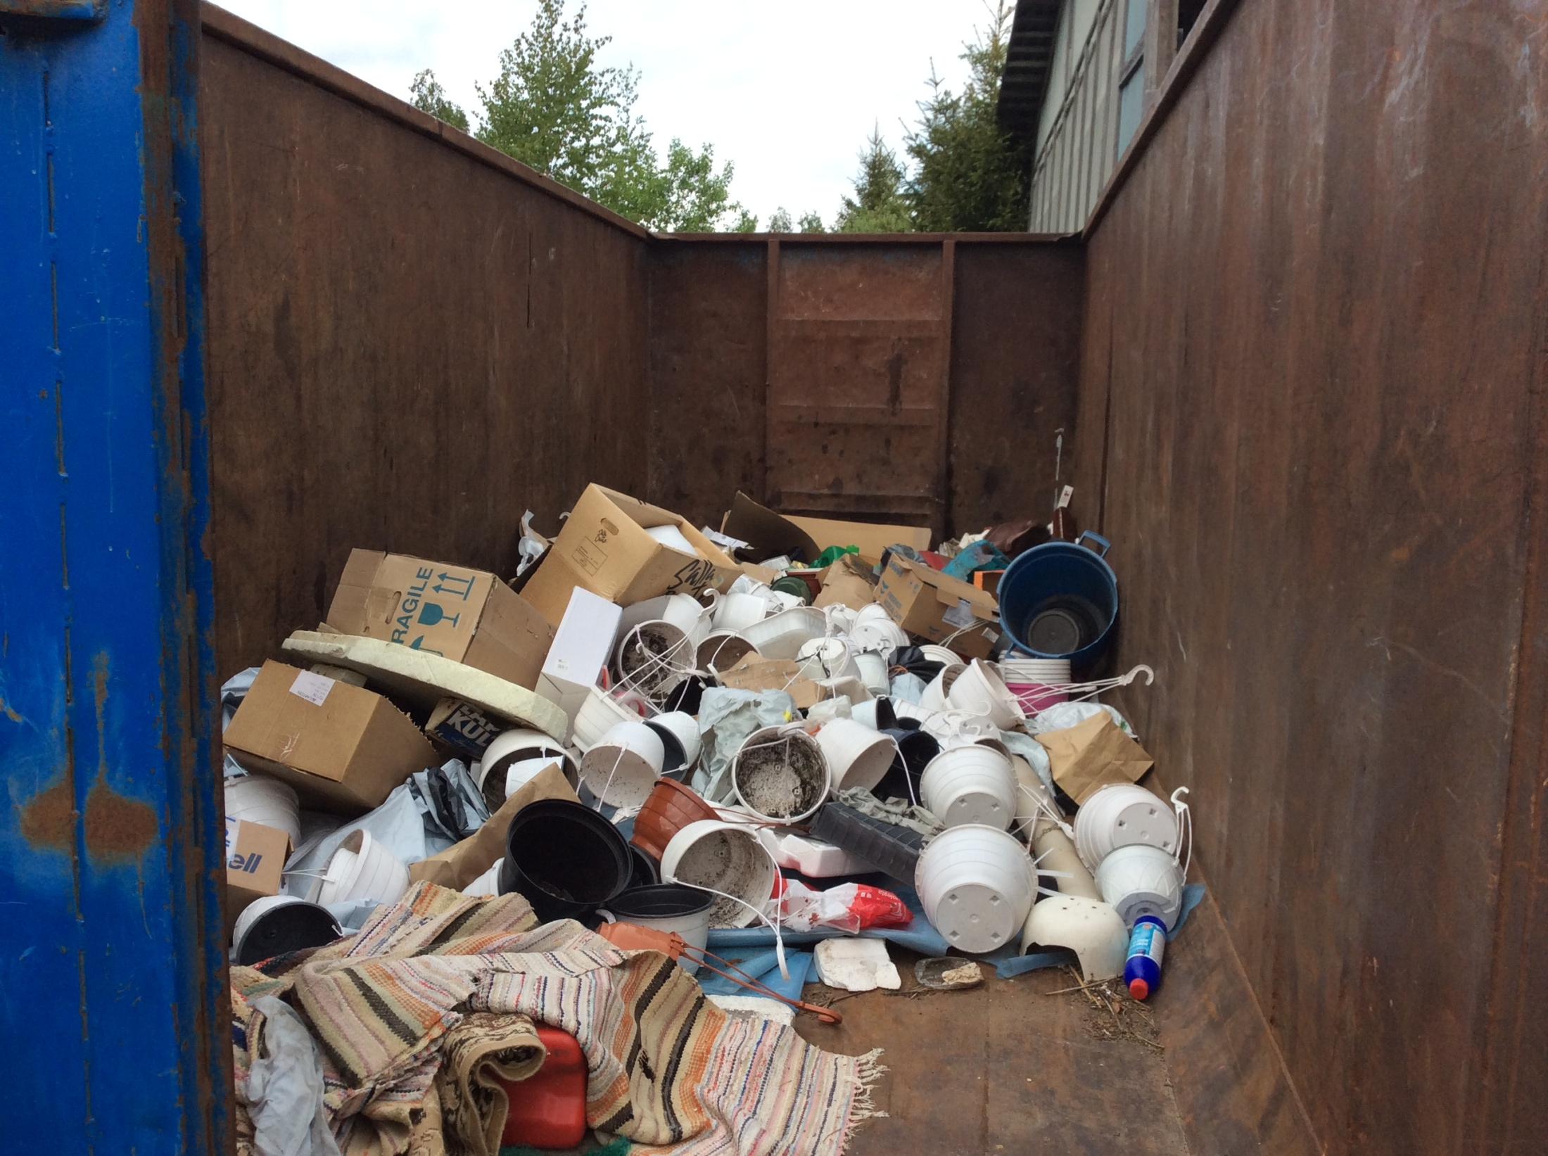

Slide 5
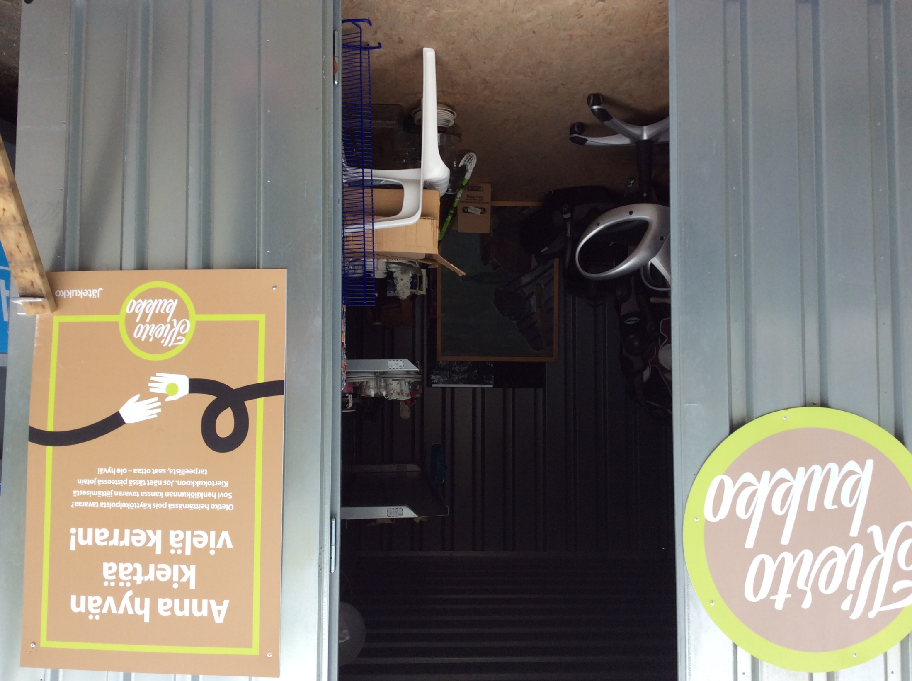
Things that somebody can still use.

Slide 6
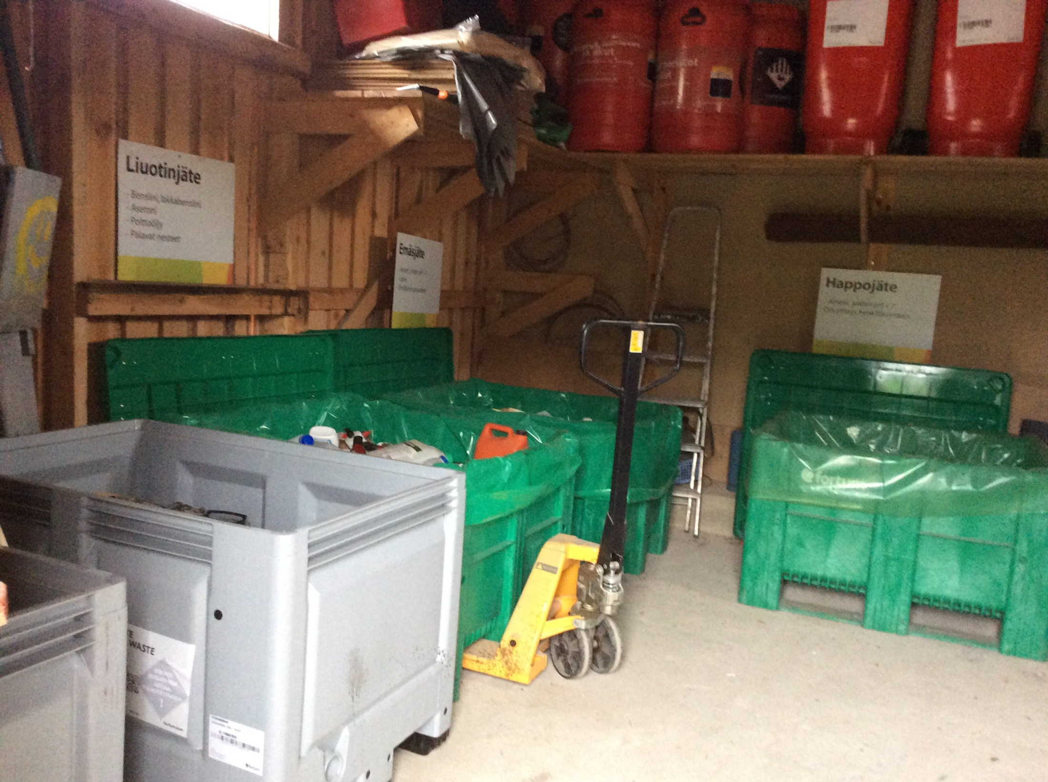
Hazardous waste

Slide 7
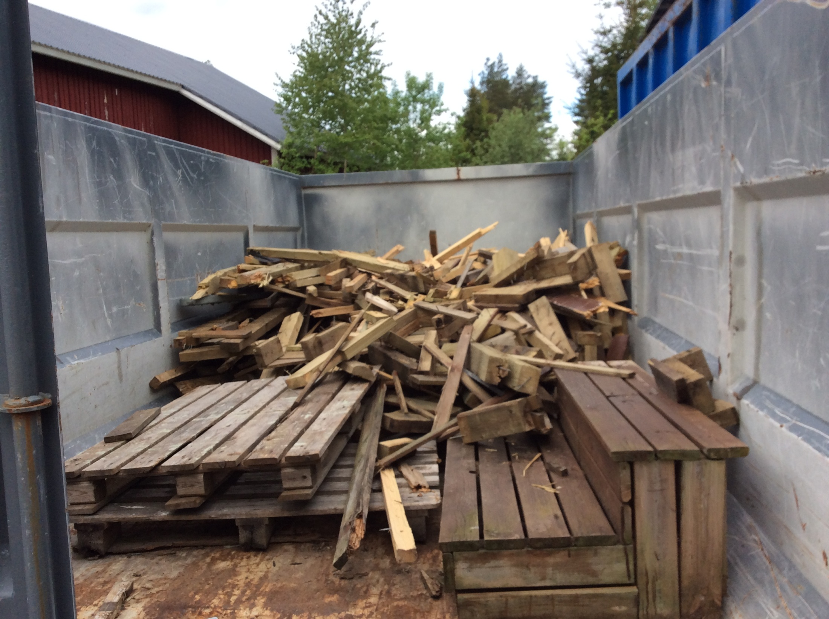

Slide 8
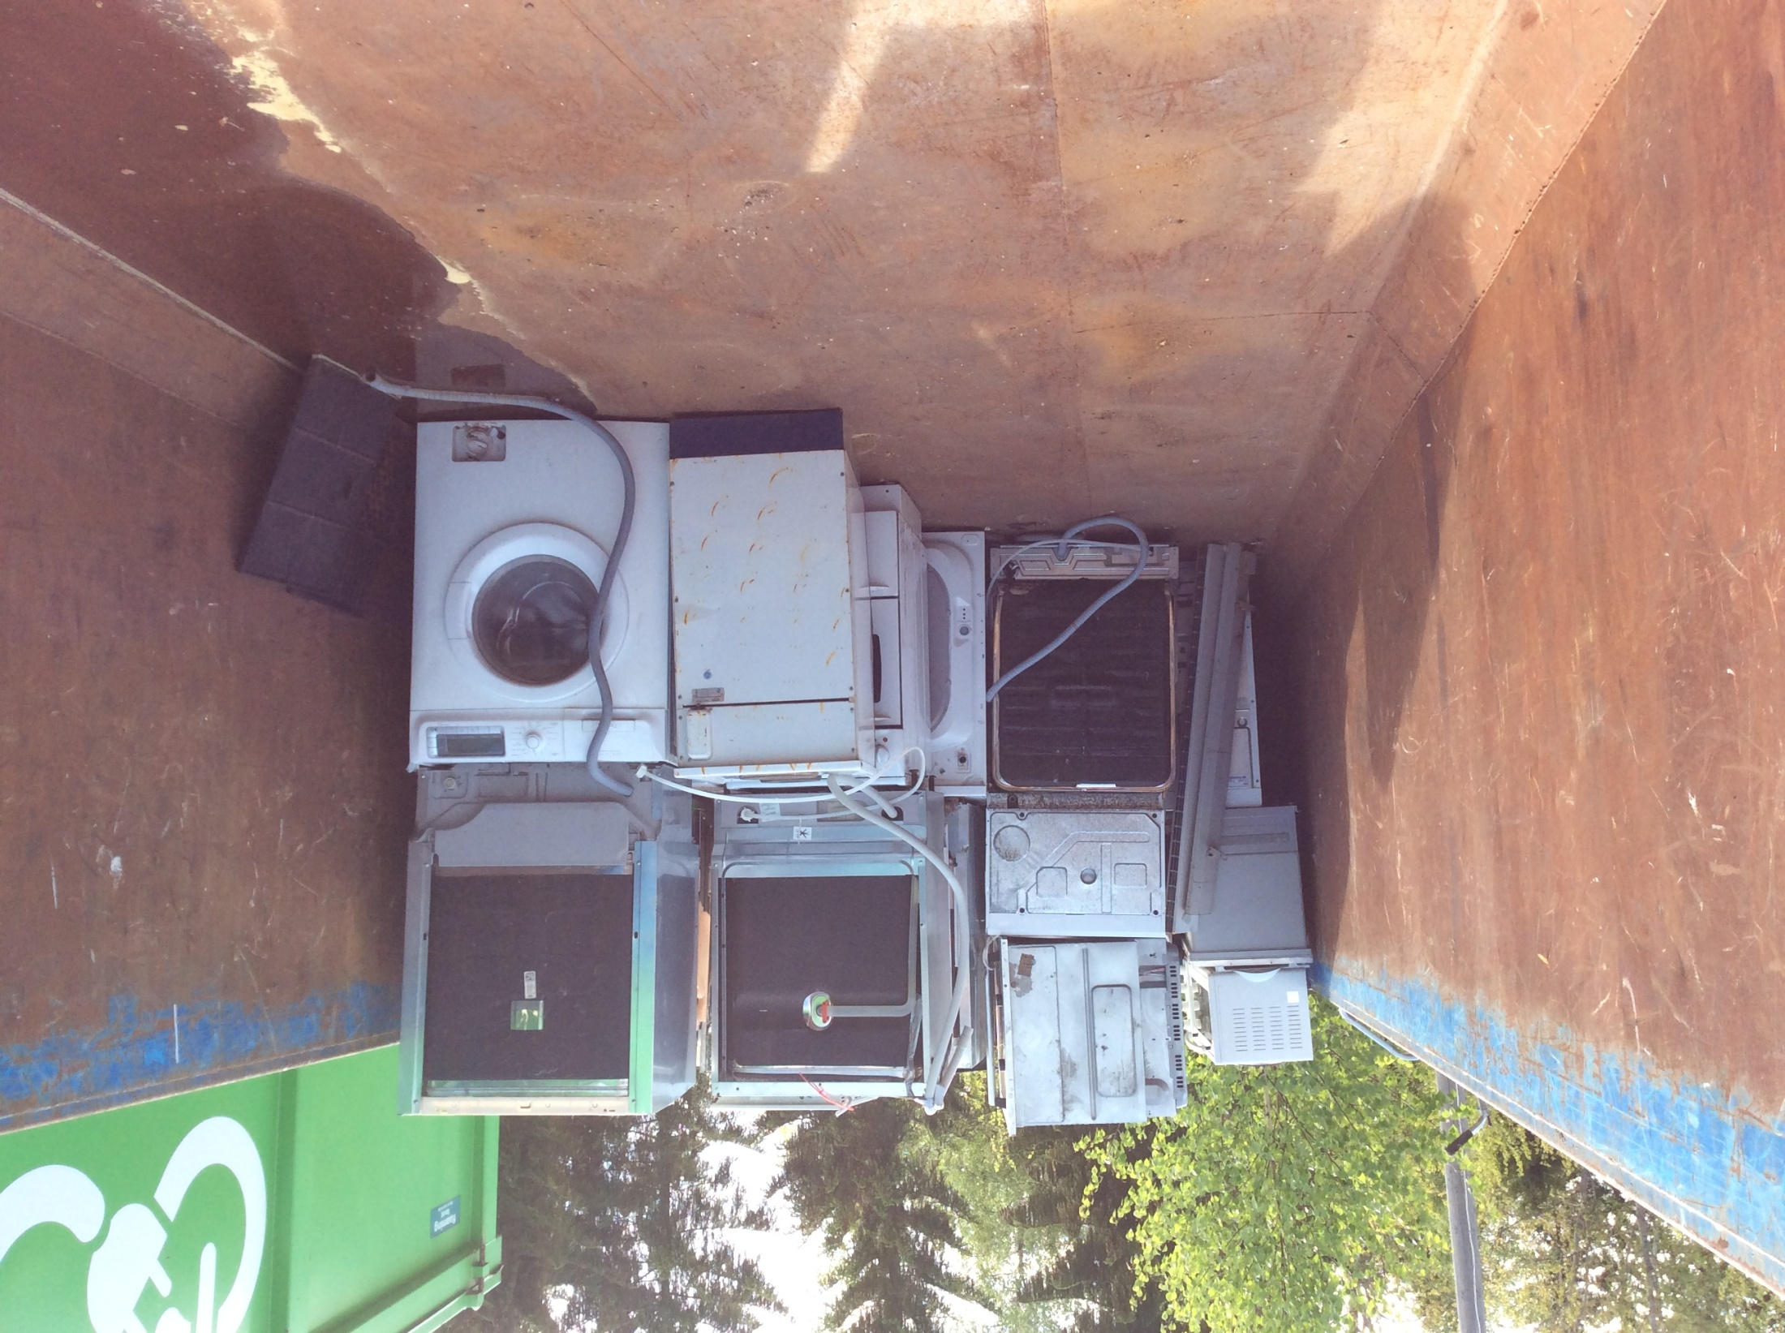

Slide 9
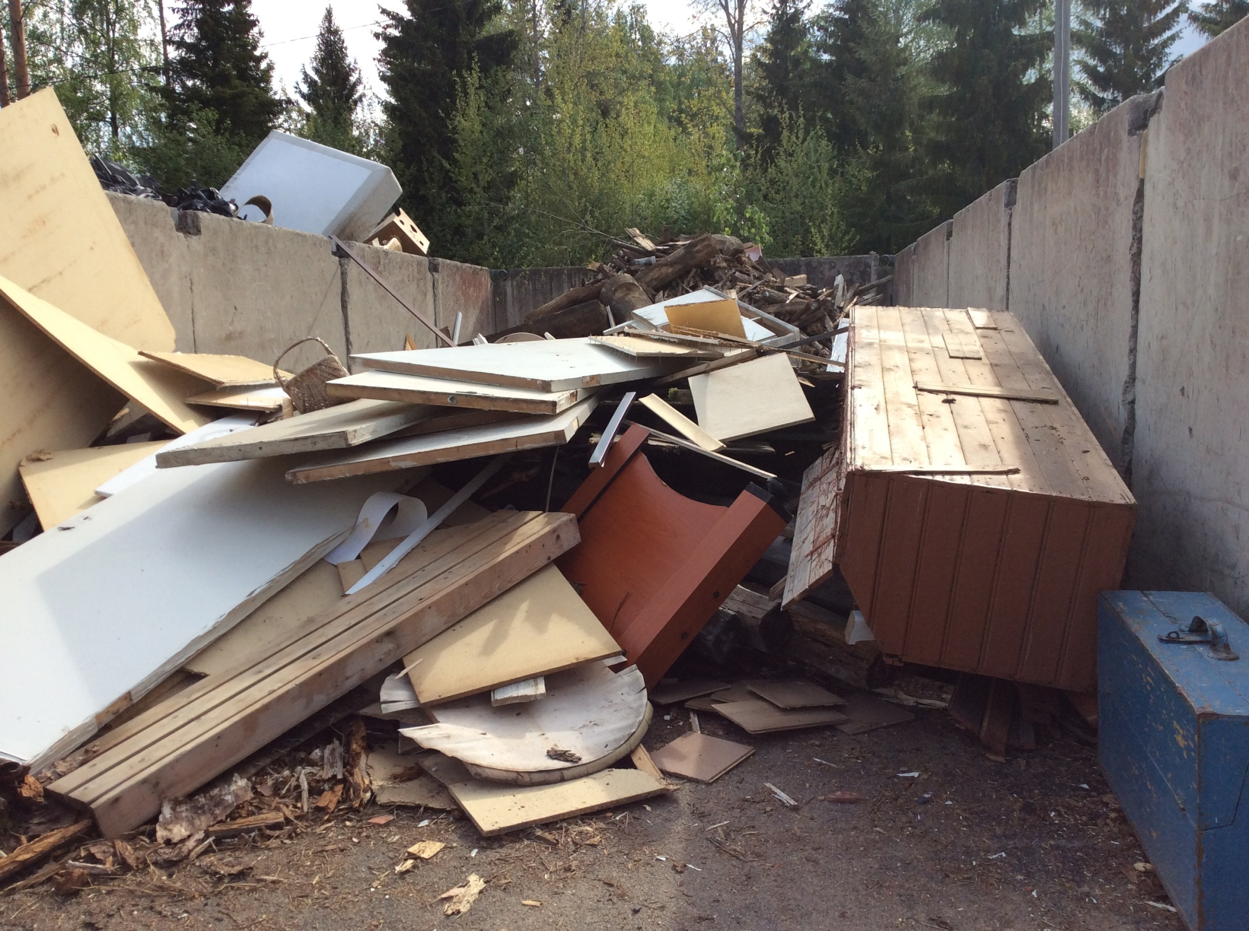

Slide 10
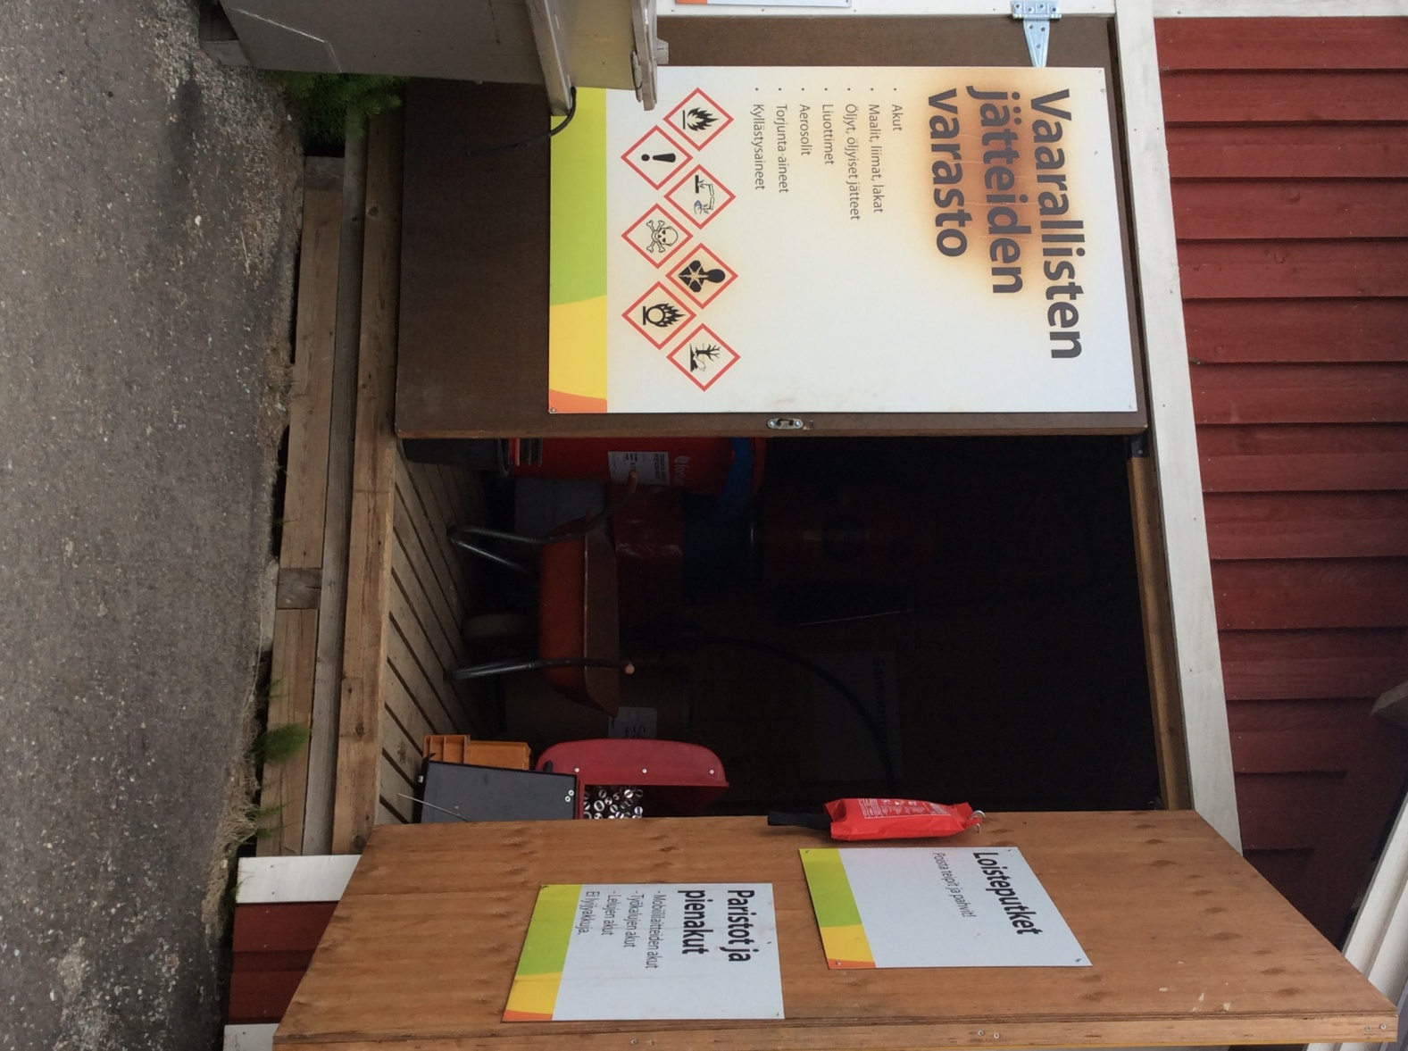
Hazardous waste
Fluorescent lamps Batteries

Slide 11
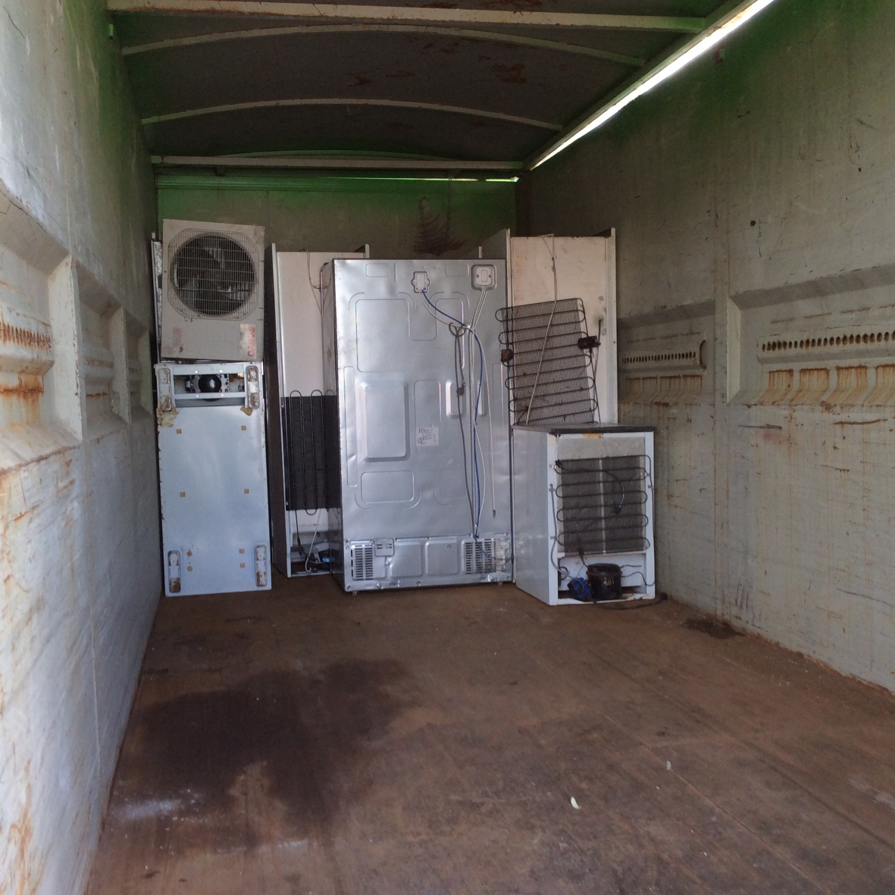

Slide 12
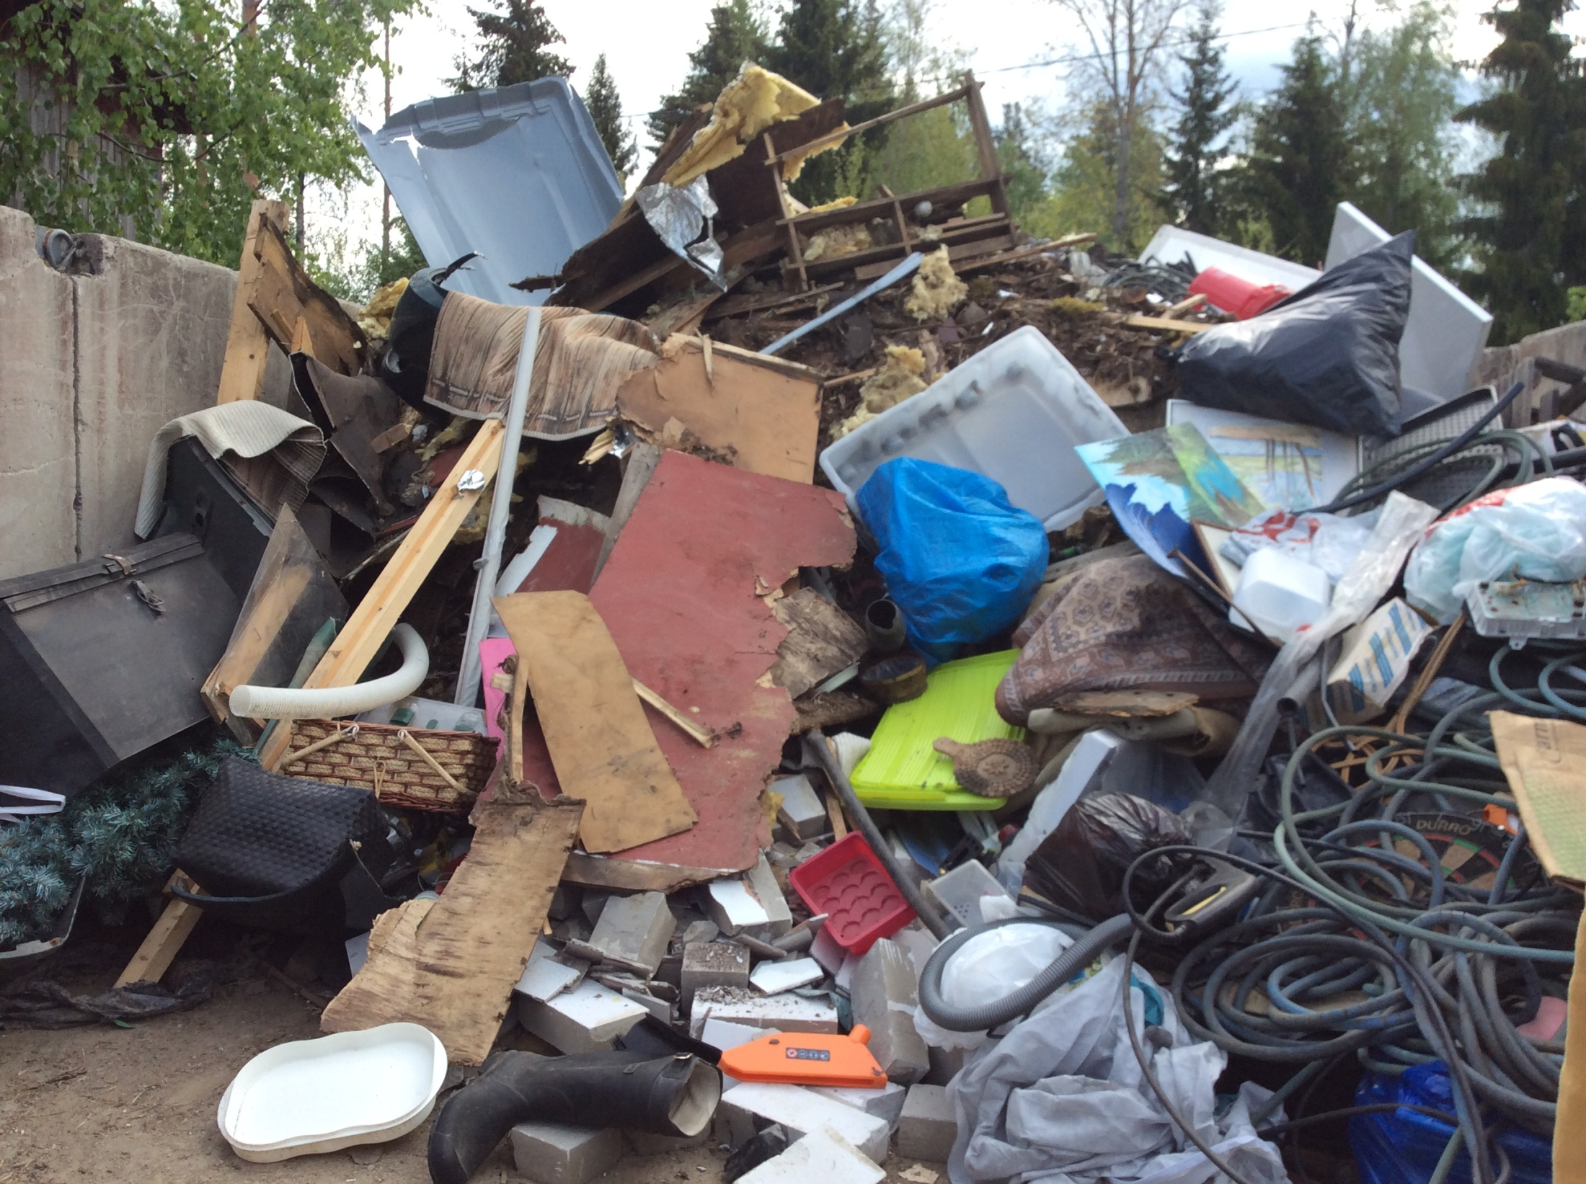

Slide 13
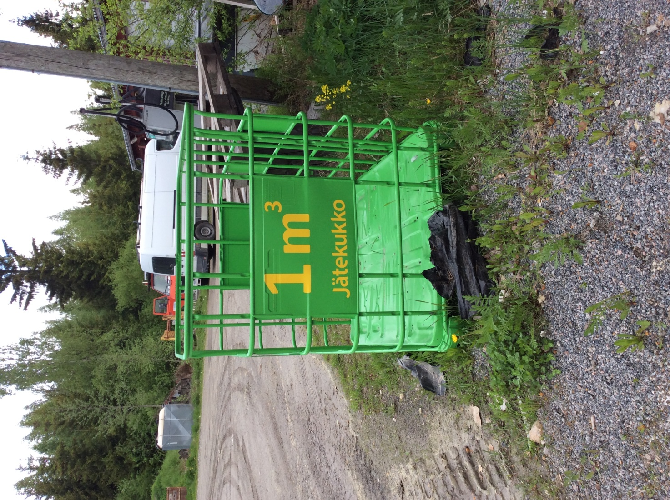
You don’t pay for bringing hazardous waste, electrical waste and some other types of waste.
You pay for bringing miscellaneous waste, cost per cubic metres.

Slide 14
Nothing goes to a dumping ground.
Everything will be recycled or used for source of energy.

