Slide 1
Erasmus+ works May-June 2022
Muuruvesi School, Finland

Slide 2
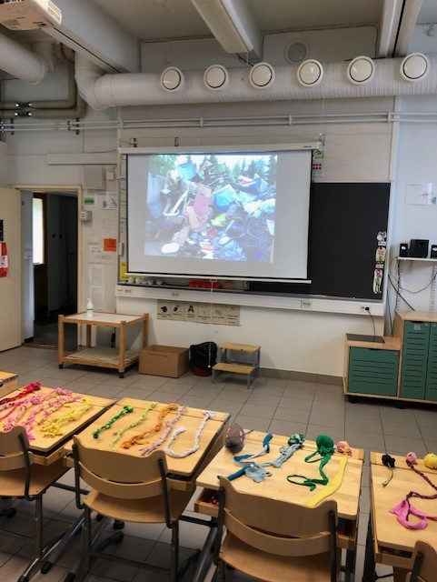

Slide 3
Class 1-2 made colourful ”glitter bottles” that helps you to feel calm: Shake the bottle and watch the glitter flakes dance.

Slide 4
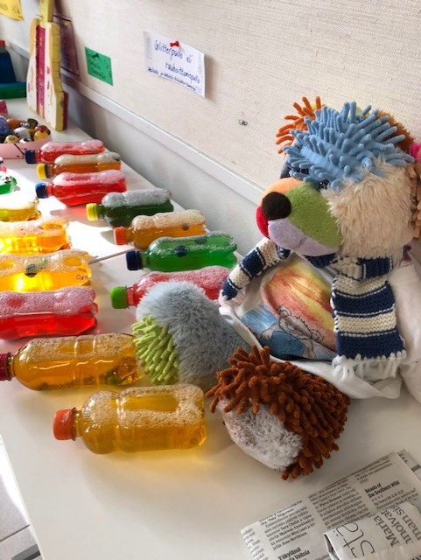

Slide 5
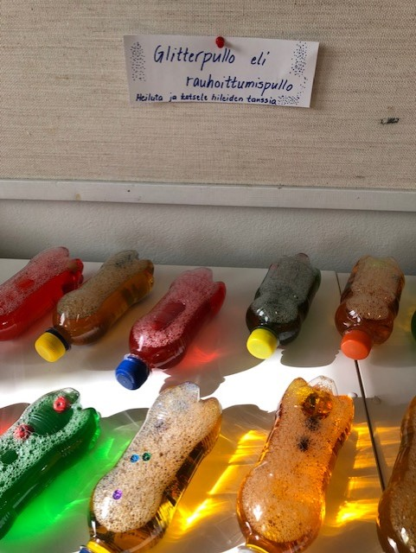

Slide 6
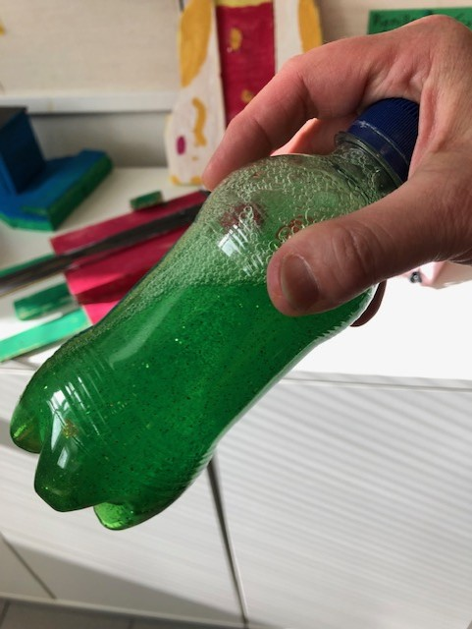

Slide 7
Class 1-2 made ”space art” using recycled materials.

Slide 8
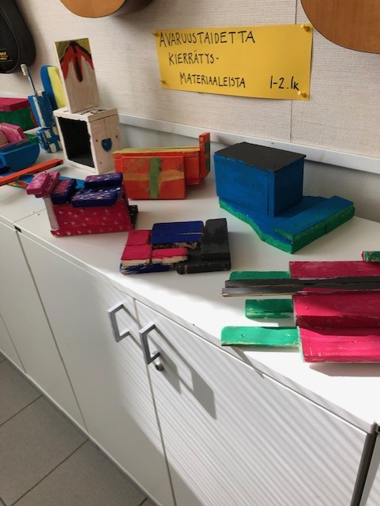

Slide 9
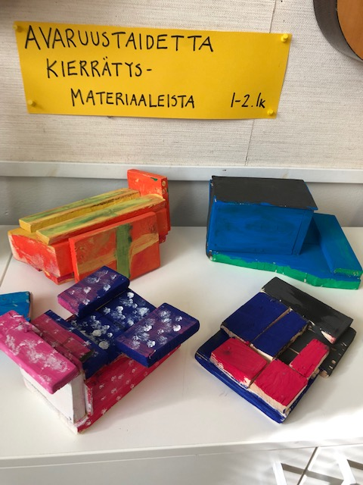

Slide 10
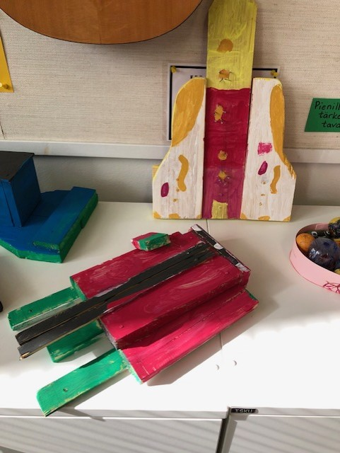

Slide 11
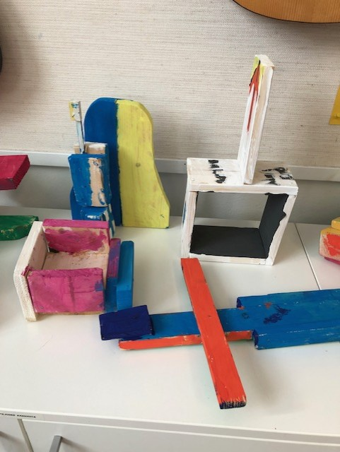

Slide 12
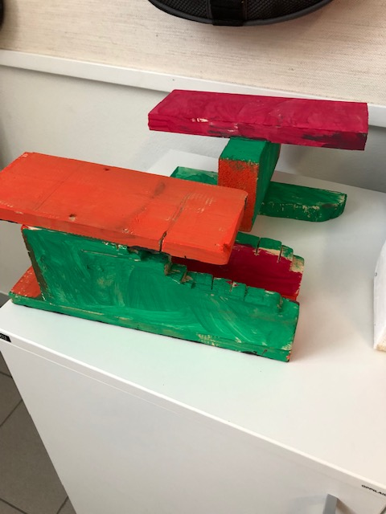

Slide 13
Turning old into something new
Class 3-4 used old T-shirts for making toys for dogs and cats and old socks for making mascots.

Slide 14
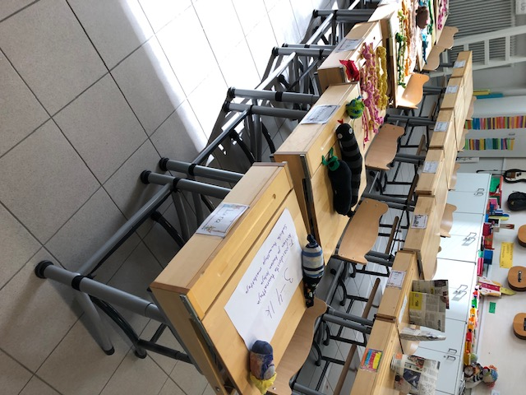

Slide 15
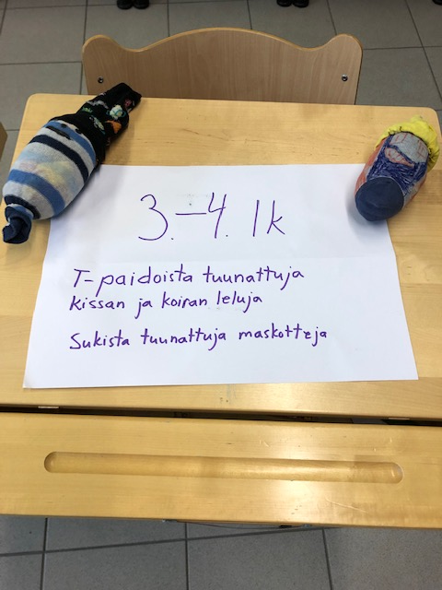

Slide 16
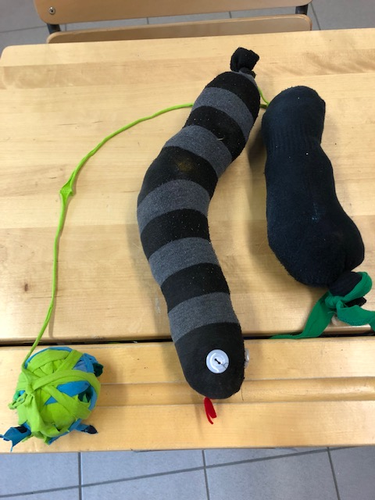

Slide 17
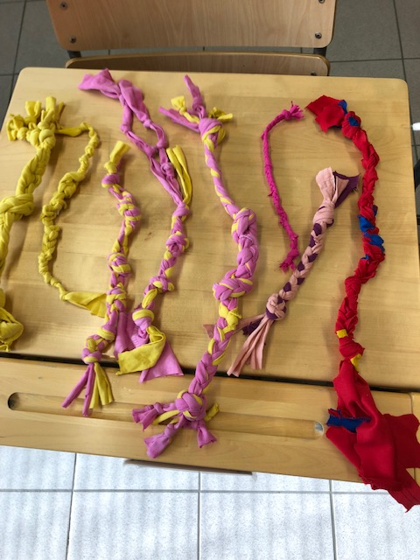

Slide 18
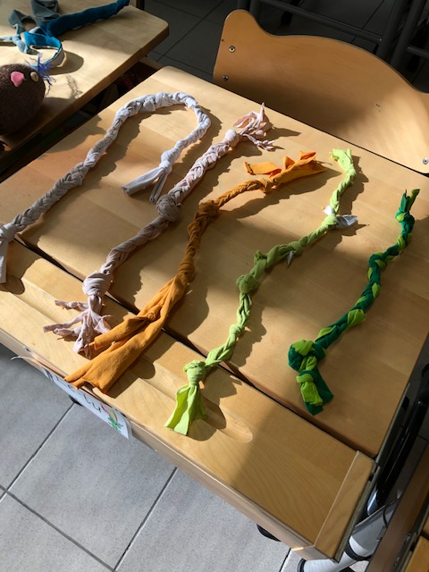

Slide 19
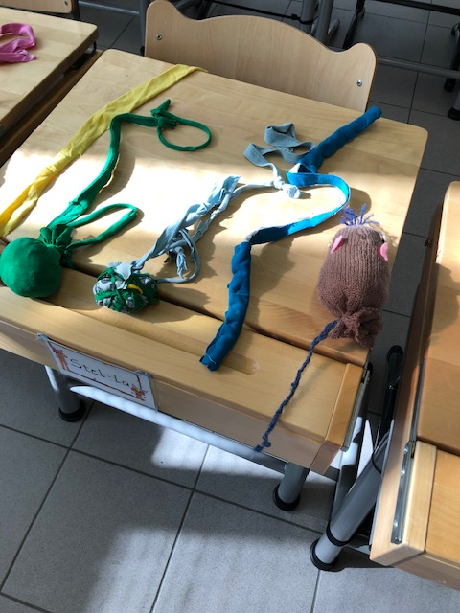

Slide 20
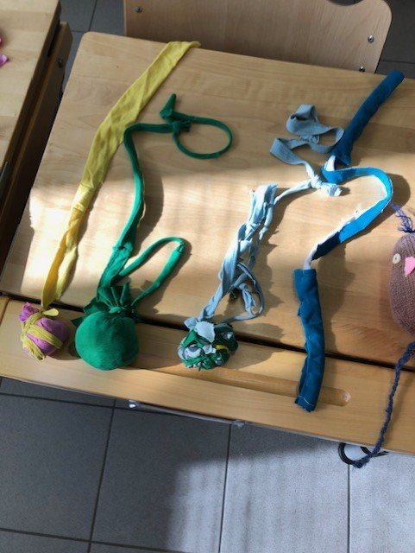

Slide 21
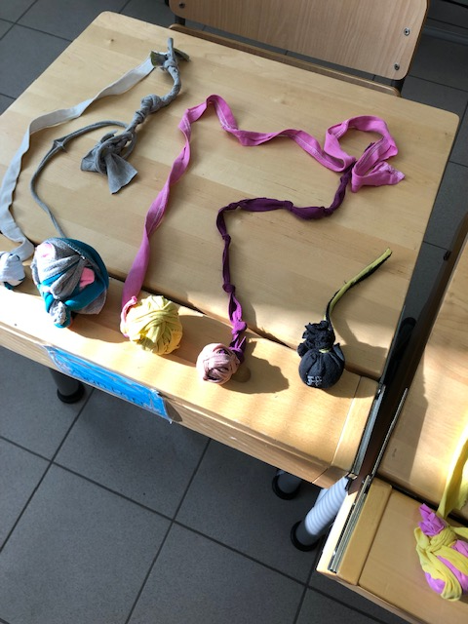

Slide 22
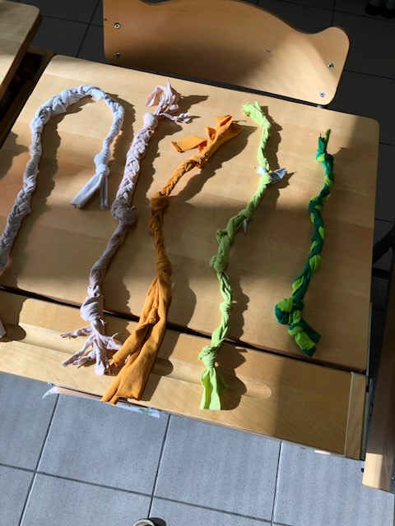

Slide 23
Class 5-6 used old T-shirts for making something else of them or tuning them into a new design.

Slide 24
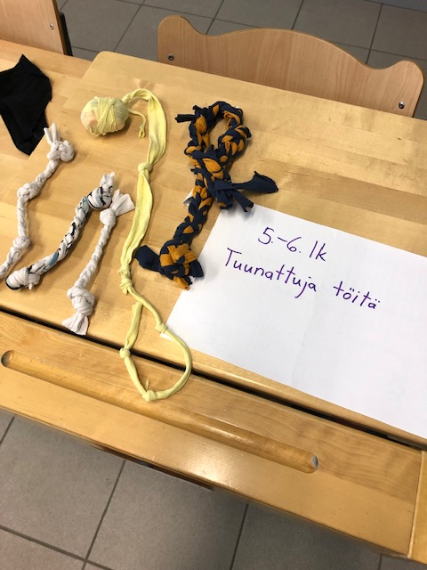

Slide 25
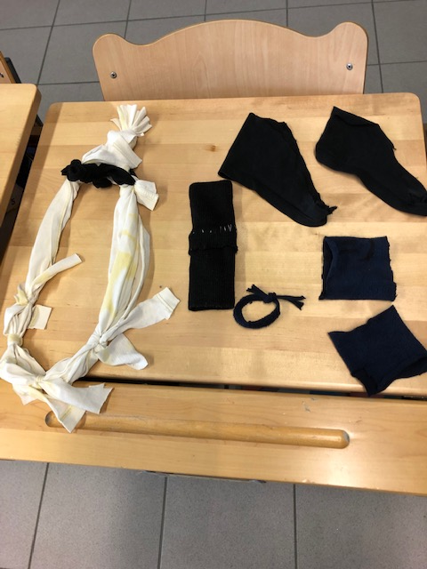

Slide 26
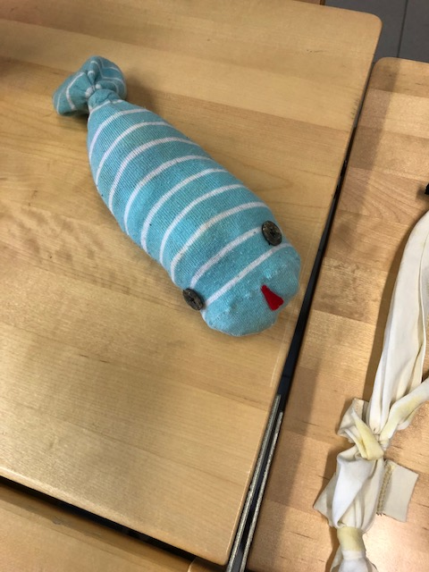

Slide 27
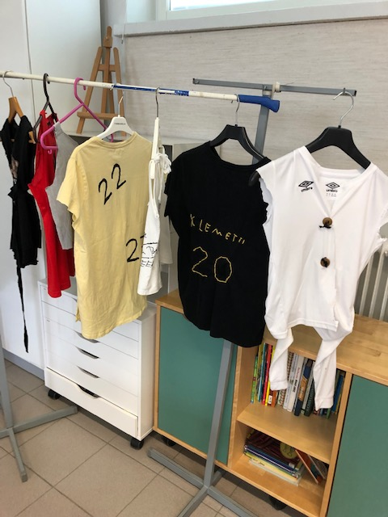

Slide 28
New rhytmic life for tins.
Drums made by the class 5.

Slide 29
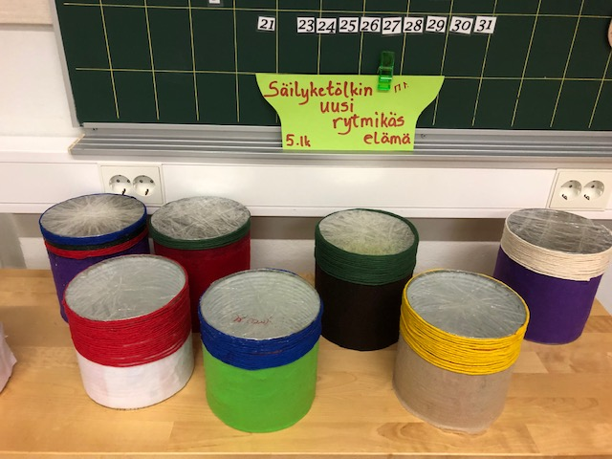

Slide 30
Kierrätä niin säästät luontoa ja luonto hymyilee
Recycle and you save the nature and the nature smiles

Slide 31
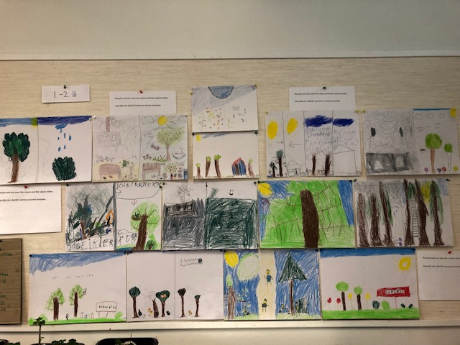

Slide 32
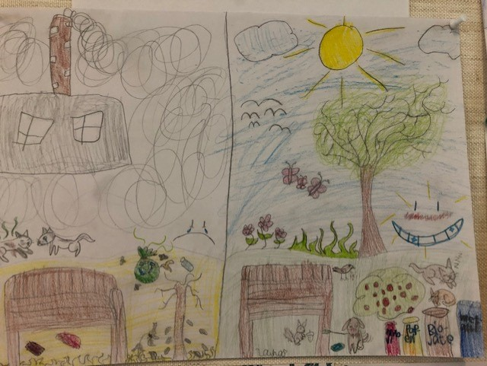

Slide 33
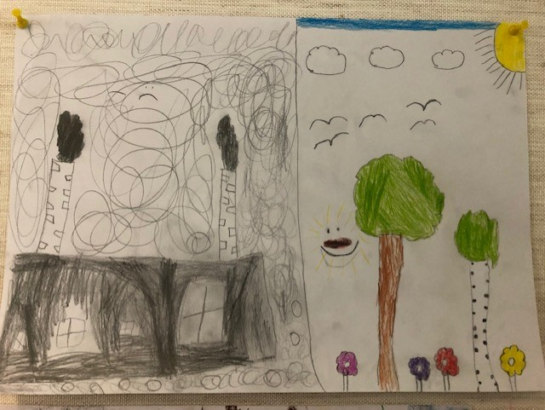

Slide 34
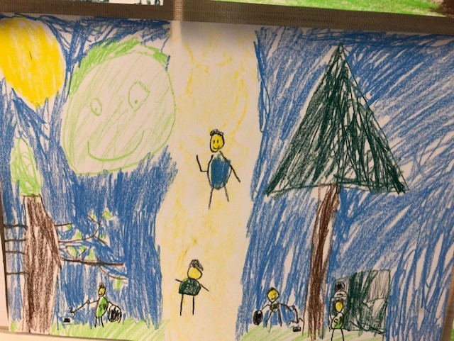

Slide 35
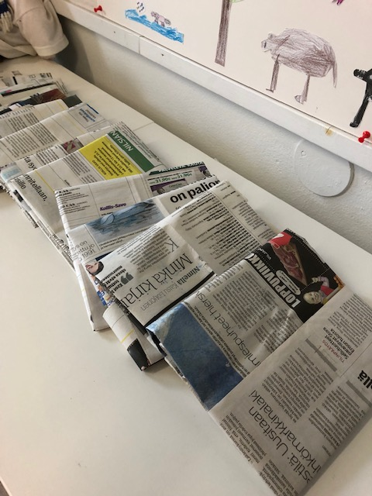
Compost bags made by class 5-6 of newspapers

Slide 36
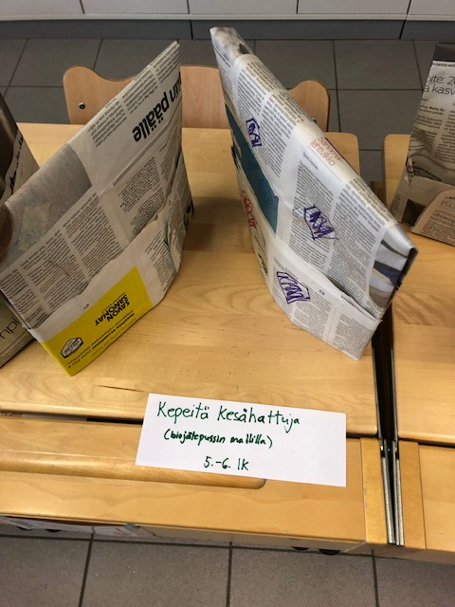
Class 5-6 made
”light summer hats” using the same model as for making compost bags.

Slide 37
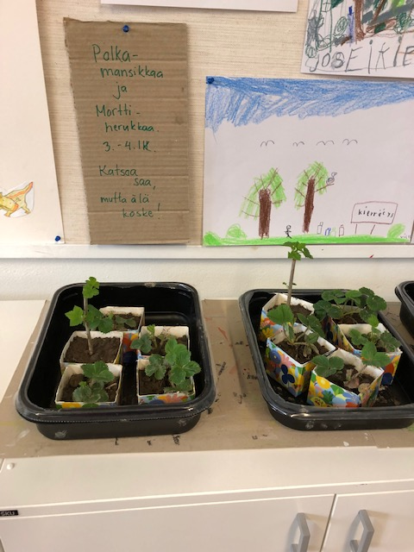
Class 3-4 planted strawberries and black currants.

