Slide 1
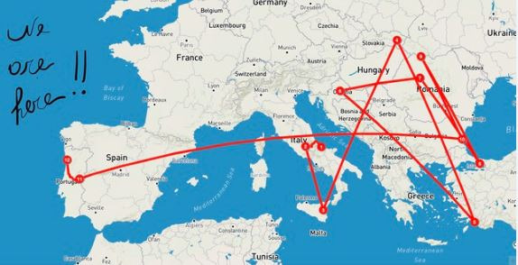


Netiquette
for students ...
made by students

Slide 2
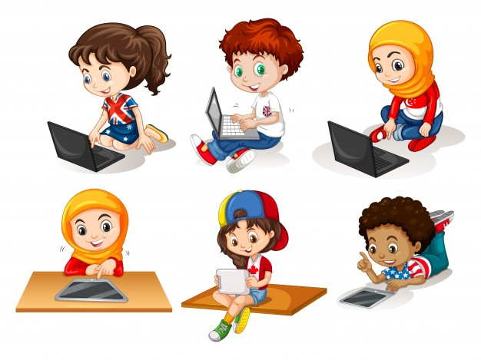
Always use a correct language
with everyone
classe 4^C San Salvo -Italy

Slide 3
Respect everyone´s work and ideas
Class 4C, Portugal

Slide 4
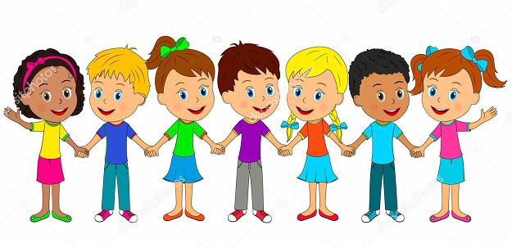
Always reply to the messages you receive
Class VA Tagliacozzo Italy

Slide 5

Make decisions together
Students 4^C Paternò CT- Italy

Slide 6
Try to do the activities
Class VB tagliacozzo Italy

Slide 7
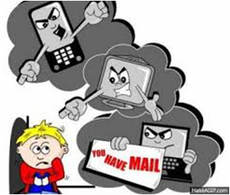

YOU SHOULD BE AGAINST INTERNET BULLYING!
Class 3A
San Salvo - Italy
dddddd4^C San Salvo -Italy

Slide 8

Class 3A
San Salvo Italy

Slide 9
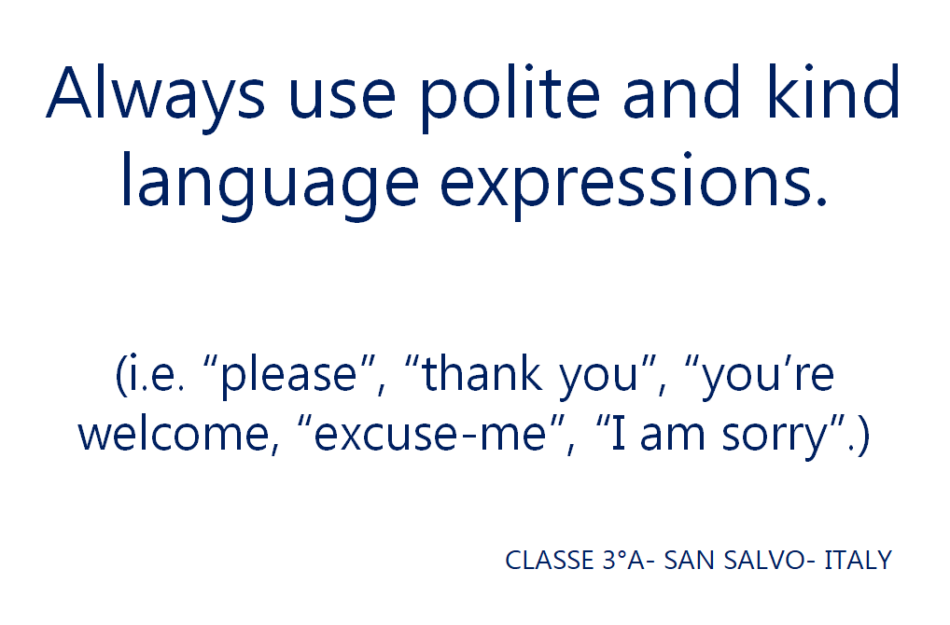

Slide 10
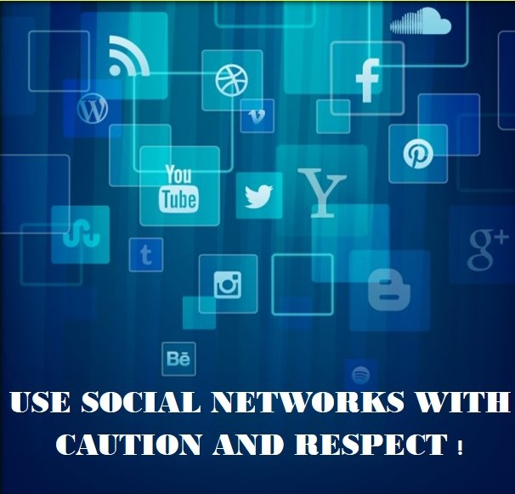
Class 3A
San Salvo Italy

Slide 11
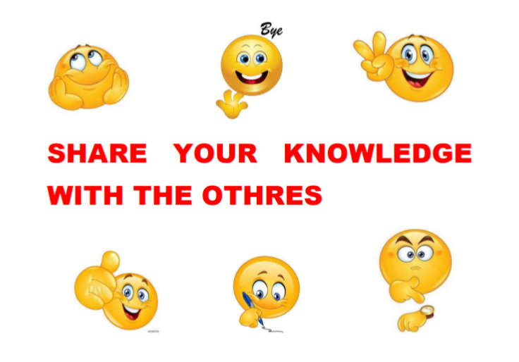
Class 3A
San Salvo Italy
Class 3A
San Salvo Italy

Slide 12
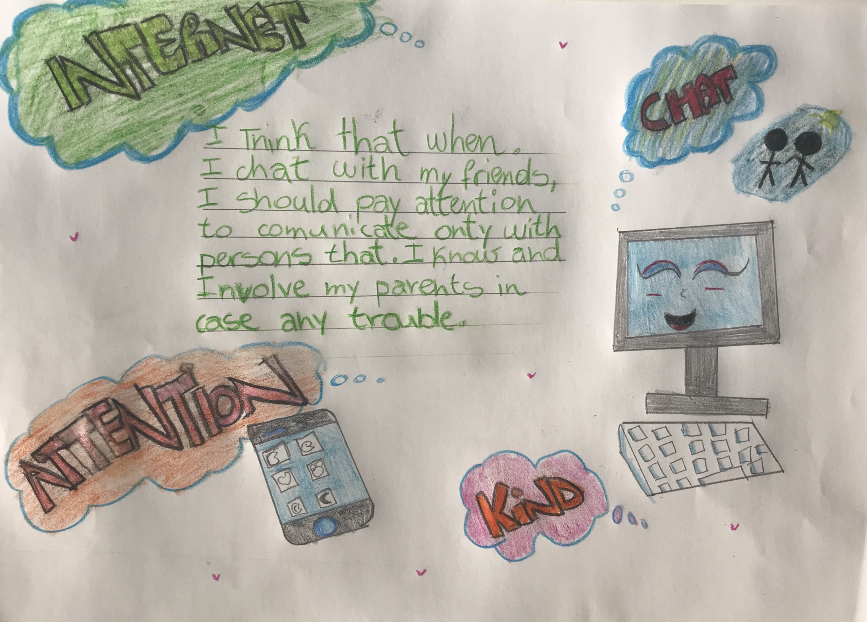
Class 3A
San Salvo Italy

Slide 13
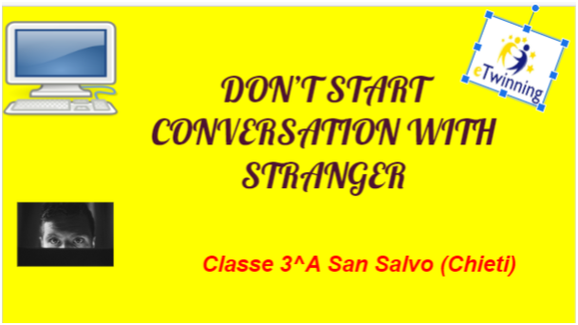

Slide 14
Be respectful to everyone...
5th class from TURKEY

Slide 15

Be enthusiastic and friendly with everyone
EB1 Sarzedas - Portugal

Slide 16

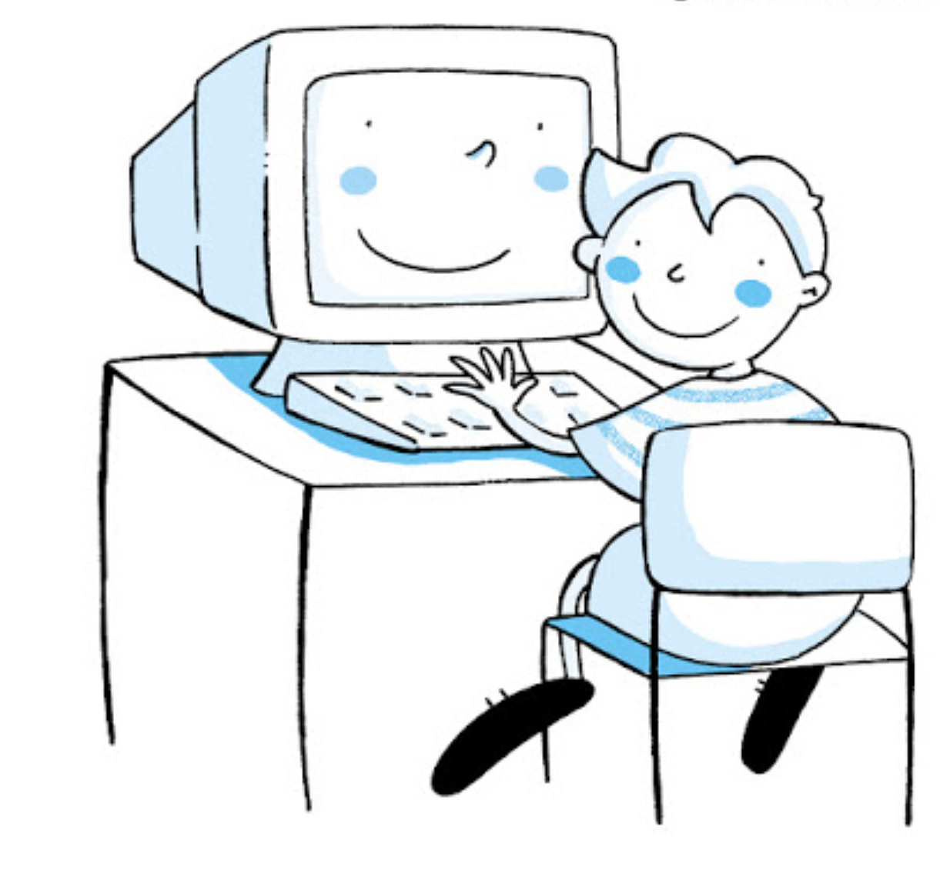
SHARE YOUR IDEAS
WITH
OTHER COUNTRIES
CLASSE 3 ^C SAN SALVO ITALY

