Slide 1

Project k219 enineering energy vehicle for european environment
Vocational trainning/High School

Slide 2

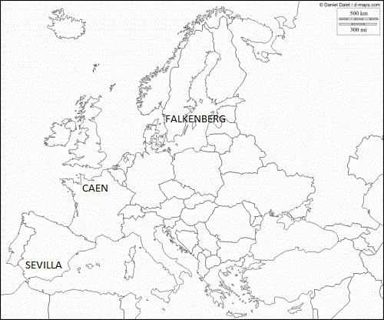


project between three partners

Slide 3
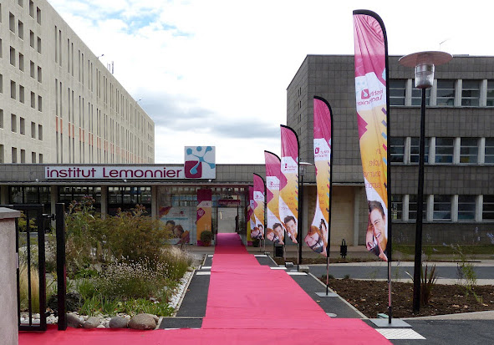
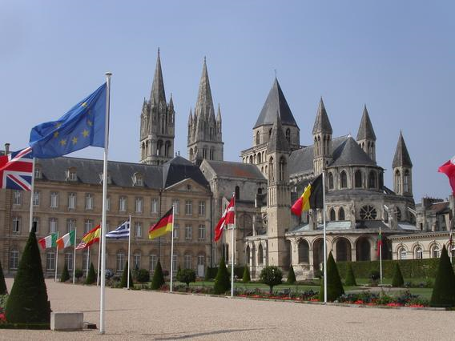
“Institut Lemonnier“

Slide 4
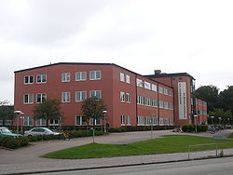
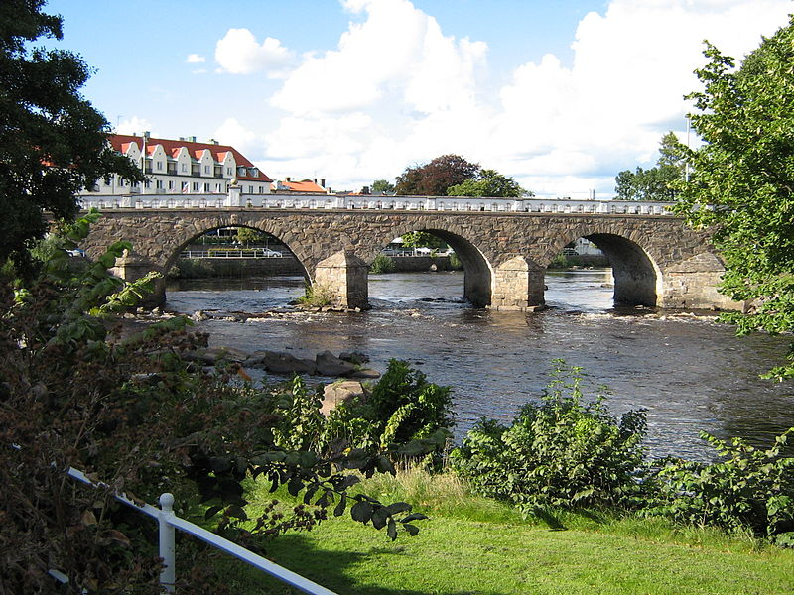
“gymnasieskola falkenberg“

Slide 5
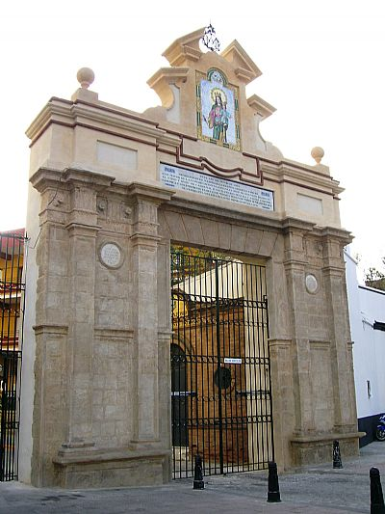
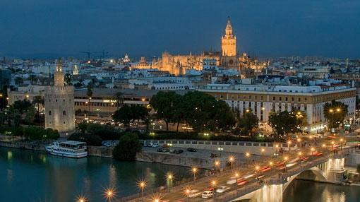
“salesianos santísima trinidad“

Slide 6
Salesianos trinidad celebrates its 125th anniversary
We show you a little history of our school

Slide 7
project objectives
  - The EEVEE project is based on the design and construction of an electric vehicle betting on an energy act for the environment.
  - It will be carried out by the three partner schools of France, Spain and Sweden with students of high school and vocational training students.
  - This design and manufacture of the vehicle is aimed simultaneously at interlacing numerous subjects of different educational stages such as vocational training and high school such as purely technical, with mathematics and humanities.
  - The European project will provide students with skills and competences in the profile of their studies.
  - develop in another language.
  - greater autonomy and will work as a team
  - YOU WILL EXTEND YOUR EUROPEAN VISION

Slide 8
PROJECT schedule
The project begins on 1 September 2017 and ends on 31 August 2020
We will have a transnational meeting and two learning and training mobility each course
Course 2017-18
- September 11-15, 2017: 1st Meeting teachers in Sweden
- November 8-15, 2017: 1st Mobility in France
- February 9-16, 2018: 2nd mobility in Spain
Course 2018-19; 2nd Meeting teachers in Spain, 3rd Mobility in Sweden, 4th mobility in France
Course 2019-20; 3rd Meeting teachers in France, 5th Mobility in Sweden, 6th mobility in Spain
ón

Slide 9
PROJECT mobilities
Course 2017-18
1ª Mobiltity in france; November 2017, student learning meeting to design
2ª Mobility In spain; February 2018, student learning meeting to agree on the chassis
course 2018-19
3ª Mobility In Sweden; October 2018, student learning meeting to assemble the direction, the breaks and suspension
4ª Mobility In France; March 2019, student learning meeting to assemble the motorisation
course 2019-20
5ª mobility in sweden; October 2019, student learning meeting to assemble the electric circuit
6ª mobility in spain; april 2020, student learning meeting to reach the car body painting and vehicle testing

Slide 10
during this course we have done a meeting of teachers and the
1ª mobility for students

Slide 11
1ª Project Meeting teachers
Falkenberg
(11-15 september)

Slide 12
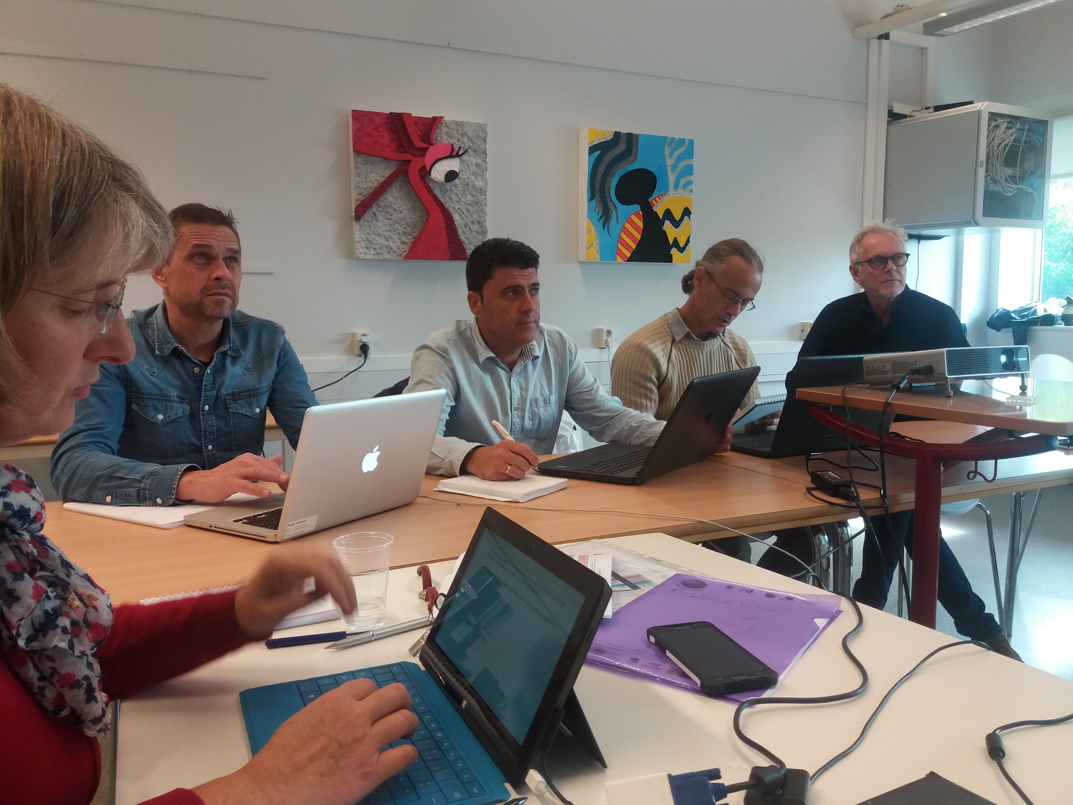
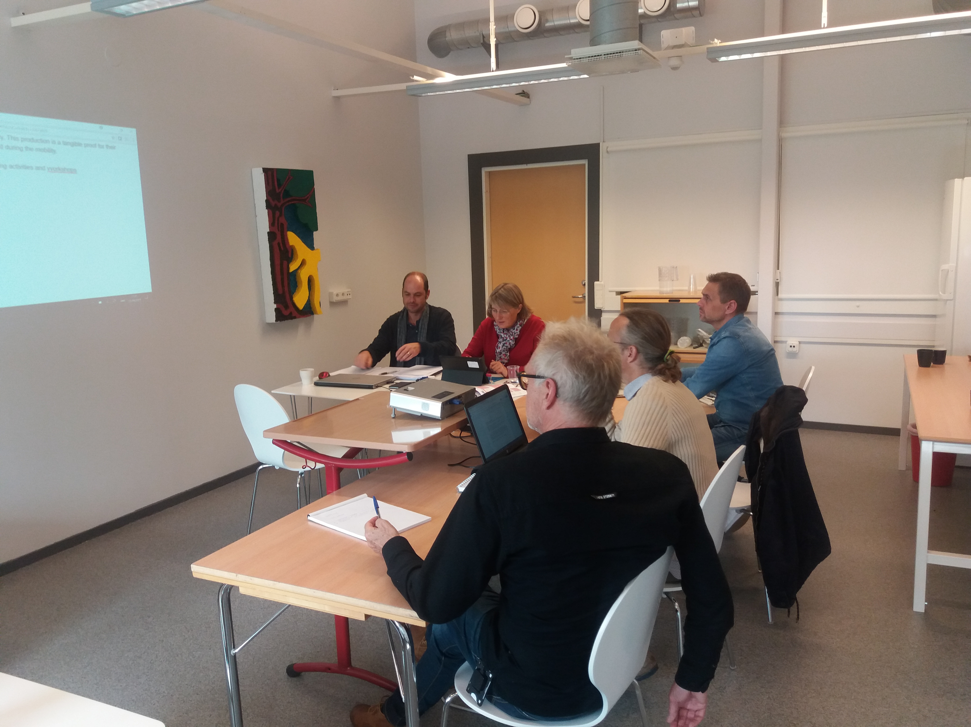

Slide 13
1ª mobility students caen
(8-14 november)
Erasmus+ EEVEE Project 1st mobility in France

Slide 14
And now we have
2ª mobility students in sevilla
(8-13 february)

Slide 15
But you must know where
we are
Visiting Sevilla

Slide 16
Who are the students participating in this mobility?

Slide 17

Spanish Team
Arias Herreros, Diego Antonio | Astola Macías, Germán | Ballesteros Liébanes, Marta | Barroso Sánchez, Francisco
Bersabé Delgado, Francisco Javier | Castrejón Rebollo, Alberto | Fernández Navarro, Alejandro | González Carvajal, Amalia

Slide 18
Spanish Team
Naranjo Muñoz, Jaime | Quintero Sanz, Sergio | Román Villa, Brian | Soria Sánchez, Jorge
Torregrosa Domínguez, Ángel

Slide 19

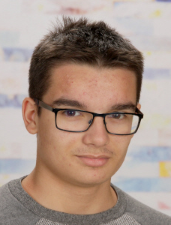
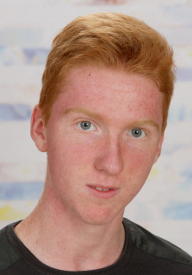
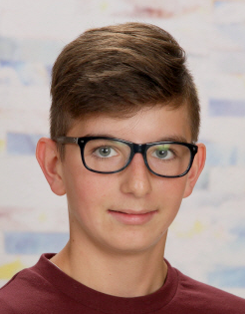
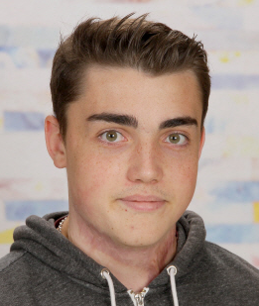
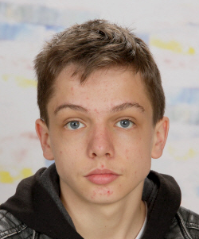
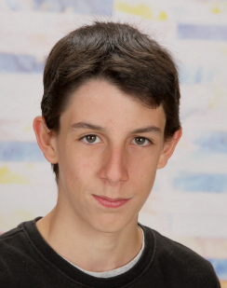
French Team
Demey, Théo | Dubosq, Valentin | Hebért, Benjamin | Marcadet, Pierre
Renaud, Fréderic | Sauer, Romain

Slide 20

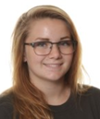
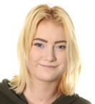
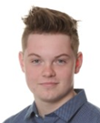
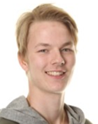
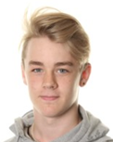
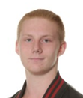
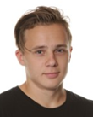
Swedish Team
Båth Emma | Dahlberg Ebba | Edeman, Pontus | Larsson, Joel
Nilsson, Alfred | Qvarnström, Kenny | Valeisa, Lukas

Slide 21
Who are the host families ?

Slide 22
Alberto Castrejón/ Alfred Nilsson Francisco Javir Bersabé/ Pontus Edeman
Alejandro Fernández/ Valentin Dubosq German Astola/ Joel Larsson
Amalia González / Ebba Dahlberg Jaime Naranjo / Benjamin Hébert
Ángel Torregrosa / Théo Demey Jorge Soria / Kenny Qvarnström
Brian Roman / Pierre Marcadet Marta Ballesteros / Emma Båth
Diego Antonio Arias / Frédéric Renaud Sergio Quintero / Romain Sauner
Francisco Barroso/ Lukas Valeisa

Slide 23
What is
the program
in Sevilla?

Slide 24
Wednesday, 7th February
Partner students’ arrival
13;30 French students will arrive to the school
18;00 Swedish students will arrive to the school
Thursday, 8 th February
8;30-9;30 Welcome to Director and School presentations “Spanish team, Swedish team and French team K2”
Presentation of program
9;30-11;00 Students: Ice breaking activities
Teachers: First Meeting and visit to School
11;00-11;30 Break
11;30-14;00 First activity Mathematics workshops in teams (Group 1 students)
First Technical activity workshops in teams (Group 2 students)
14;00-15;30 Lunch break at restaurant
15;30-17;30 First activity Mathematics workshops in teams (Group 2 students)
First Technical activity workshops in teams (Group 1 students)
17;30-19;30 Visit to Seville students and teachers (Visit to the viewpoint of the “Setas”)

Slide 25
Friday, 9 st February
8;20-8;30 Welcome
8;30-11;00 Students: Sport activities and visit to school
Teachers: Second Meeting (8;30-10;00)
11;00-11;30 Break
11;30-14;00 Second Technical activity workshops in teams (Group 1 students)
Third Technical activity workshops in teams (Group 2 students)
14;00-15;30 Lunch break at restaurant
15;30-17;30 Second Technical activity workshops in teams (Group 2 students)
Third Technical activity workshops in teams (Group 1 students)
Saturday, 10 th February
Cultural tour to Seville; Alcázar (10:00), Spain Square, María Luisa Park and Boat trip on the Guadalquivir river (16:00)

Slide 26
Sunday, 11 st February
Students by their host families
Monday, 12 nd February
8;20-8;30 Welcome
8;30-11;00 Second activity Mathematics workshops in teams (Group 1 and 2 students)
11;00-11;30 Break
11;30-14;00 Meeting: Electric Vehicles (BMW, Nissan and Volkswagen)
14;00-15;30 Lunch break at restaurant
15;30-17;30 Fourth Technical activity workshops in teams (Group 1 and 2 students) Final Technical
Teachers; Third Meeting (15;30-17;00)
17;30-20;00 Games and official snack/dinner in school with students and host families

Slide 27
Tuesday, 13 rd February
8;20-8;30 Welcome
8;30-10;00 Students: Documentary videos and pictures preparations
Teachers; Third Meeting (15;30-17;00)
10;00-11;00 Showing students’ documentary videos and pictures. Group picture
11;00-11;30 Break
11;30-14;00 Meeting: Repsol autogas efficient vehicles
14;00-15;30 Lunch break at restaurant
15;30-17;30 Meeting Evaluation and Closing sesión
Wednesdary, 14 th Frebuary
Partner students departure;
In the airport; French team; 9,15 a.m since Sevilla
In the school; Swedish team; 14;25 p.m since Málaga

Slide 28
And when it finished
destination to Falkenberg

