Slide 1
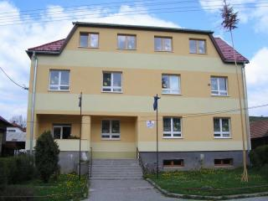
THIS IS MY SCHOOL PRIMARY SCHOOL IN VITANOVA

Slide 2
BASIC FACTS
Location : in the north of Slovakia
Address: Vitanova 90, 027 12 Vitanova
Founded: 1996
Head master : Mgr. Maria Kudlickova
Teacher : 15
Pupils 124

Slide 3
OUR SCHOOL SYSTEM
Kindergarden : 3 – 6 years olod
Primary school : 7 – 15 years old
Secondary school : 16 – 19 years old
University : 20 – 24 years old
School holiday : Autumn holiday – 2 days, Christmas holiday – 2 weeks, Mid-year holiday – 1 day, Spring holiday – 1 week, Easter holiday – 2 days, Summer holiday – 2 months

Slide 4
CLASSROOMS
We have got one form in each year – 9 classes
School starts at 8:00 a.m.
School finishes at 1:30 p.m.
Classes are from 8:00 to 1:30 usually for 6 lessons.
One lesson lasts for 45 minutes, then we have a break for 10 minutes.
We do not wear a uniforms at school.
Our native language is Slovak language.
But we learn English and German language too.
After school we have lunch in our cafeteria.
We can buy some sandwitches at the break time which lasts for 20 minutes after second lesson.

Slide 5
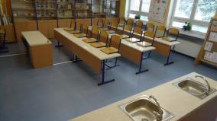
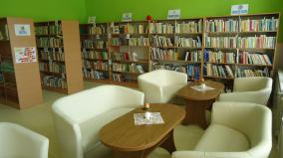
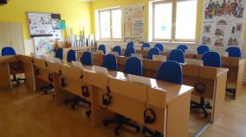
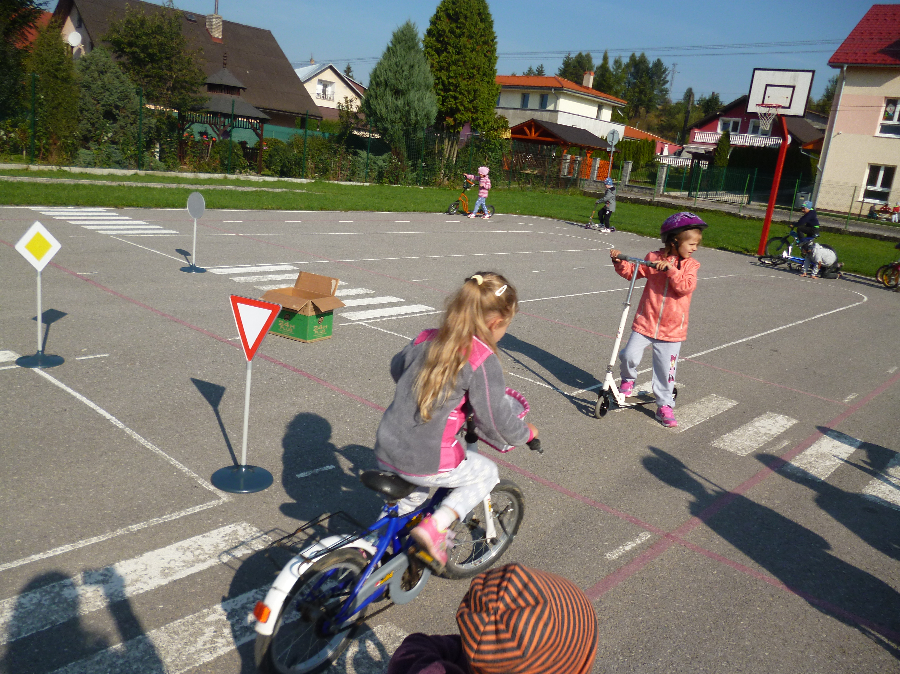
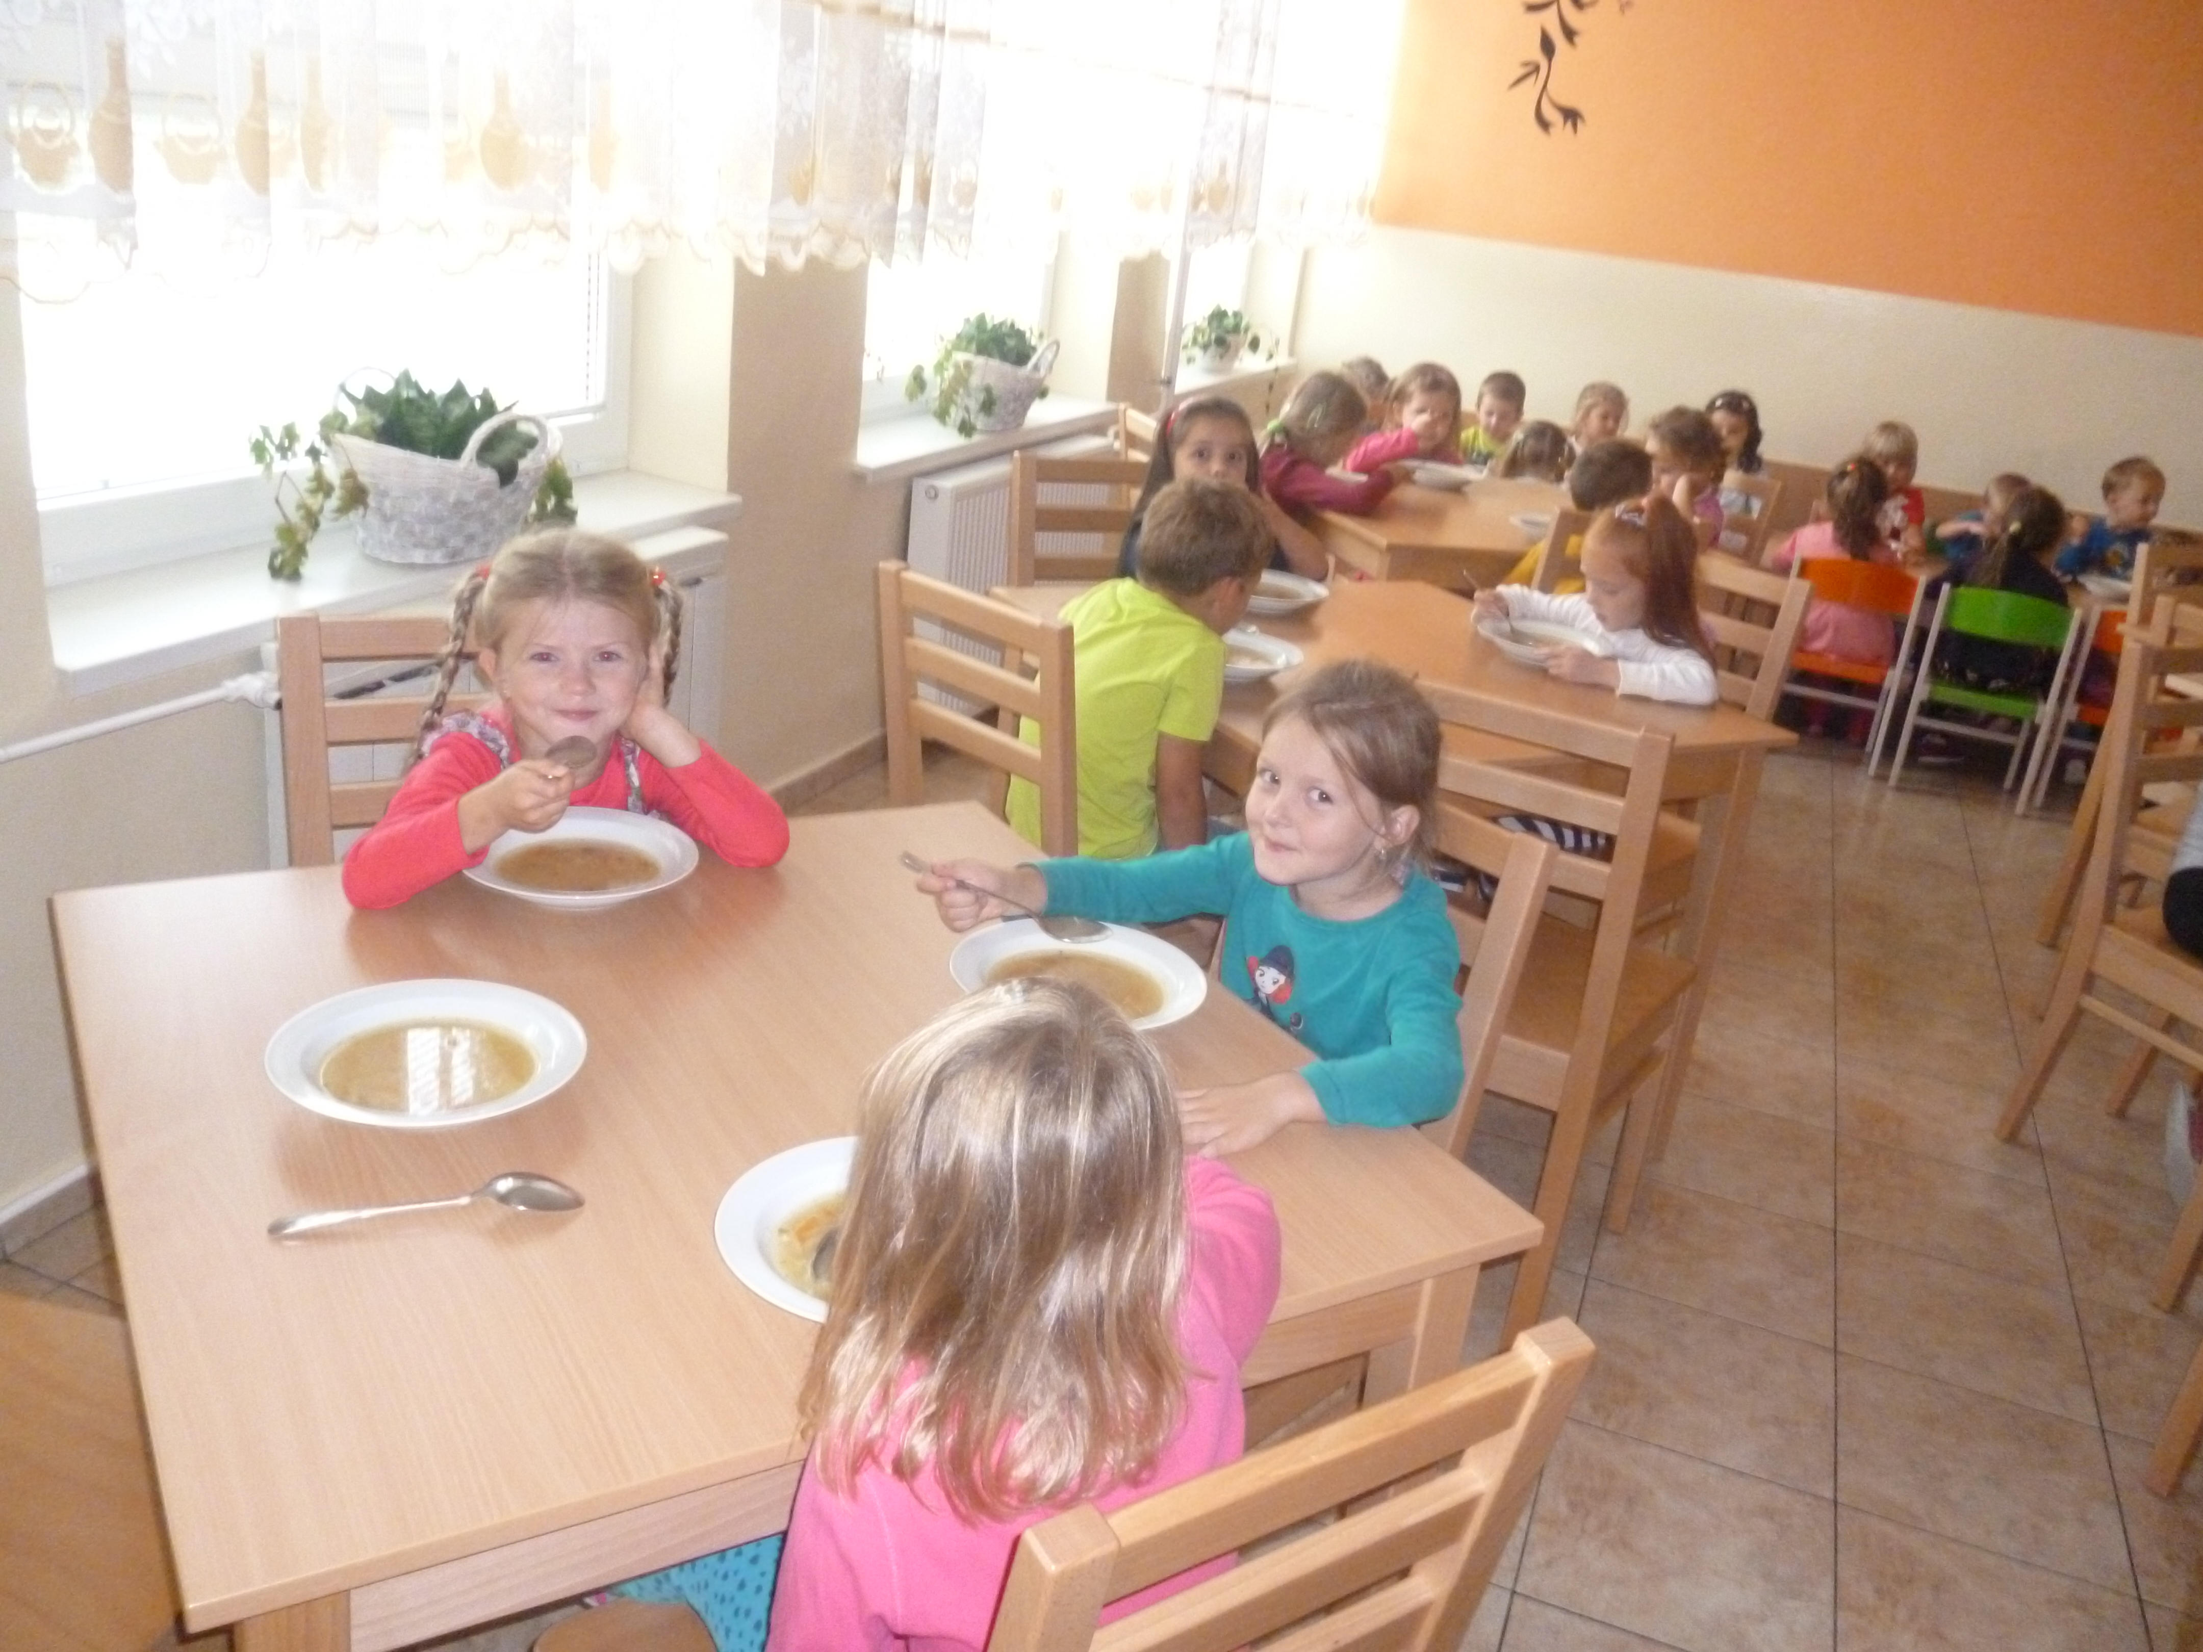
FACILITIES
COMPUTER ROOM -
- SCIENCE ROOM
LIBRARY -
- LANGUAGE ROOM
CAFETERIA -
- PLAYGROUND

Slide 6
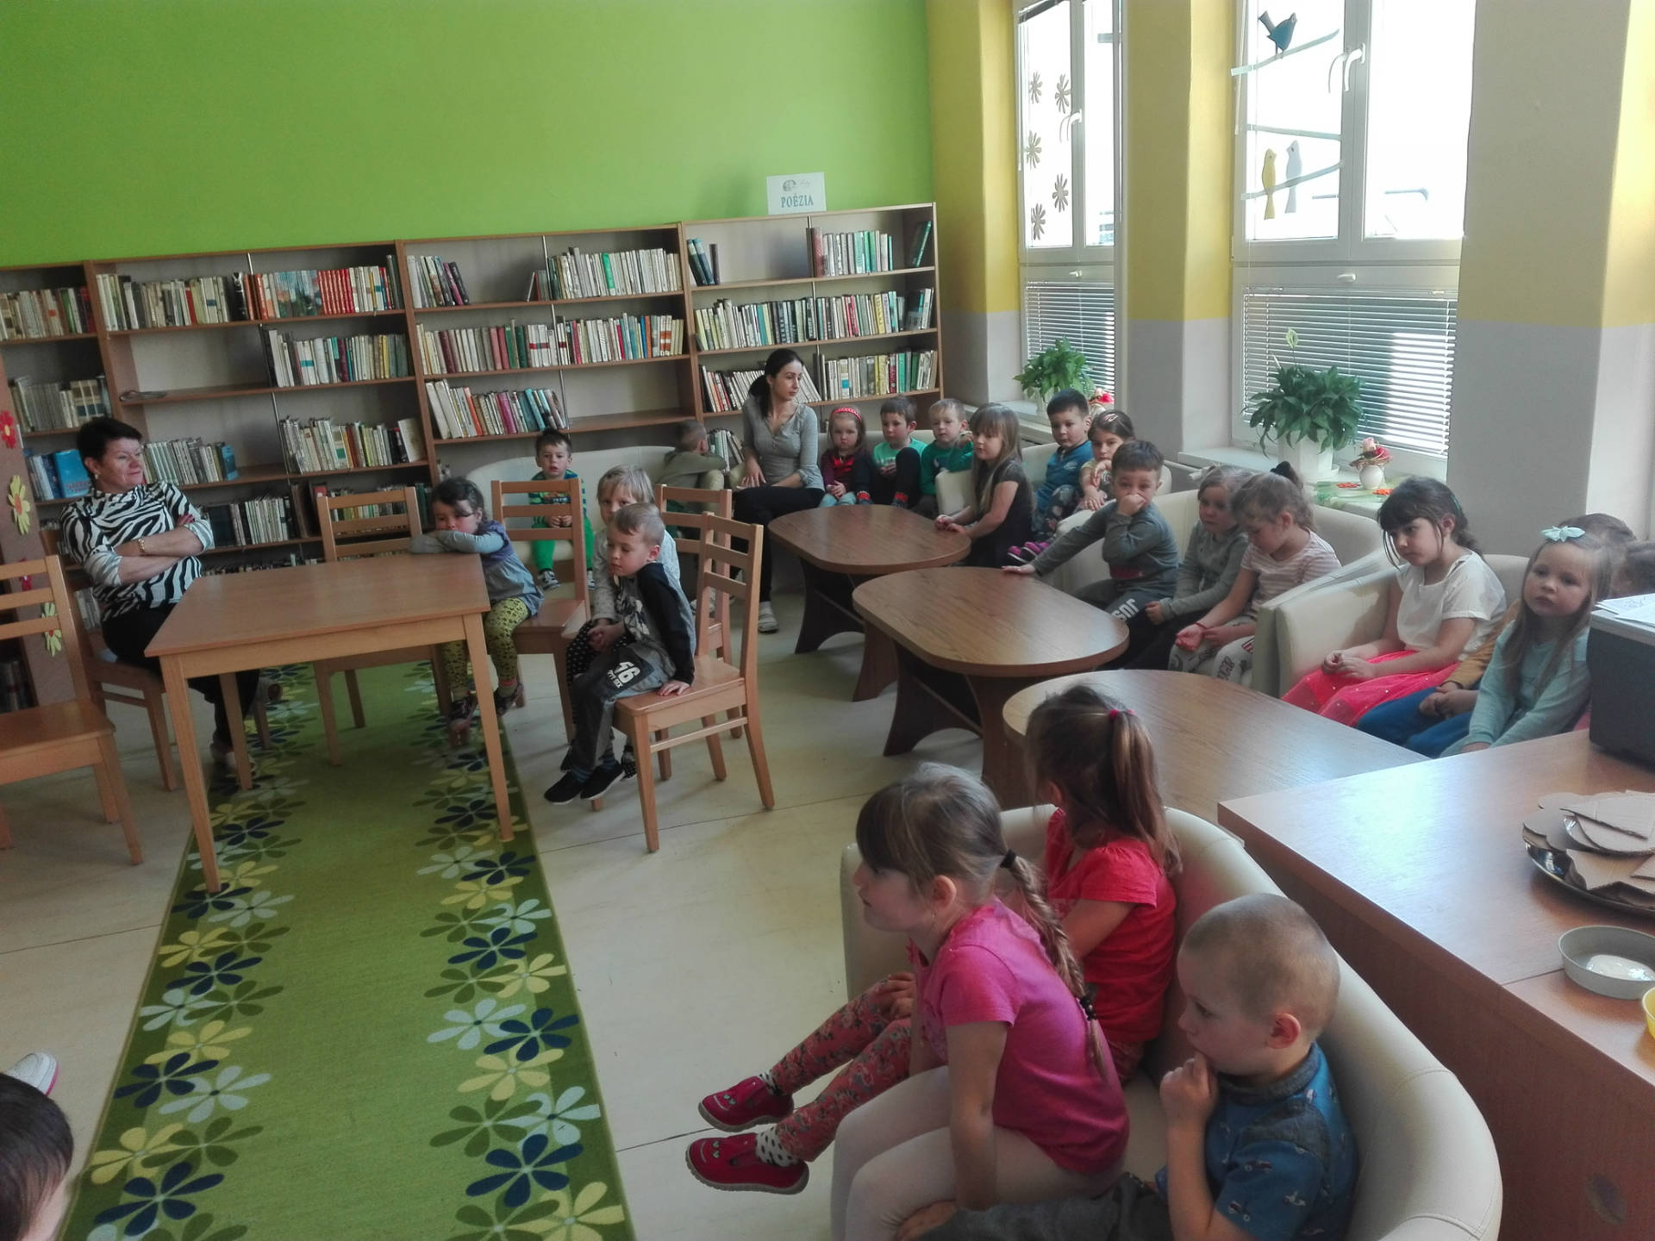
SCHOOL PROJECTS AND ACTIVITIES
GREEN SCHOOL
E- TWINING
LIBRARY DAY
EARTH DAY

Slide 7
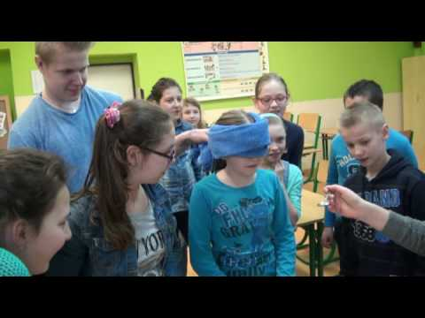
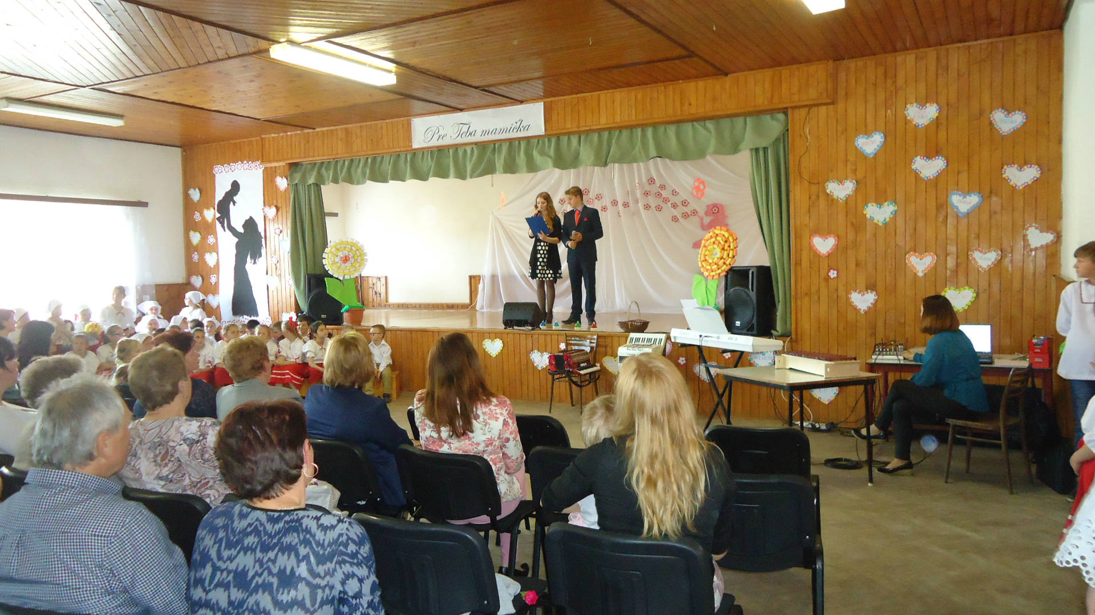
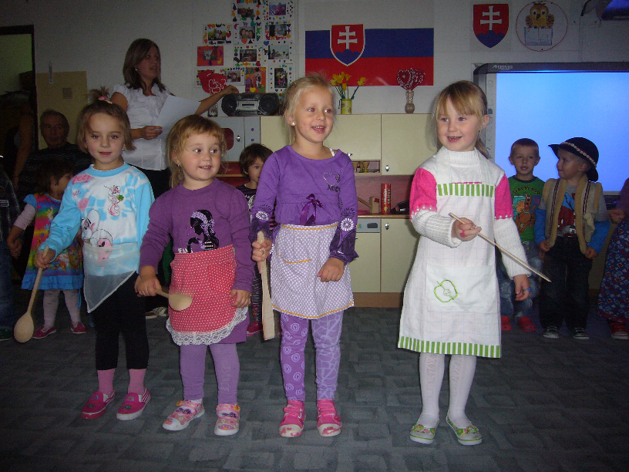
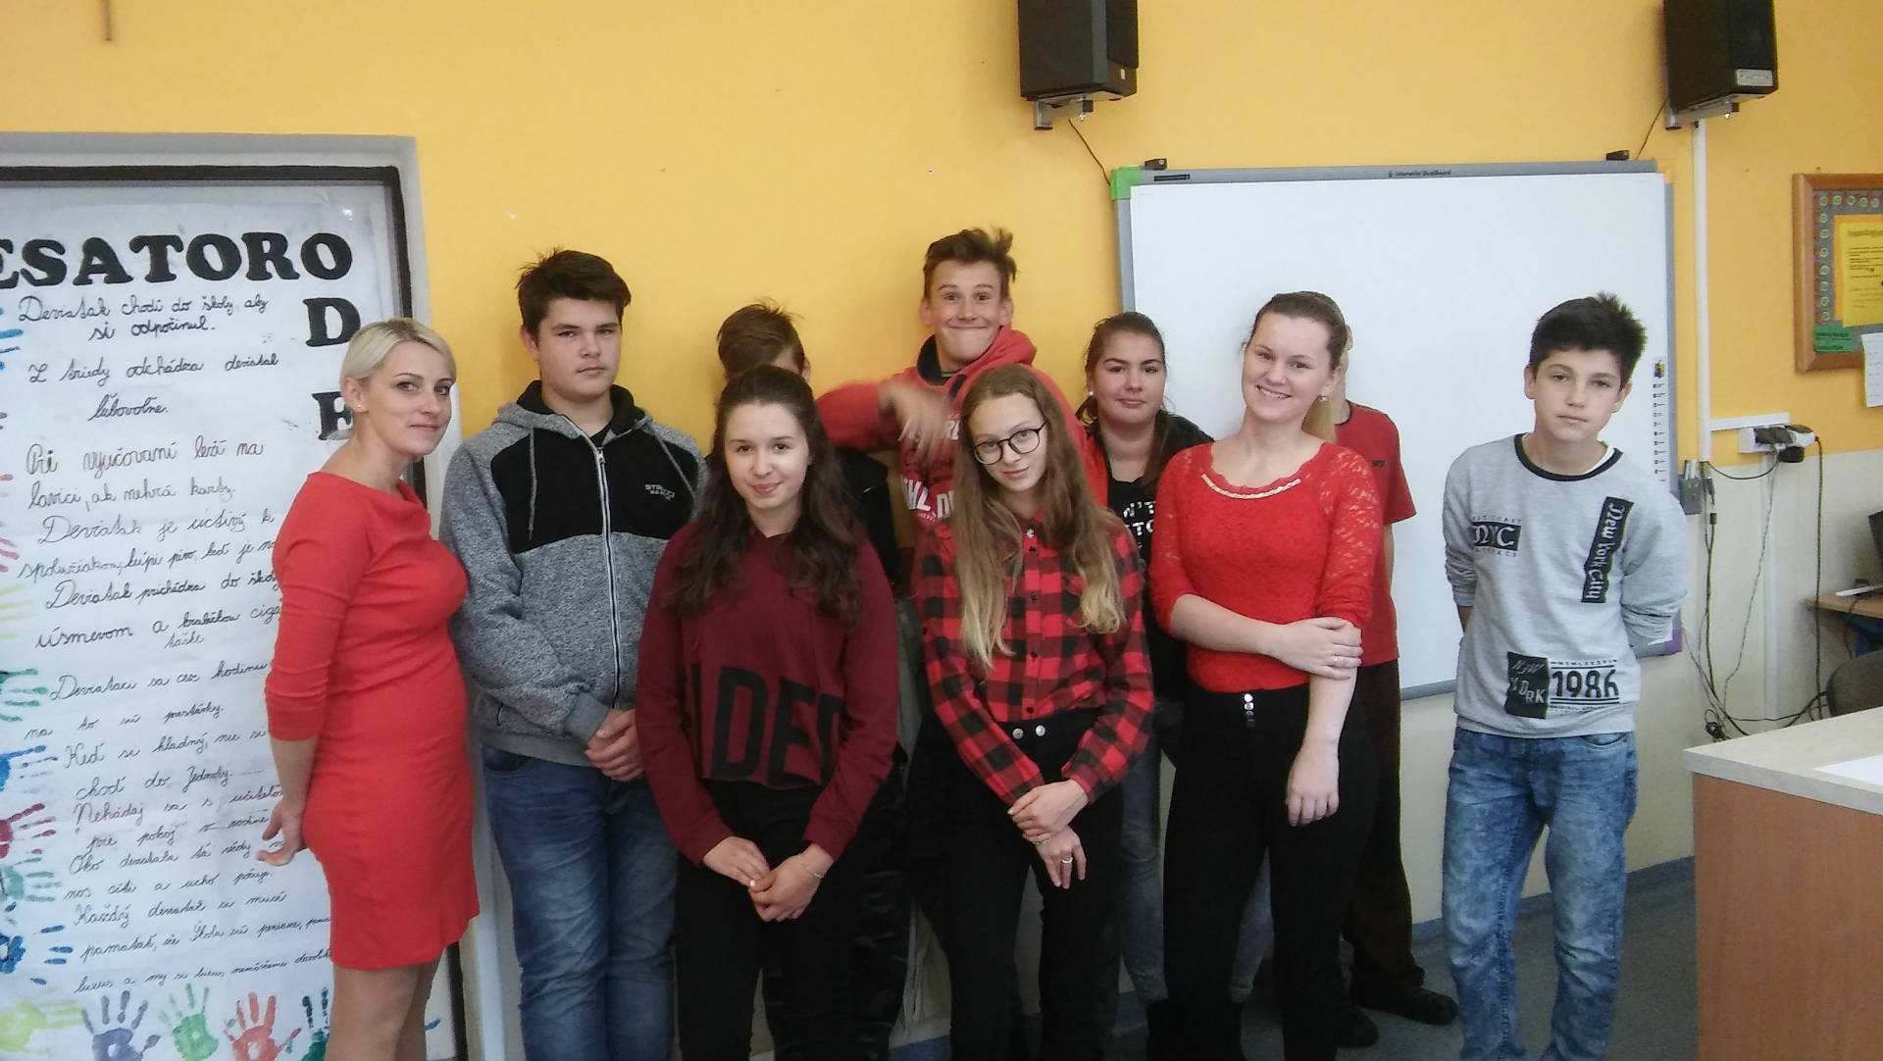
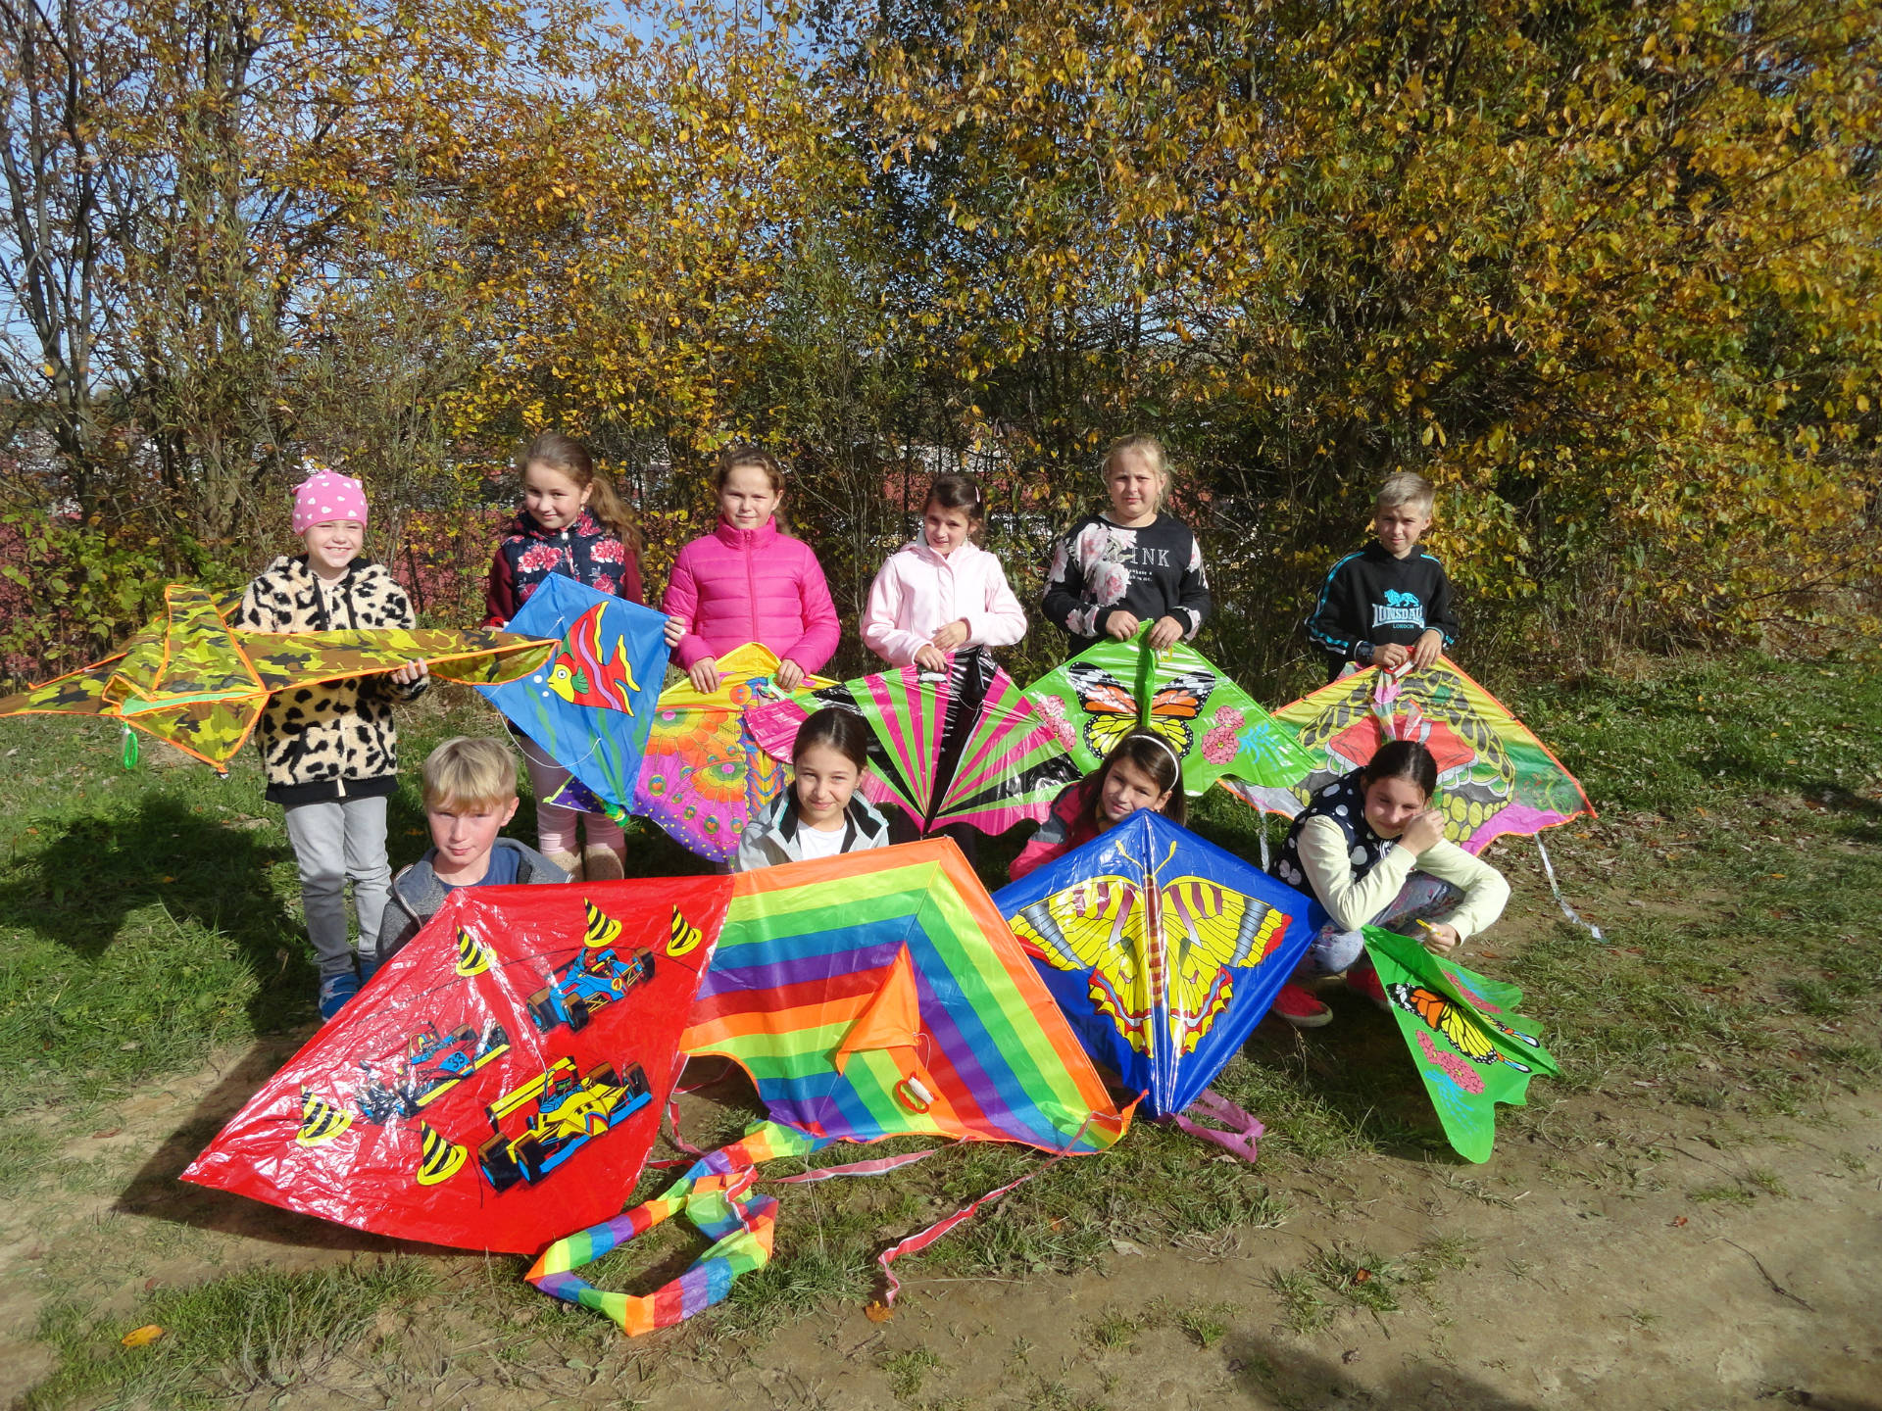
WATER DAY
MOTHERS DAY
GRANDPARENTS DAY
THE WEEK OF COLOURS
FLYING KITES DAY

Slide 8
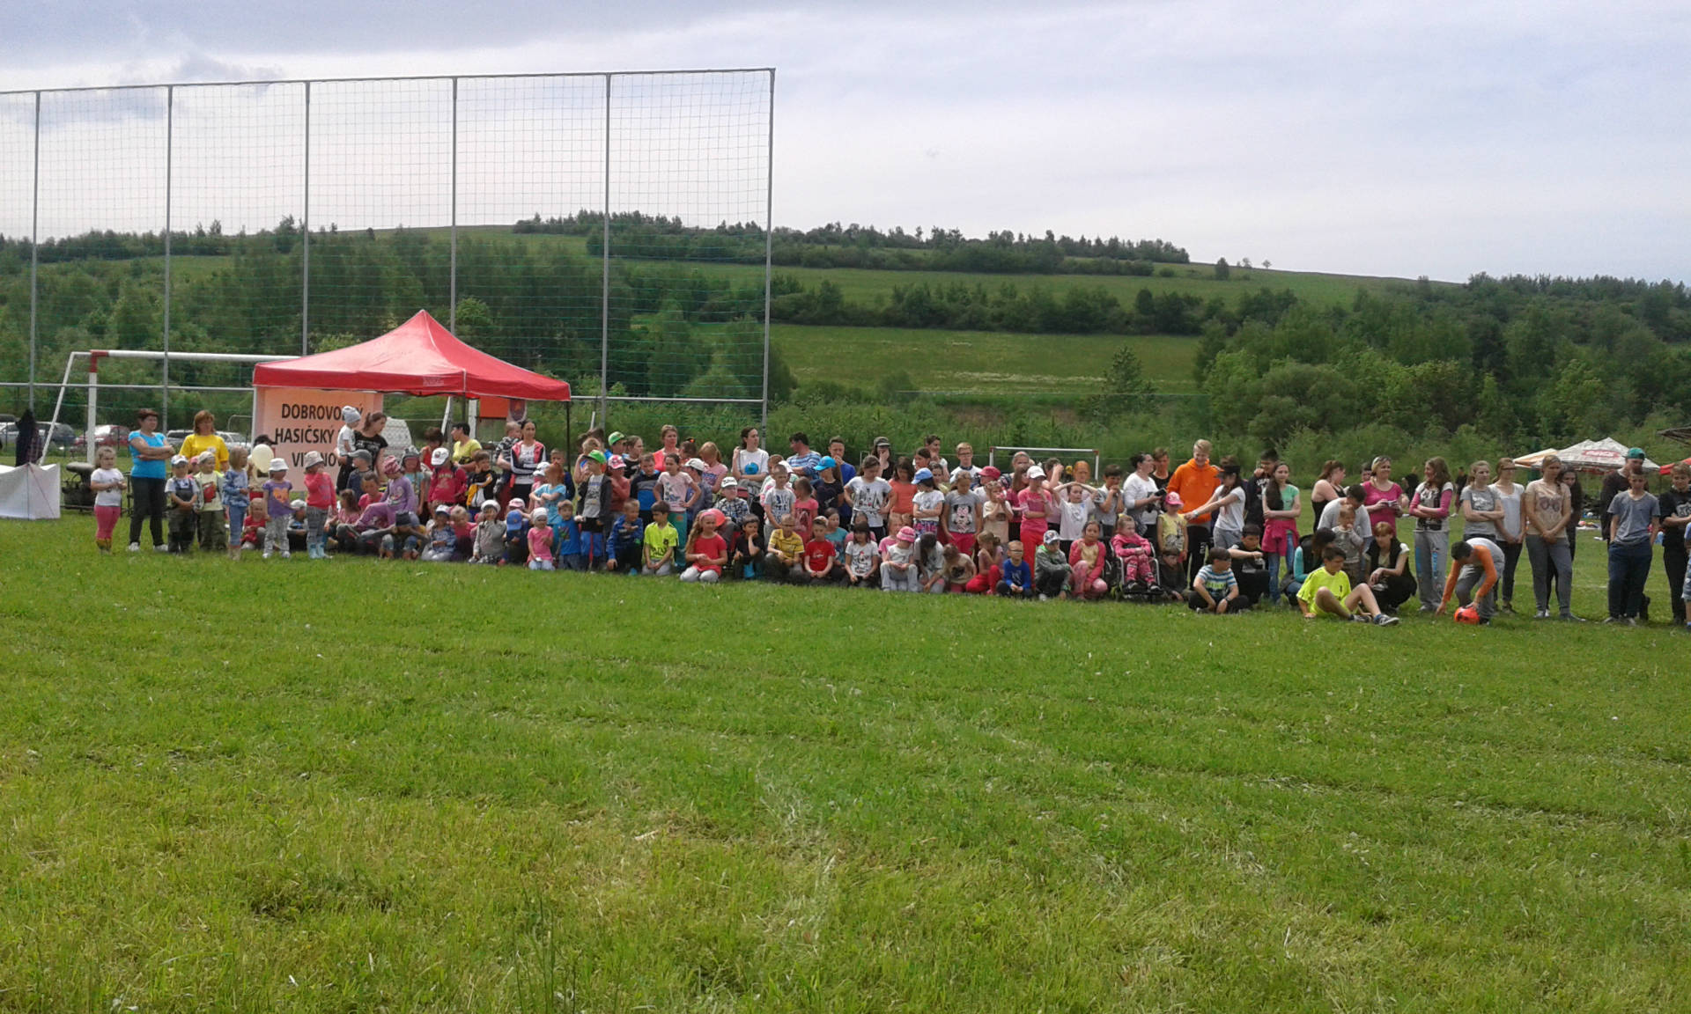
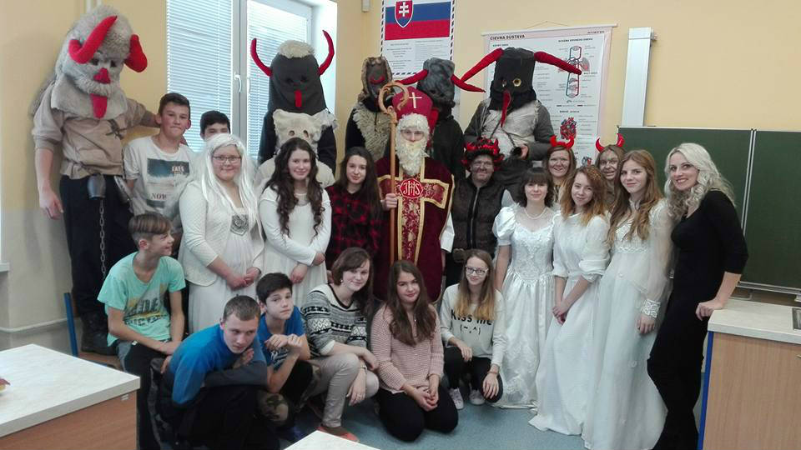
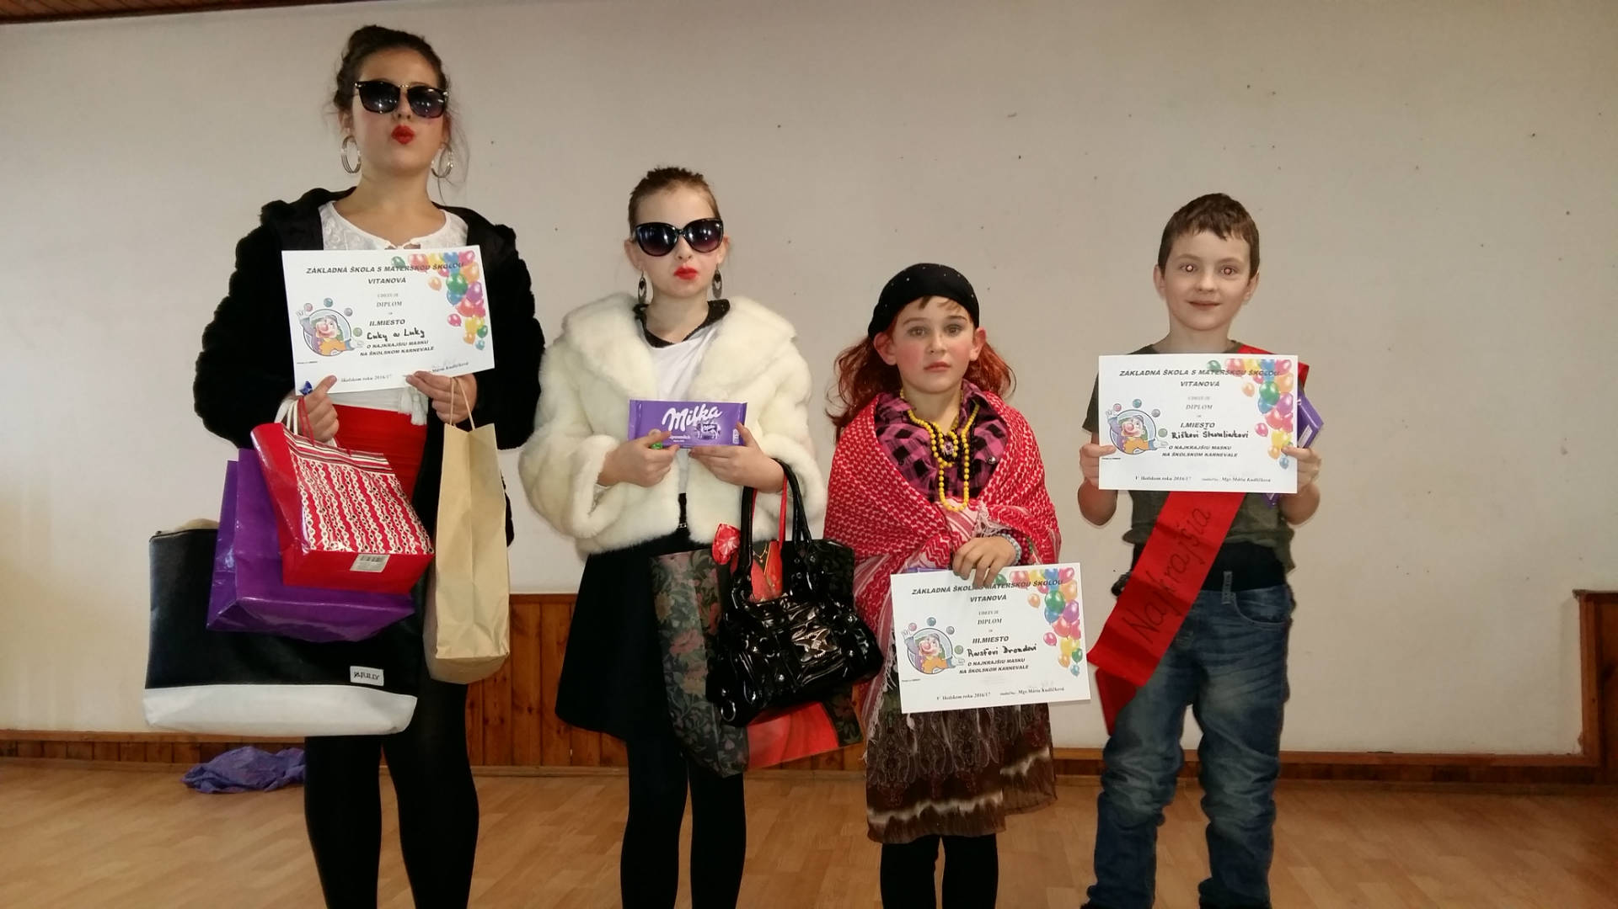
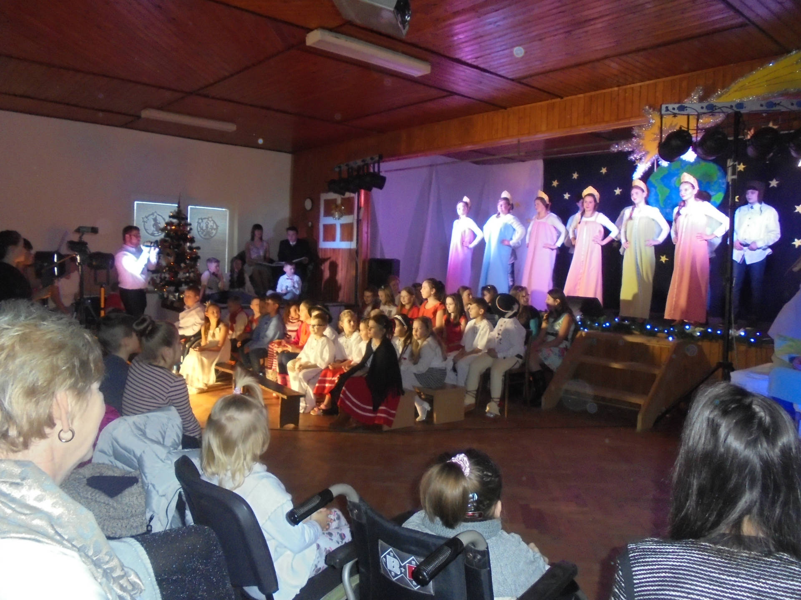
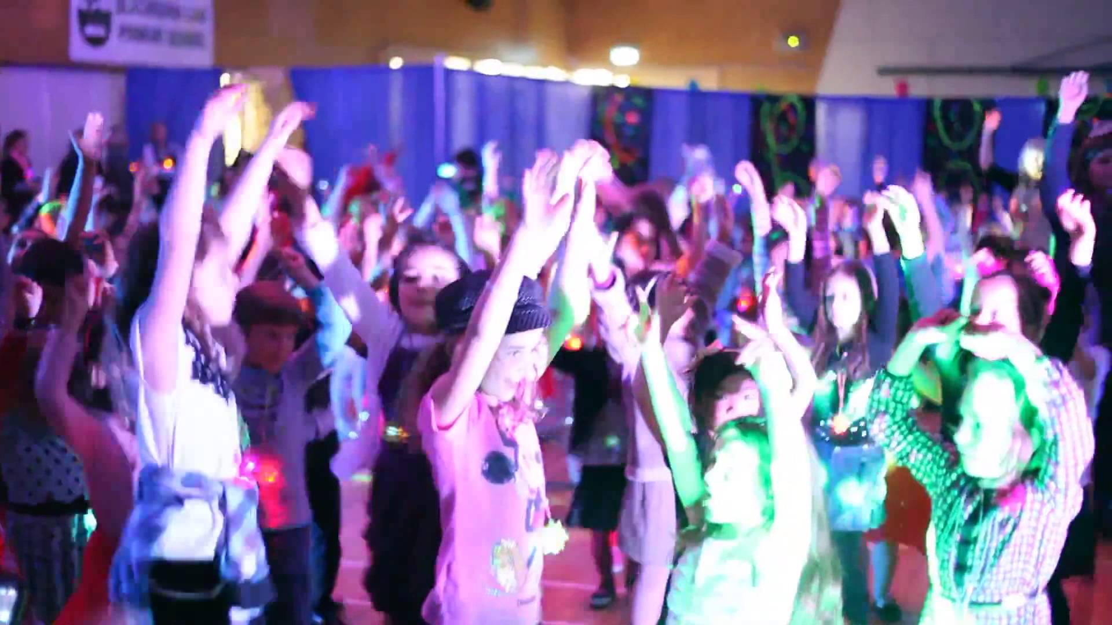
CHILDREN DAY
ST. NICOLAS DAY
MASQUARADE SHOW
CHRISTMAS SHOW
SCHOOL DISCO

Slide 9
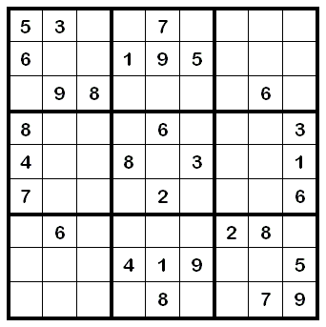
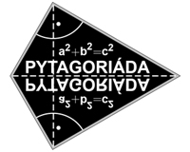
SCHOOL COMPETITONS
MATHS:
SUDOKU
KANGAROO
MATHEMATICS OLYMPIAD
PYTAGORIADA

Slide 10
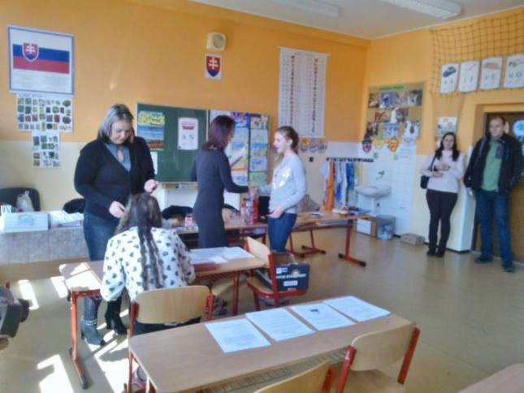
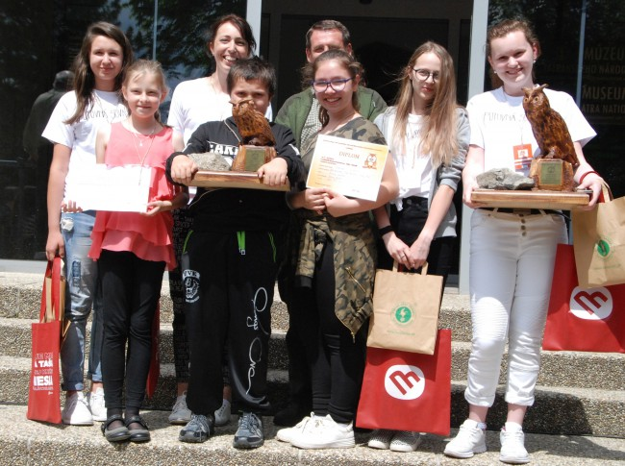
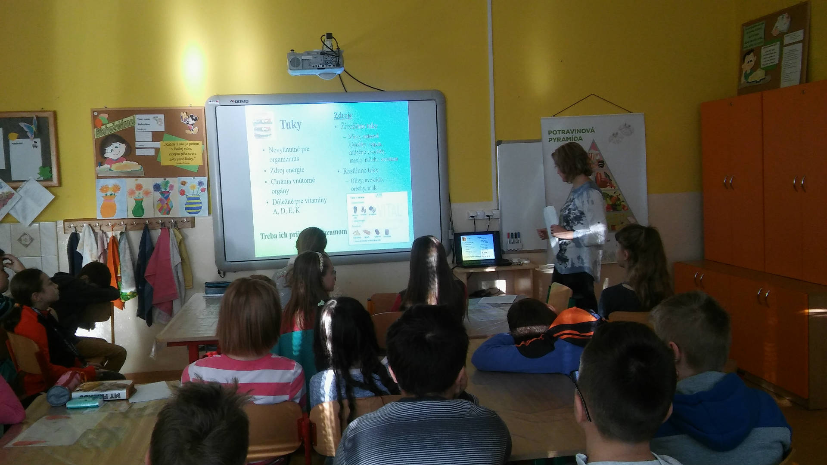
BIOLOGY AND CHEMISTRY
BIOLOGICAL OLYMPIAD
PUTOVNA SOVA
HRAVO A ZDRAVO
POVEDZ MI PRECO
CHEMICAL OLYMPIAD

Slide 11
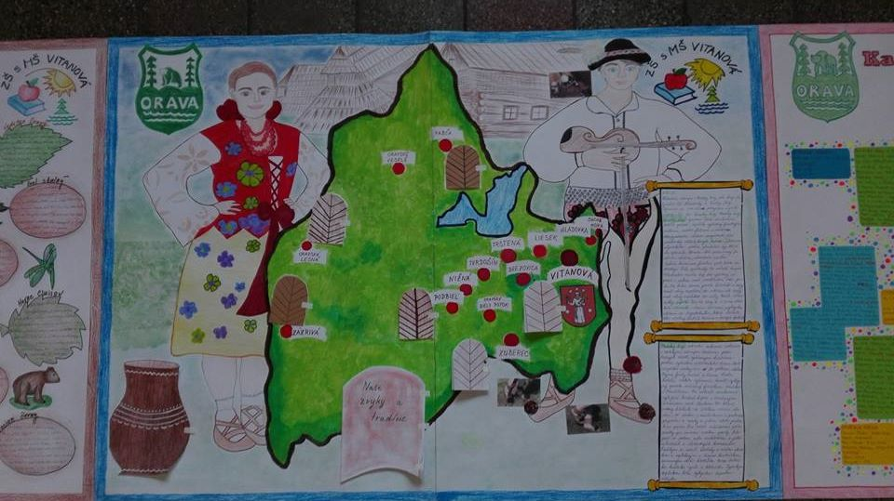
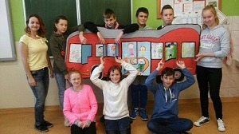
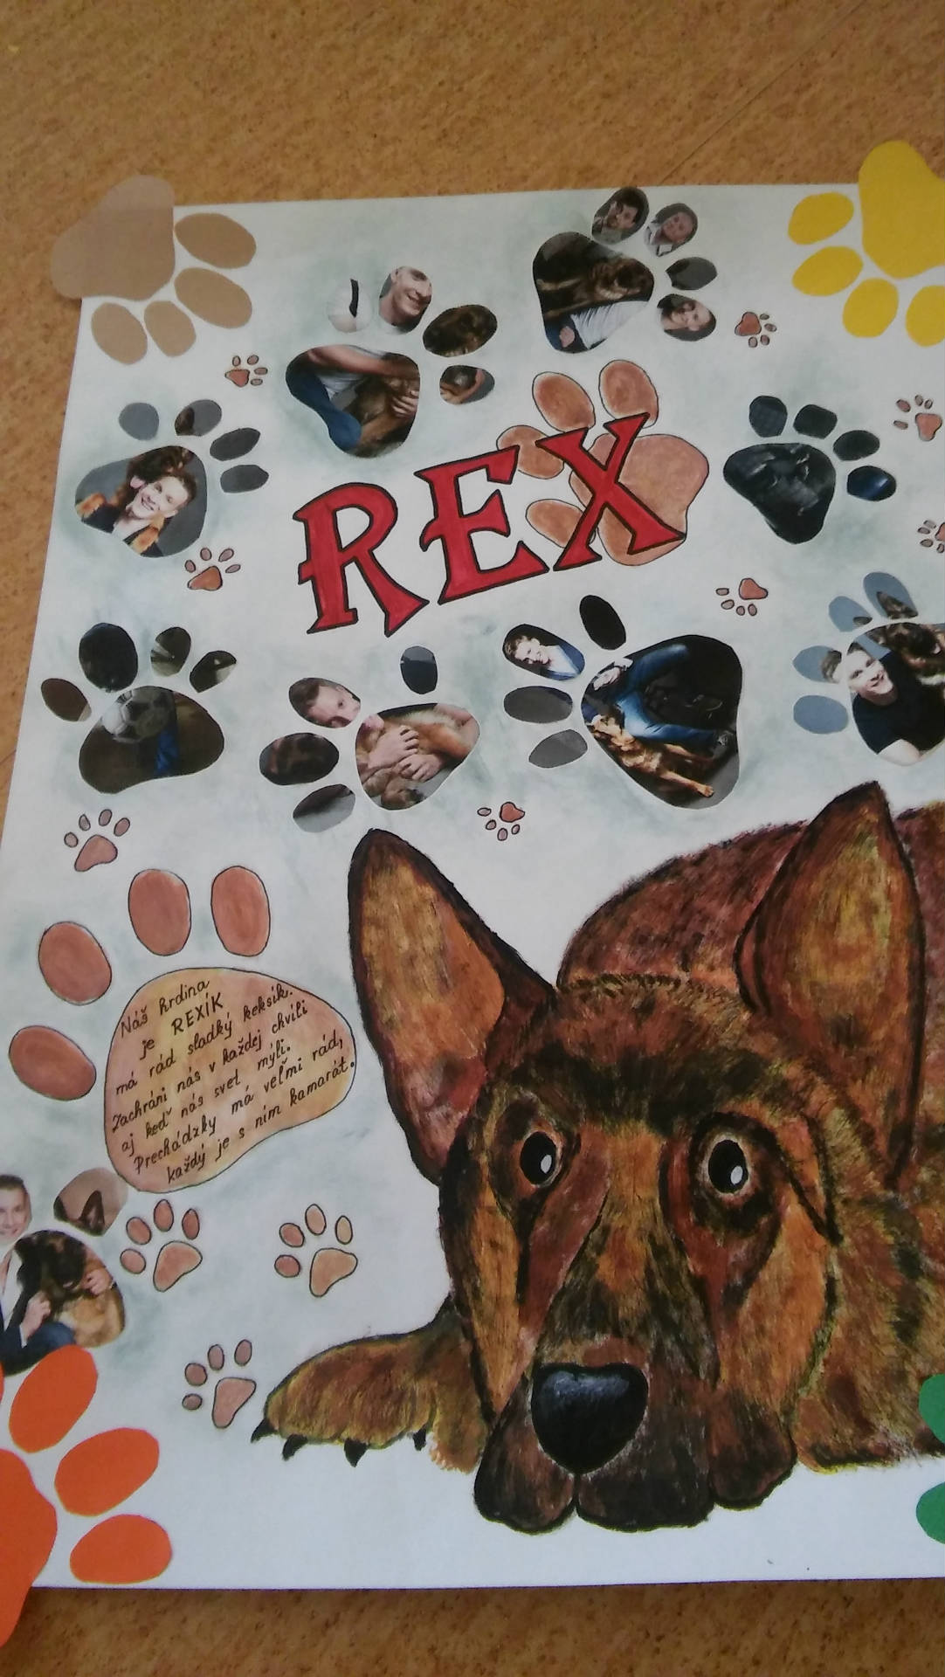
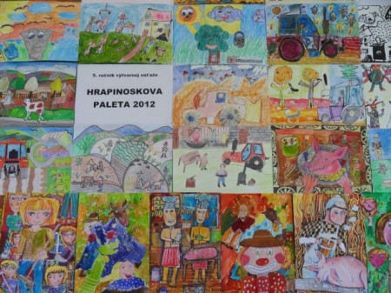
ART:
MY REGION
AUTOBUS OCAMI DETI
MY FRIEND REX
HRAPINOSKOVA PALETA

Slide 12
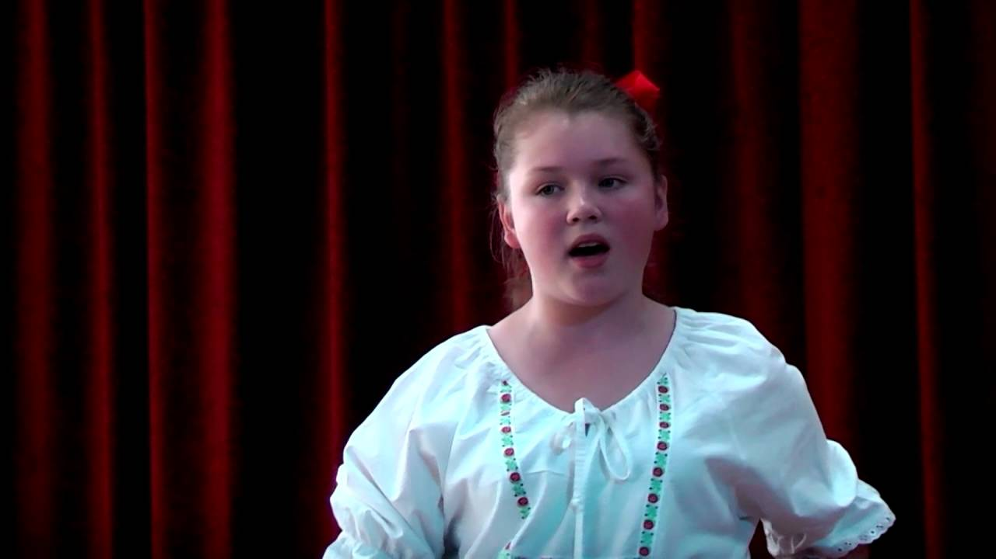
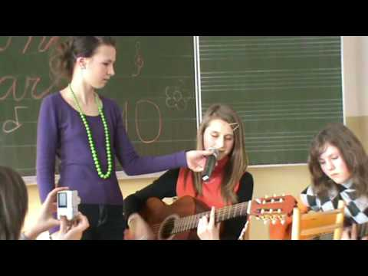
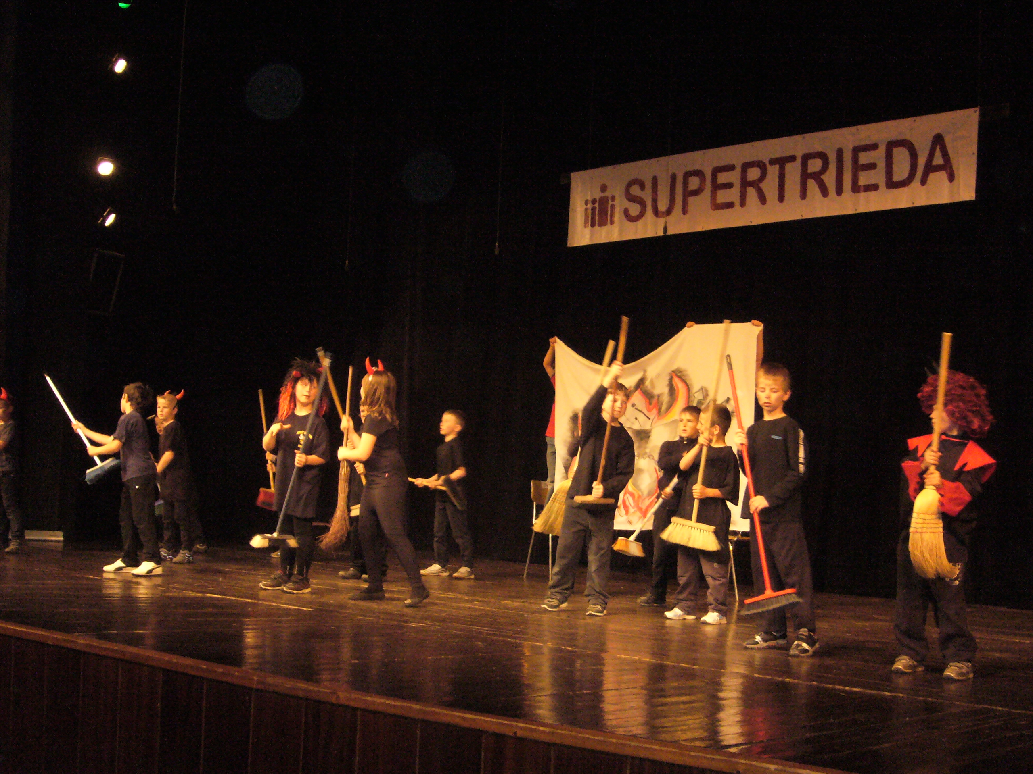
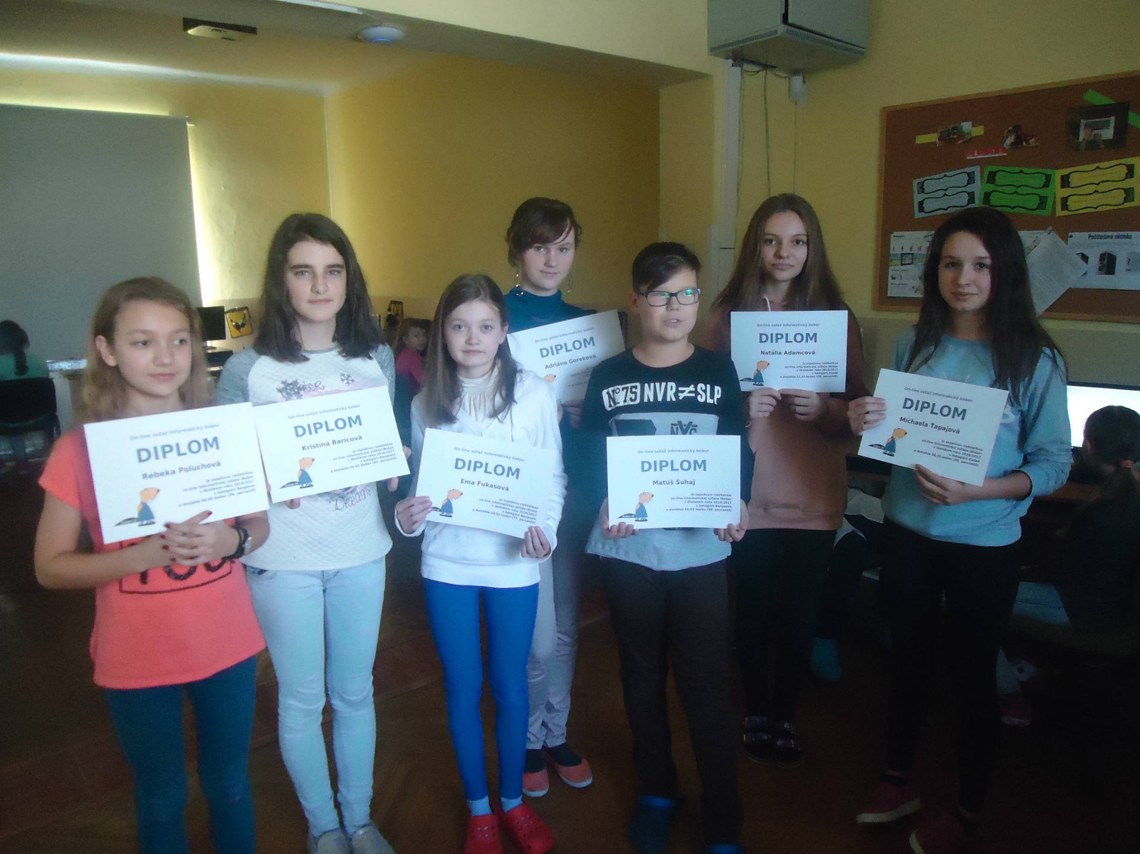
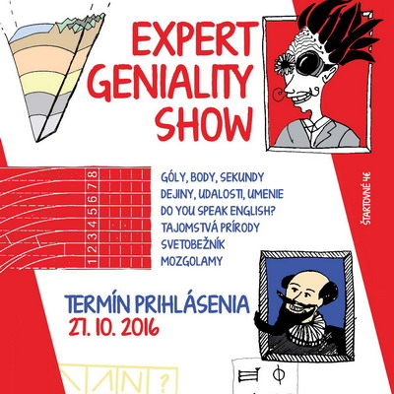
MUSIC AND ICT:
SLAVIK SLOVENSKA
DILONGSTAR
SUPERCLASS
BOBOR
EXPERT

Slide 13
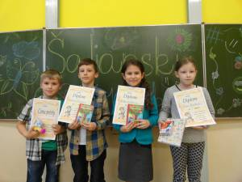
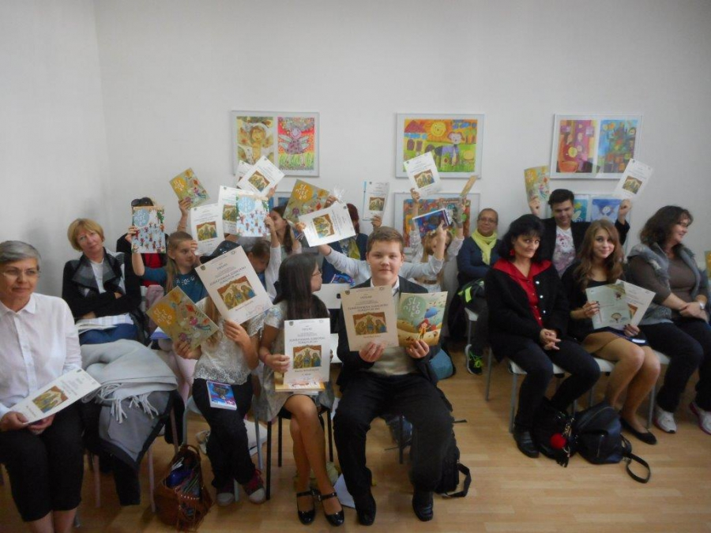
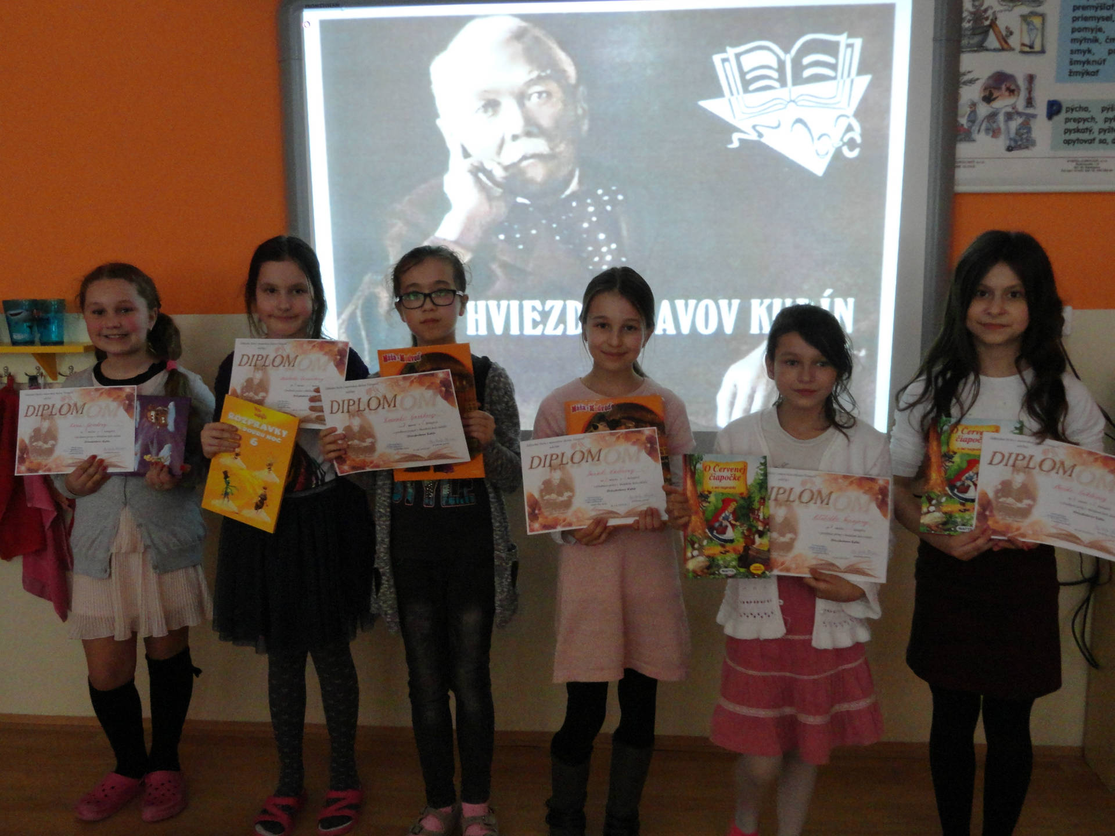
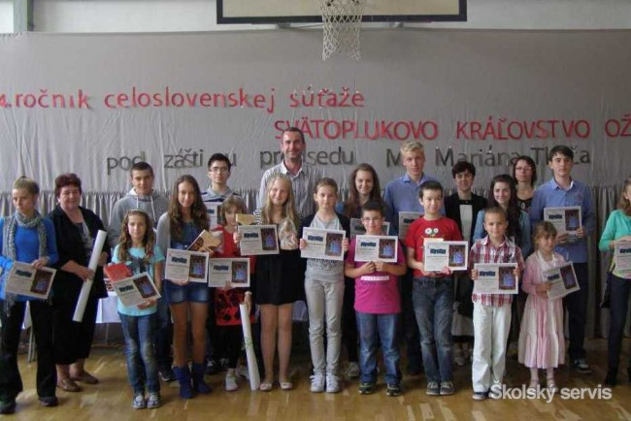
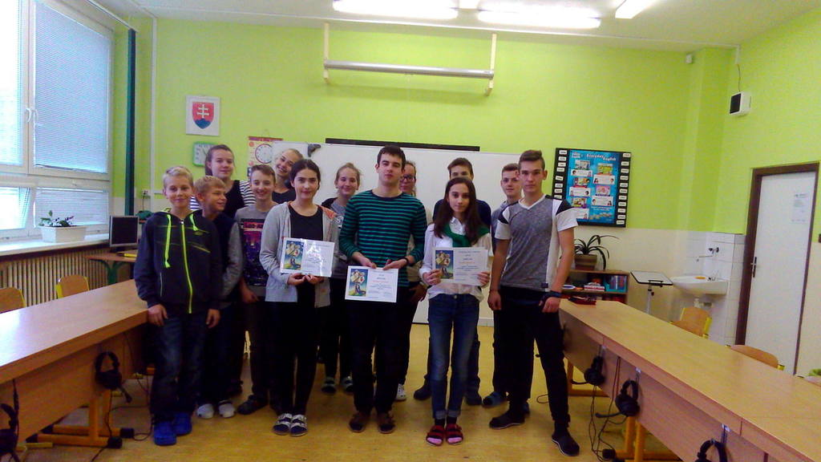
SLOVAK LANGUAGE :
SALIANSKY MATKO
ZLATA PODKOVA
HVIEZDOSLAVOV KUBIN
SVäTOPLUKOVO KRALOVSTVO
SLOVAK OLYMPIAD

Slide 14
THANK YOU FOR WATCHING

