Slide 1
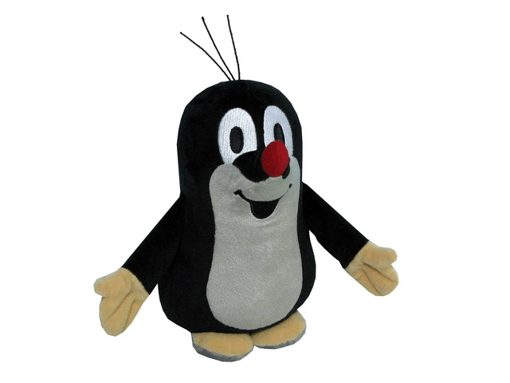
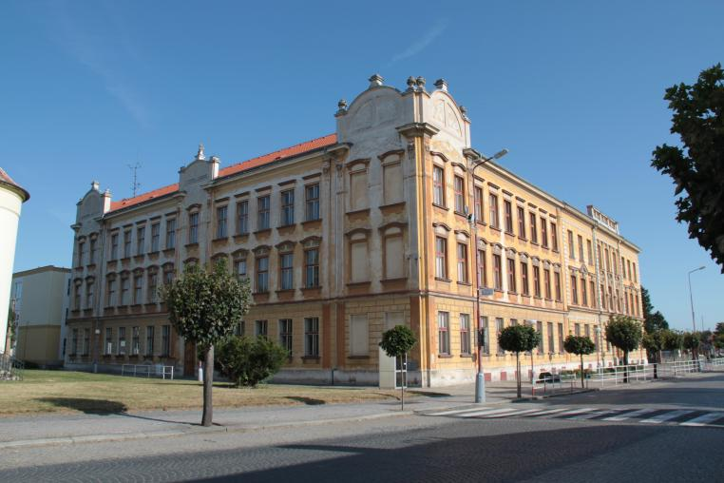
OUR SCHOOL

Slide 2
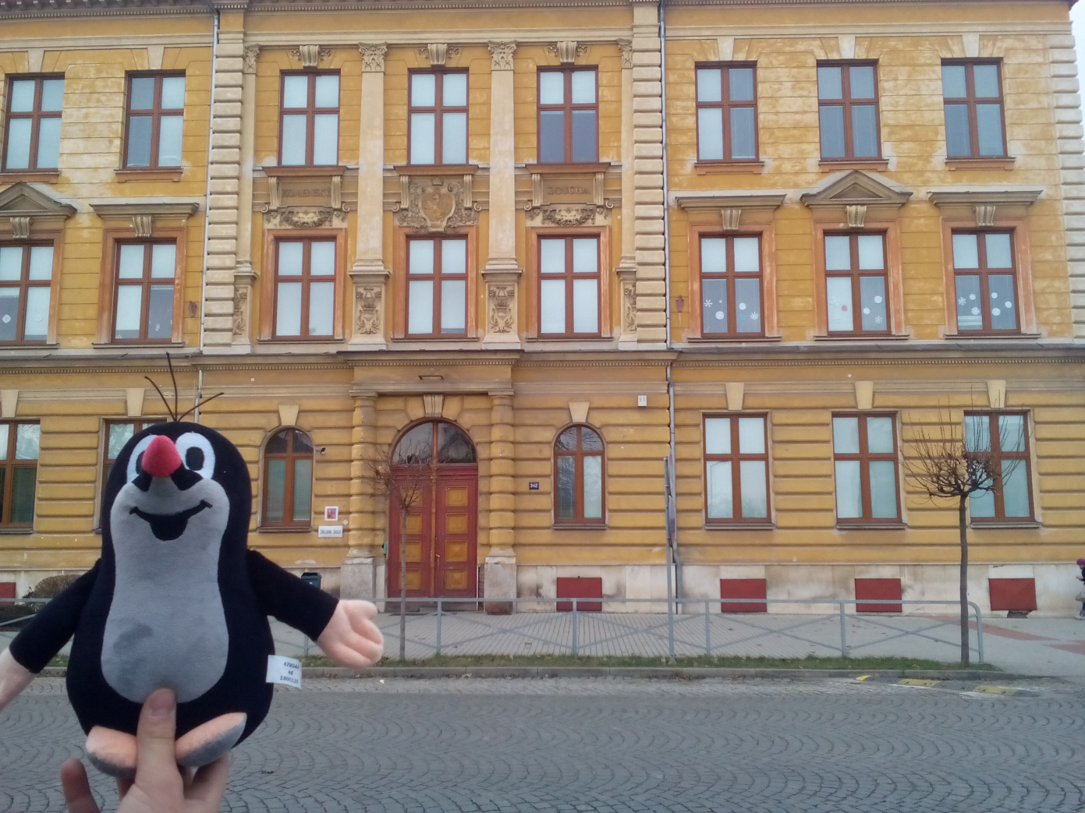
This is our school. Our school is faded yellow and is very big.Our school is very old,too.In the school there are 600 students and 25 teachers.

Slide 3
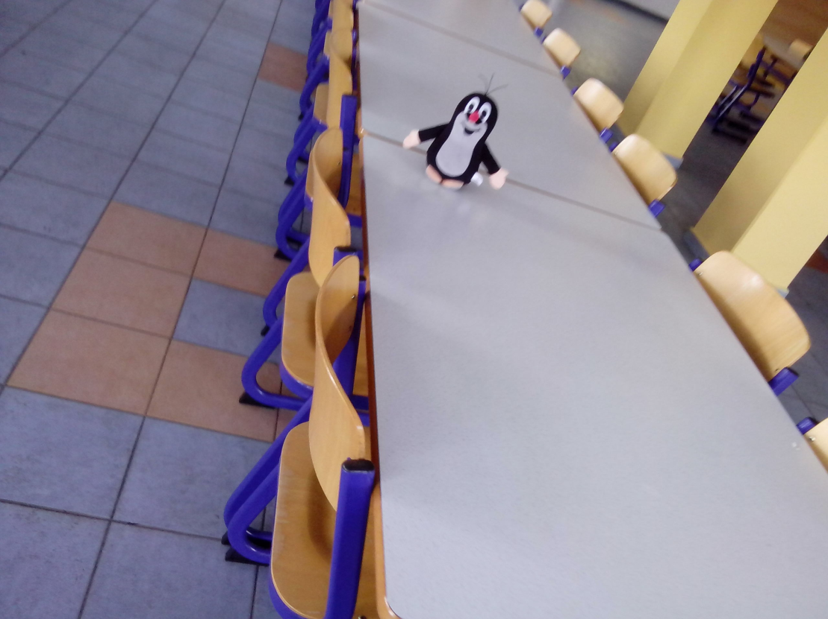
This is our school canteen.It is new and very big.Every day we have lunch here.The meals are very good.We sometimes have snacks,to.

Slide 4
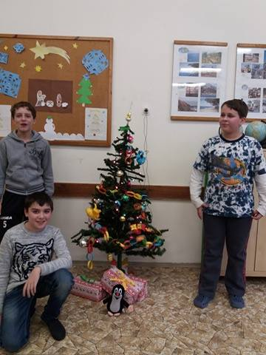
Our classroom is on third floor. Our teacher’s name is Jan Hranička. In our classroom there are about 28 children. Our classroom is big.
On Christmas we have a Christmas tree in the classroom

Slide 5
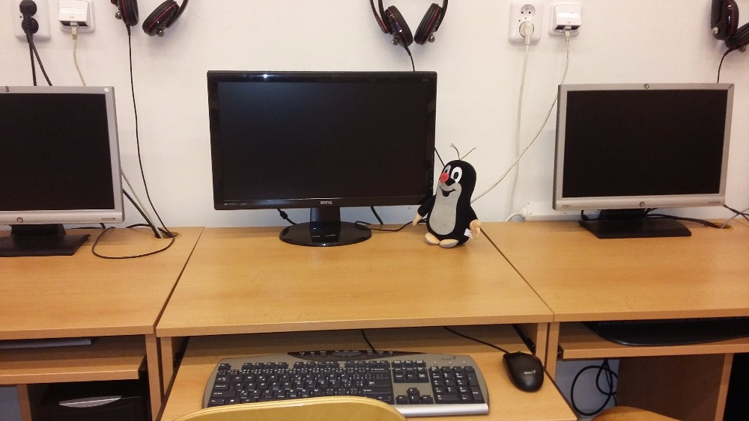
This is our school IT room.We have got two rooms.We study computer science.We have IT class once a week.We like this class. Our teacher is very good.

Slide 6
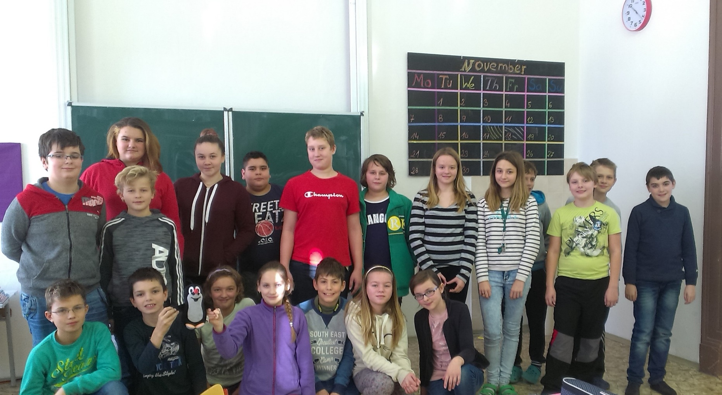
This is our English classroom. Our teacher is Mrs Hronová. We have got English lessons every Monday, Tuesday and Thursday. English lessons are fun.

