Slide 1
Erasmus +
Hi, we are Camilla and Lucrezia and we were lucky enough to partecipate in the Erasmus trip to Romania. It was a unique and very engaging experience, and we are here to tell it! We left with some students from other classes and 2 teachers at 02.00 in the morning from the Pescara station, we were all very excited about what awaited us and so, without thinking about it, we got on the bus. We arrived at Rome at about 05.00 in the morning, at the airport there was already an air of freshness while we were still sleepy. We ate breakfast, time seemed to pass slowly, until we had to board the plane, we were also late! It was a short trip, all the families welcomes us at the airport with a poster that read “Erasmus +”. How beautiful! We immediately felt welcome, and after about 5 minutes, we were each sent with out families. We were still tired, so we rested and when we woke up we got to know the families who hosted us. And so the first day passed, slow! It felt like everything was going slower, and we enjoyed every moment.

Slide 2
The rest of the week was even better! The activities were many and we learned many things about Romanians: habits, lifestyles, means of transport, activities, centers, services, typical dishes.. The city we were in is Bucharest, the capital, modern with features of very fascinating history! The day after we arrived we started to act like real romanians, with a guide. The first place we visited was the school, it was huge! Many classes of different ages, we also visited some classes and interacted with the students. We noticed the activities they did and how they worked, we also joined them, it was fun and at the same time it taught us something. In the school we did different activities with the students participating in the Erasmus from other countries, some activities were: painting typical masks on canvas, building a miniature house and watching a show made by the school’s students performing. Some sang, some played an instrument, and in the end we also danced all together some of the dances they taughts us, to Italian and Spanish songs! Outside the school we visited many places: castles, museums, shopping centers, tried restaurants and of course visited the city! The most interesting castle we visited was that of Dracula, in Transylvania. It was huge, the interior was decorated with antique supplies, kept in good condition. We also visited 2 museums, 1 couldn’t take pictures but they illustrated and told us some things about the castle and the works while sitting in the living rooms on huge decorated carpets.

Slide 3
The other museum was inside a shopping center, it was a museum of optical illusions! It was a more modern and interactive museum. We walked through a few rooms, but the room we all preferred was the room that "ran". It gave a headache but it was the most fascinating, we walked into that room 3-4 times! In some of the rooms we even took some amazing photos. At the end of the museum there were mirrors that changed the reflection and boxes in which we had to insert our hand and guess what object was inside. It was an experience that most of us had never had before, in fact we had a lot of fun and took lots of group photos. Another activity was indoor climbing on huge climbing walls. There were some very good climbers who made us climb the climbing walls after putting on the suitable harness. We also tried a jump from a kind of trampoline that made us go from right to left. At the end of the day we ordered some pizzas. After many activities, the part dedicated to food has obviously arrived! We went to different restaurants to try typical foods, one of the most served foods was the soup. In addition to trying typical restaurants, we also tried popular Italian restaurants, and of course McDonald's too. Finally we visited the city! Who with the family and who also with the guides. Some of us visited museums, others took the bus tour visiting important parts of the city while a guide explained everything. We also witnessed the fountain show, which lasted about 40 minutes, it was very beautiful, many colored lights of different colors that mixed with each other with water accompanied by music.

Slide 4
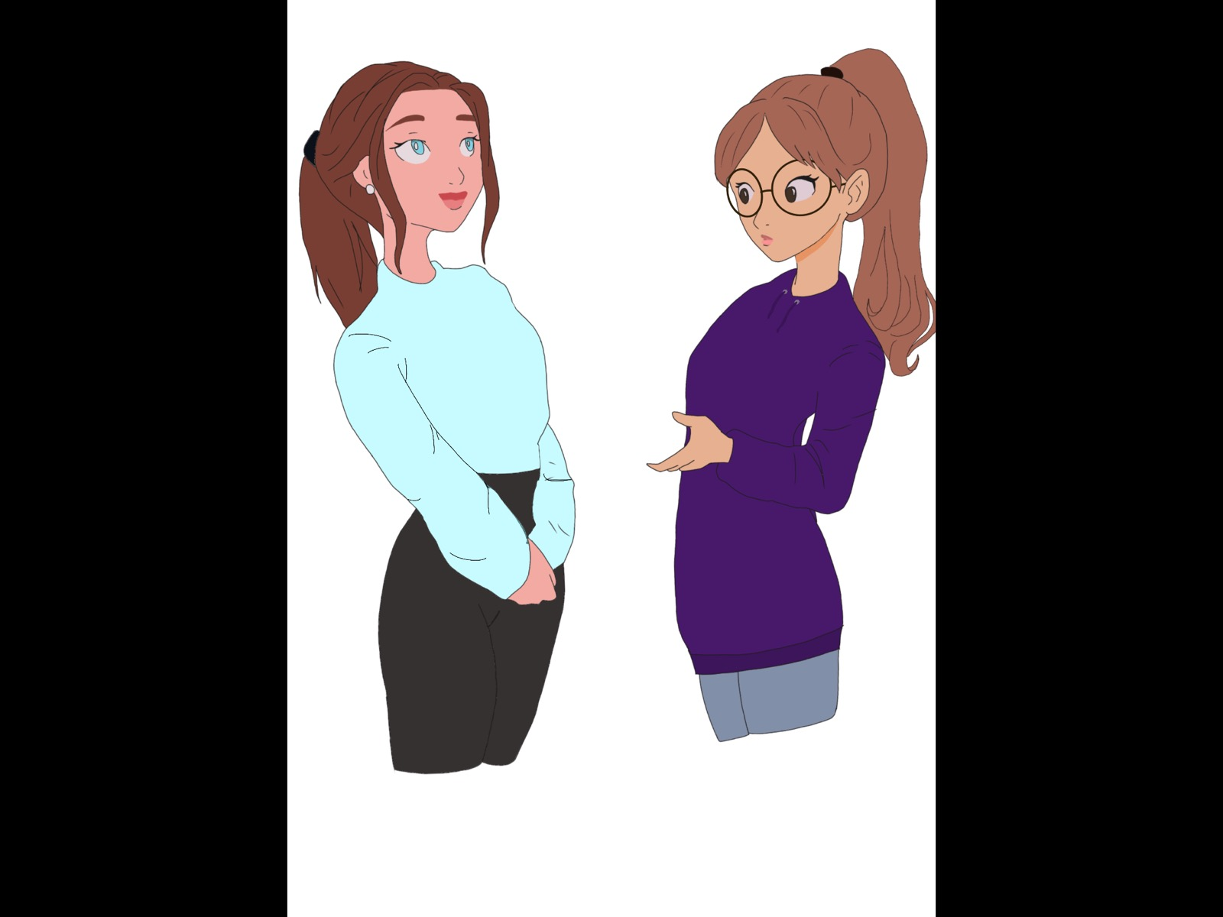
It was a week-long trip, but it seems like it was double! An experience that everyone liked and we hope it will be repeated. Some of us bought souvenirs from a small shop near the school to take home and to our family!

