Slide 1
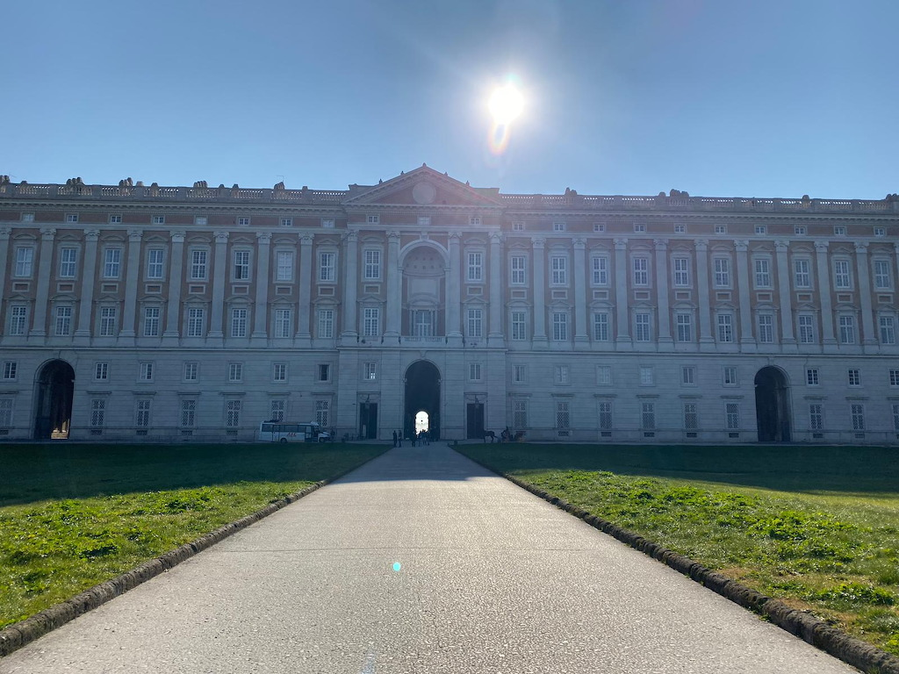
THE REGGIA OF CASERTA OUT
Link foto esterna
https://www.jigsawplanet.com/?rc=play&pid=2c4685969713

Slide 2
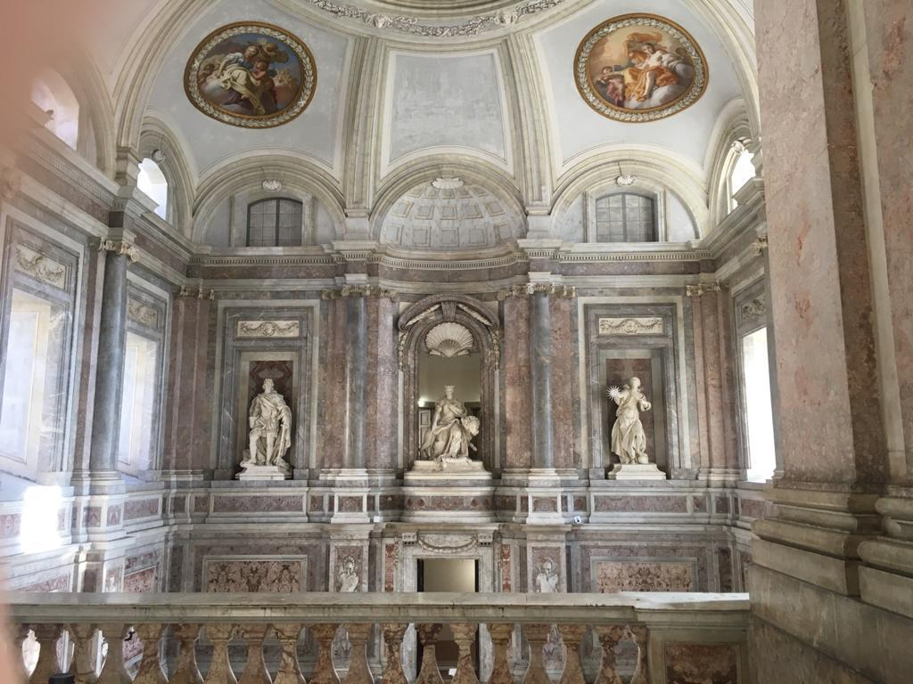
THE REGGIA OF CASERTA IN
Link foto interna
https://www.jigsawplanet.com/?rc=play&pid=243c30940cc3

