Slide 1
Our school
Nino Cicvidze.
20.05.2016

Slide 2
About our school
Our school was founded in 1956.
Today it consists of two buildings.
520 students are studying in school.
Our students take part and win the national Olympiads and conferences each year.
Students work on various projects.
Our schoouol is one of the most successful in our village.

Slide 3
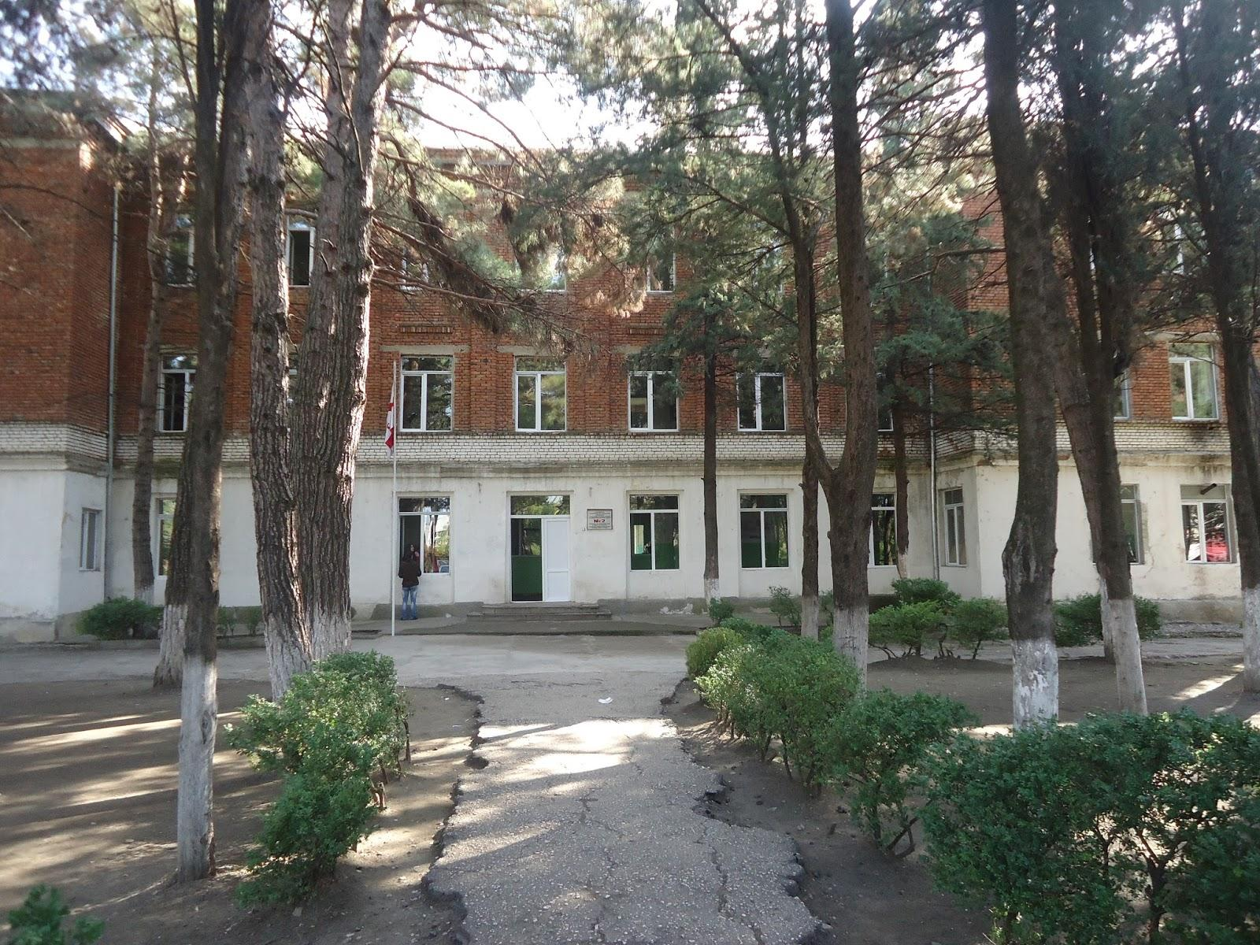
The first building of our school

Slide 4
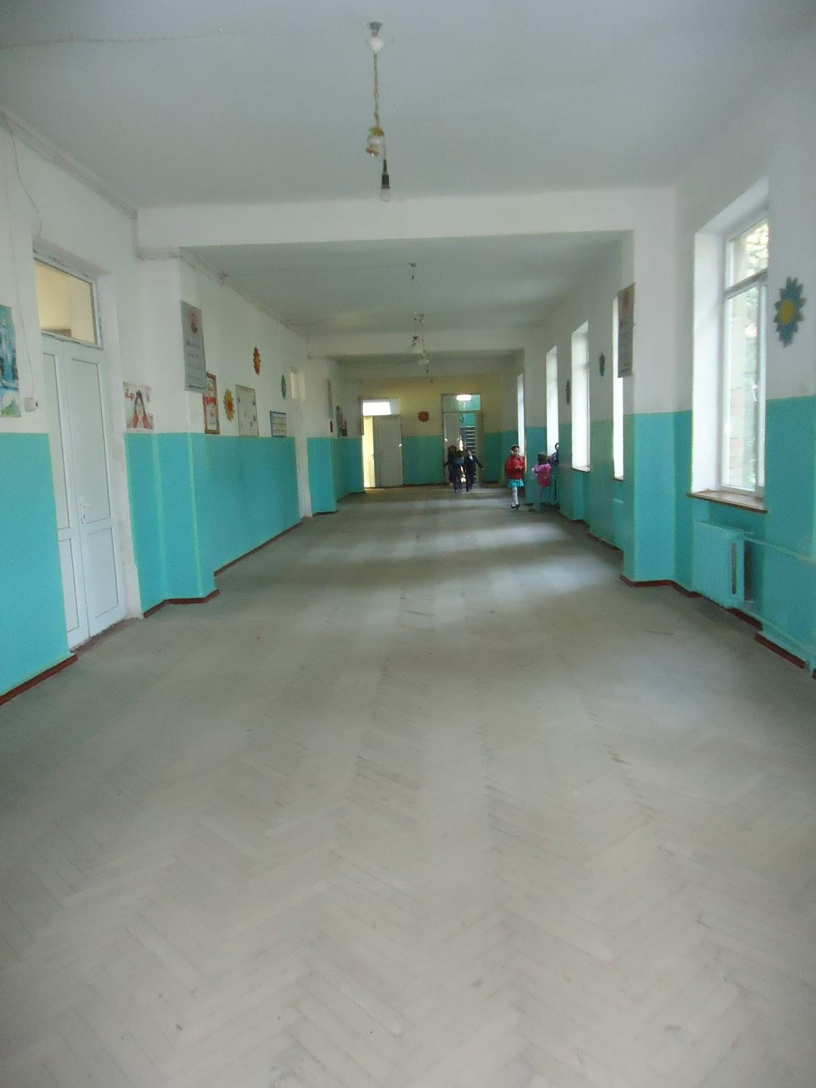
School Interiors

Slide 5
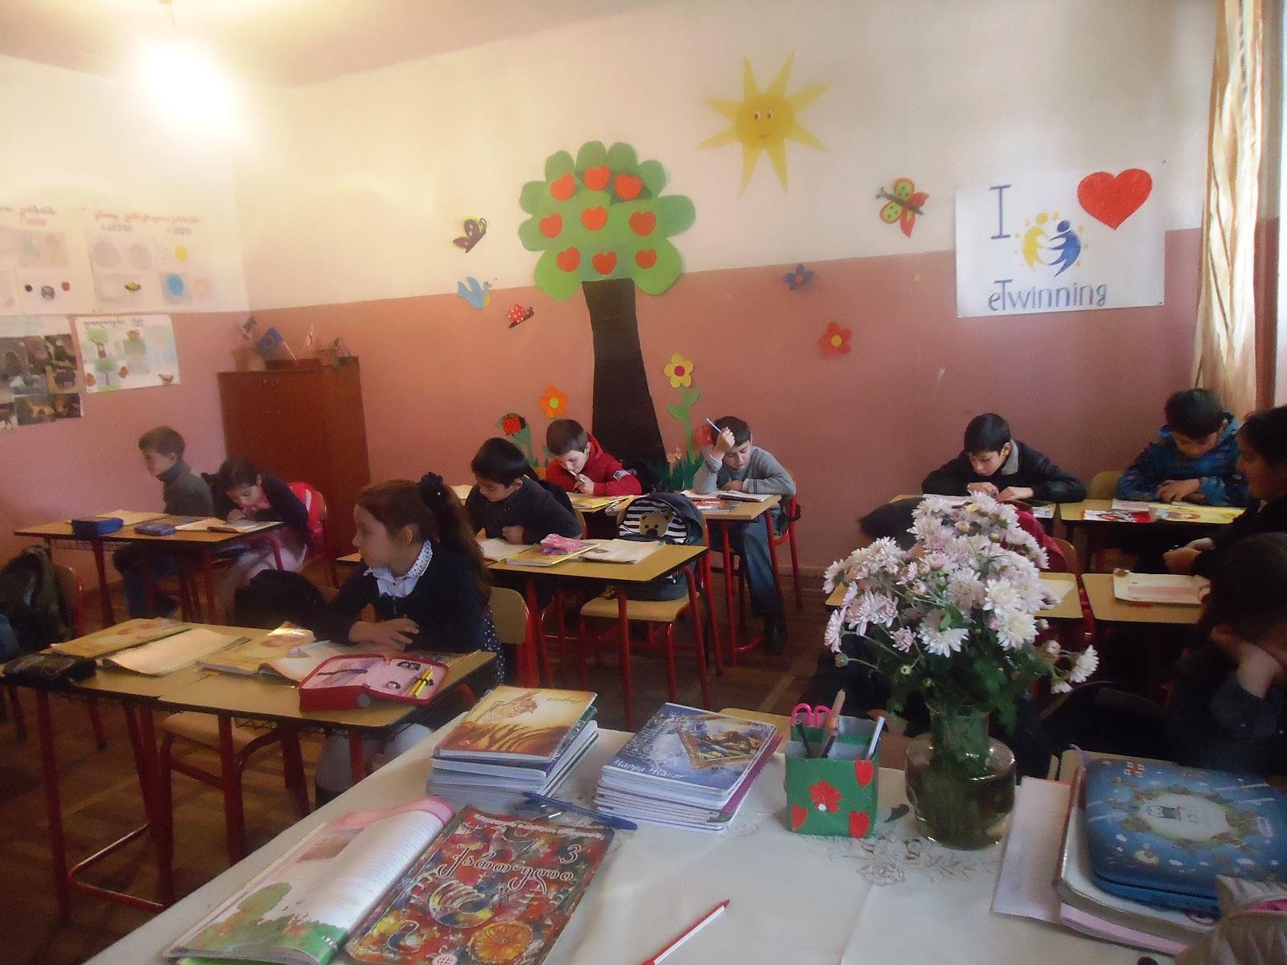
This is our classroom

Slide 6
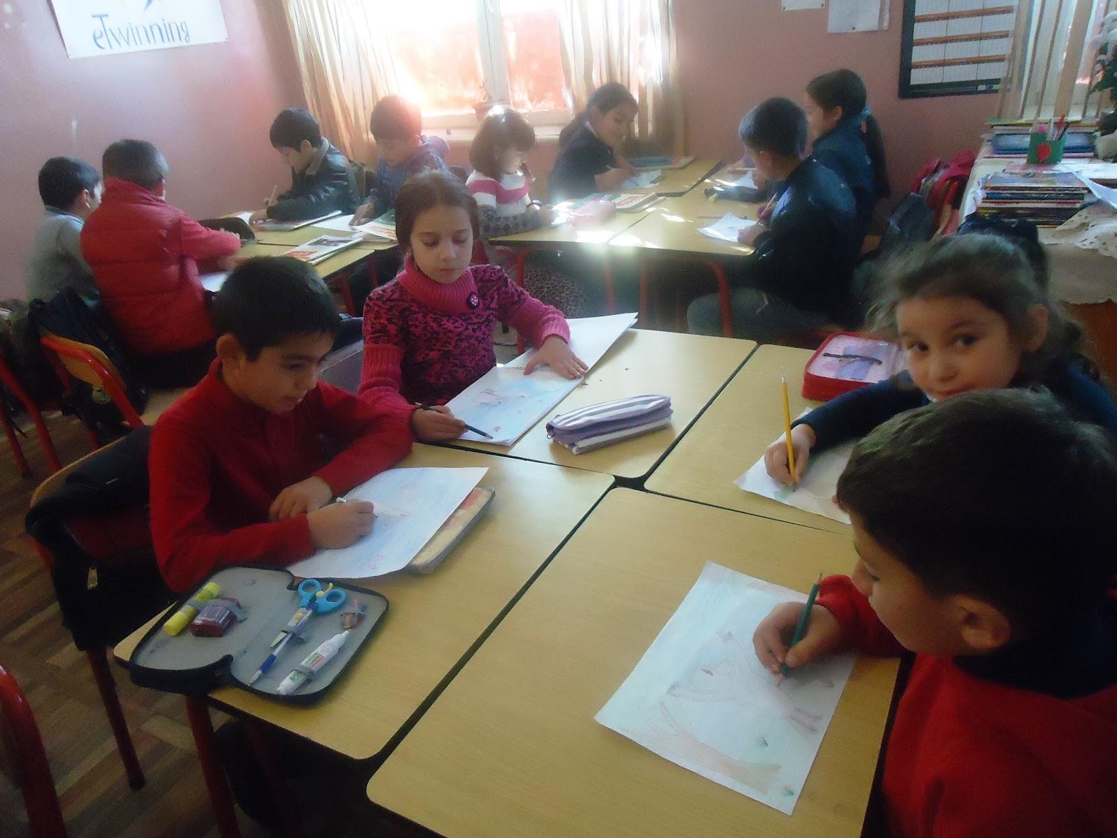
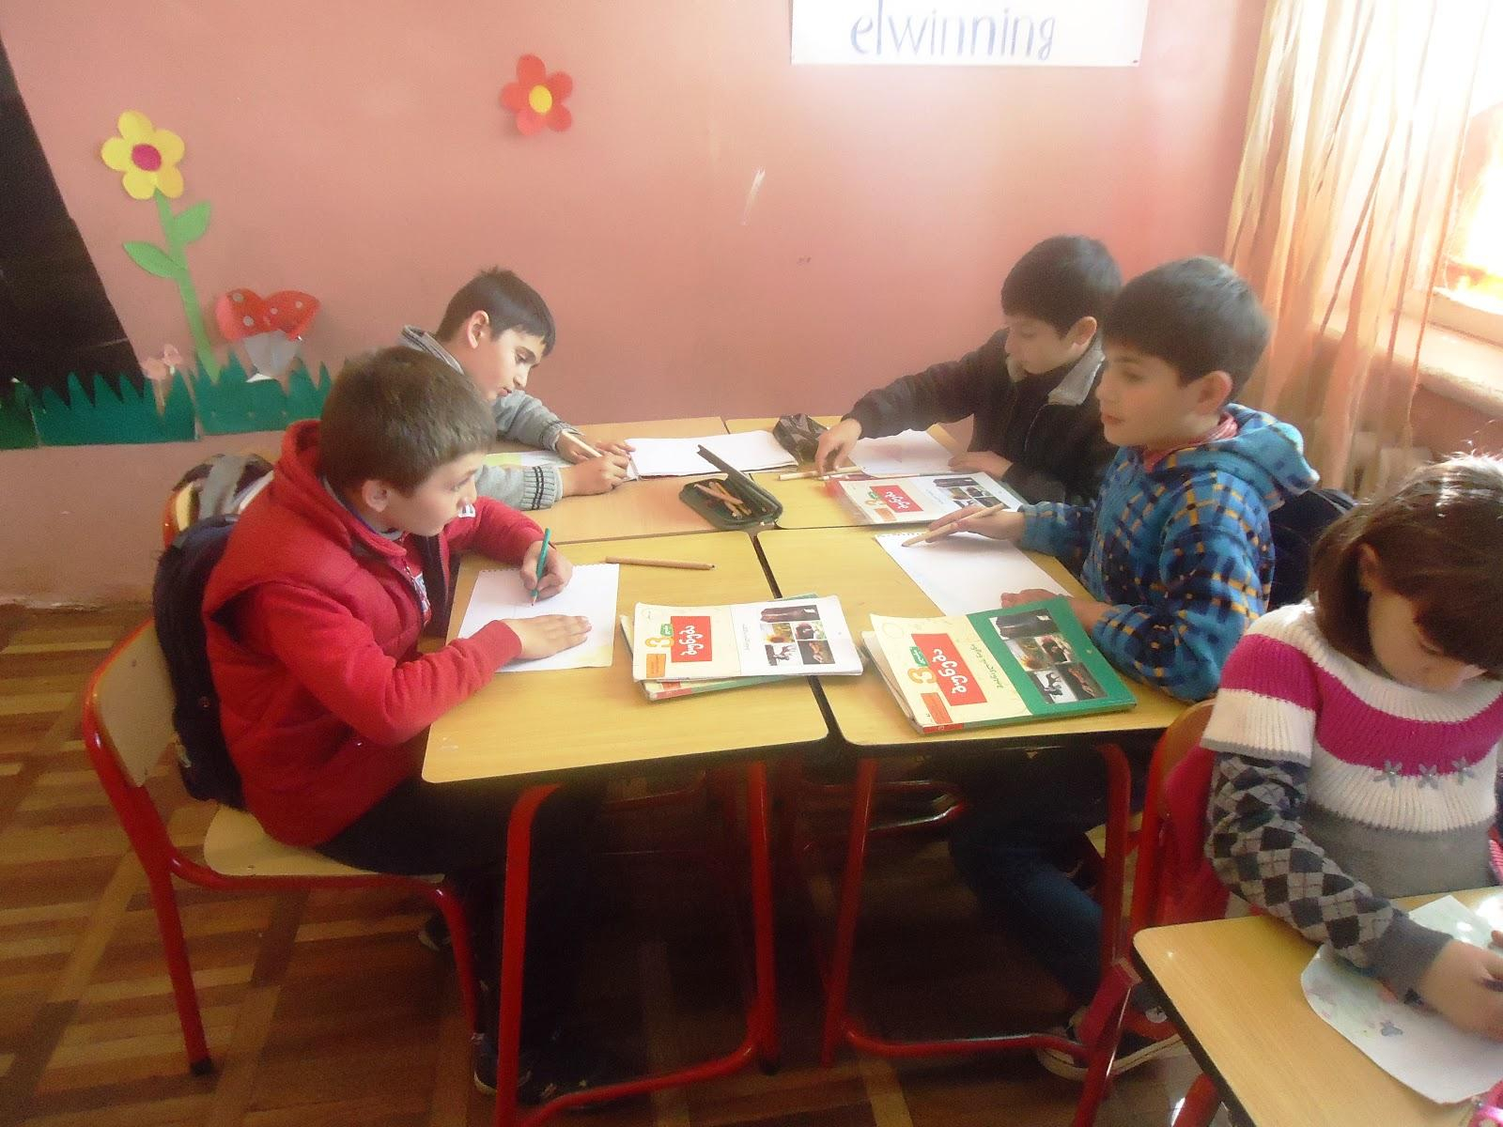
We love working in pairs.

Slide 7
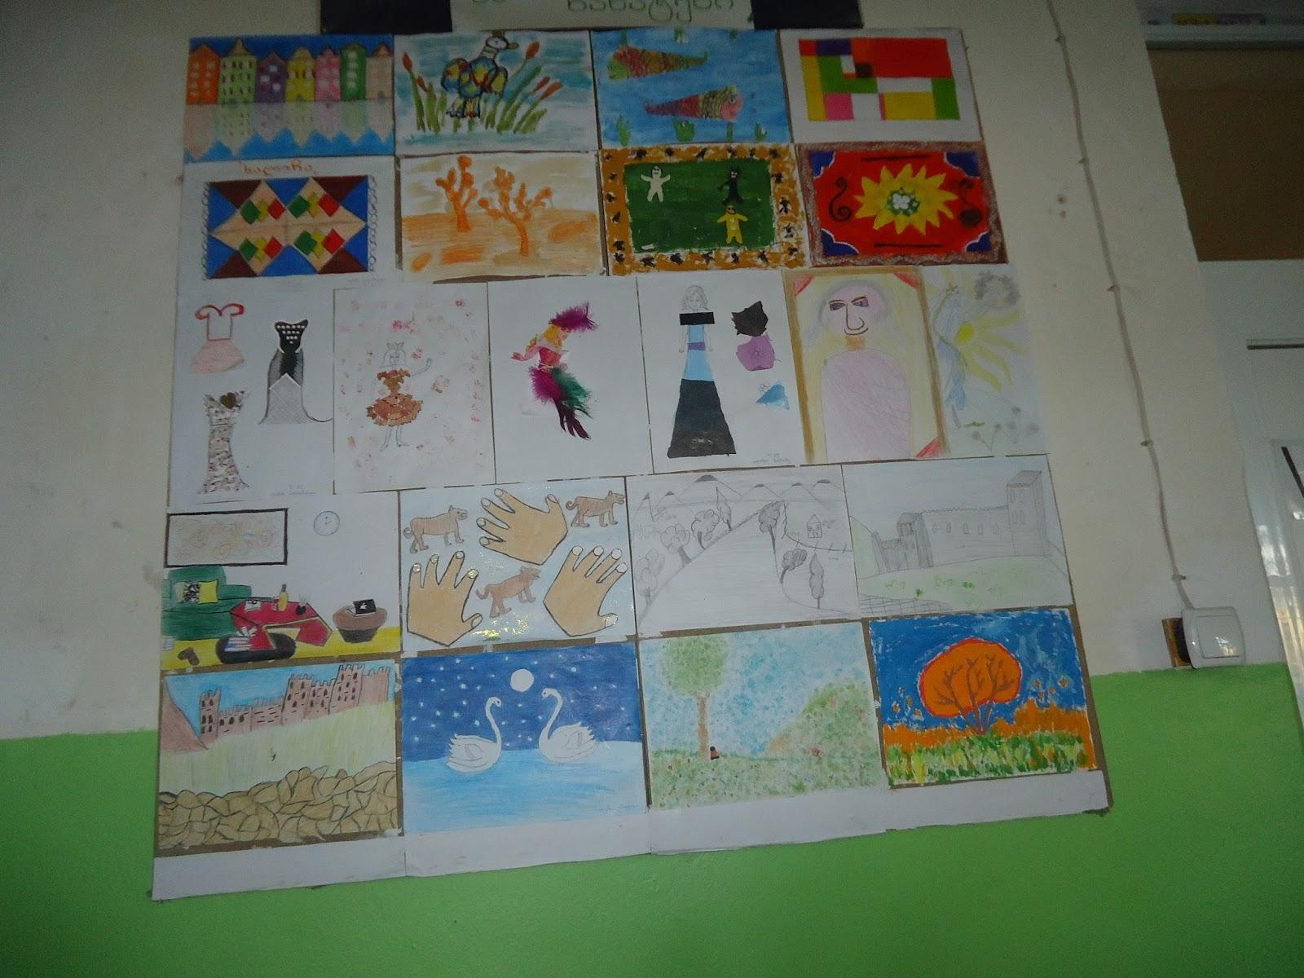
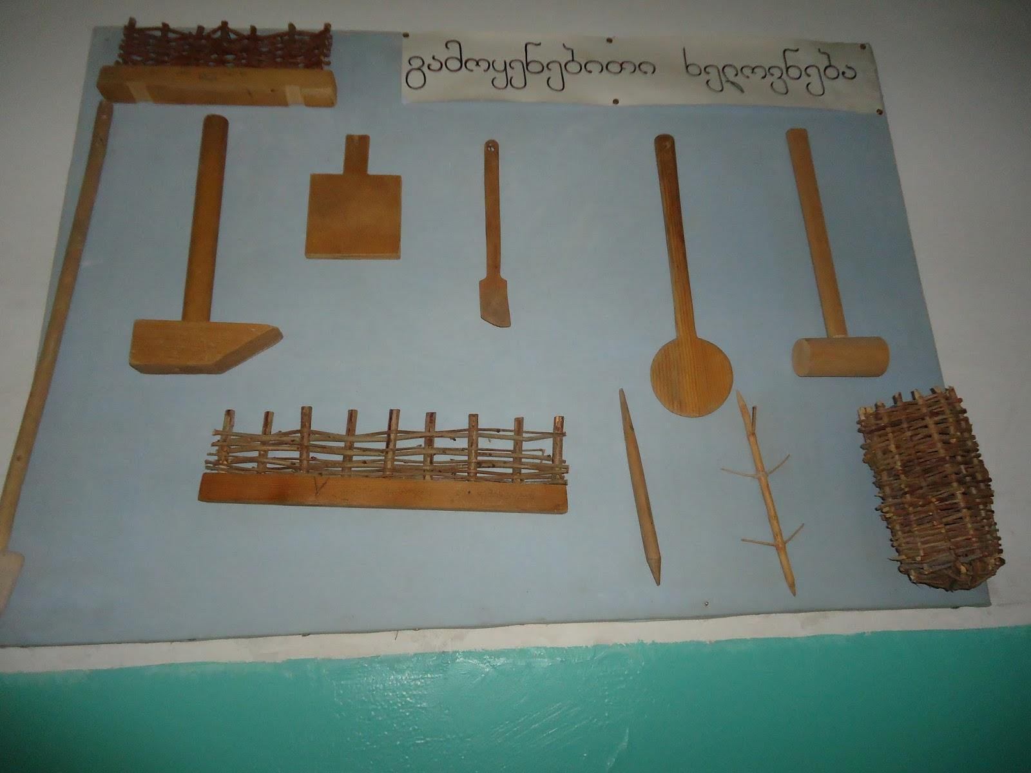
Handmade objects and pictures.

Slide 8
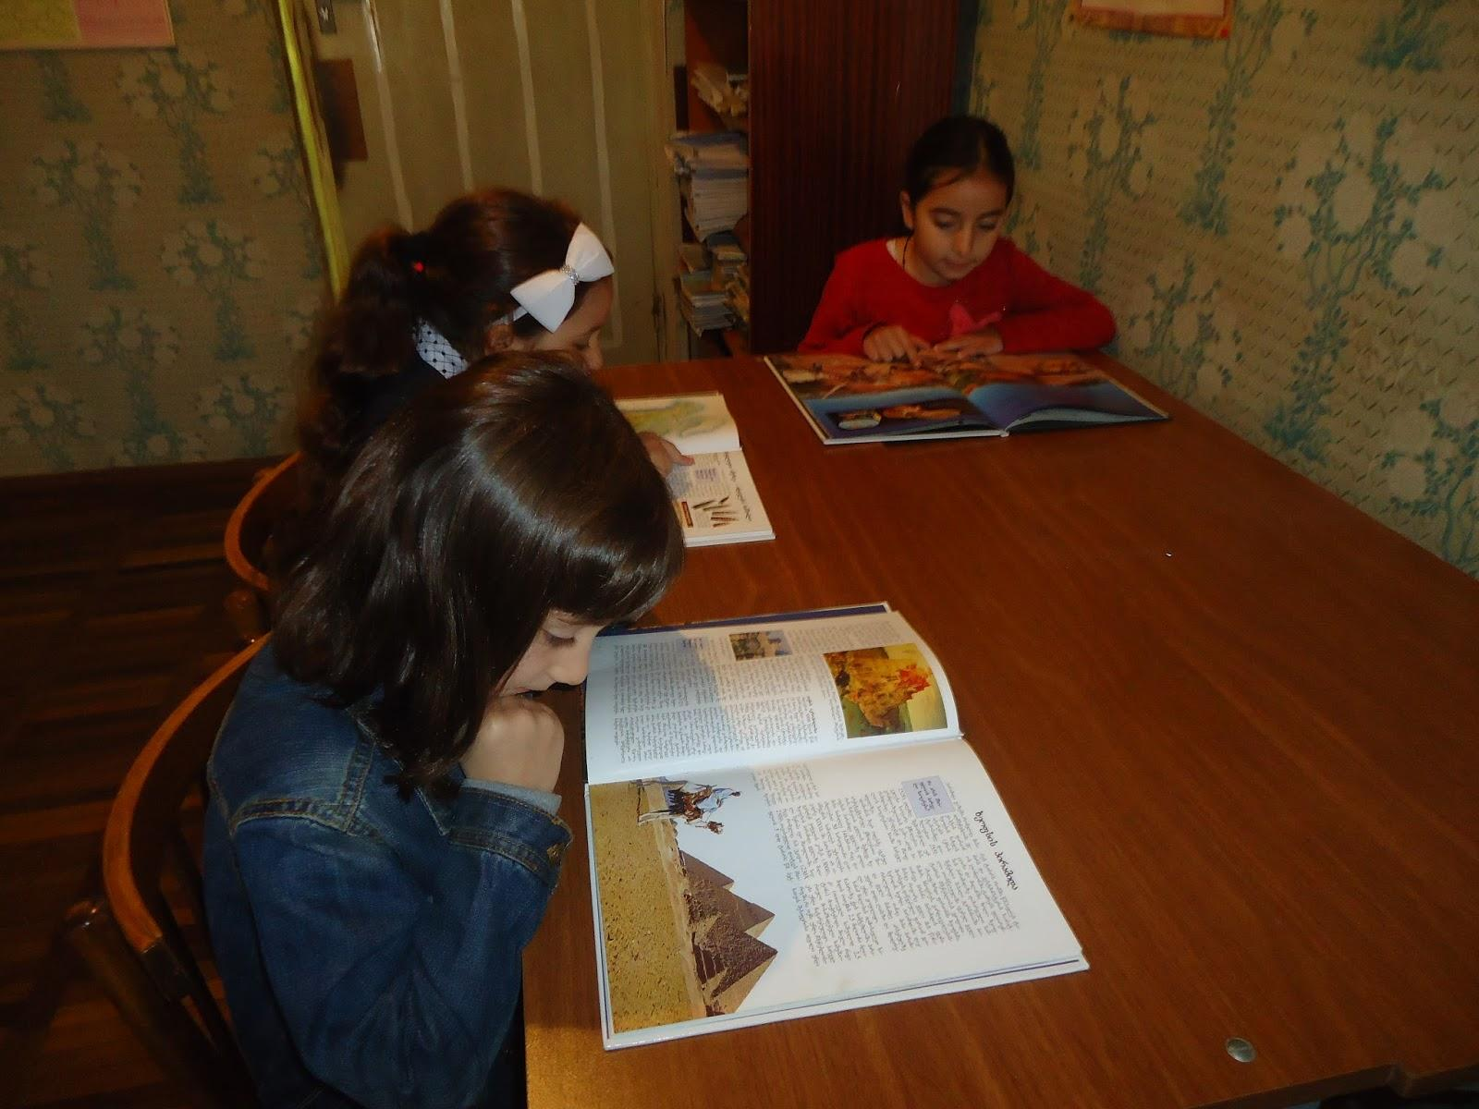
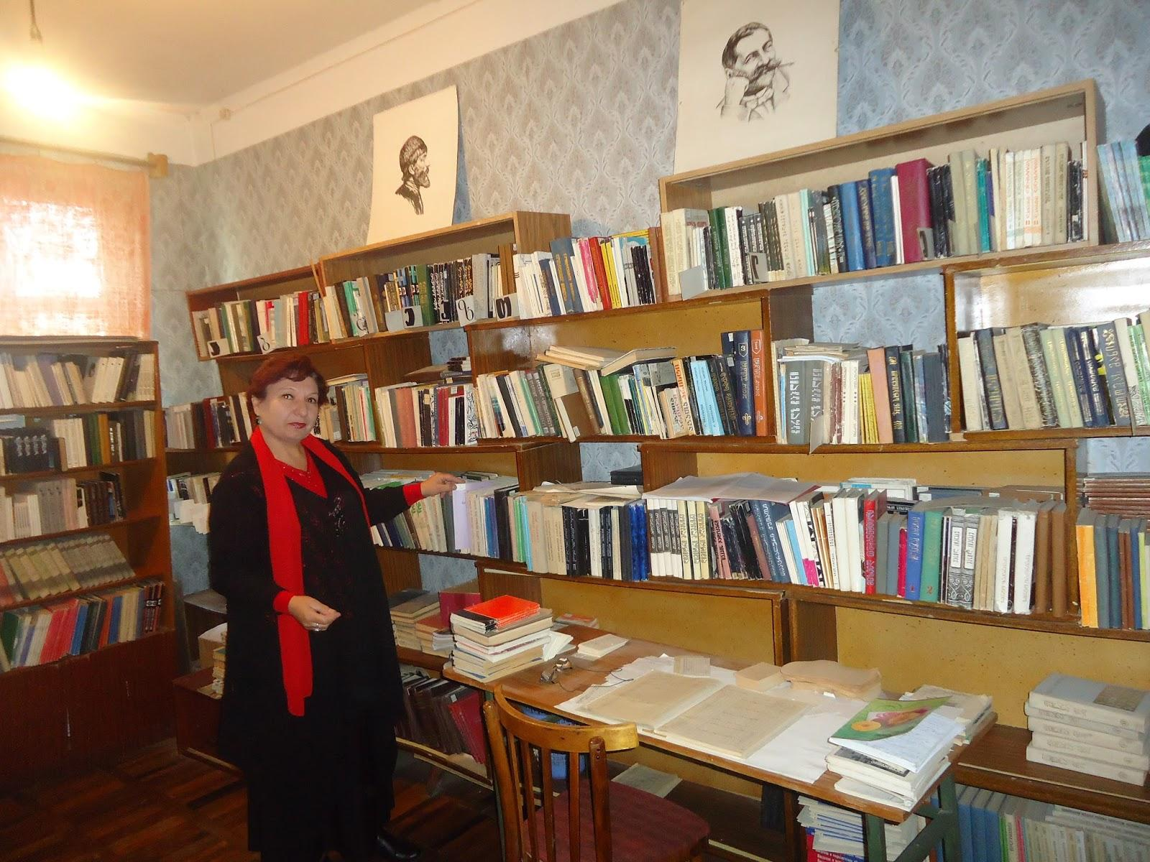
Students are working on projects at the library.

Slide 9
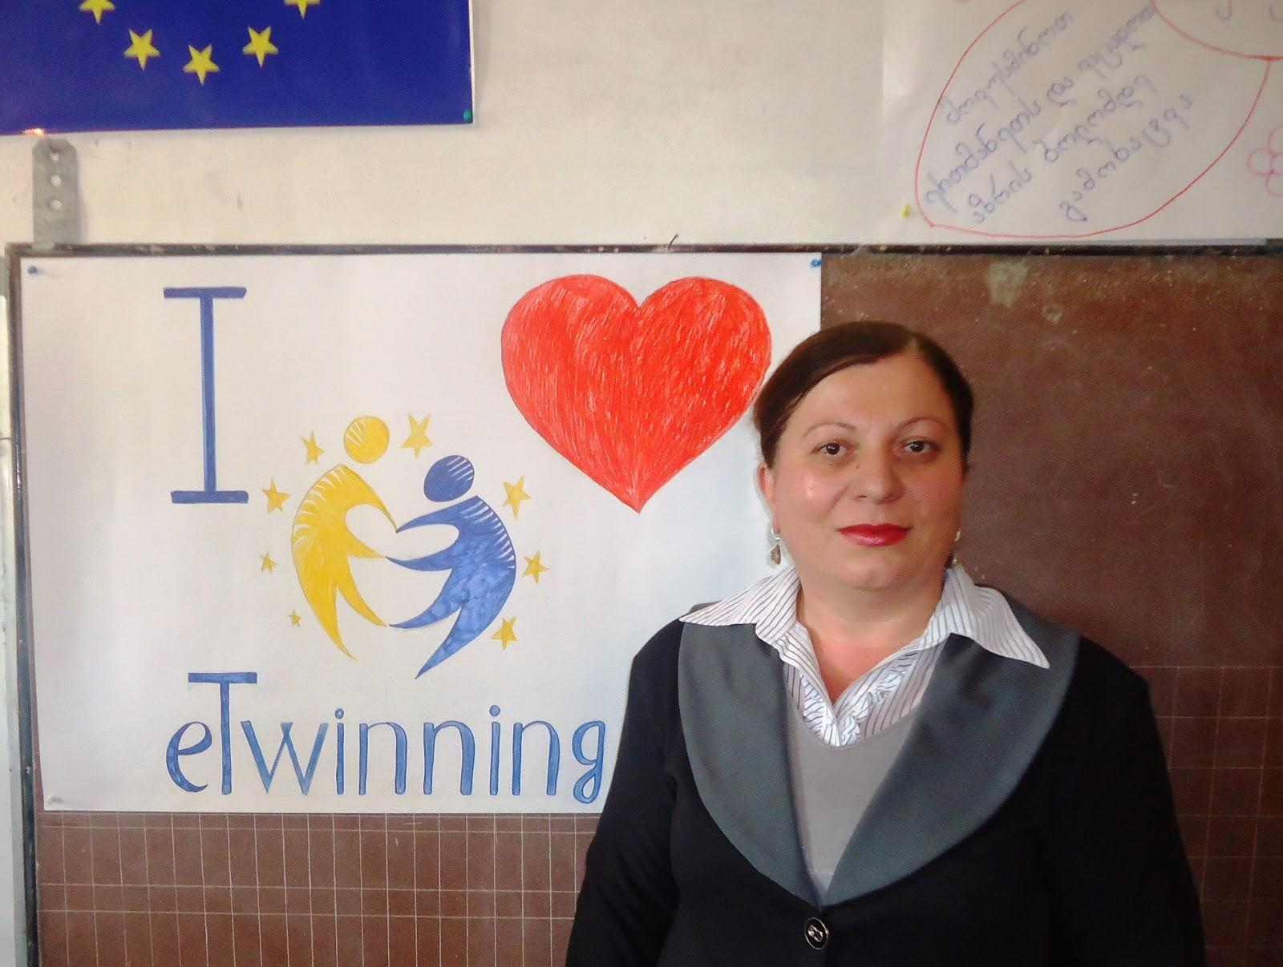
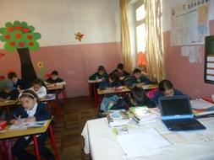
A partner teacher Nino Cicvidze

Slide 10
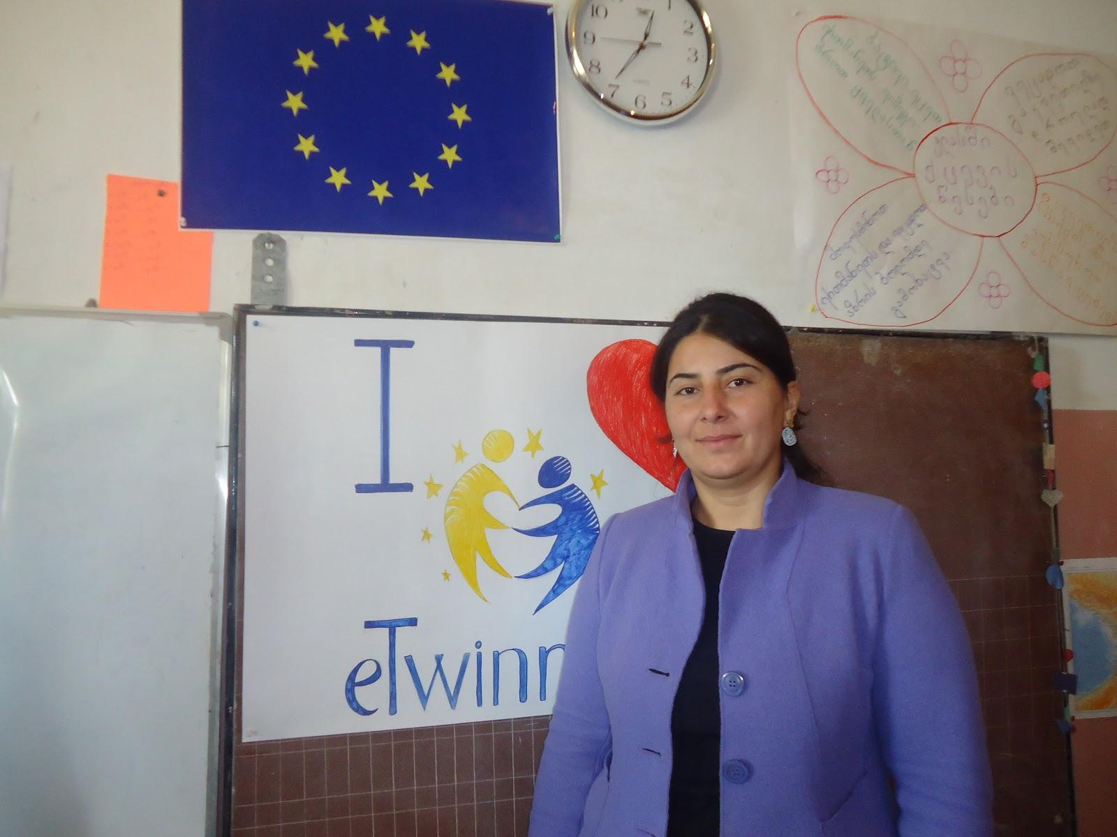
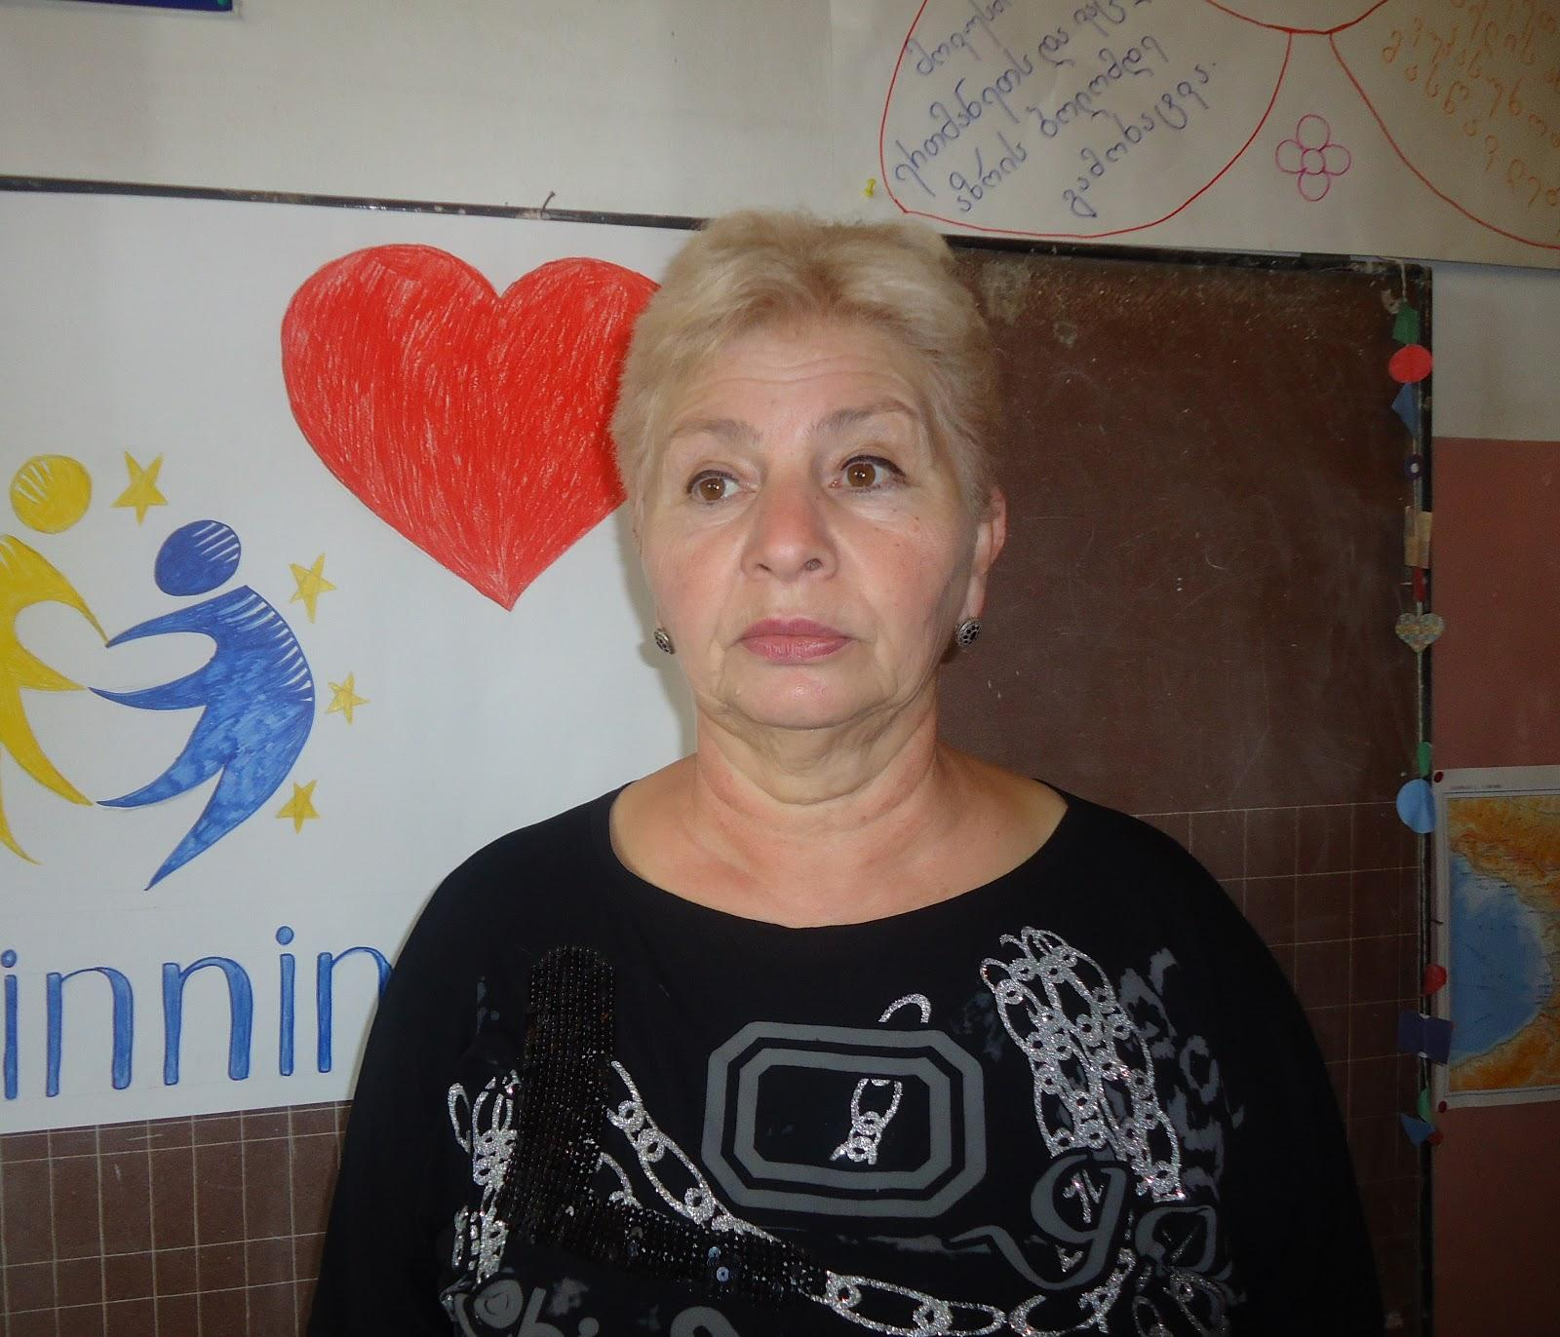
Teachers involved in the project
An art Teacher Shorena Burduli
A music Teacher julieta kurtanidze

Slide 11
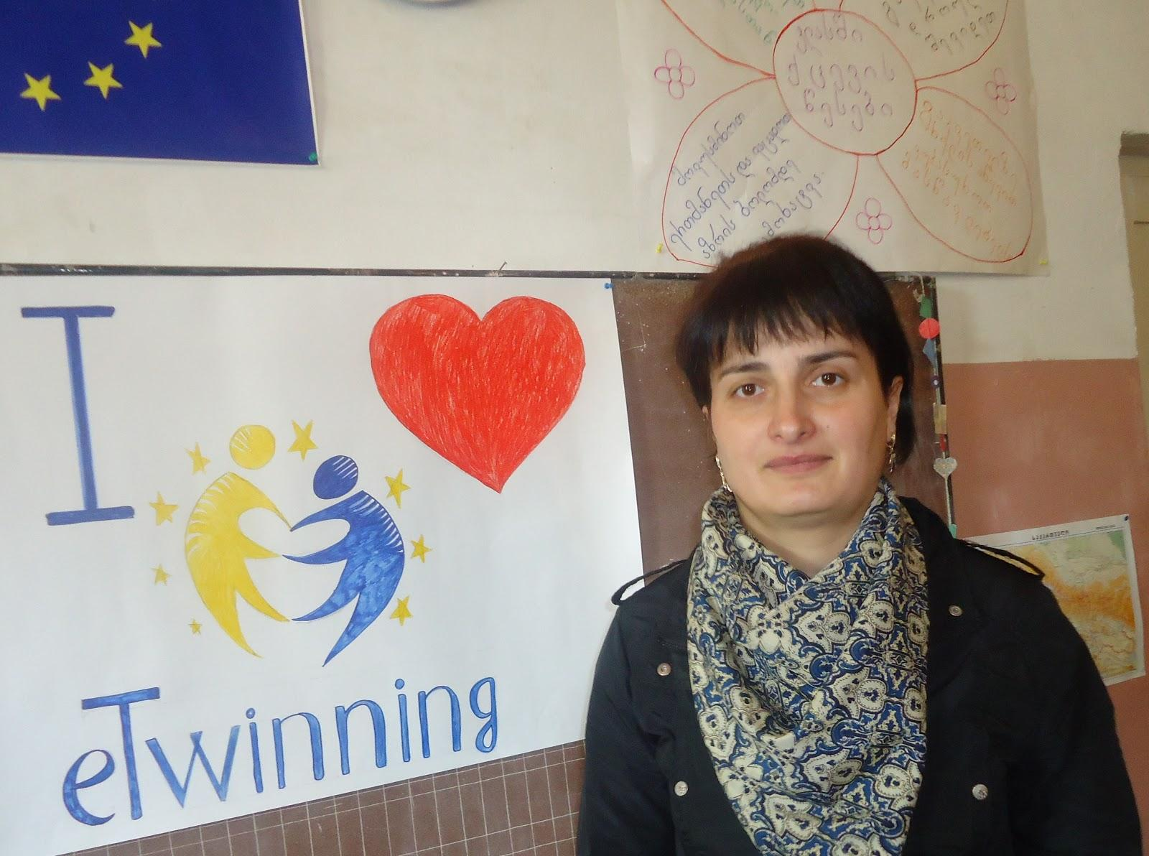
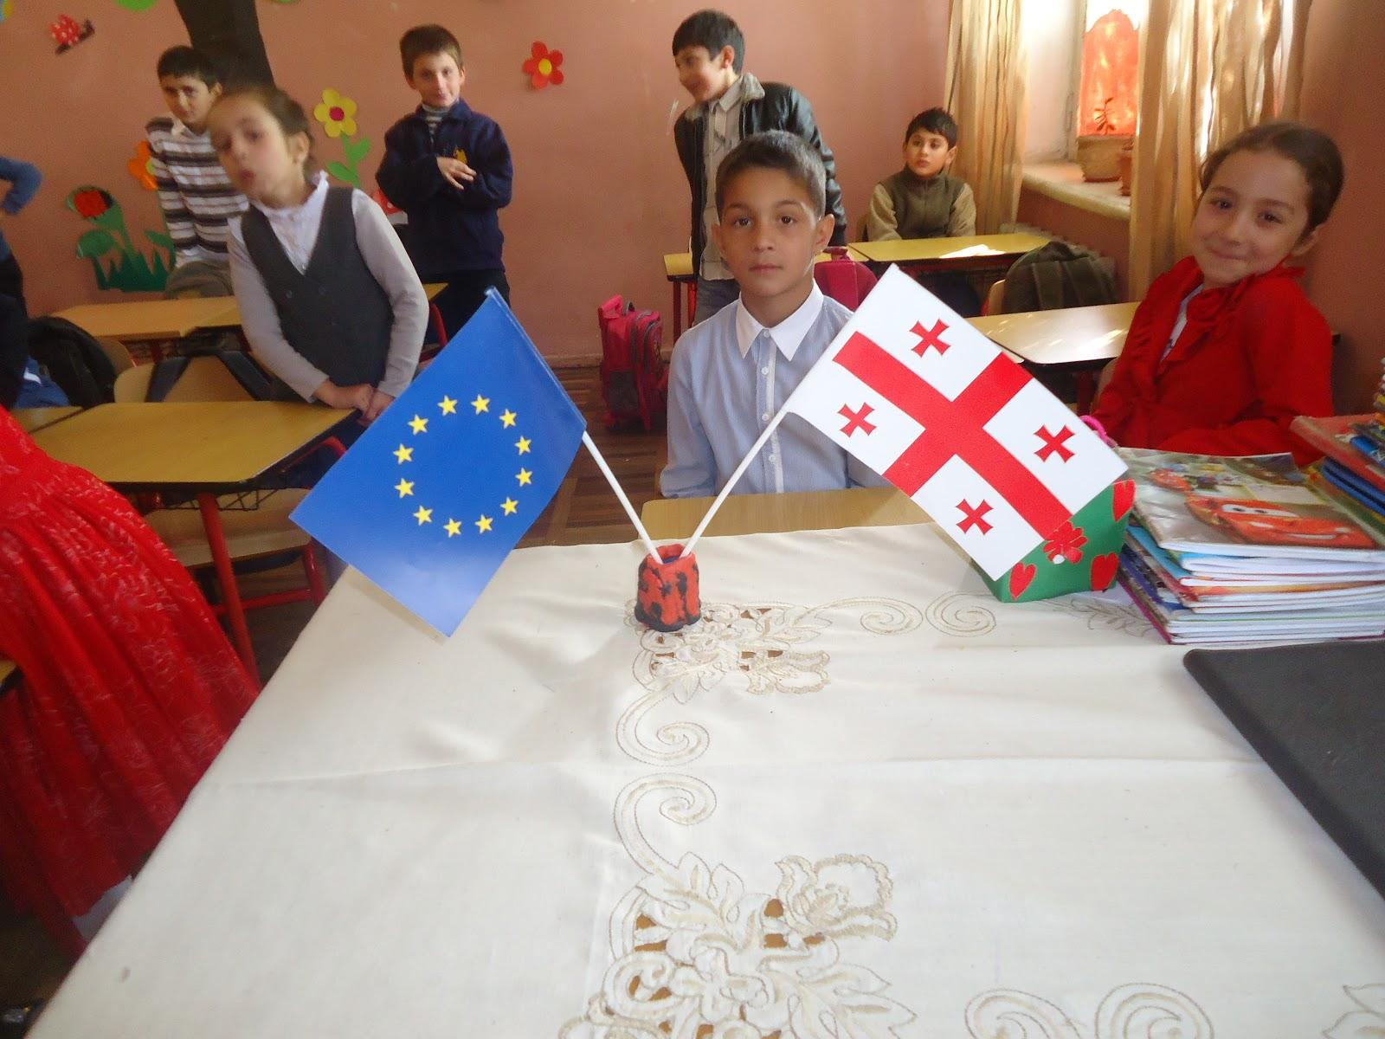
An English teacher Tamta Chaduneli

Slide 12
Welcome to our cooperation.

