Slide 1
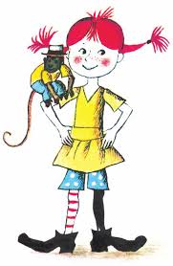
PIKA NOGAVIČKA
Pippi as a guest of classes 2.a and 2.b
At Primary school Žirovnica in Slovenia
Teachers: Petra M. Sedminek, Irena Bohinec, Barbara Cankar

Slide 2
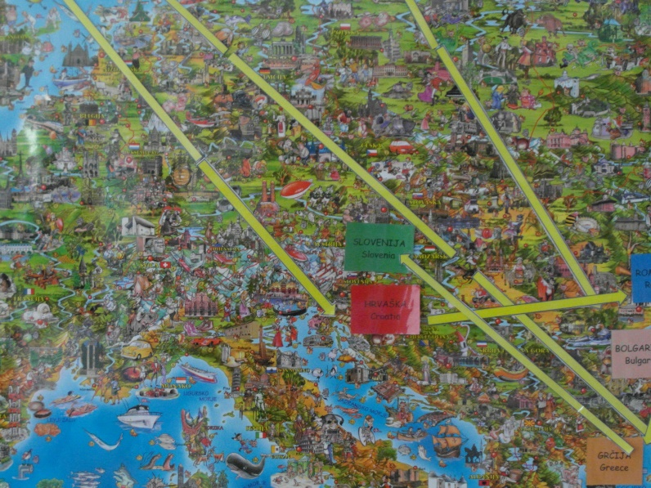
A map in our hallway. She traveled all around Europa and finally she came in Slovenia.

Slide 3
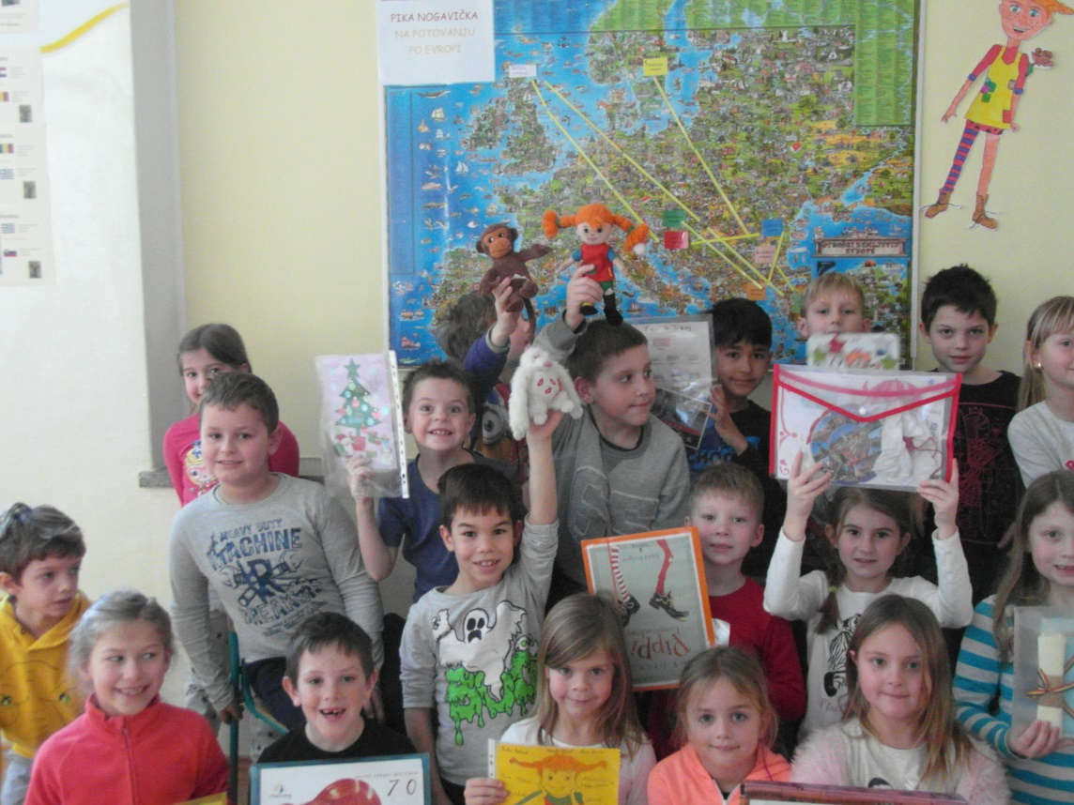
Pippi Longstocking came to our school on Monday, on 18th of January. We were very happy when she came. She was an important guest in two classes at our school, 2.a and 2.b.

Slide 4
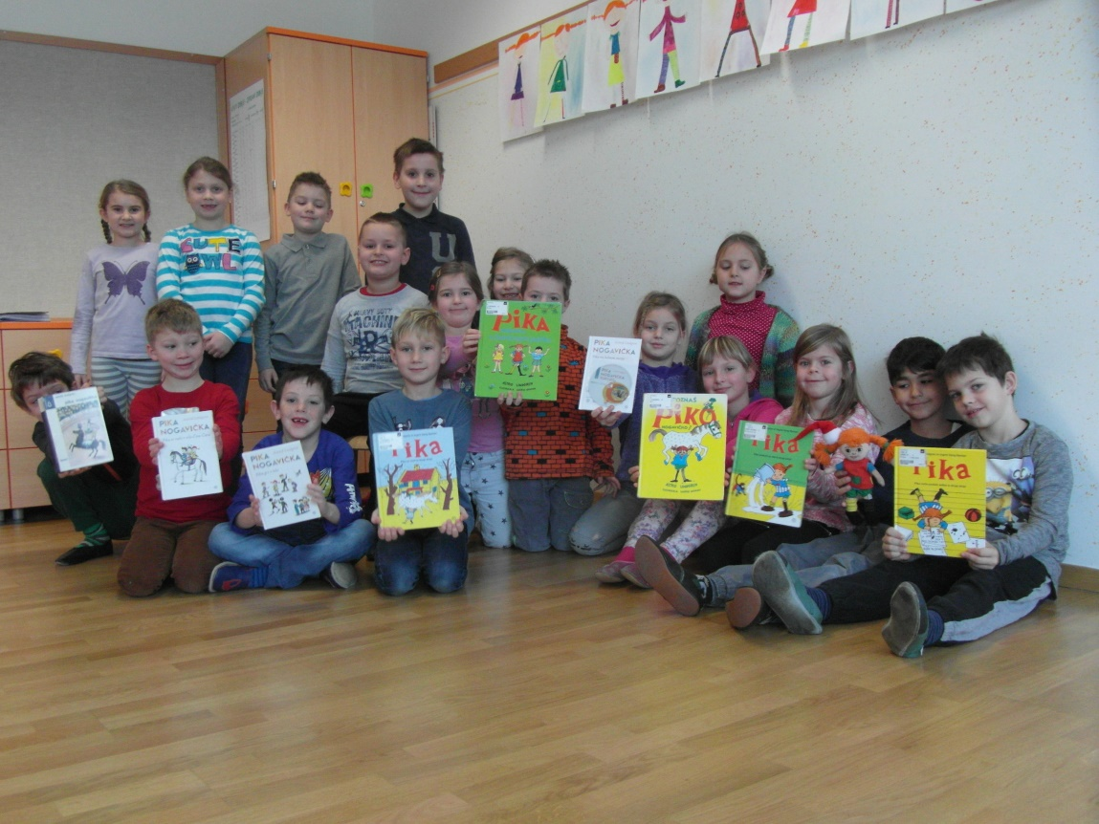
We read all of Pippi Longstocking's books in Slovene language.

Slide 5
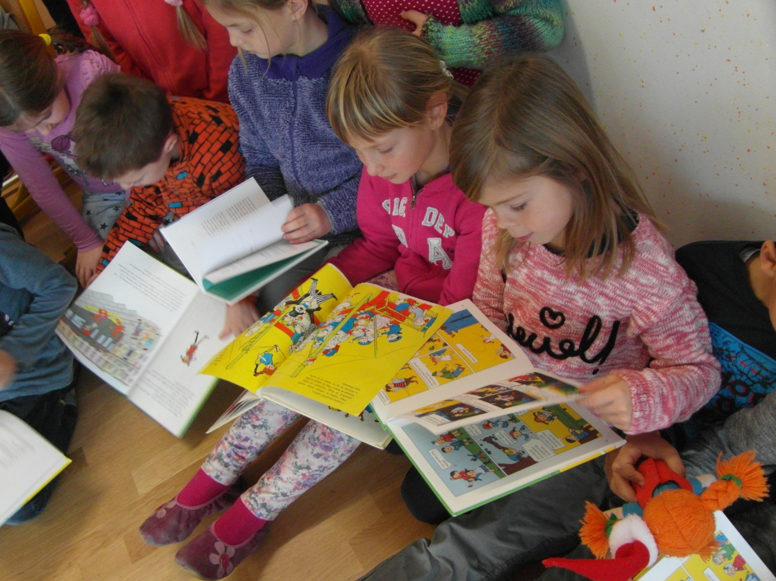

Slide 6
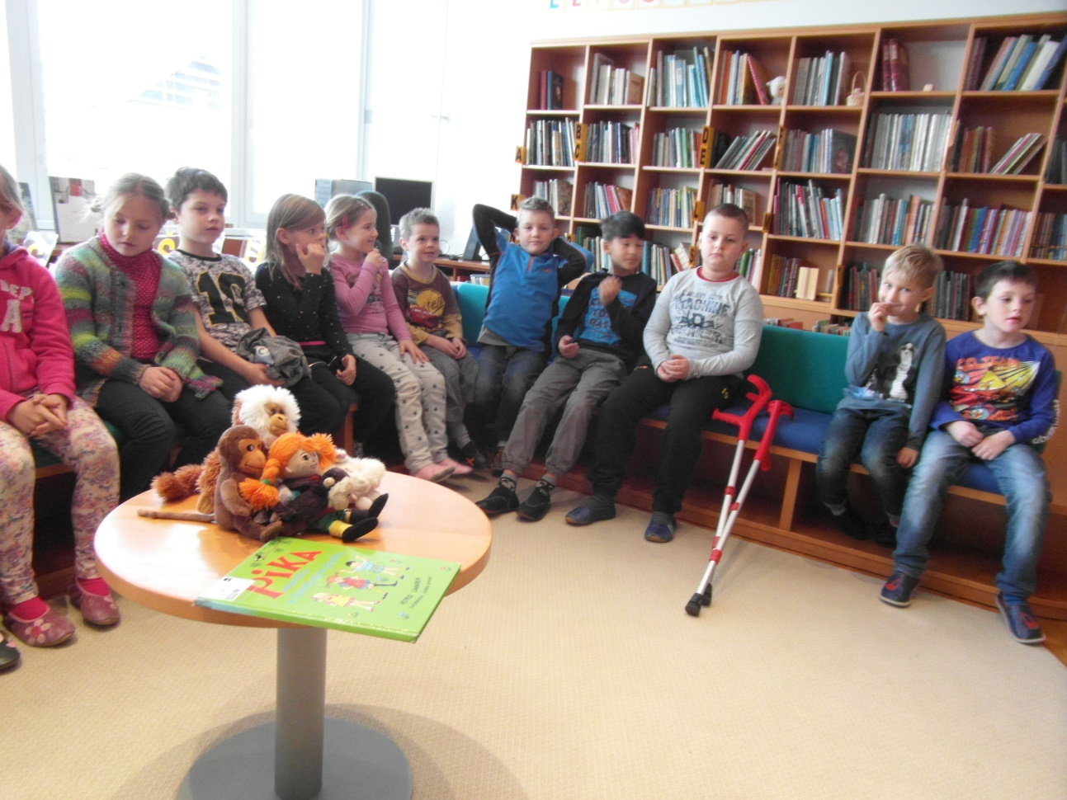
We took her to the school library.

Slide 7
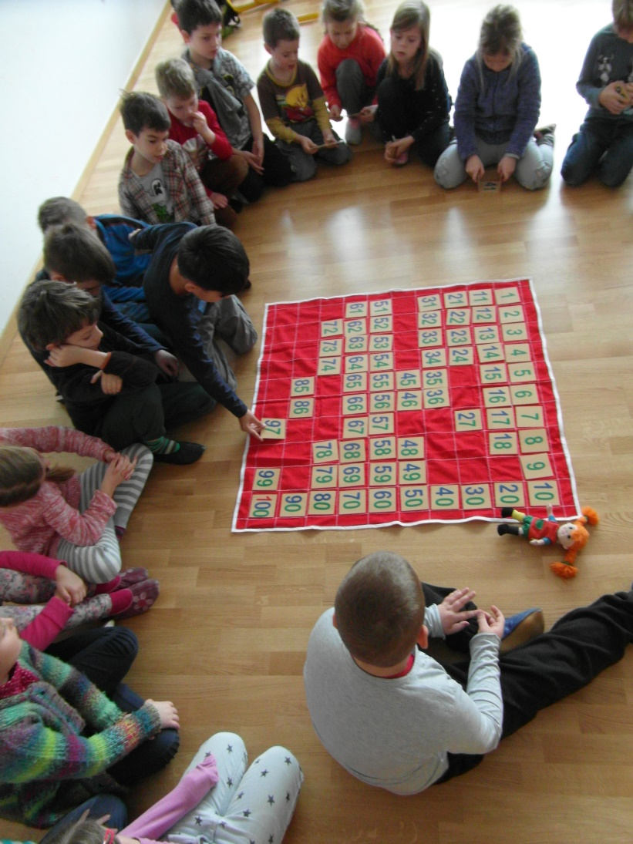
Pippi has helped us to count to a hundred.

Slide 8
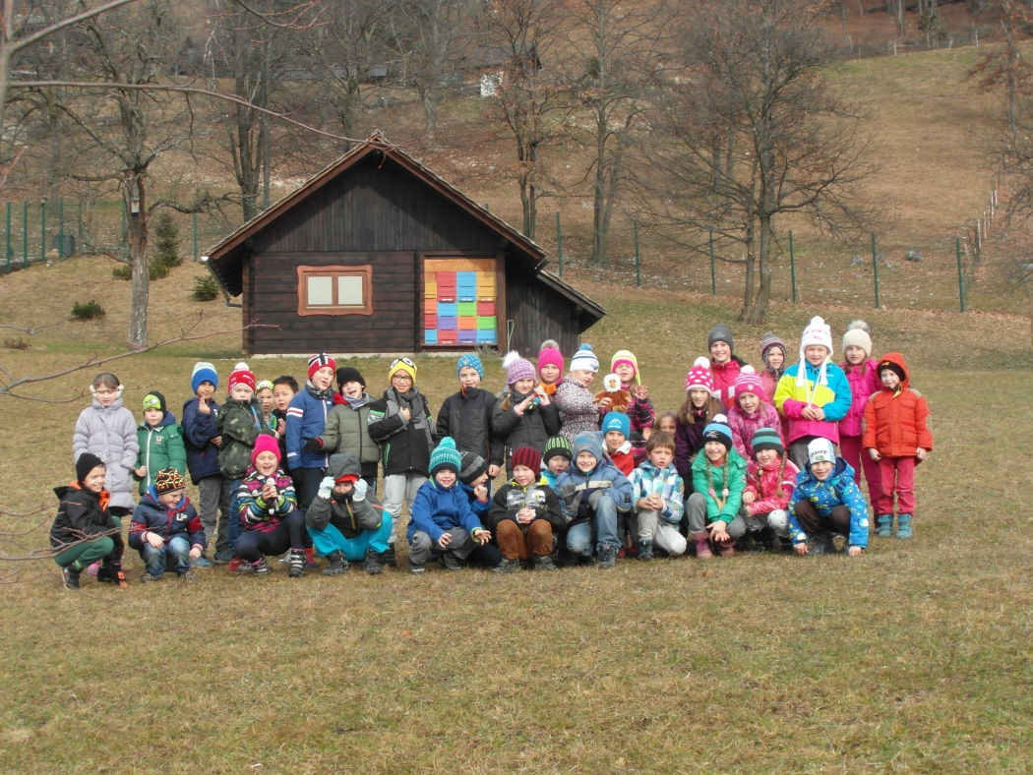
We took her to the school garden and showed her our beehive.

Slide 9
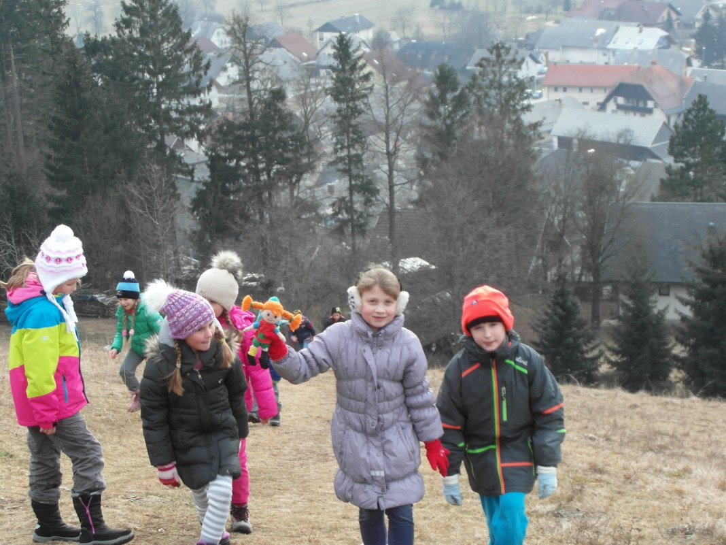
We climbed on a nearby hill, so she could see how beautiful our country is.

Slide 10
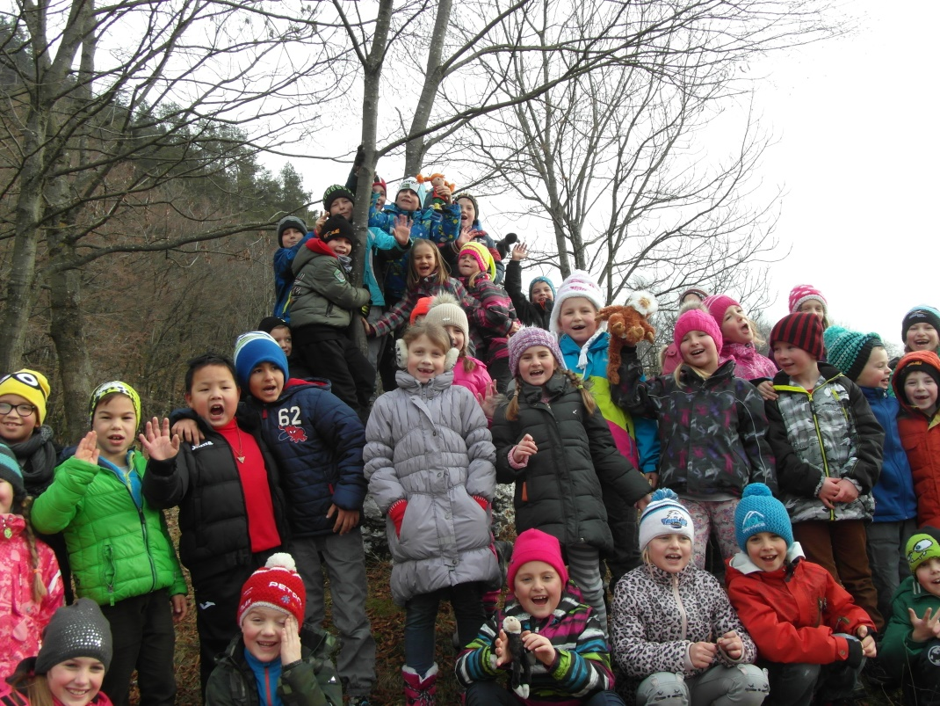

Slide 11
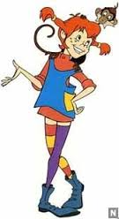
Pippi
joined us in our games
and
helped us study
and
learn new things.

Slide 12
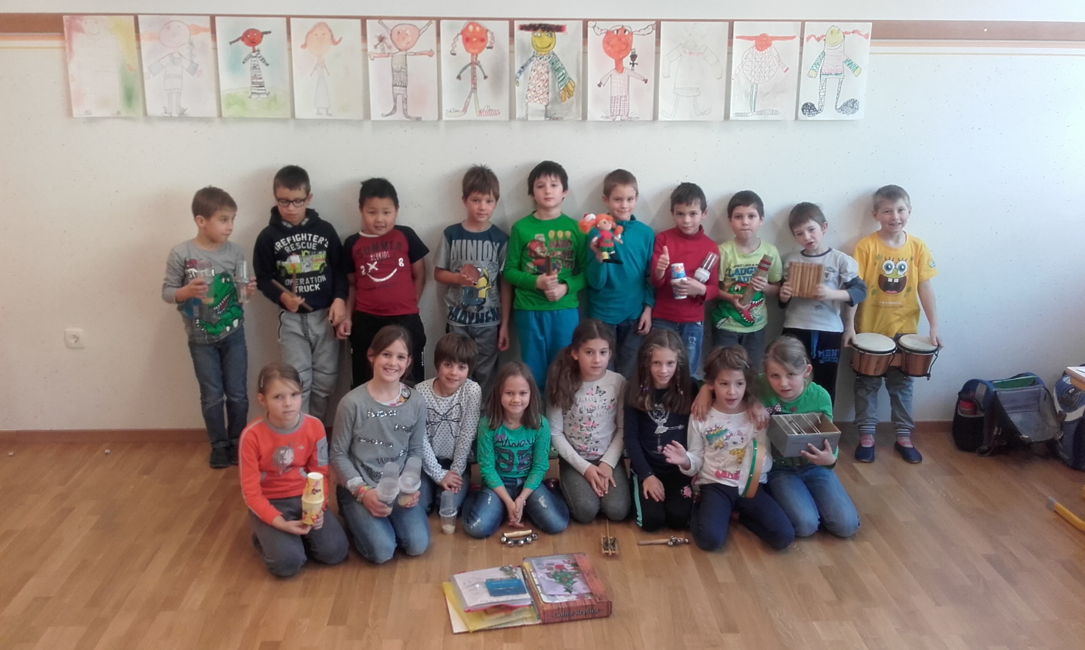

Slide 13
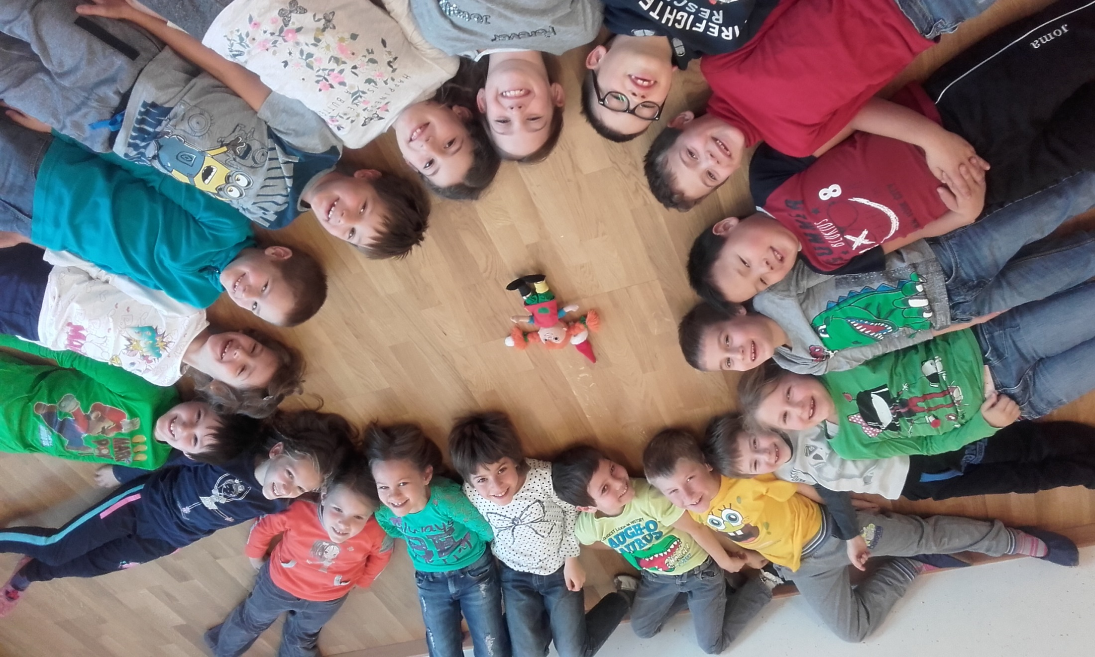

Slide 14
