Slide 1
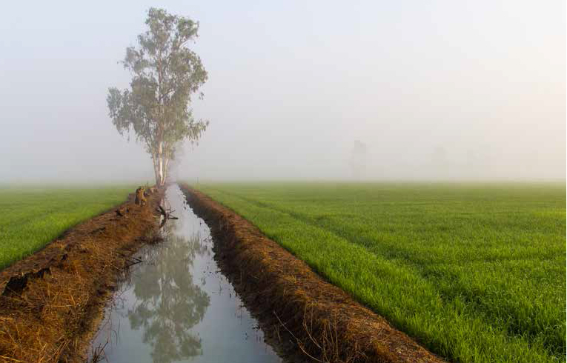
Climate change and environmental challenges

Slide 2
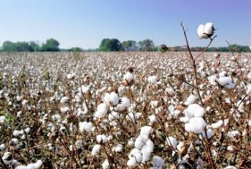
Located in the Mediterranean basin to be most affected by the climate change debate on Turkey's agriculture and food production is increasing day by day. The workshop organized by the General Directorate of Agricultural Research and Policies (TAGEM) also discussed the effects of climate change on agriculture

Slide 3
Organized by the Ministry of Agriculture and Forestry General Directorate of Agricultural Research and Policies (TAGEM) within the framework of “Climate Change and Agricultural Ecology Studies”. Workshop on the Effects of Climate Change on Agriculture ”was held between 5-7 November 2018.

Slide 4
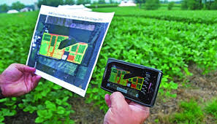
Within the scope of the workshop; The issues of atmosphere, climate change scenarios and projections in the climate change process, sustainable soil and water management, climate-related agricultural risks and adaptation processes and climate change and innovative approaches in agriculture were discussed.

Slide 5
Deputy General Manager of Agricultural Reform Metin Türker also talked about the practices of the Ministry of Agriculture and Forestry in his presentation on the subject of “The Effects of Climate Change on Agriculture”.

Slide 6
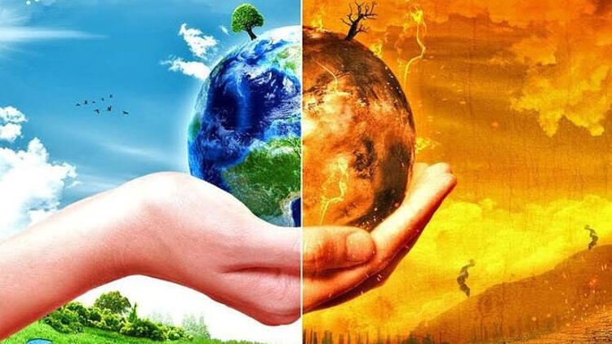
Agriculture is located at the interface between ecosystems and society. At the same time, agriculture and food security represent the most vulnerable sectors in terms of climate change. Undoubtedly, vegetative production climate
affected by the change and at the same time food security of a nation
capacity, population growth and climate variability of crop yields.
It depends on how you react

Slide 7
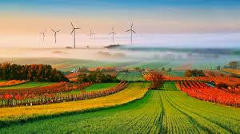
Thank You For Listening To Me My Presentation Is Over Here …
Şehit Mehmet Ali Körükçü Mesleki Ve Teknik Anadolu Lisesi

