Slide 1
The impact of climate change on plants and animals
Liceul Teoretic Gaudeamus
Clasa 6g5 Preda raluca

Slide 2
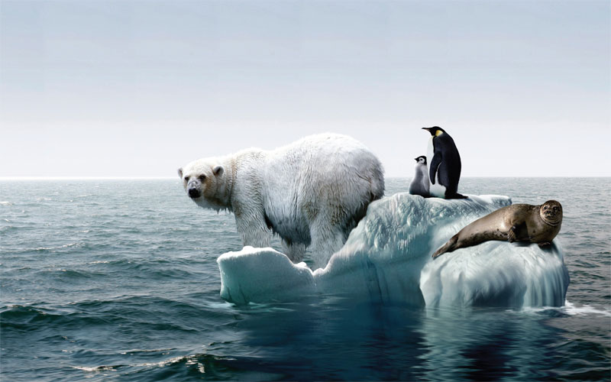
The impact of climate change on animals

Slide 3
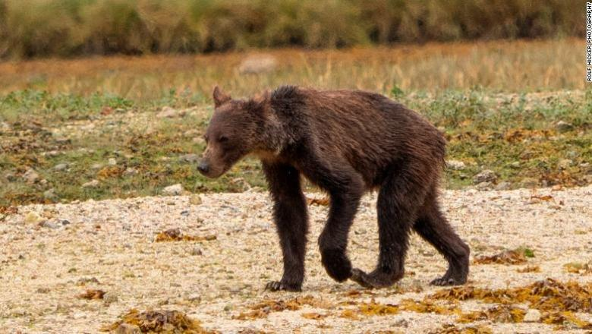
Bears do not find much food anymore

Slide 4
Global warming

Slide 5
Half a billion animals have died as a result of the Austalia fireplace

Slide 7
The impact of climate change on plants

Slide 10
Global warming

