Slide 1
Impacts of climate change to forests
Turcan Eugeniu & Dumitrscu Cristian-Patriciu

Slide 2
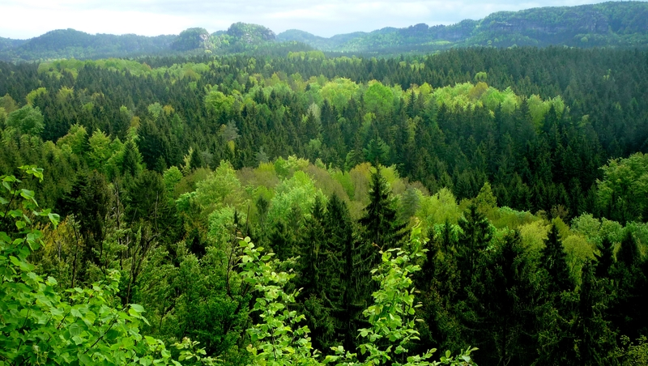
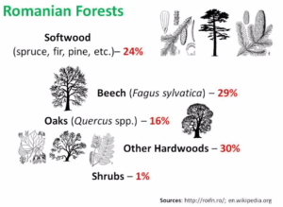
In the Moldova, forests occupy most of the country, about one third of the country's total land area. America's forests provide many benefits and services to society, including clean water and air, recreation, wildlife habitat, carbon storage, climate regulation, and a variety of forest products. Climate influences the structure and function of forest ecosystems and plays an essential role in forest health. A changing climate may worsen many of the threats to forests, such as pest outbreaks, fires, human development, and drought.

Slide 3
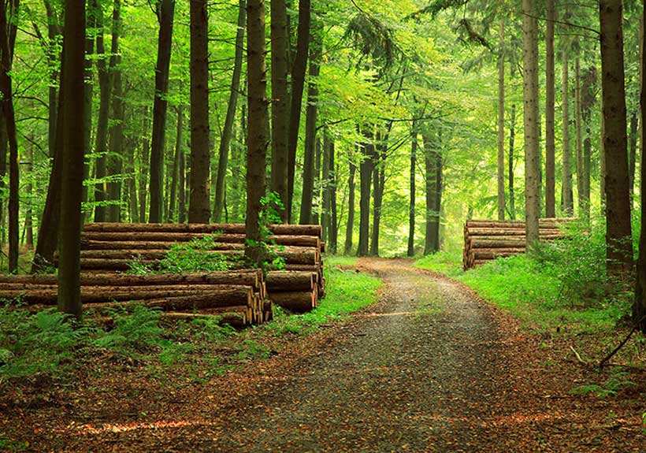
Another effect of the high temperatures is represented by forest fires, which are becoming more frequent especially in the forest steppe area of ​​our country. Maybe we should consider ourselves lucky that we did not arrive as in the situation of the Italians or the Greeks. Last but not least, climate change also has its mark on biodiversity in forest ecosystems, often leading to its decline. A low-biodiversity forest ecosystem will face more challenges in the future!
The temperature recovery favors the exponential development of pathogens. Perhaps the best known example is that of bark beetles that bear the part between wood and bark, that is, the living part of the tree, leading to their death. Both in the specialized literature, where the results of scientific research in the field, as well as in the online or offline publications, less specialized, are reported more and more cases in which these "wonderful" cockroaches have destroyed entire forests, especially softwood, especially spruce - Picea

Slide 4
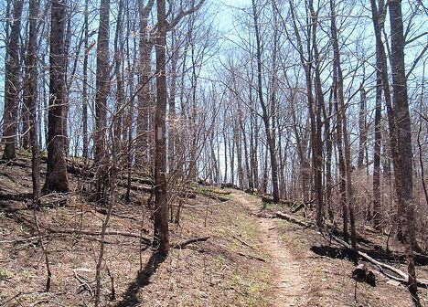
Drying of trees and trees. A notable example in this regard is the drying of hardwood specimens from Tâmpa and from the neighboring areas of Brasov. In a simple search on any of the online search engines, the list is filled with articles about this problem, most of which have appeared in the last two to three years. But this is not a singular case! In countless other places in Romania, but especially in Transylvania (personal observations), there are many resinous trees that dry from day to day. Well, another possible cause may be the expansion of softwoods outside the natural area, an expansion that was "fashionable" three or four decades ago. The gradual drying of trees will lead both to their death and, consequently, to the decrease of the productivity of the trees, as well as to massive infestations with pathogens.

