Slide 1
Climate change on social issues
De Botnaru Cornelia ,Moldova
cl,.6G5
L.T.,,Gaudeamus,,

Slide 2
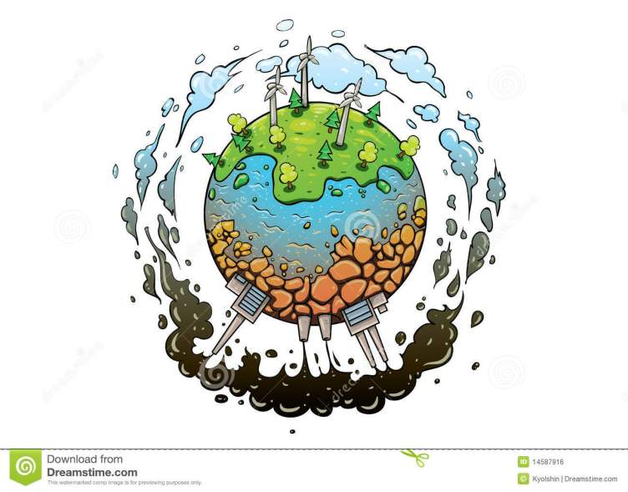
Climate

Slide 3
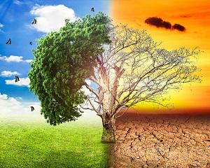
The planet die

Slide 4
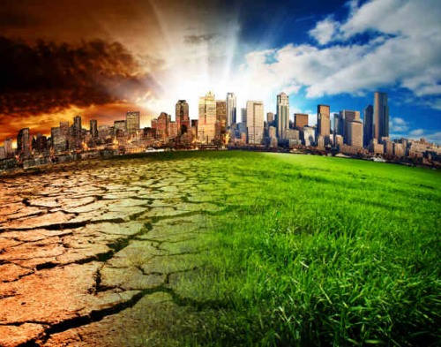
The world has changed into evil
Because of the people,the earh was destroyed and drastic changes were made.

Slide 5
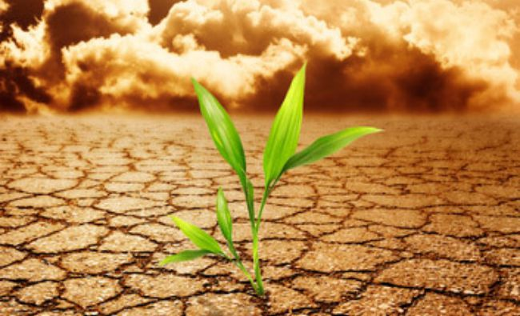
What you need to do?
Protect the plants and animal,
Cline the rivers,
Protect the world.
Etc.

Slide 6
Dont forget you can change thinks
YOU ARE THE FUTURE

