Slide 1
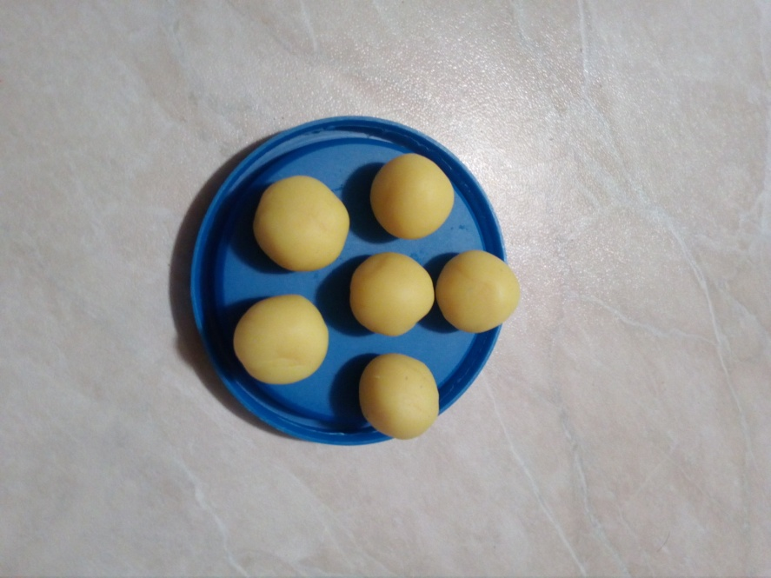
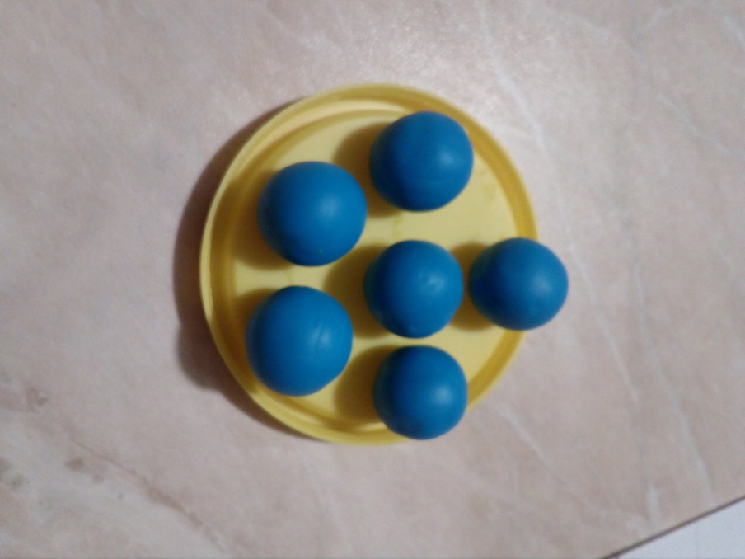
Benzene Molecule
YELLOW MOLECULES=CARBON
BLUE MOLECULES=HYDROGEN
WE BUILT THE HYDROGEN AND CARBON MOLECULES.

Slide 2
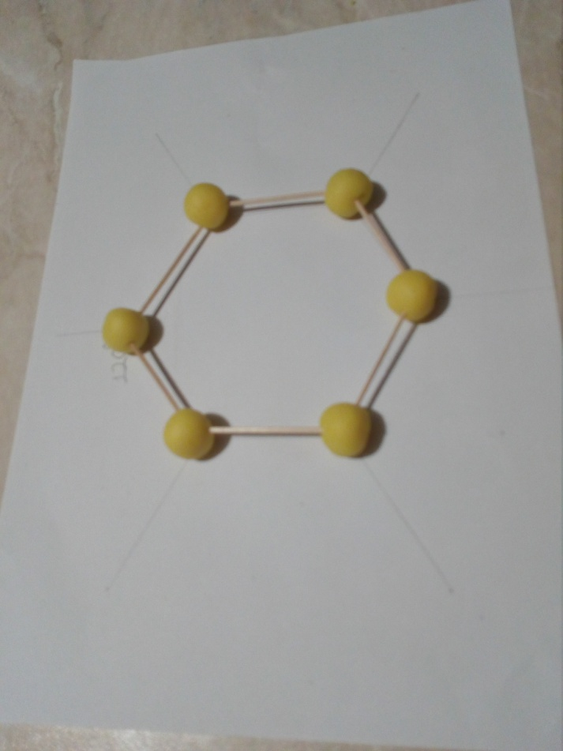
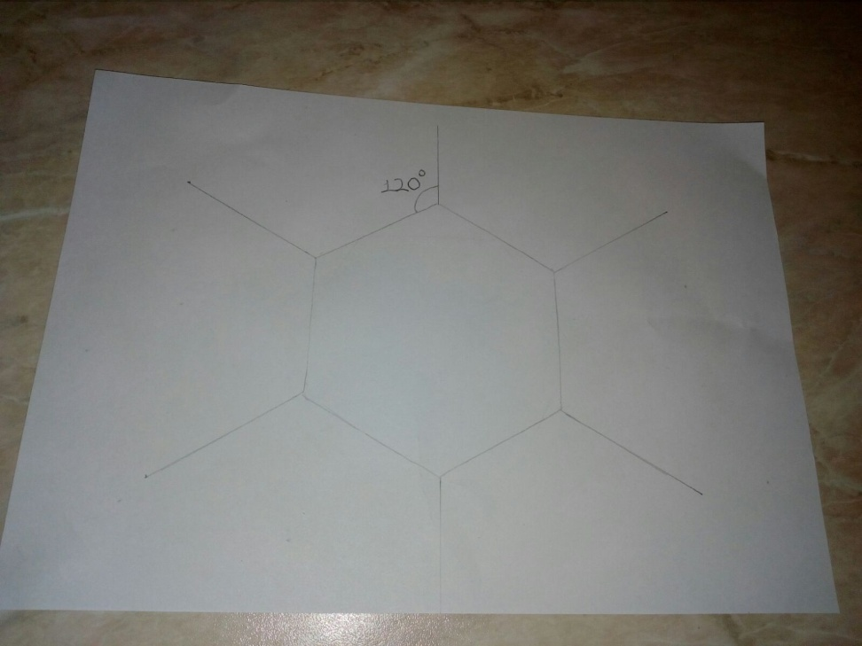
To be continued…
TO REPRODUCE THE MOLECULE, WE DREW A HEXAGON.

Slide 3
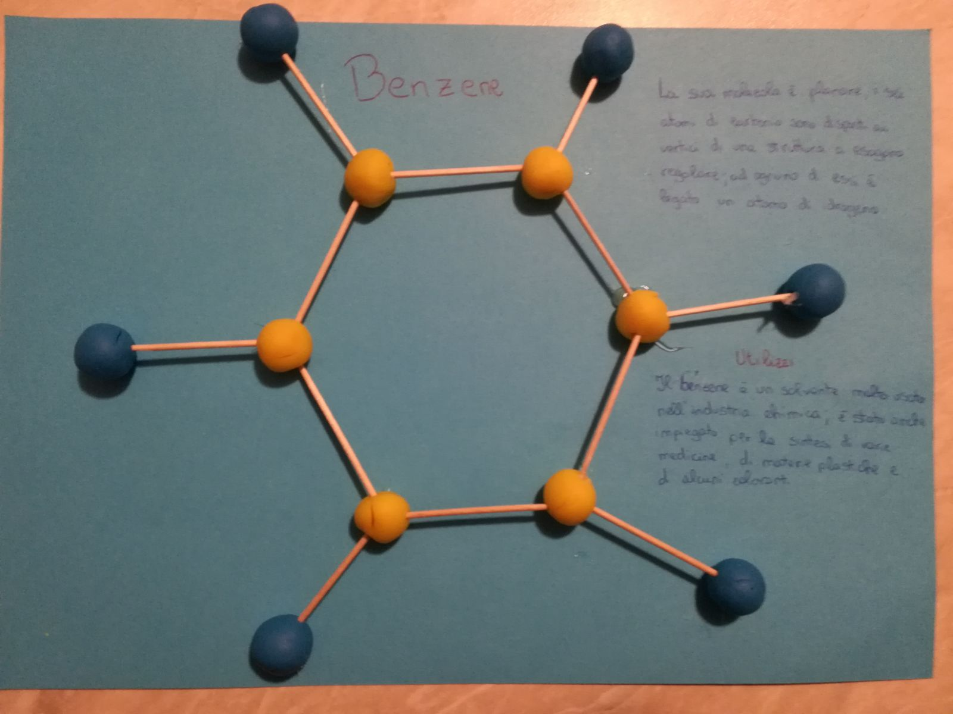
The End…

Slide 4
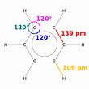
The structure of benzene
ITS MOLECULE IS PLANAR, THE SIX CARBON ATOMS ARE PLACED AT THE TOP OF A REGULAR HEXAGON STRUCTURE; EACH OF THEM IS BOUND TO A HYDROGEN ATOM

Slide 5
BENZENE USES
BENZENE IS A WIDELY USED SOLVENT IN THE CHEMICAL INDUSTRY; IT HAS ALSO BEEN USED FOR THE PRODUCTION OF VARIOUS MEDICINES, PLASTICS AND SOME DYES.

Slide 6
Angela and Francesca
Secondary School
Monteleone di Puglia
ITALY

