Slide 1
OUR SCHOOL
ESCOLA SECUNDÁRIA
VIRIATO
VISEU
PORTUGAL

Slide 2
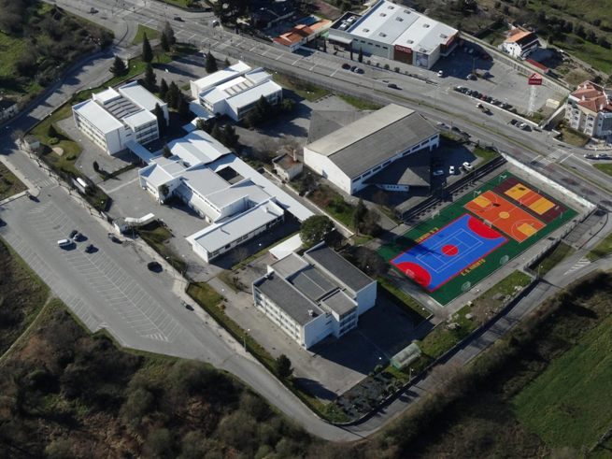

Slide 3
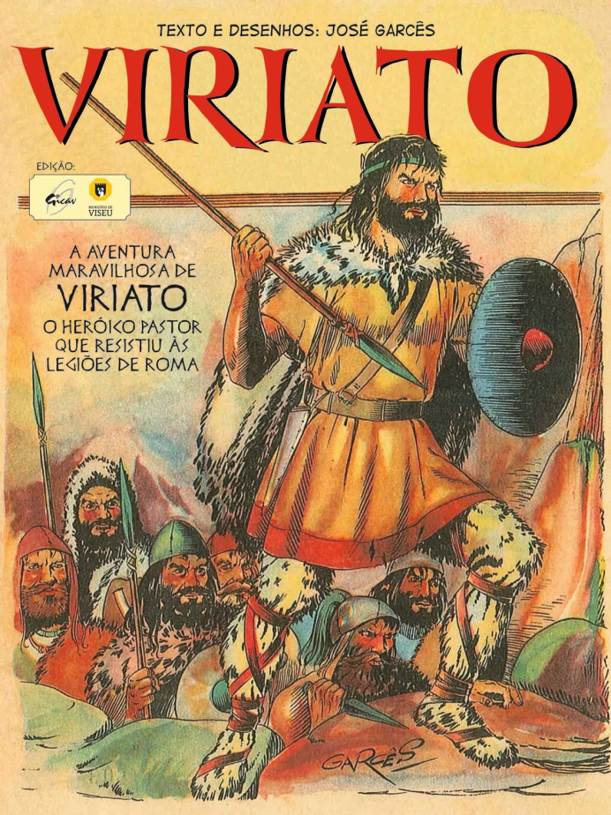
School´s name
«ESCOLA SECUNDÁRIA»
means secondary school
BASIC ➔ three levels : 7, 8, 9
SECONDARY ➔ tree levels : 10, 11, 12
Students age: 11 – 18
«VIRIATO» is the name of a national hero

Slide 4
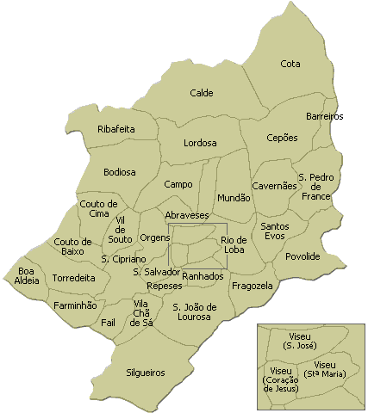
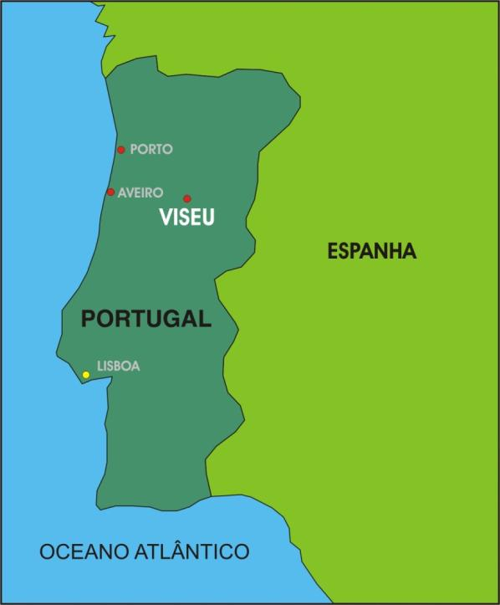
School’s location

Slide 5
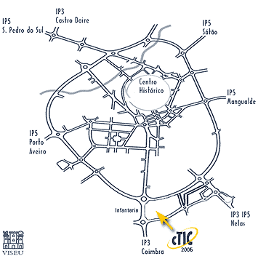
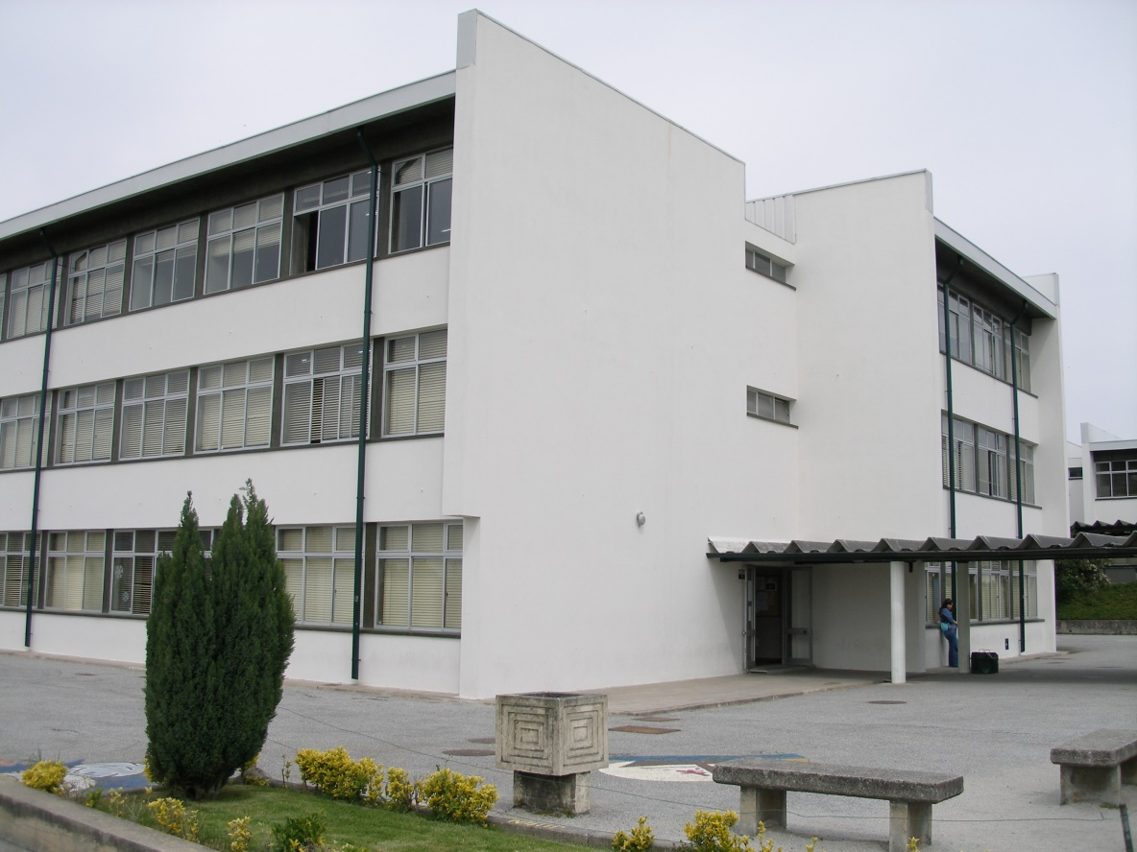
Viriato Secondary School, founded in October 1985, is one of 3 secondary schools in Viseu.

Slide 6
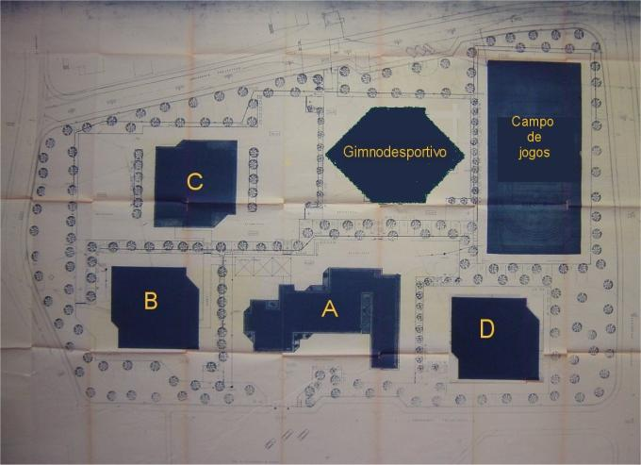
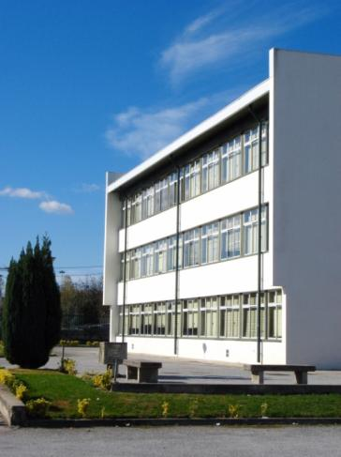
School´s structure
It is located in the outskirts of the city and it is composed by 4 buildings plus a sports centre, which is also used by the Town Hall of Viseu.

Slide 7
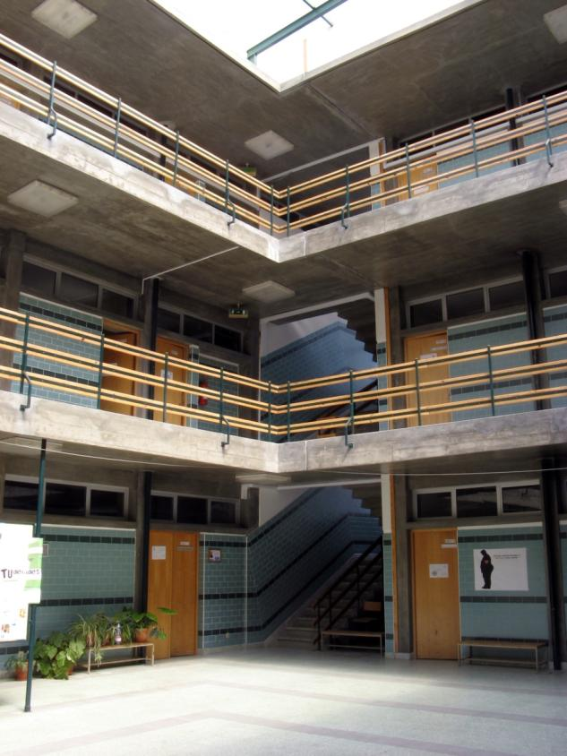
School’s numbers
Students : 712
➔ 179 – Basic level
11-14 years old
➔ 305 – Secundary level
14-18 years old
➔ 228 – Secundary Professional level
14-18 years old
Teachers: 102
Education employees: 40
Pshycologist: 1
Social Assistant: 1

Slide 8
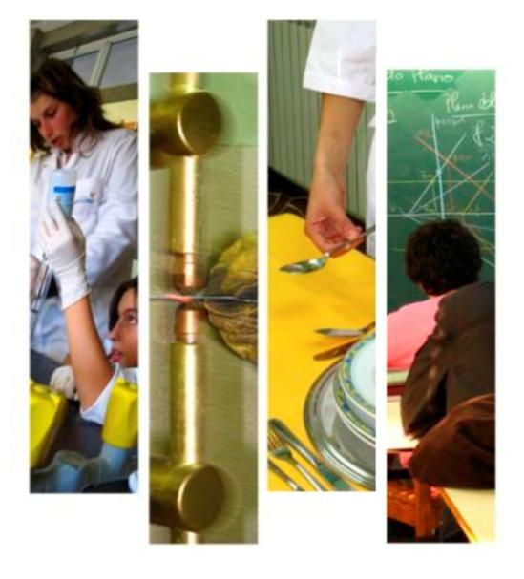
In the 3rd cycle of the basic teaching, we have: - regular classes/general curriculum – 7th, 8th and 9th - a course of Academic Education and Training (CEF) for ICT. In secondary level, we have courses such as: - Scientific-Humanities – 10th, 11th and 12th => Science and Technology => Art => Economy => Languages and Social sciences - Professional – 10th, 11th and 12th, in areas like: => Sport Management => Marketing => Healthcare => Electricity and mechanics => Social and cultural support => Computer and ICT => Laboratory analyses => Electric connection => Commerce/Business
School´s curriculum

