Slide 1
THIS IS WHERE WE LIVE
Žiga Iršič
Niki Vantur

Slide 2
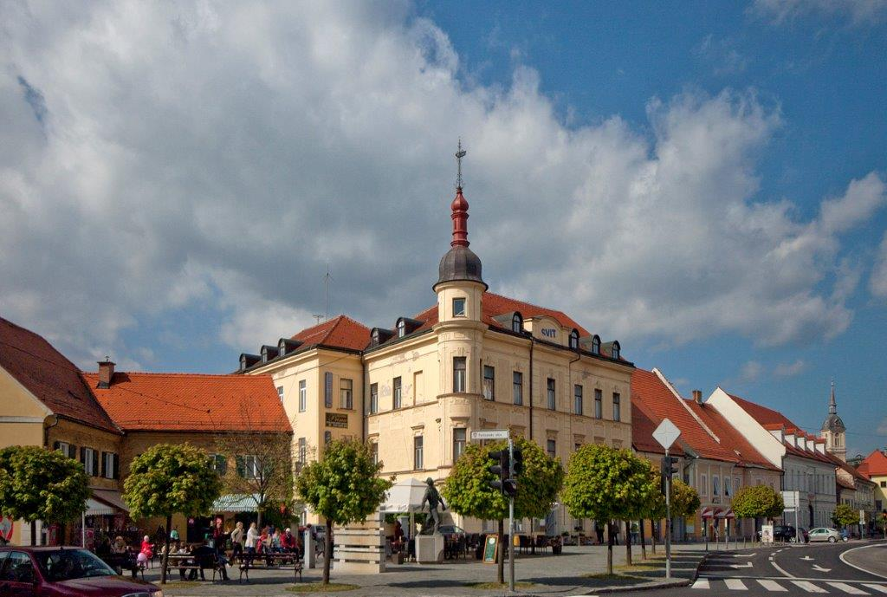
Community Slovenska Bistrica
One of the biggest and oldest communities in Slovenia
Northeast Slovenia, region Styria
260 km2, 25 265 residents
Very interesting area, tourist attractions and cultular sights
Castle Slovenska Bistrica with castle park, 3 churches (sv. Jerneja, sv. Marije, sv. Jožefa), Maria's mark on square of Alfonz Šarh and sqare of peace
Atlethic stadium Slovenska Bistrica
Altitude -274.9 meters
Town Slovenska Bistrica – industrially, civic, cultural centre
8000 residents, 8km2

Slide 3
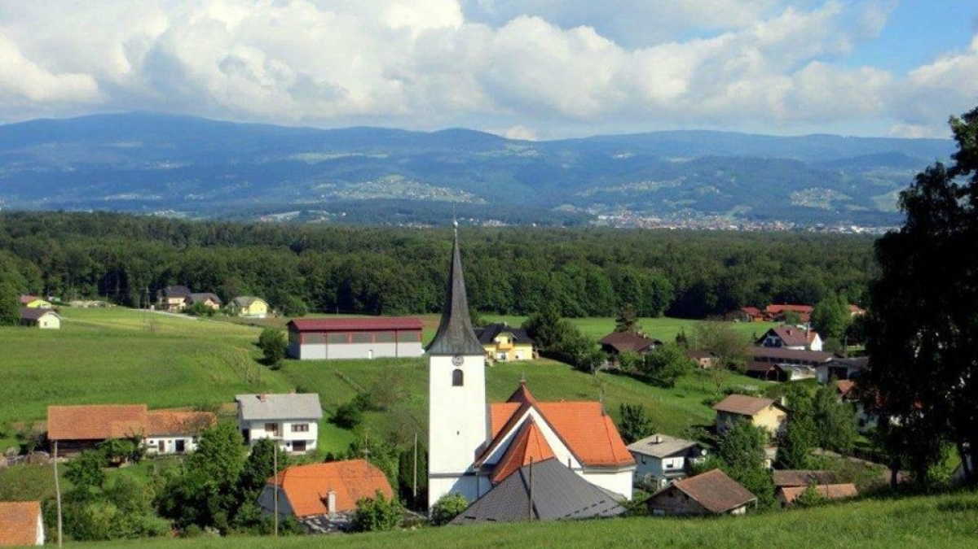
Laporje
Small nucleated village in Ložnica valley
A lot of forests and meadows
3,59 km² , 420 residents
Church, post office, bar, bakery
Our school – centre of village
Altitude: 269m

Slide 4
Castle Slovenska Bistrica

Slide 5
Stadium

Slide 6
SQARE OF SLOVENSKA BISTRICA

