Slide 1
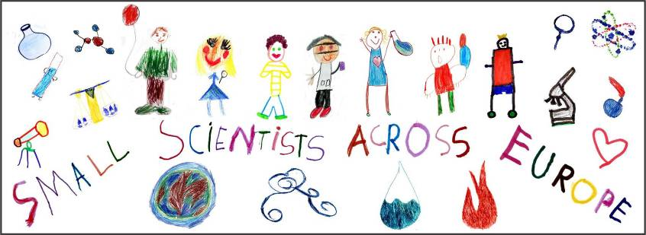
Book of experiments: WATER
Erasmus+ Project
KA 219 Strategic Partnership
SMALL SCIENTISTS ACROSS EUROPE
2017-1-FR01-KA219-037465_7
Prepared by
Director assistant of education
Almeda Kmieliauskaite

Slide 2
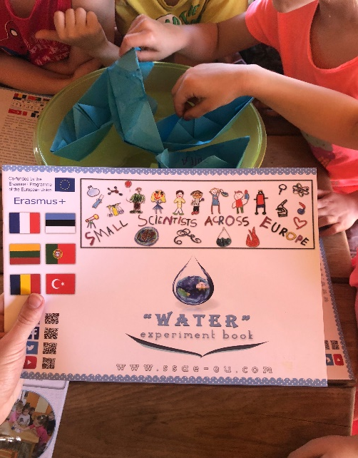

Slide 3
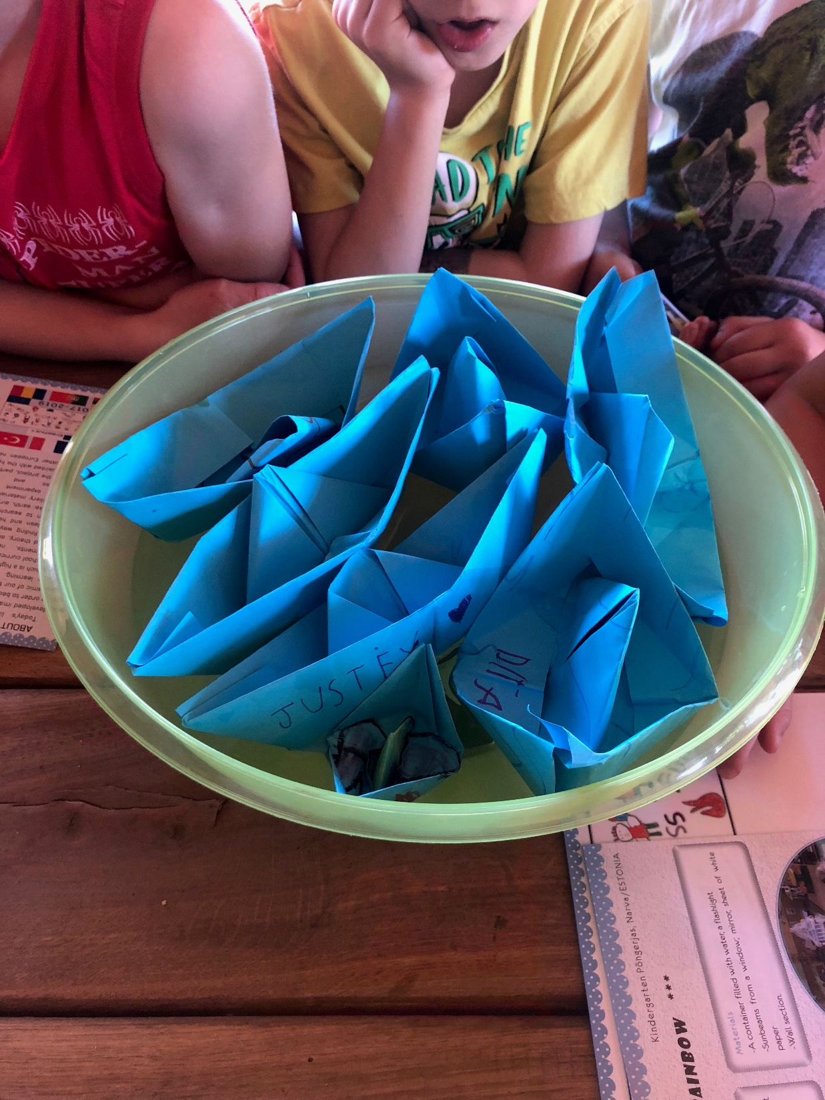
Firstly, children do activities with water...

Slide 4
What is in the book?

Slide 5
In very beautiful summer day, teacher and children enjoying new activities together...
To get new knowledges is very important. Children are little scientists...

Slide 6
SMALL SCIENTISTS ACROSS THE EUROPE, 2019 SUMMER

