Slide 1
Green seaweed:
A problem in Brittany ?

Slide 2
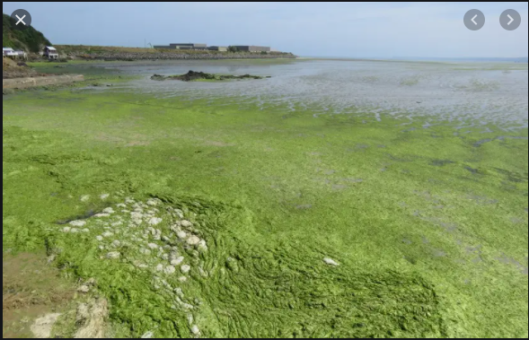
The phenomenon of green algae appeared in Brittany in the 1970s. Since then, other areas have been affected and it is now present from Normandy to the Gironde estuary. Even if it is in smaller quantities.
In 2020 there are about 100,000 tons of green seaweed in France

Slide 3
What is green seaweed?
Green seaweed is a natural phenomenon that occurs on many coastlines around the world.
But in some coastal coastal areas, their excessive development leads to leads to "green tides".
Green seaweeds develop mainly due to the combination of three factors:
- the morphology of the coastline: in closed, shallow bays, algae shallow bays, the seaweed, with little exposure to the swell and clear water, proliferate more easily;
- Nitrogen, in the form of nitrates which feed the algae; weather conditions (temperature, sunshine, rainfall, etc.).
It is in the spring and autumn that green seaweeds wash up on our coasts.

Slide 4
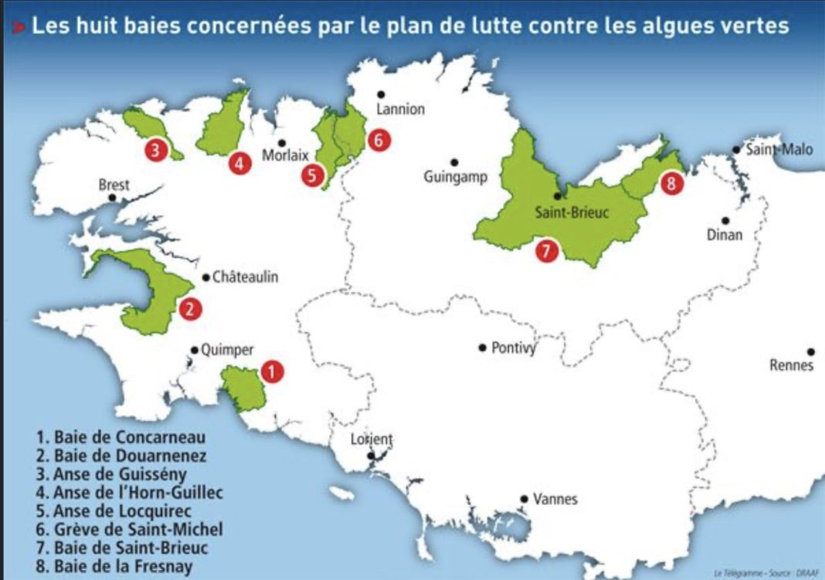
Affected areas in Brittany
6. Grève de Saint Michel
7. Saint Brieuc Bay
8. Fresnay Bay
5. Anse de Locquirec
3. Anse de Guissény
4.Anse de L’Hora-Guillec
2. Douarnenez Bay
1. Concarneau Bay

Slide 5
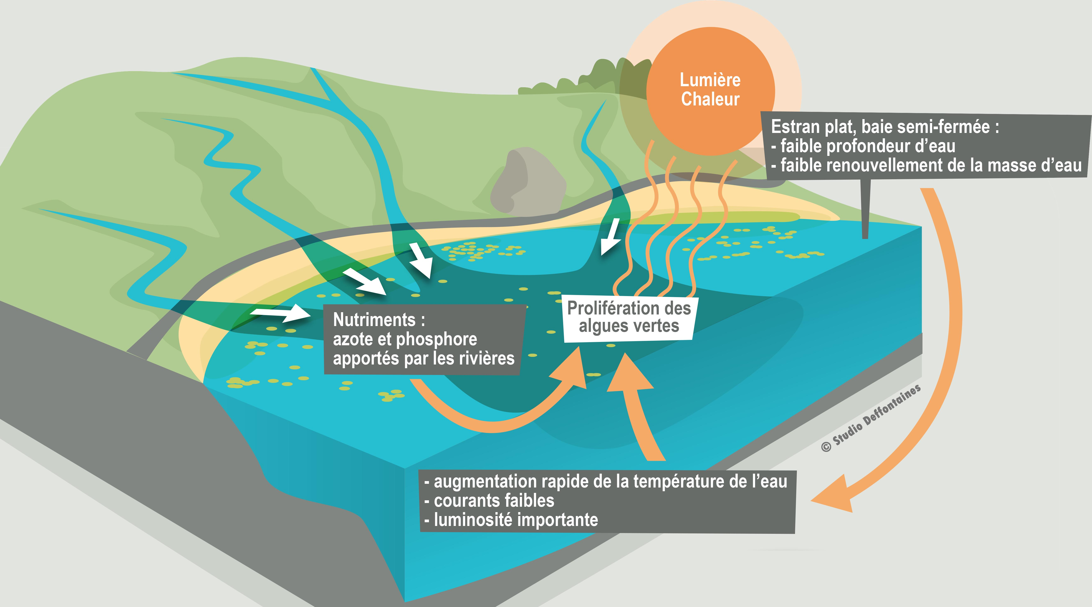
causes
Light
heat
Flat foreshore, semi-enclosed bay:
- shallow water depth,
- low turnover of water mass.
Nutrients:
nitrogen and phosphorus from rivers.
Proliferation of green seaweed
-Rapid increase in water temperature
- weak currents
- high luminosity

Slide 6
Actions
Transformation into compost
-Seaweed is systematically collected from the beaches and on the beaches and then they are transformed into compost or directly spread on agricultural land.
Preventing the excessive development of seaweed: farmers and local actors are supported, advice and direct aid to farmers and local actors to adopt practices and farming systems that limit nitrogen leakage into waterways and into waterways and then the sea.
If collection is not possible (difficult to access areas, rocks access, rocks, mudflats, etc.), the areas concerned are access is forbidden and specific signs are put up. specific signs.
https://europeecologie.eu/wp-content/uploads/importedmedia/blogmedia-10492.jpg

Slide 7
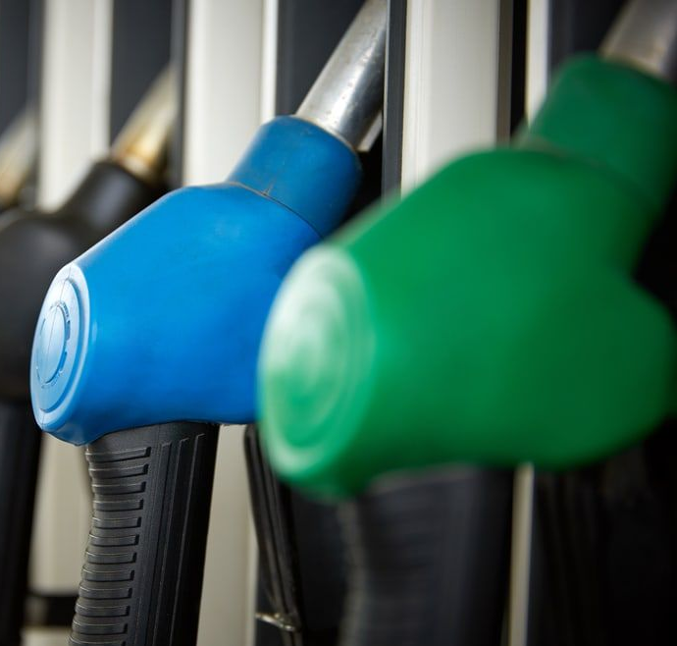
civilians and government's actions
FUTURE OF GREEN SEAWEEDS
Green seaweeds, fuel of the future?
The question of alternatives to fossil fuels for hydrocarbons is becoming increasingly pressing. Several teams of scientists are working on this subject and are exploring the potential of micro-algae in particular.
https://static.fnac-static.com/multimedia/Images/FR/NR/5b/4a/a8/11029083/1507-1/tsp20200429070322/Algues-vertes-l-histoire-interdite.jpg
https://observatoire-des-aliments.fr/wp-content/uploads/2017/09/16068173-il-a-respire-les-algues-vertes-c-est-ca-qui-l-a-tue-1.jpg

