Slide 1
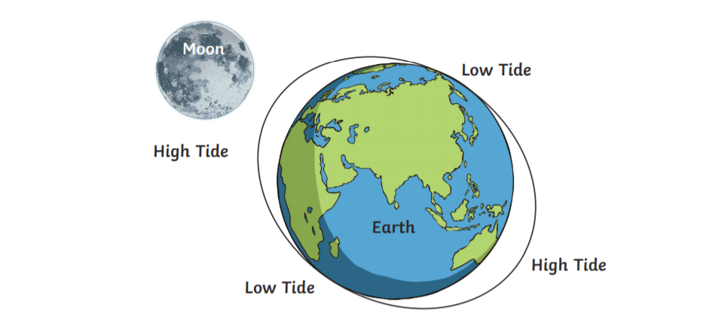
Tides in the emerald cost
Tides are the rise and fall of sea levels caused by the combined effects of the gravitational forces exerted by the Moon and the Sun, and the rotation of the Earth.

Slide 2
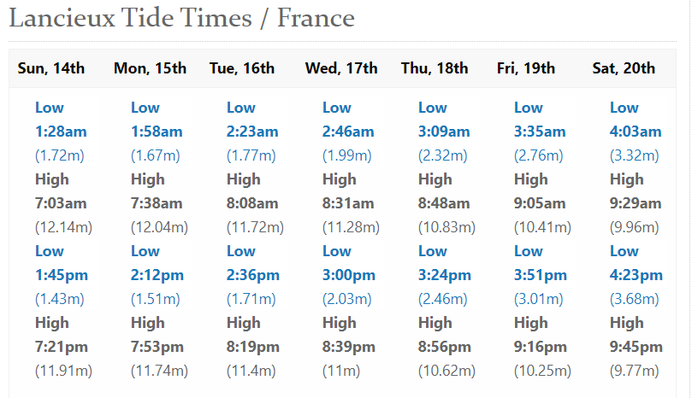
Tide tables can be used for any given locale to find the predicted times and amplitude. The predictions are influenced by many factors including the alignment of the Sun and Moon, the phase and amplitude of the tide (pattern of tides in the deep ocean) and the shape of the coastline. They are however only predictions, the actual time and height of the tide is affected by wind and atmospheric pressure. They are very useful for fishermen, people who sail and for all the water sports like catamaran, surf, kayak...
This is an example of a table tide in Lancieux (15min of Dinan). We can observe that there is always 6 hours between the low and high tide.

Slide 3
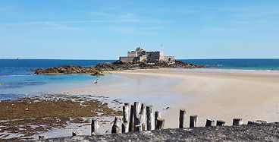
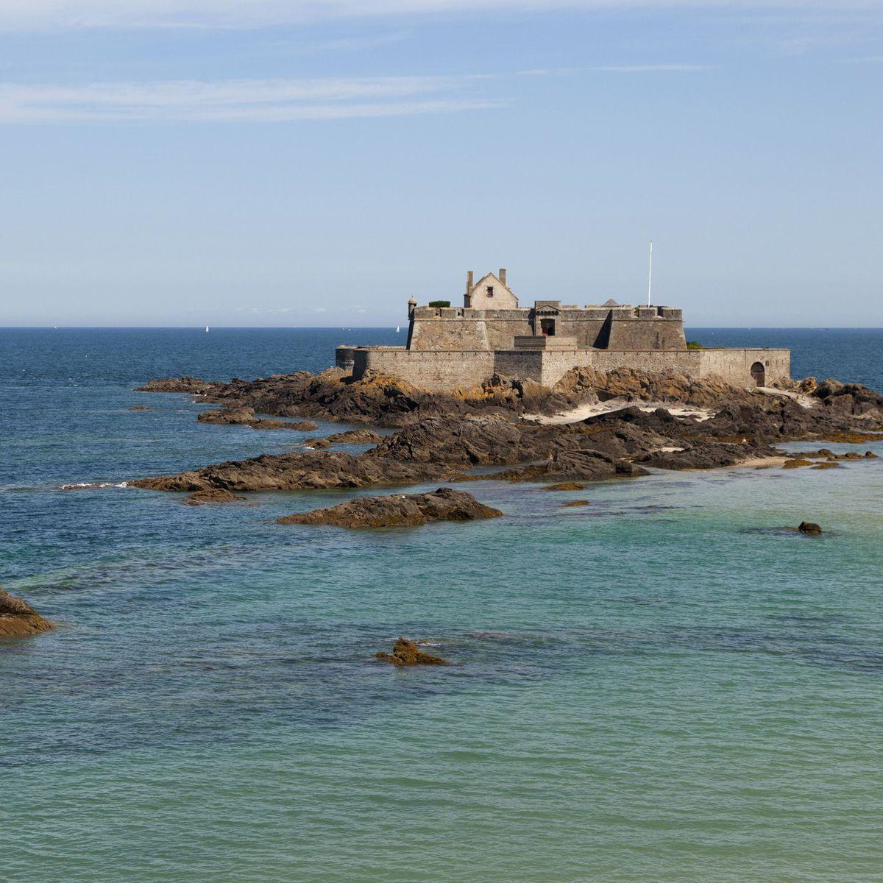
Types of tides
Semi-diurnal tide : two nearly equal high and low tides each day. This is the more common type and it is what we have in Brittany.
Other locations have a diurnal tide : one high and low tide each day.
« mixed tide » : two uneven magnitude tides a day.
Low tide
Vs
High tide
In Saint-Malo, it is possible to go on the fort of Grand Bé only when the tide is low.

Slide 4
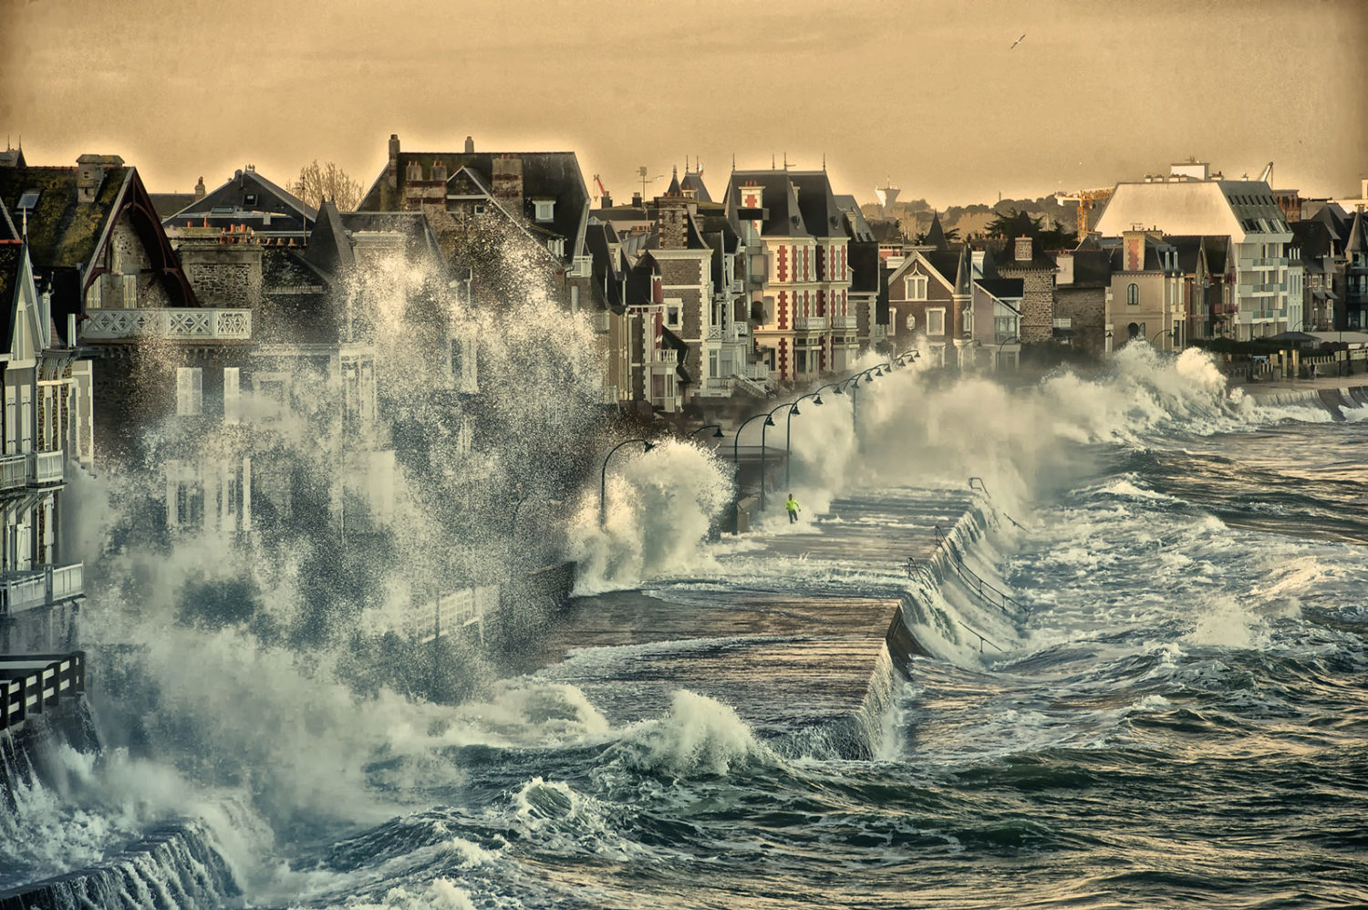
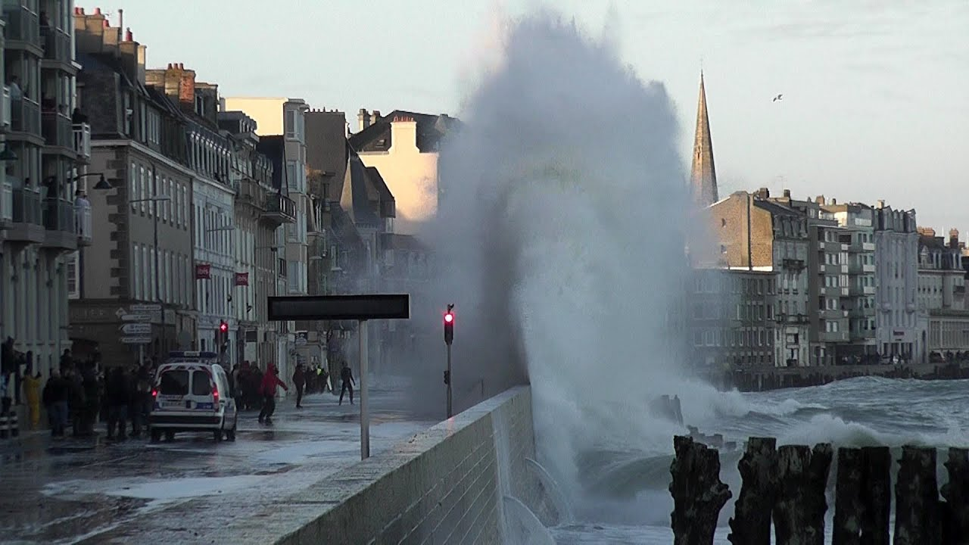
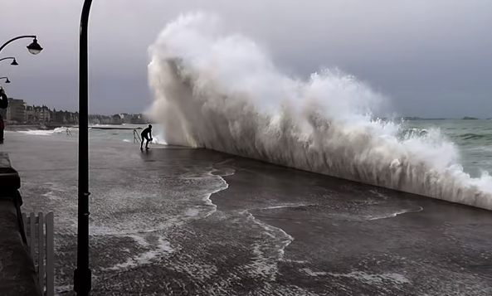
High tides in Saint-Malo
Saint-Malo is a beautiful historic town, known for its high tides because when the waves hit the dyke it creates a very majestic spectacle !

