Slide 1
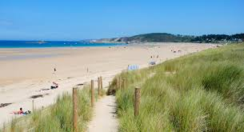
The preservation of coastal systems in Northern Brittany, in the face of rising waters
due to global warming of the planet.
The geographical environment of Sables d'Or les Pins
Notes:
1

Slide 2
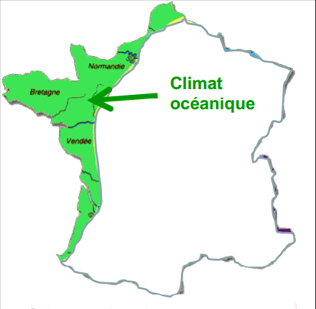
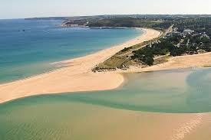
What kind of climate?
The climate of Brittany is oceanic belonging to the temperate climate.
2 /
Notes:
2

Slide 3
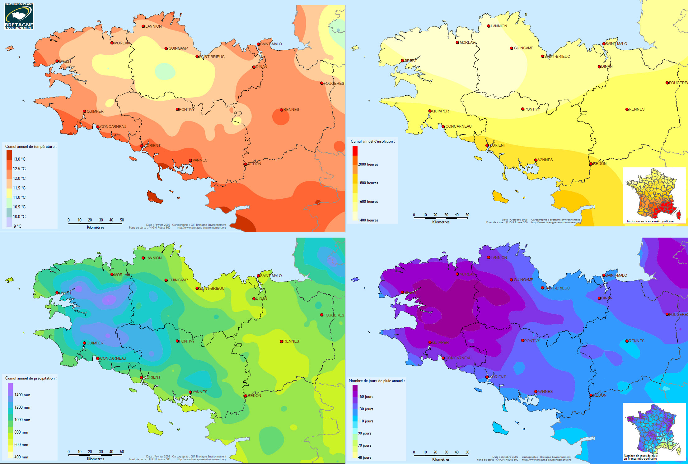
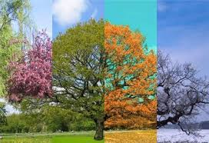
What is the type of climate?
What are the special features of each season?
The climate of Brittany is an Oceanic climate.
The oceanic climate belongs to the temperate climate,
it is characterized by more beautiful and milder summers,
wetter and more windy winters.
The autumns are nice and gradually it gets colder and
there is more rain, and the springs are cold at first,
sometimes in March it still snows,
it has rain frequently, and the days start to get longer.
Notes:
3

Slide 4




What are the special features of each season?
The ocean climate is characterized by mild, wet winters and cooler summers.
SPRING
Cool, sometimes cold, with sun
.
WINTER: Temperatures are generally above freezing, but wind and humidity increase the feeling of cold
SUMMER
Generally fresh; some days may be hot.
But now global warming is creating hotter summers in Brittany.
AUTUMN
Soft and pleasant in September, but then it gradually becomes
colder, dull and rainy, and also windy.
4 /
Notes:
4

Slide 5




Are there climatological excesses ?
Rainfall is abundant on the west coast, where it exceeds 1100 millimeters per year.
While they descend to 950 mm on the south coast, below 800 mm along the north coast, and about 700 mm in the interior of the east.
But the rains are frequent almost throughout the year.
5 /
Notes:
5

Slide 6
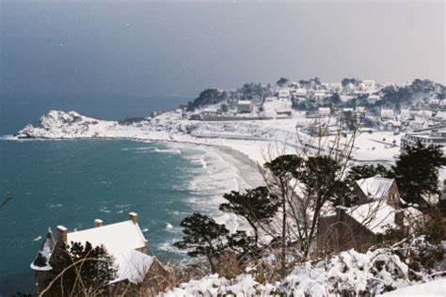
Are there climatological excesses?
In winter there is frost, sometimes snow, there is a lot of wind, they are often strong winds.
Temperatures are around -10 ° C
Notes:
6

Slide 7
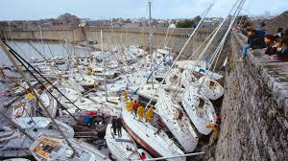
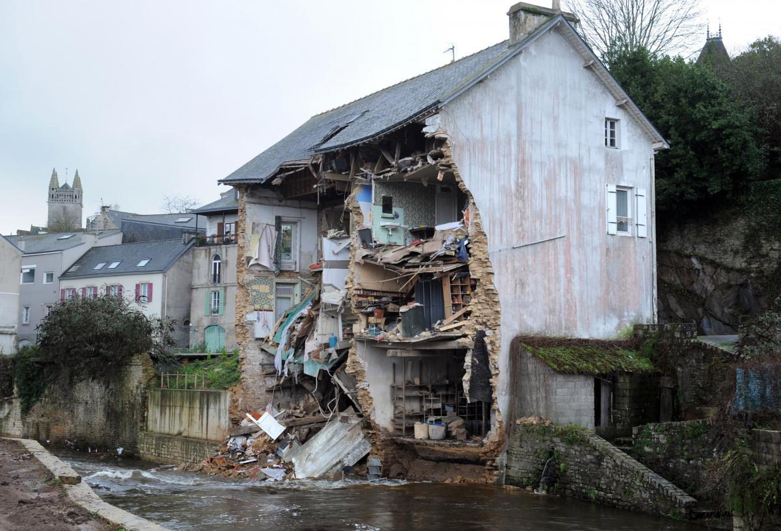
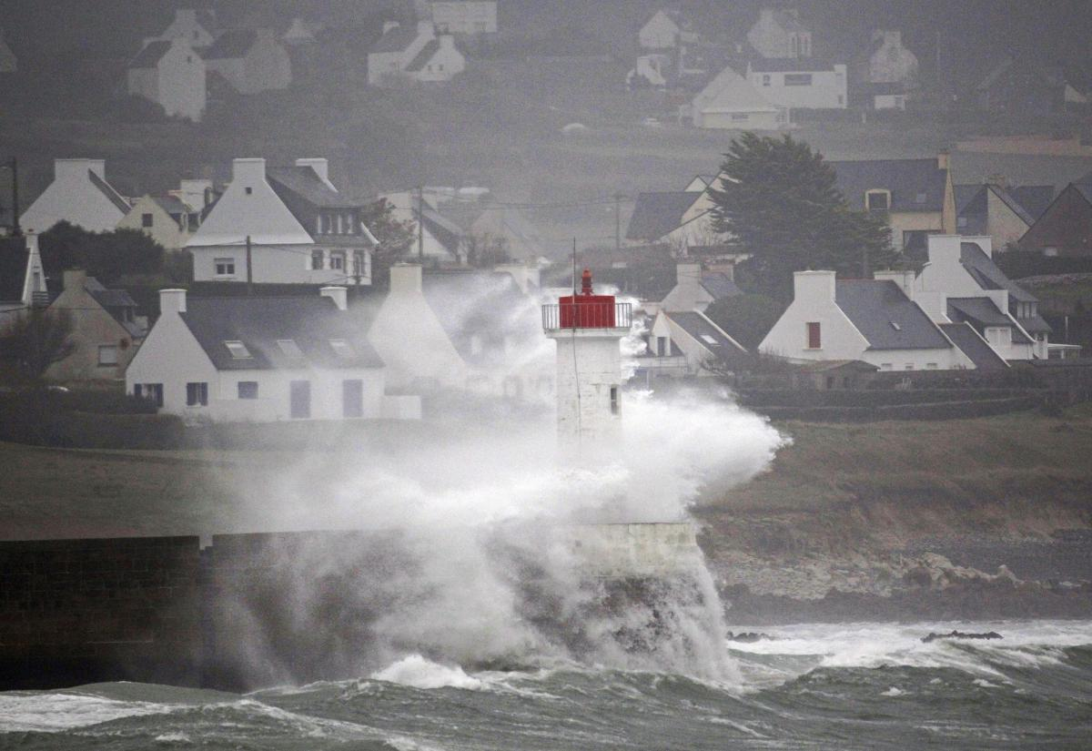
What are the types of bad weather and their consequences?
.
The types of bad weather in Brittany are mainly storms which are the cause of many floods
October 15 to 16, 1987
An extremely violent storm struck northwestern France.
So violent, so devastating that it was classified as
a hurricane.
Winds up to 220 km / h devastated Brittany and Normandy,
killing 15 people
December 23, 2013
Brittany was hit by the violent Dirk
storm accompanied by heavy rain,
causing many rivers to overflow.
This storm will last a fortnight and
will cause a lot of damage.
7 /
Notes:
7

Slide 8
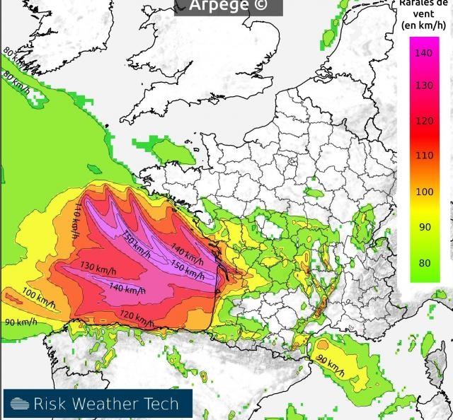
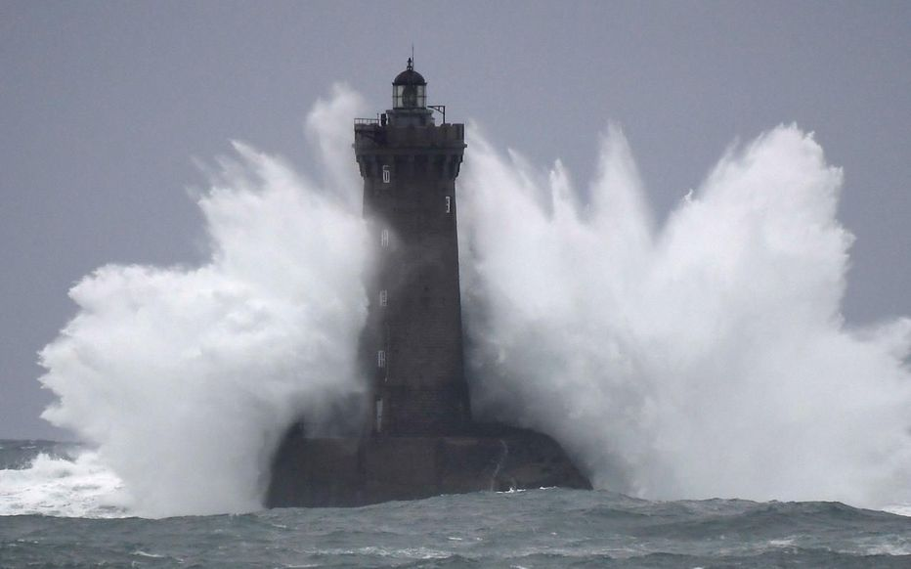
the bad weather types and their consequences
Amélie storm
There was an Amélie storm in Brittany on November 2 and 3, 2019.
Storm Amélie was the first storm of the fall that swept the Atlantic coast,
there were winds at more than 160 km / h, rough seas,
and highways cut by trees.
There were two wounded in Morbihan,
because of the storm Amélie.
They were injured by a 15-meter tree that fell on their car,
on the four voices.
Morbihan firefighters recorded seven floods,
35 fallen trees, and a commercial roof flown away.
Notes:
8

Slide 9
Global warming
Notes:
9

Slide 10
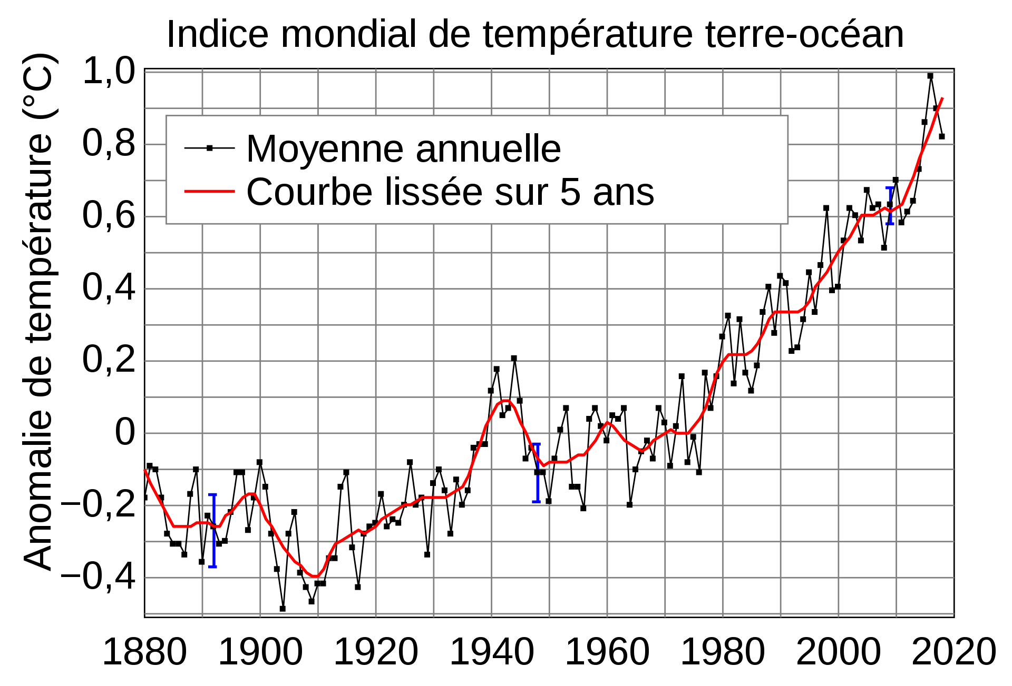
When does it date?
Since 1850, in the 20th century, the average temperature of the globe has increased by 0.6 ° C and in mainland France, the temperature has increased by more than 1 ° C.
10
Notes:
10

Slide 11
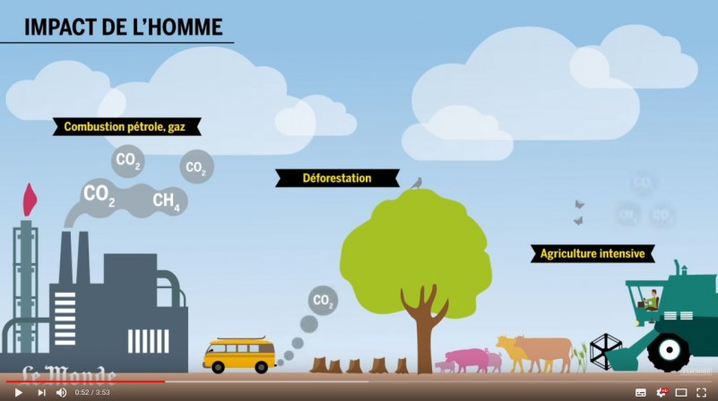
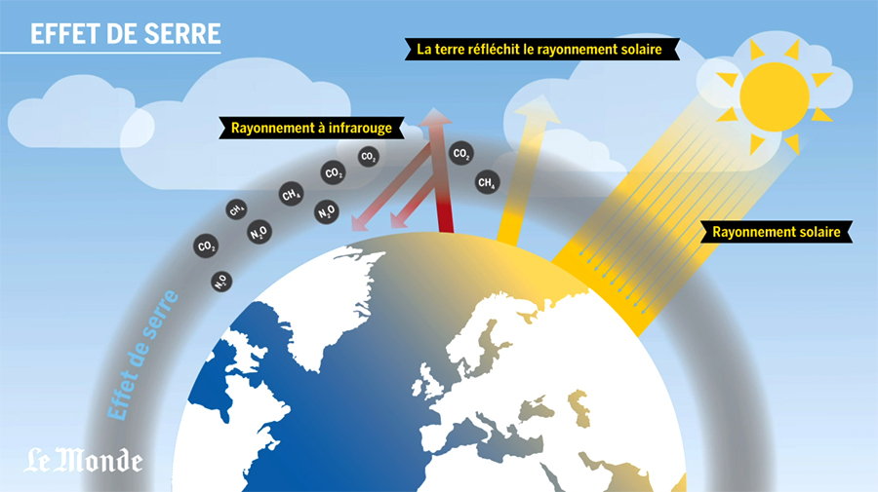
What are the causes ?
Humans are responsible for global warming:
- transport using oil releases Co2 (example: cars, trucks, planes, etc.).
- factories can reject gases 7000 times more powerful than Co2.
- constructions of concrete houses and heating with fuel or gas which
release Co2 into the air.
- in farms cows that ruminate and the excrement of animals reject
a greenhouse gas, methane.
- in the fields the fertilizers release nitrous oxide (a greenhouse gas)
- to grow trees capture Co2 in the air but when it burns or rots,
this gas is released into the atmosphere.
Those who use coal and petroleum are the main causes of global
warming because they emit greenhouse gases like Co2 into the
atmosphere.
11
Notes:
11

Slide 12
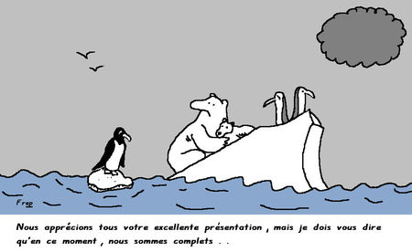
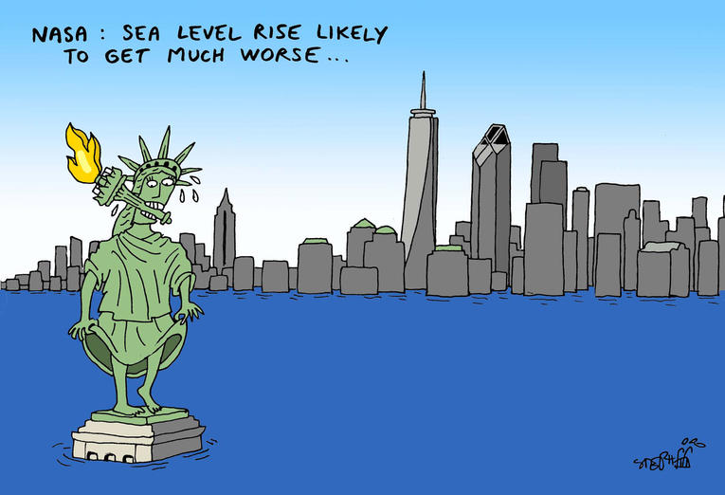
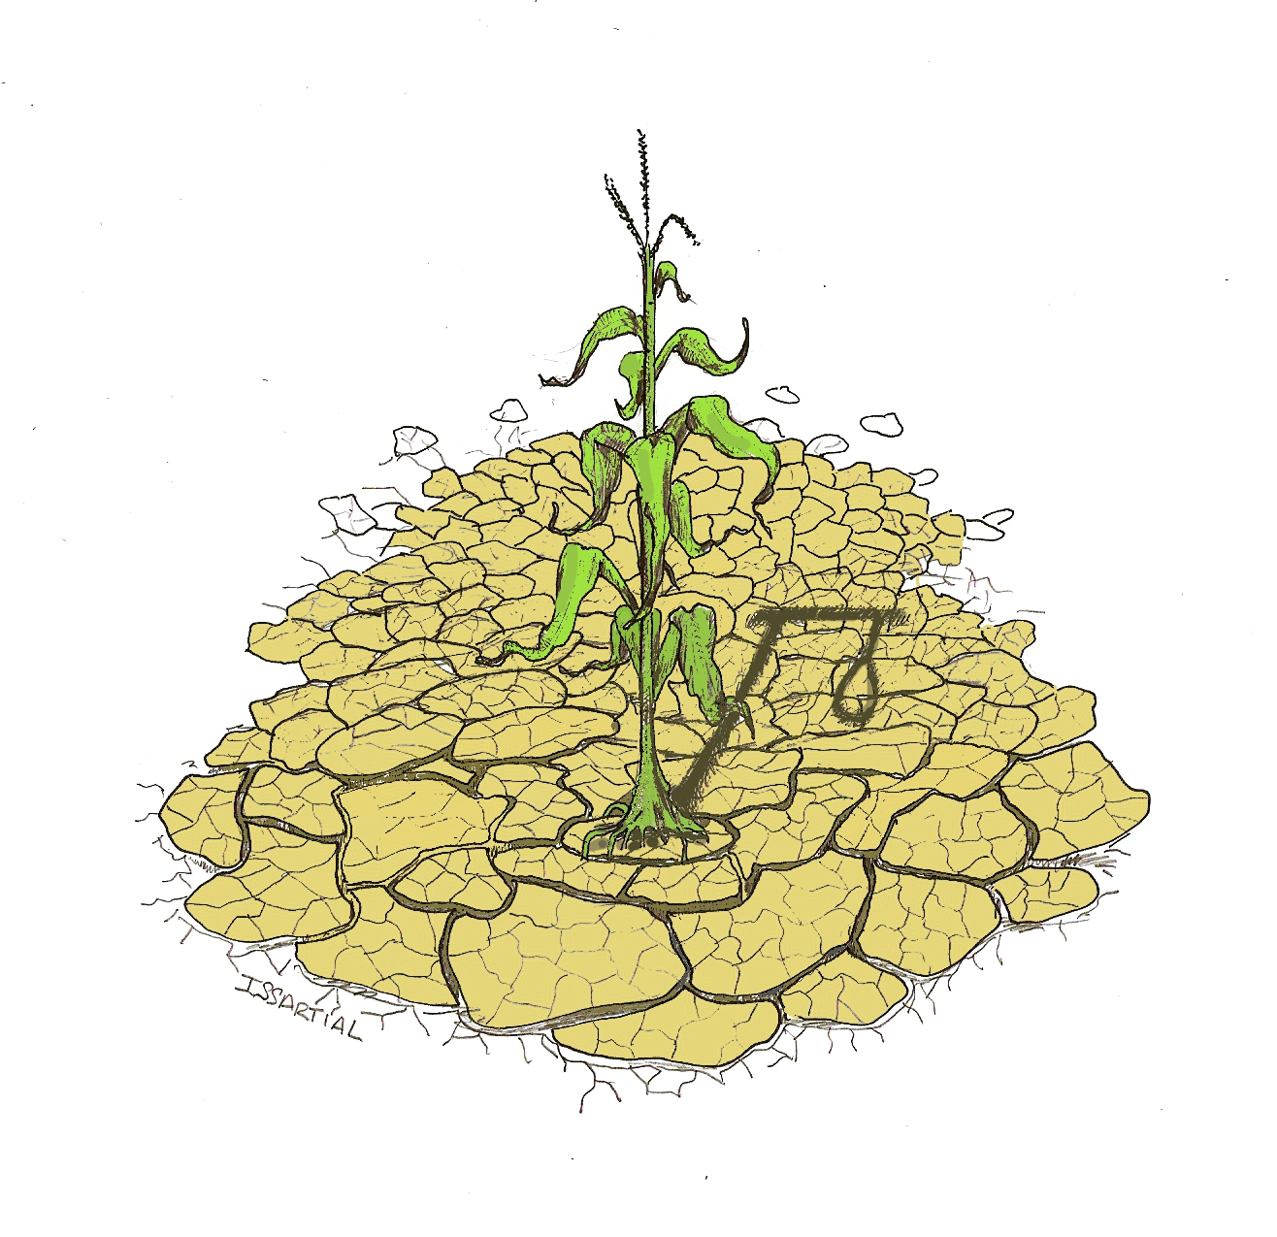
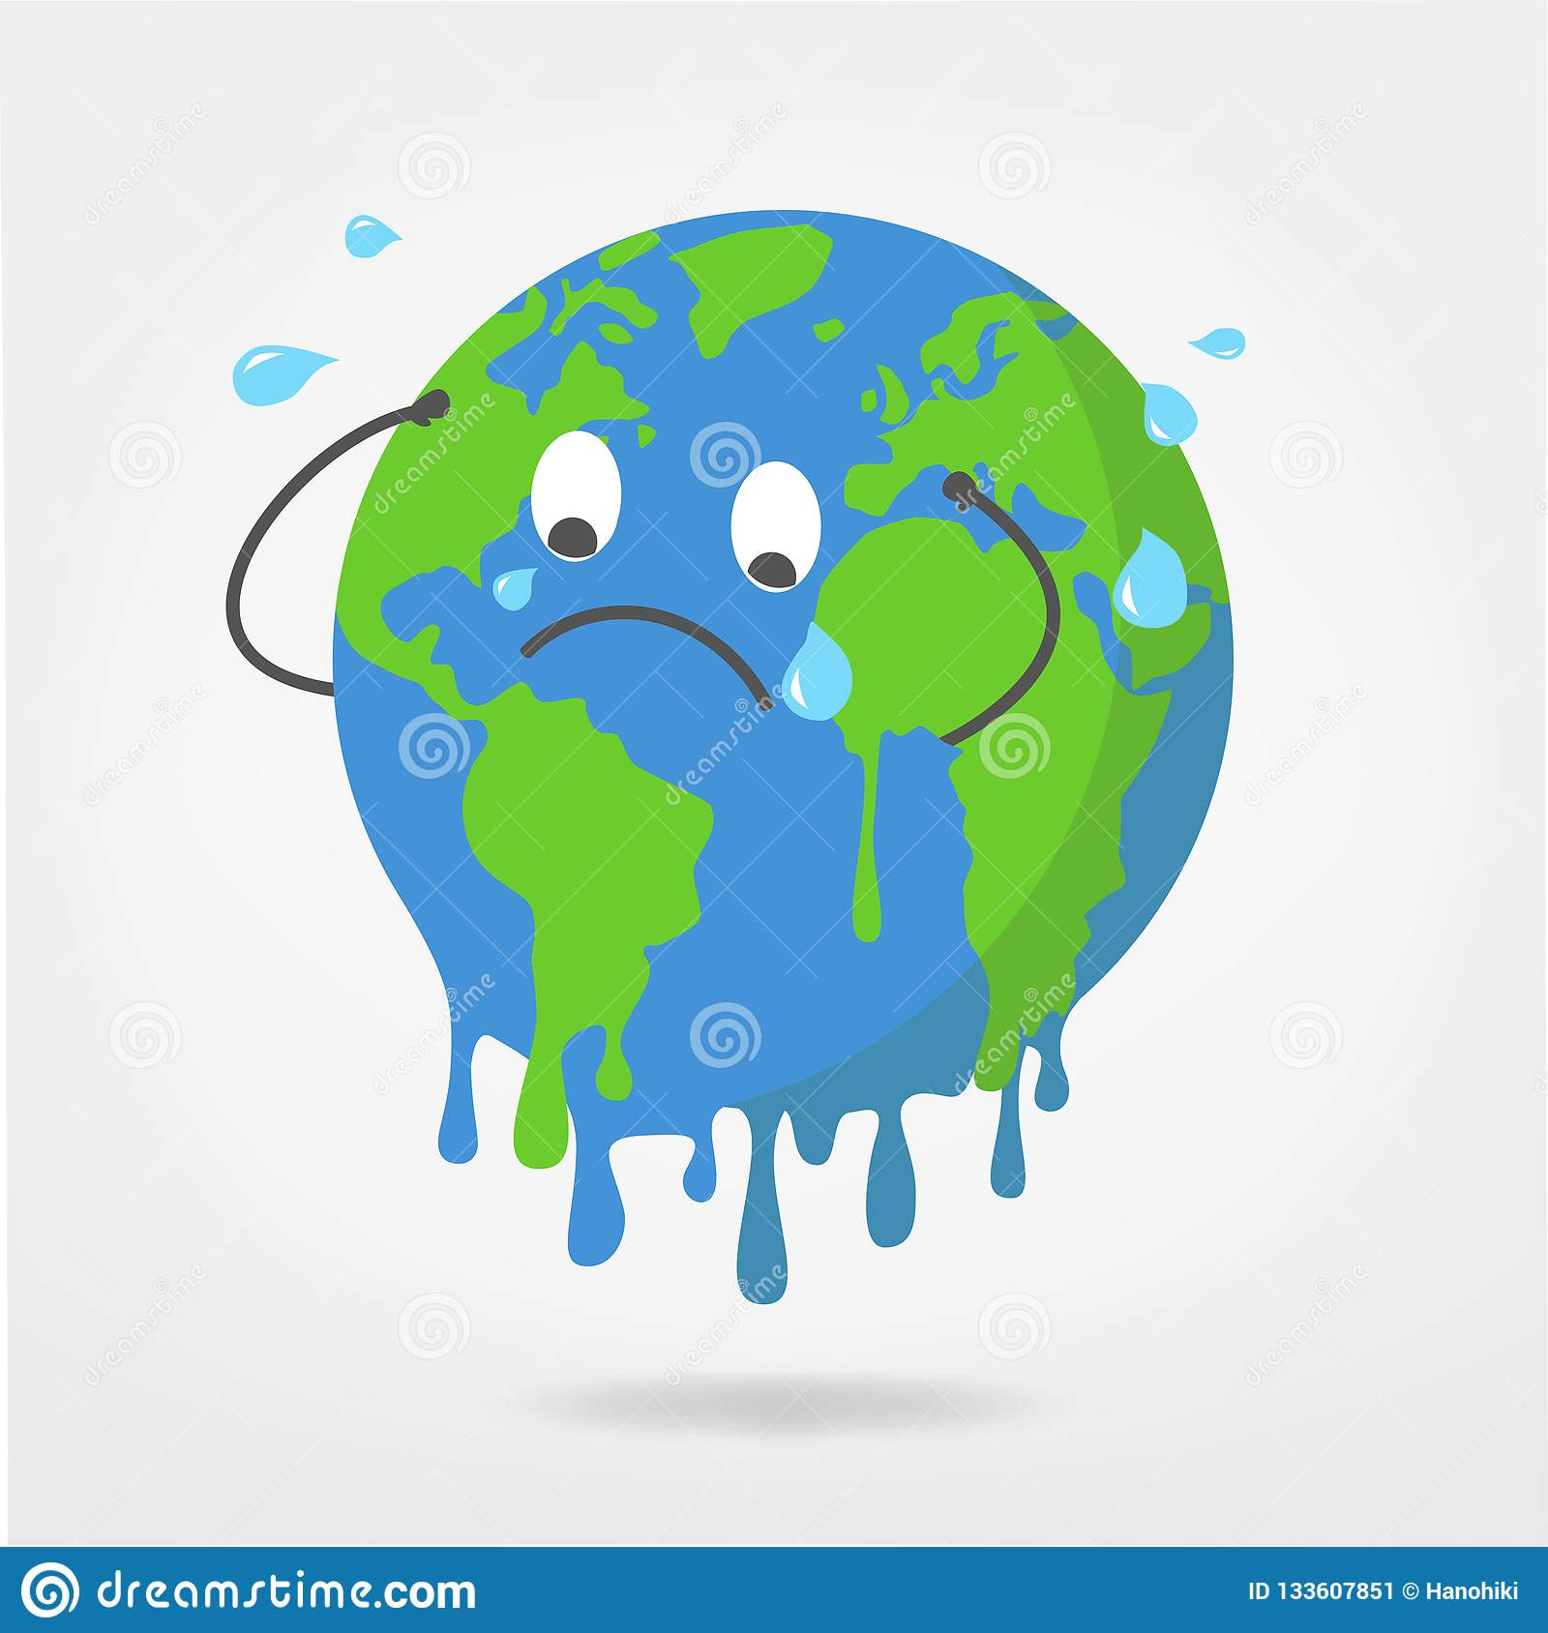

What are the consequences on the natural environment? On the distribution of animal species? On migration?
Ice melting → rising waters → floods (which can cause migration of populations).
Weather disruptions = more and more hurricanes, heavy rain,
floods and major atmospheric disturbances.
Drought, less food and less water → could lead to wars.
Disappearance of species: no adaptations to global warming.
World Wildlife Fund
12
Notes:
12

Slide 13
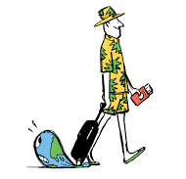

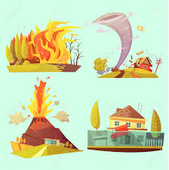
What are the consequences for humans?
According to a study by scientists,
8% of global greenhouse gas emissions (mainly CO2) are due to tourism.
This takes into account transport, food, accommodation and shopping for
travelers.
Agriculture, some crops do not resist heat
Natural damage: floods, earthquakes ...
… can lead to a drop in tourism
13
Notes:
13

Slide 14
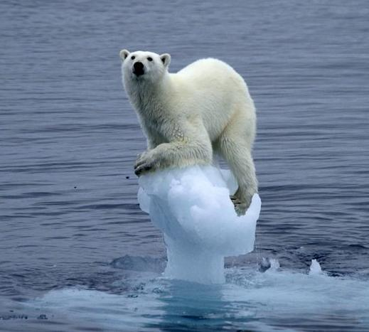
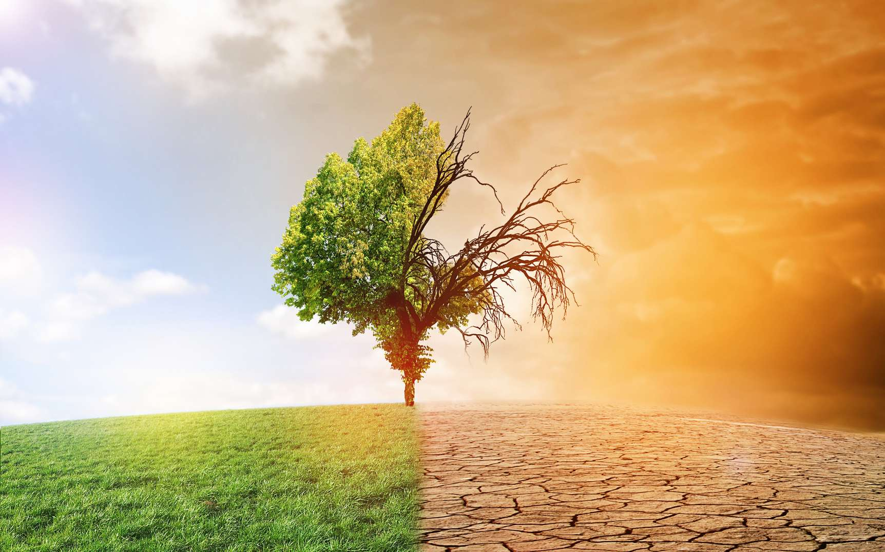
How does global warming translate? What are the different phenomena observed on the planet and in France?
Climate change is most clearly manifested by an increase or
decrease in average temperature, changes in atmospheric
circulation and water cycle and, as a result, cloud cover and
the amount of precipitation on Earth.
Droughts, tornadoes, heavy rain:
will there be more extreme weather events in
the coming years due to global warming?
14
Notes:
14

Slide 15
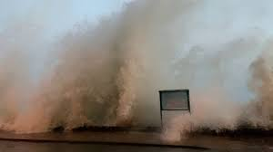
The last storm images of St Malo, near Sables d'Or les Pins.
The consequences in Brittany will be, according to scientists, more storms with more violent winds.
https://www.youtube.com/watch?v=zH1o9TPETYk
Notes:
15

Slide 16

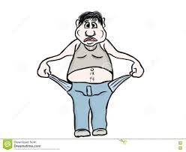
What are the consequences for a rich country? For a poor country?
The rise in temperatures will approach the ideal temperature, but will modify the natural environments.
Rich country
The rise in temperatures will cause migration, and upset the economies because of the damage.
Poor country
16
Notes:
16

Slide 17
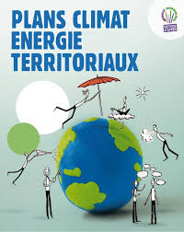

What are we planning to do? What is the IPCC?
What have we already started?
The IPCC is an organization open to all members of the UN which currently includes 195 states.
Its role is to assess the risks of global warming without bias in order to prevent possible consequences.
territorial climate-energy plan in France
PCET has already been implemented, which consists of reducing greenhouse gas emissions in all communities with more than 50,000 inhabitants
17
Notes:
17

Slide 18

What is a climate skeptic?
Climato-skeptique means a person who does not really believe in global warming or the impact of human activity on it. It questions the most widespread theories on global warming
.
Generally, climate skeptics consider that global warming is cyclical and that it is completely normal
18
Notes:
18

