Slide 1
Circle Environmental Children's Palace Botosani ROMANIA
COORDINATOR,
PROF. CECILIA VICOVEANU

Slide 2
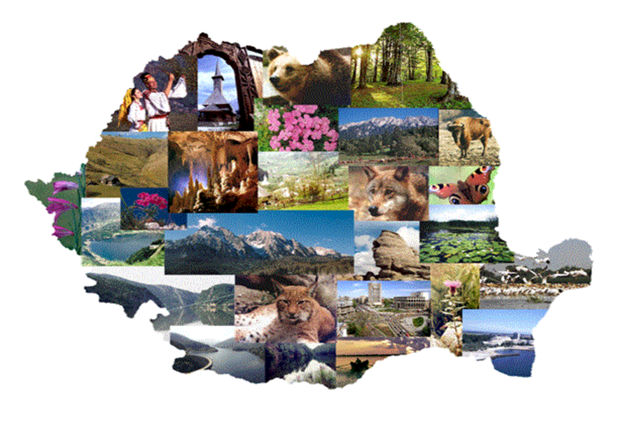
ROMANIA
County Botosani

Slide 3
Children's Palace Botosani
Botosani Children's Palace was founded in 1955. Here are aiming conducts non-formal education.
Educational activities will have the following objectives:
Full development of the human personality and to the strengthening of respect for human rights and fundamental freedoms;
Educating children in a spirit of respect for parents, for identity, its language, its cultural values​​, as well as for the national values ​​of the country in which he lives;
Preparing children to assume the responsibilities of life in a free society, in a spirit of understanding, peace, tolerance, equality of sexes, and friendship among nations and ethnic groups, national and religious;
Education of the child in mind the natural environment.

Slide 4
Non-formal education ( " extra " or " replacement " ) is characterized by:
compensatory function in school , conducted according to the specifics , but as partners with the school ;
specific responsibility requirements set;
allow moments of abstraction , the extraction of knowledge from practical life ;
out of education, teaching position , leaving room learning tool ;
aims of education are established for each activity, without a long-term organization ;
qualified personnel in various fields ;
content of education , relatively organized areas of interest ;
earner autonomy in the choice of themes / activities is relatively high ;
Certification ways - through certificates of participation , graduation courses , certificates , professional or vocational certificate , which can be recognized or not , sometimes , are not certified ;
not operate only within the limits assessments need to stimulate and support students;
teachers are " discrete actors " more than the moderators of these activities;
students directly involved / co-participants directly in relation to these activities .

Slide 5
Circle that you lead is the Environmental Protection
Environmental Circle aims to improve quality of life by providing children the "tools" they need to solve and prevent environmental problems. Can help children to gain knowledge, skills, motivations, values ​​and commitment they need to manage efficiently the resources of the earth and to assume responsibility for maintaining environmental quality. Children are an important audience because they are tomorrow's managers and consumers of resources. And in many cases children can influence their parents and other community members. Together with students can have a great impact on the growth of information, awareness and knowledge to the formation of attitudes to environmental projects.

Slide 6
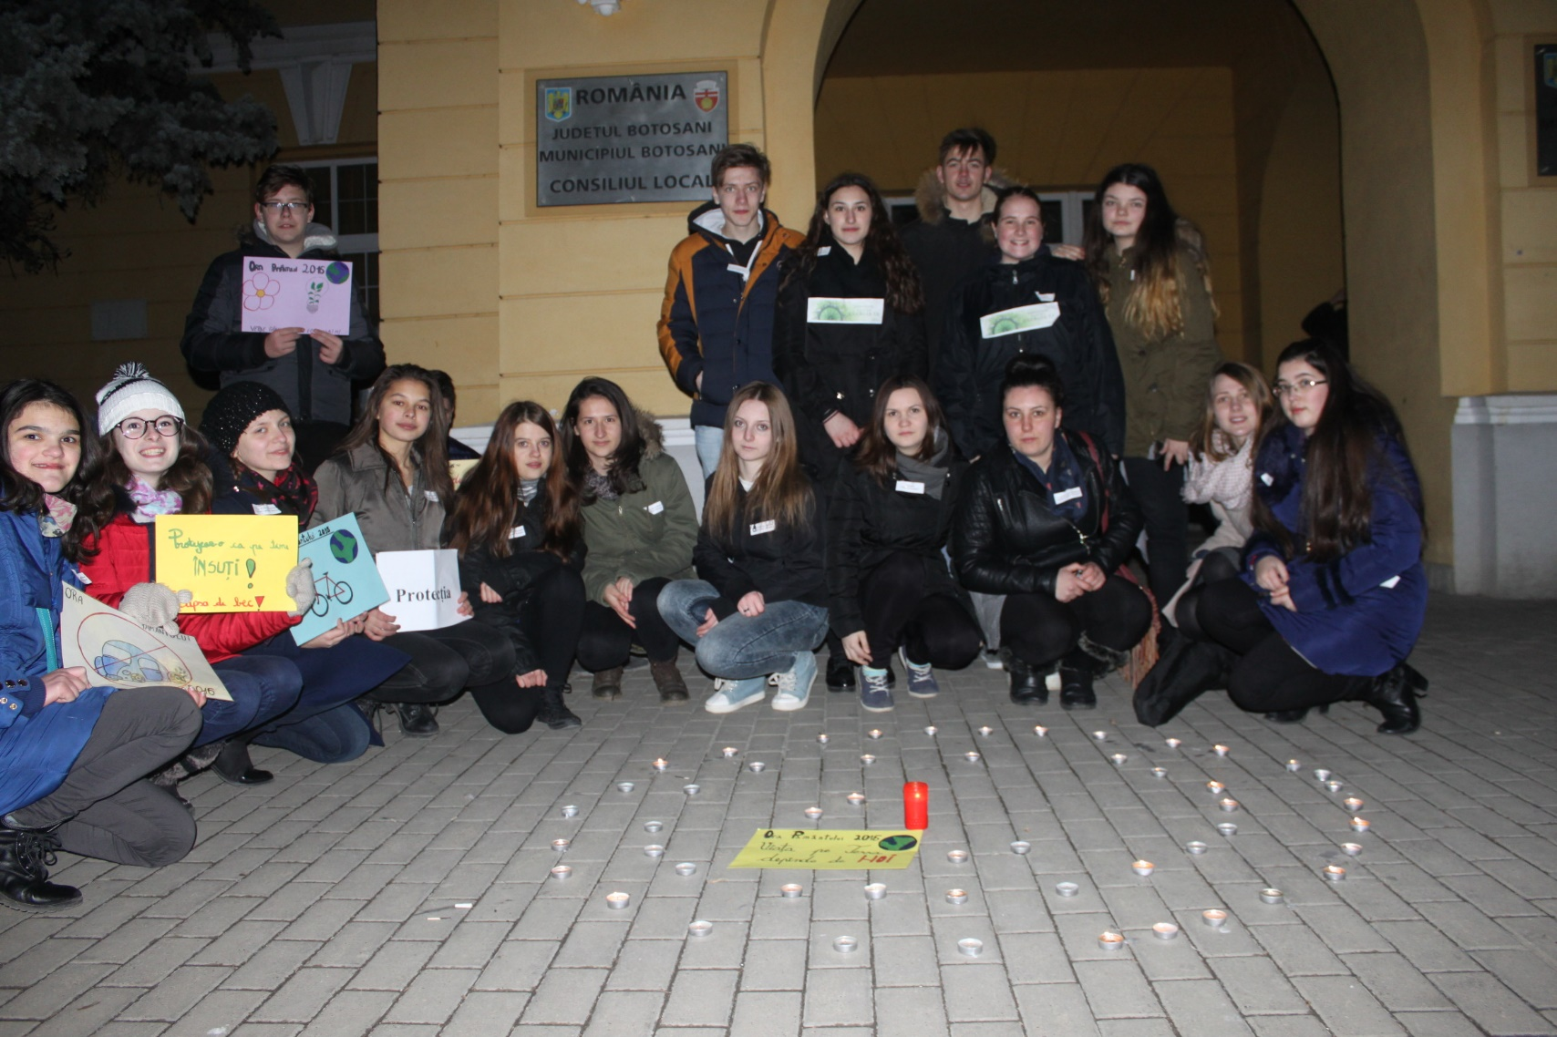
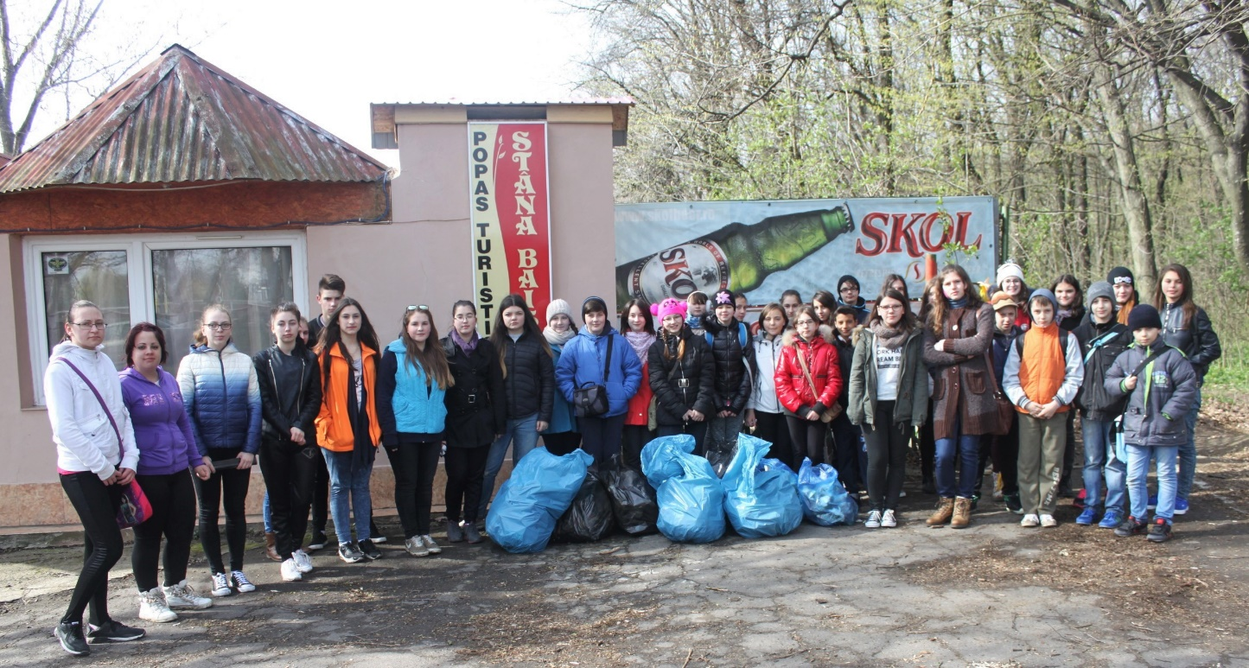
Circle that you lead is the Environmental Protection
The target group is composed of children aged 4 to 19 years loving nature and its protection.

