Slide 1
FOCUS: Developing Learning, Life and Interpersonal skills through a new FOrm – teaching CUrricula for Secondary students.
Szkoła Podstawowa w Głogowie Młp.
Poland
Copenhagen 19-23. 03. 2018

Slide 2
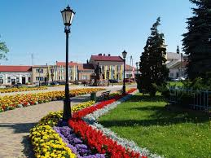
A few words about us...
Our town is called Głogów Małopolski and is situated in the south- east of Poland.

Slide 3
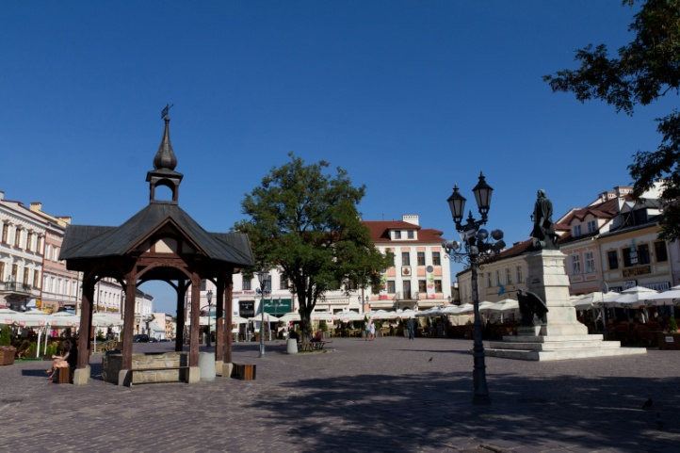
Our town is only 10 km away
from Rzeszów- Jasionka airport....
`
...and 14 km away from
RZESZÓW - the capital
of our region .

Slide 4
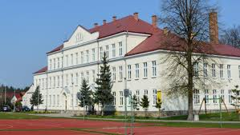
Our school
Our school is composed of two units: the primary and the lower secondary. About 800 students study here.

Slide 5
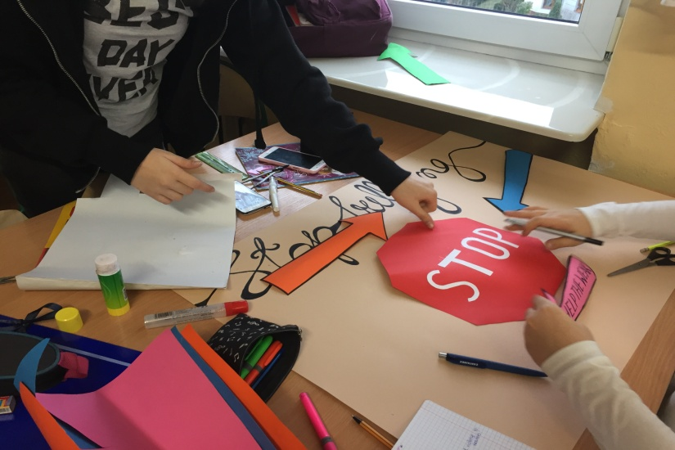
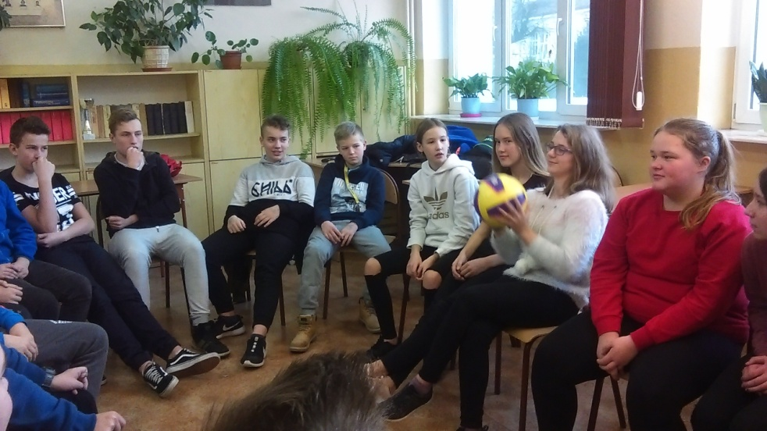
Our work within the project Erasmus +FOCUS
During the last 4 months students tried to deal with the subject of bullying, learn more about teambuilding and discover what effective communication is.

Slide 6
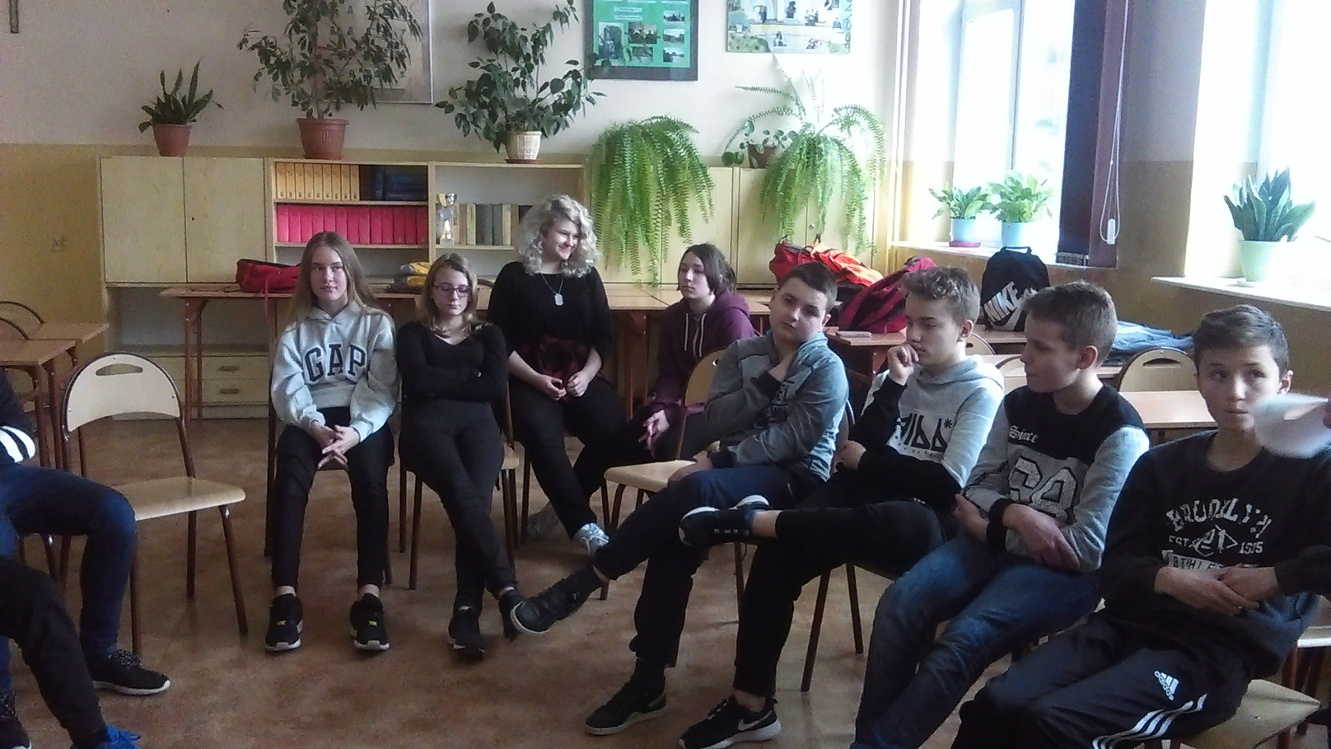
Bullying
It could be defined as unwanted negative behaviour, verbal, psychological or physical, conducted by an individual or group against another person and which is repeated over time.

Slide 7
As a practical activity we made posters encouraging other young people to react when they see the act of bullying.
These pictures show our friends from class 7a at work and one of the posters.

Slide 8
On English lesson our friends talked about bullying and learned about it from the perspective of the victim. They heard the story of two bullied teenagers from Britain who used music to fight with this problem.

Slide 9
We’ve learned from the lesson a lot. We shared our experience about bullying . We also sang the song using the karaoke version.

Slide 10
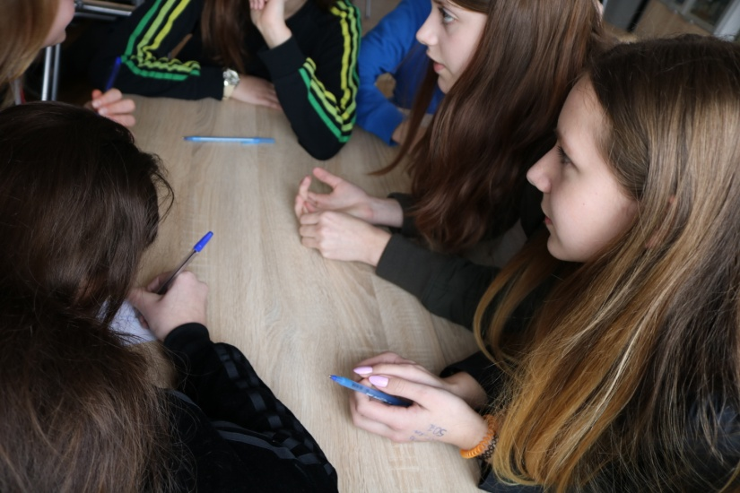
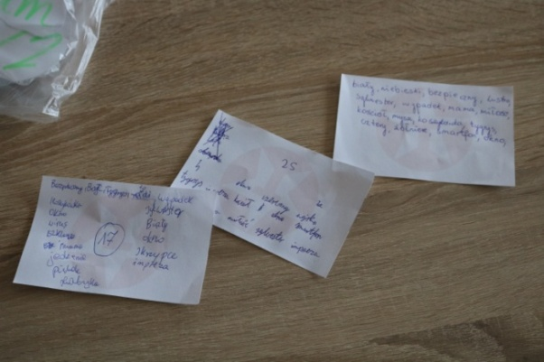
Teambuilding
This time we helped our teachers to do the lessons on teambuilding.
Here our friends are trying to memorise as many words as they can. First individually then as a team.

Slide 11
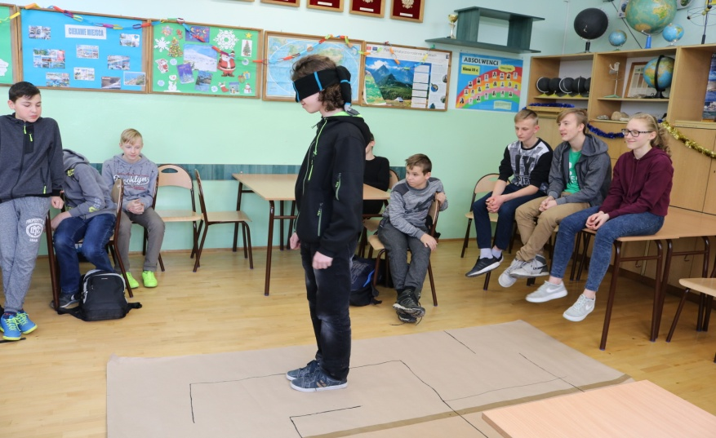
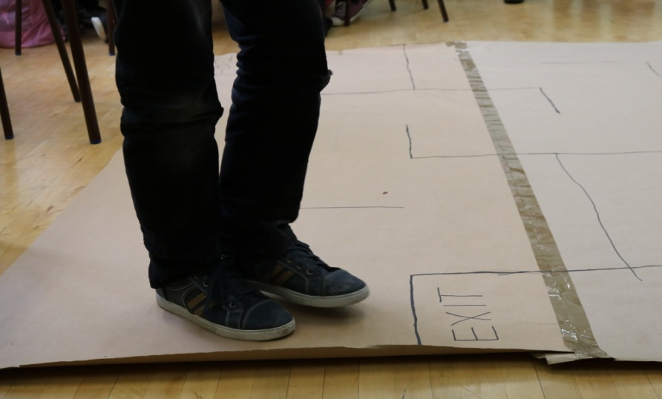
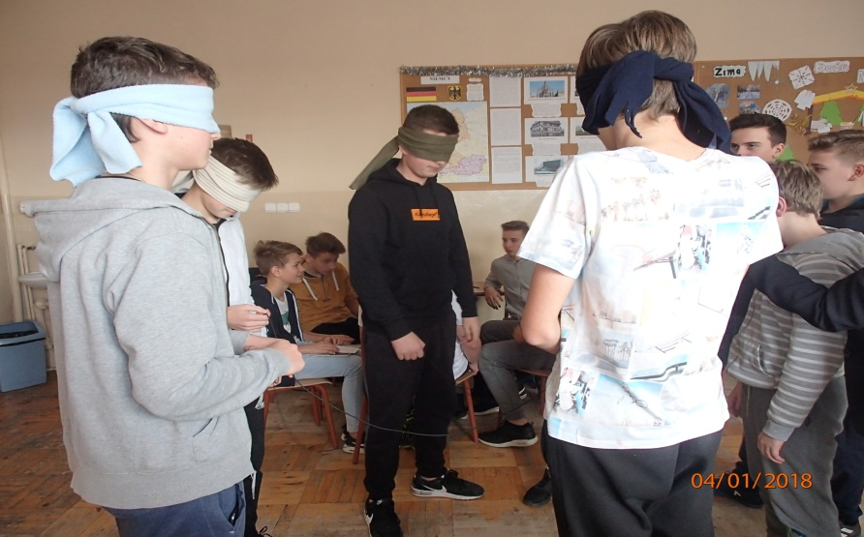
"Alone we can do so little, together we can do so much." --Helen Keller

Slide 12
"None of us is as smart as all of us."
--Ken Blanchard

Slide 13
Filmik - marshmellows

Slide 14
Conclusions

Slide 15
Effective Communication
Our success in life depends on our ability to communicate and interact with each other – at home, at school, at work, everywhere.

Slide 17
How to have a good job interview?
practise non verbal communication
-dress properly
-listen, answer the questions carefully
-don't talk too much
- ask questions
-DON’T LOOK DESPERATE.

Slide 18
And some revision....

Slide 19
To conclude.....

