Slide 1
CONSUEGRA Sights & Monuments
http://consaburuminternationaloffice.weebly.com/
http://circuloculturalconsaburense.blogspot.com.es/

Slide 2
A stay in the beautiful city of Consuegra promises plenty of fun and a number of interesting sites to see, including a medieval castle, historic architecture and a stunning landscape that make for a great day trip and a very fascinating adventure.

Slide 3
The main sights and most important monuments in Consuegra, which we will describe in more detail below, are the windmills and the castle.

Slide 4
Roman Remains and Archaeological Museum

Slide 5
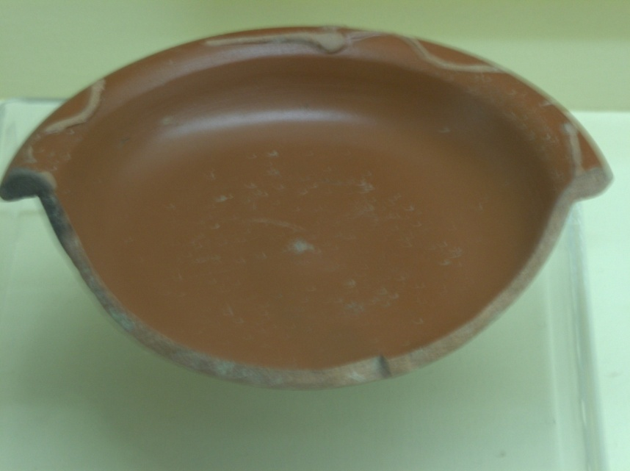
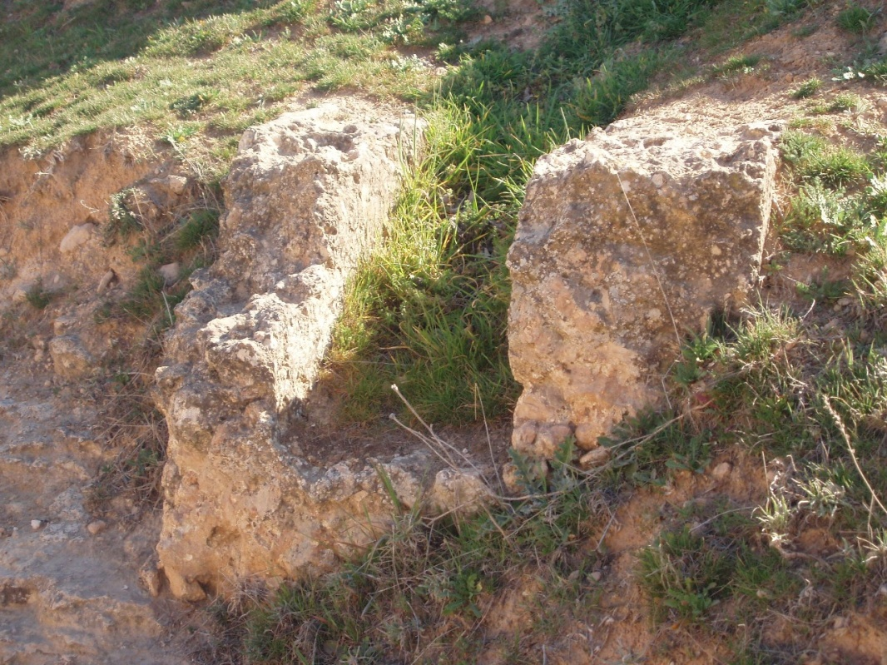
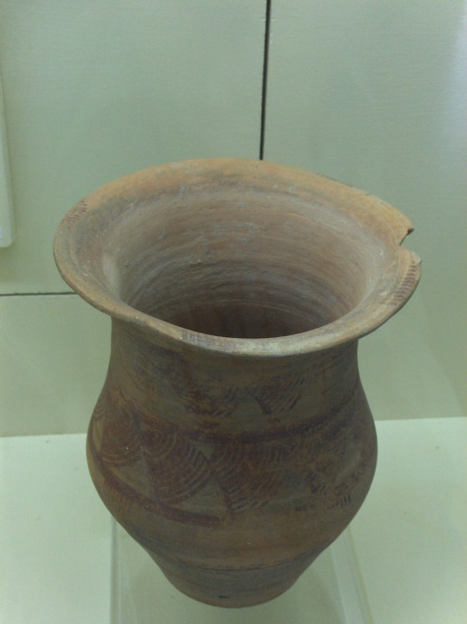
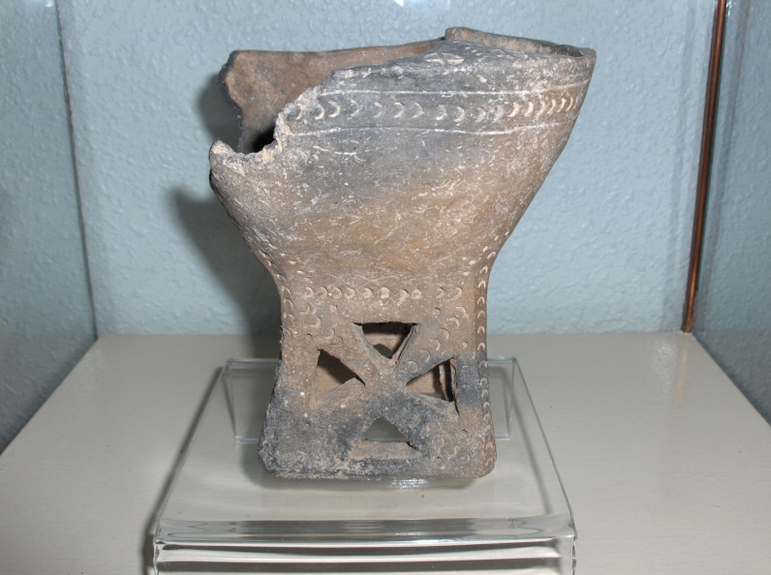
Some of its roman remains are displayed at the archaological museum, placed in The Main Square
Consuegra has a rich history dating back to Roman times as well.

Slide 6
Consuegra’s main attractions are an 11th century castle, that was once the stronghold of the Knights of San John from 1183 to 1837, and its perfectly preserved windmills. Each of the mills is named after Don Quixote's characters.

Slide 7
Castle of Consuegra

Slide 8
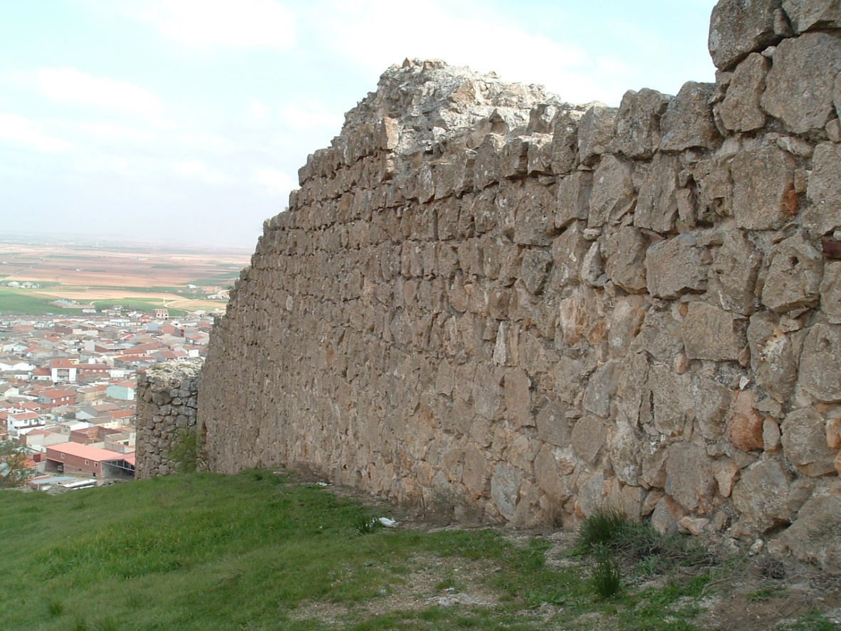
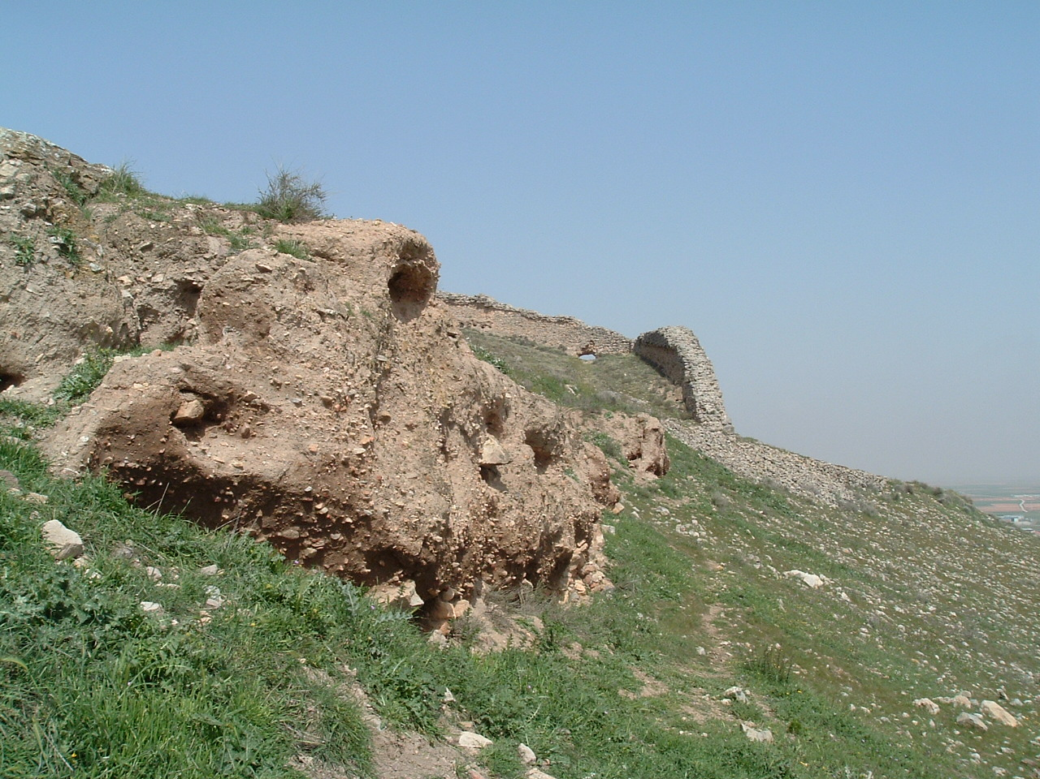
Albacar : It’s an Almoravide external Wall which surrounded the castle

Slide 9
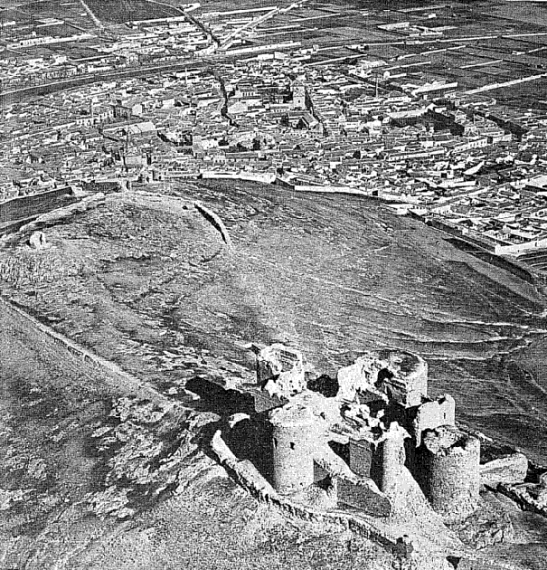
The castle was once a stronghold when Consuegra was the seat and priory of the Knights of San Juan, the Spanish branch of the Knight's Hospitallers of the Order of St. John of Jerusalem.

Slide 10
The castle was originally built as a fortress during the 10th century by the Muslim emperor Almanzor, and rebuilt during the reign of Alfonso VIII in the 12th century by the Knights of San John . In 1813 it was destroyed during the Peninsular War. In 1962, the Castle of Consuegra was ceded to the town hall and underwent major renovations that lasted for years.

Slide 11
Town Hall,
Main Square & Tercia’s House

Slide 12
The Town Hall of Consuegra is located in the city’s main square known as Plaza de España. The town hall was built in 1670,
very near to another building called Los Corredores which is a typical structure of La Mancha and which was an old townhall.

Slide 13
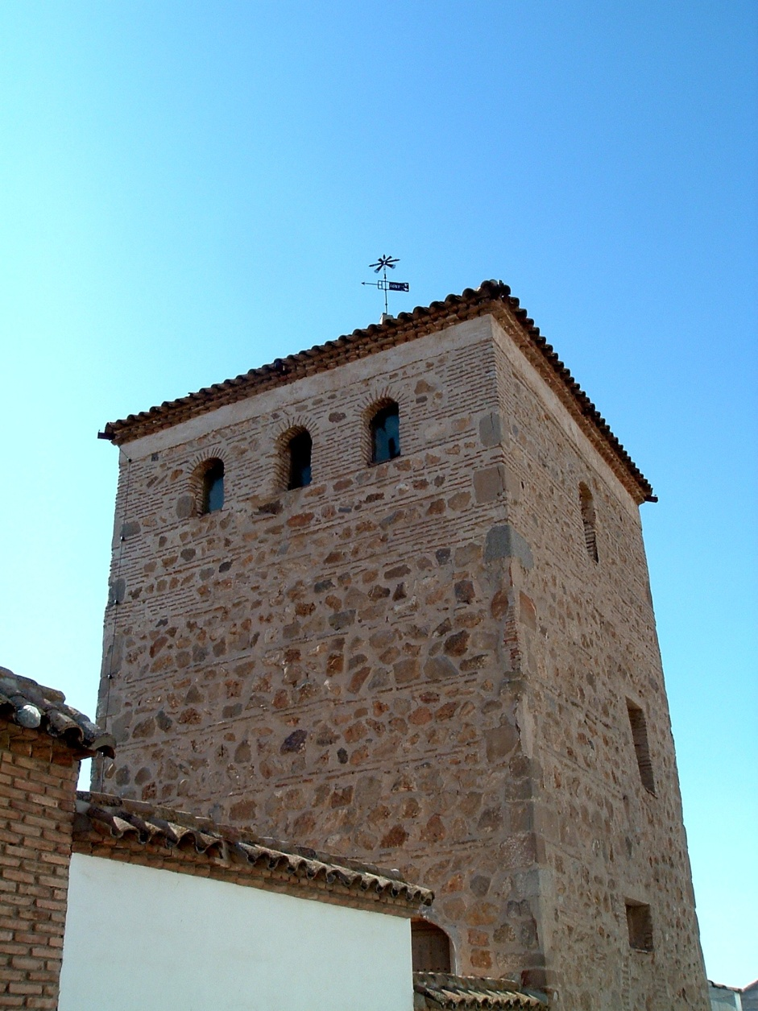
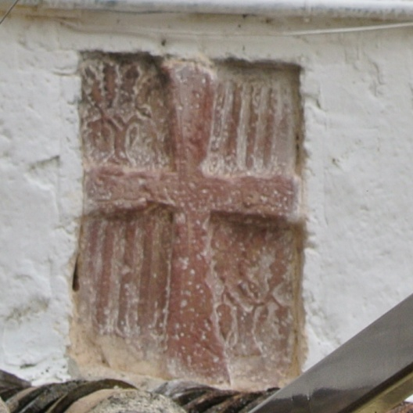
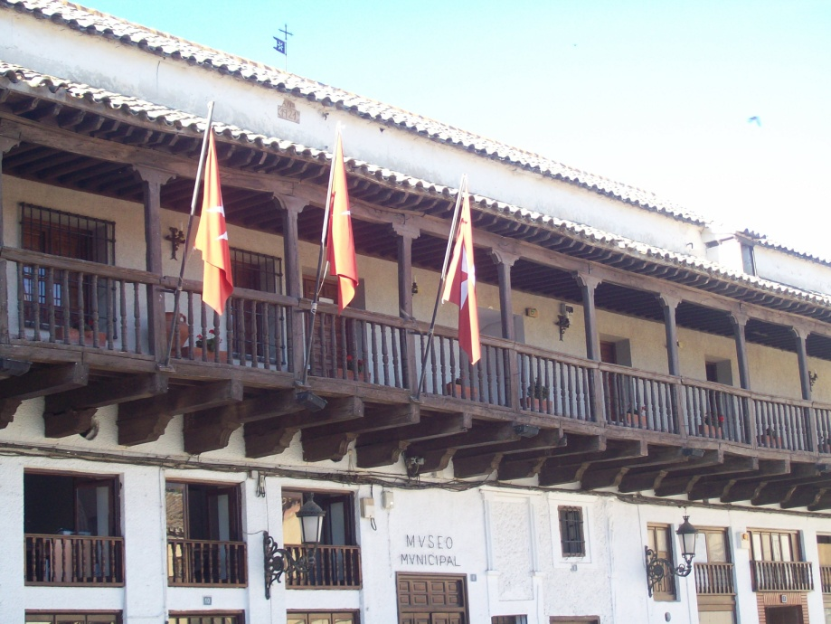
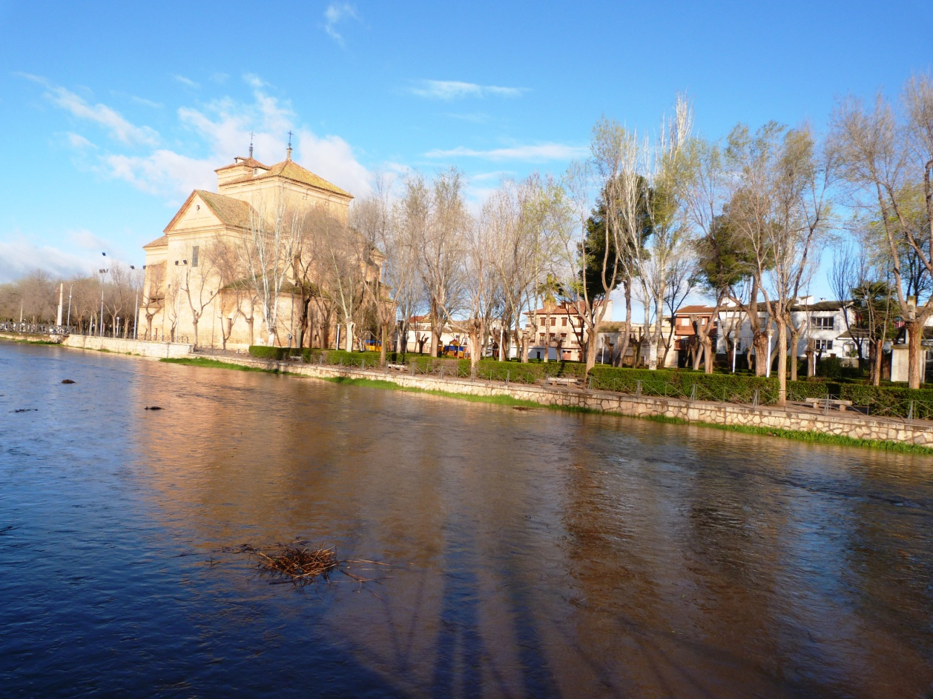

Slide 14
WIND MILLS

Slide 15
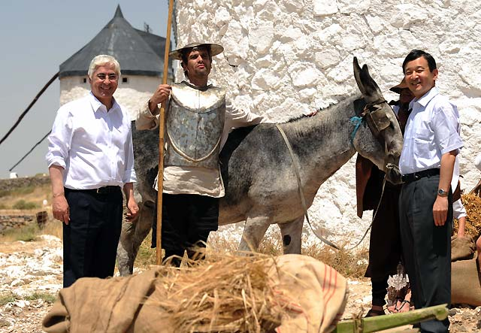
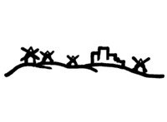
Most Spanish windmills, like those described in Cervantes’ Don Quixote , can be found here in Consuegra, and they are the best examples of restored Spanish windmills of all Several mills spike the hill just outside town, giving us a spectacular view of the 12th-century castle and of the town since 1836

Slide 16
The windmills were originally brought to the town by the St.John’s Knights to help the millers. These machines used the wind to grind grain, particularly wheat, and were transferred from generation to generation, from father to son.

Slide 17
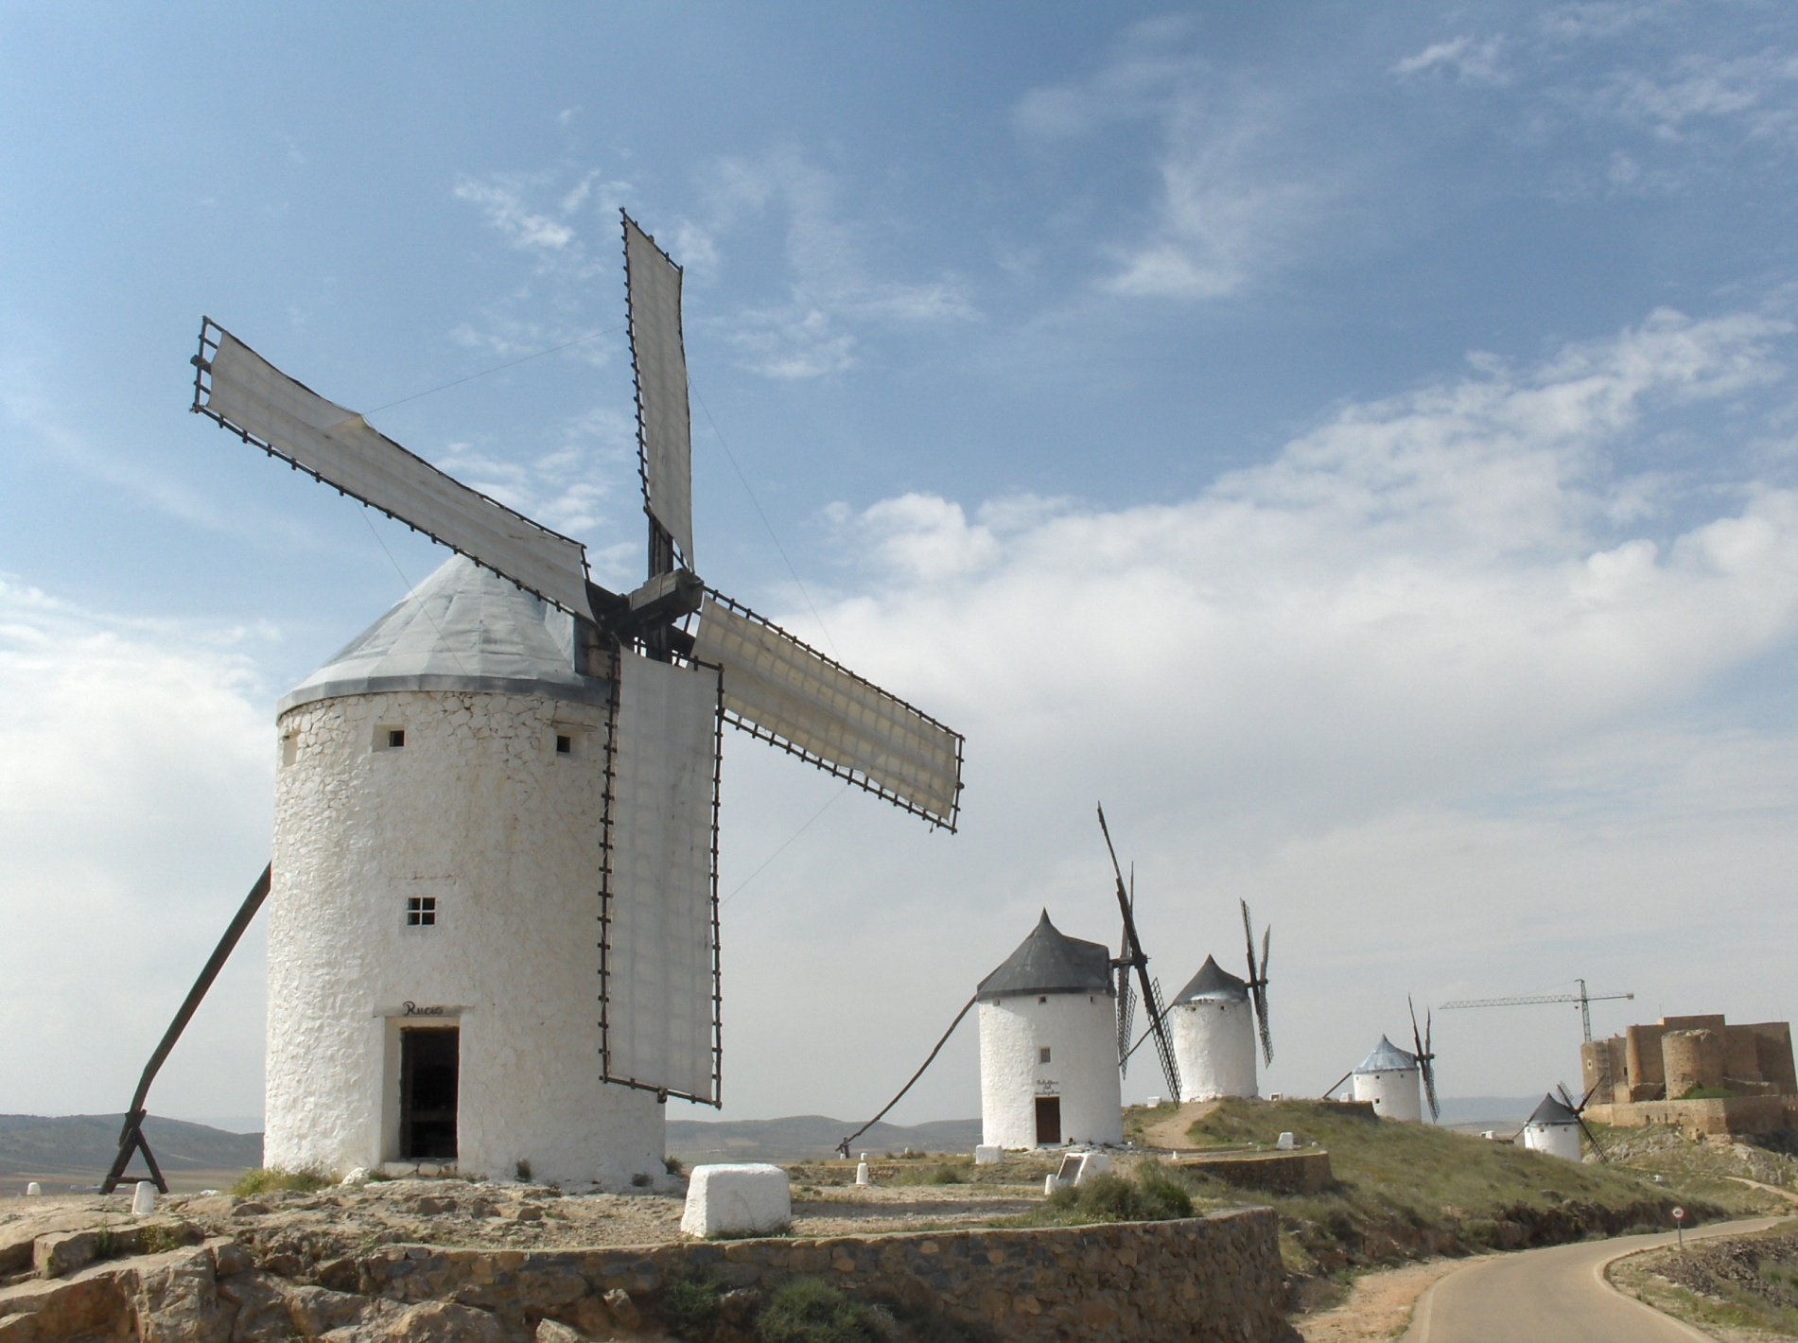
There are 12 windmills to explore on the hill just outside of the city

Slide 18
They usually consisted of two rooms or levels.
Millers had to carry sacks of grains that could weigh 60 or 70 kilos to the top floor, they rotated the sails of the windmill as the top part of the windmill was movable.
Some of the most important parts of the windmill are: Tunnel or canal: through it the grain goes down. Container: where the grain is stored Piece of wood: for moving the sails

Slide 19
Festivals, crafts and food

Slide 20
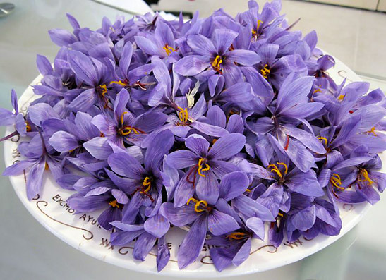
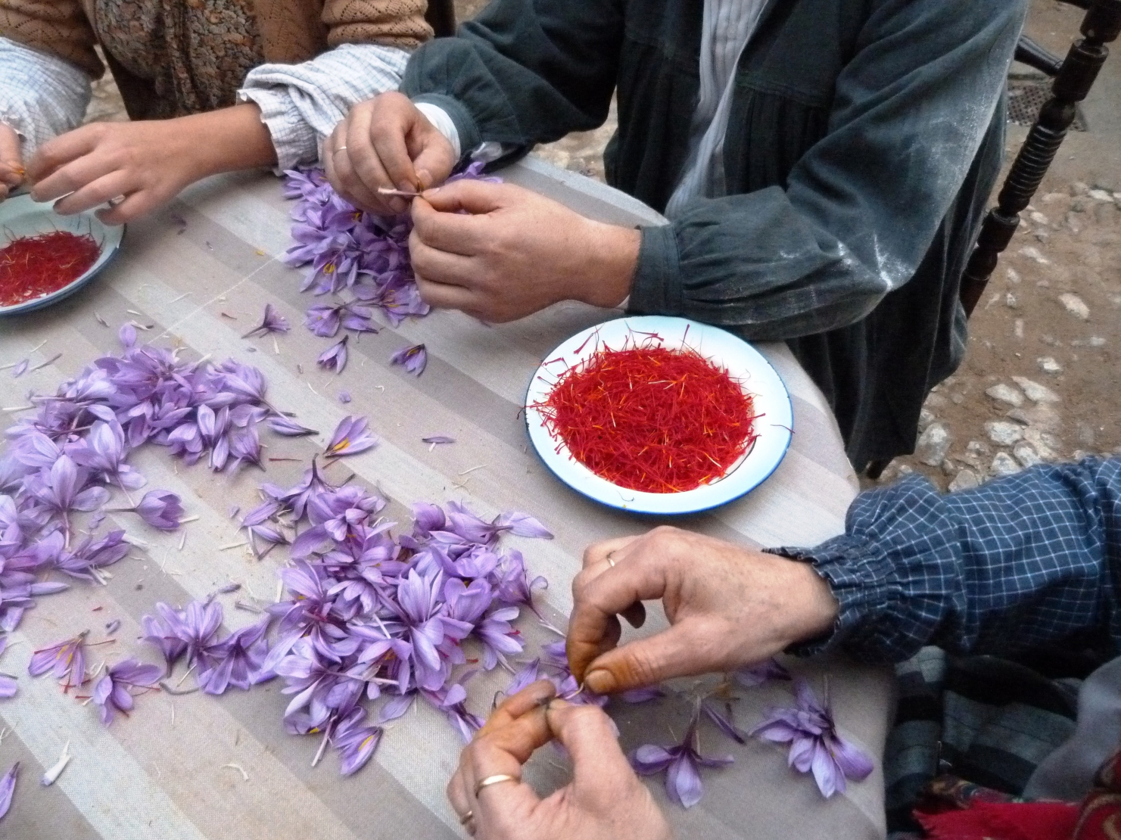
The Rose of Saffron Festival is celebrated each year on the last weekend of October . The fields are a sea of this particular bloom, which is quite a sight ! Traditionally, when the people of Consuegra finished the harvests, the festival began. It is a quaint, folkloric festival where the connection to Don Quixote is strong. The windmill called "Sancho" is used to grind the wheat, and a local beauty is crowned "Dulcinea", the name of Quixote's lady. Visitors can also get here a taste of traditional music and dancing from La Mancha.

Slide 21
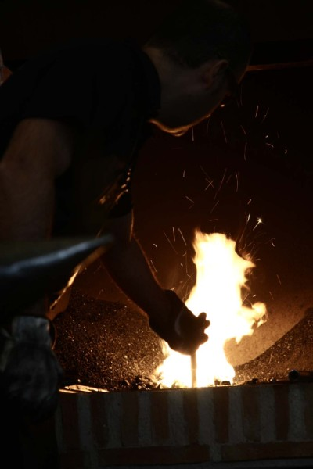
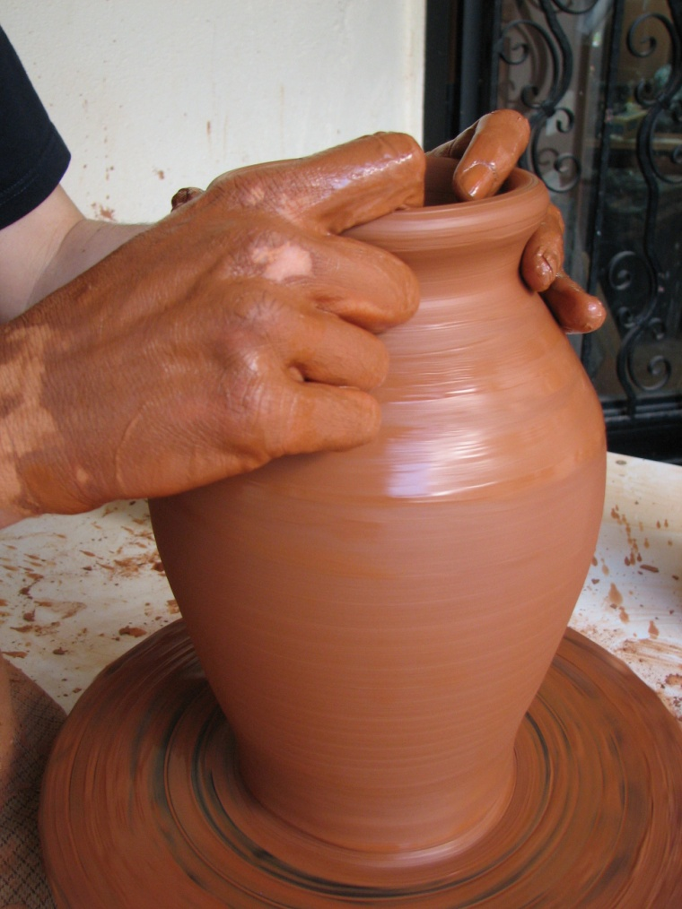
The making of crafts is a major activity in Consuegra. As pottery or forge

Slide 22
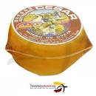
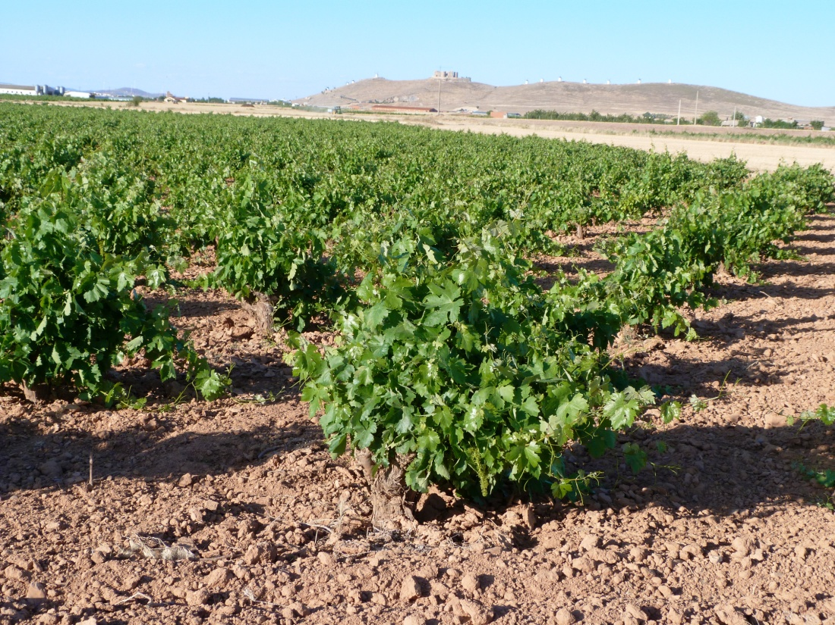
The food in Consuegra includes dishes such as migas, small pieces of bread mixed with chorizo, bacon and ham; and gachas, snacks made of flour, chorizo and other local ingredients, like Olive Oil. Wine and the cheese are quite good as well

Slide 23
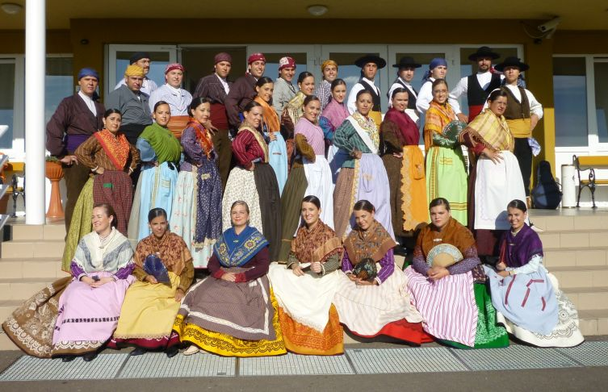
The local folck group

Slide 24
The history that can be felt from the hill is reflected in some monuments in the city of Consuegra also. At night during the last weekend of October, the windmills are lit up during the saffron festival. They stand, as they have done for centuries, on top of the hill like candles resting on the plateau.

Slide 25
ENJOY YOUR VISIT!!

