Slide 1
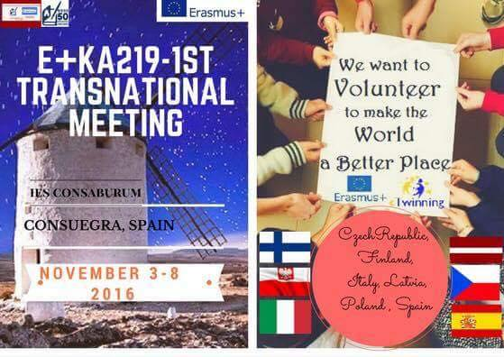
School Volunteers 2016/2017

Slide 2

SCHOOL VOLUNTARY CLUB WORKING in the lower secondary school in Psary
School Voluntary Club was founded in January 2014 in the lower secondary school in Psary by a school counselor Mrs Małgorzata Piasecka. It was formed by a group of students who selflessly and with great kindness express the desire to help others.
Being a volunteer is not only a responsibility. First of all it is a great satisfaction to help another human being who needs it from us. The best payment for our work is smile and warm words from the world.

Slide 3


SCHOOL VOLUNTARY CLUB WORKING in the lower secondary school in Psary
Volunteering is a voluntary, free, conscious work for the benefit of others or society as a whole, beyond family and friends’ relationship.
School Voluntary Club is an initiative of the youth, dedicated to young people who want to help those who are in the greatest need, to respond actively to the needs of the environment, to initiate actions in the school and local environment and to support charities or cultural actions. School Voluntaty Club works everywhere for people who need it.
Notes:
3

Slide 4
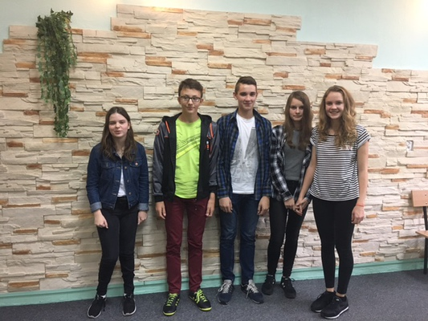

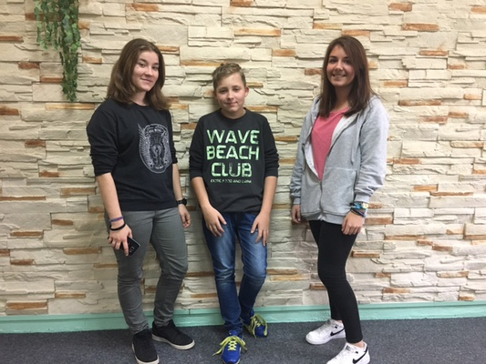
Our Volunteers

Slide 5
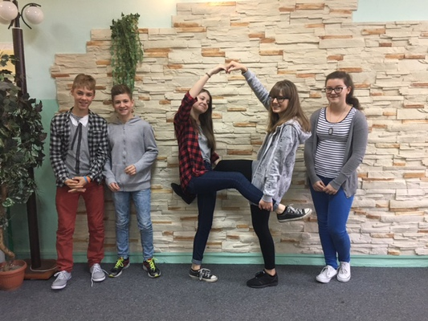
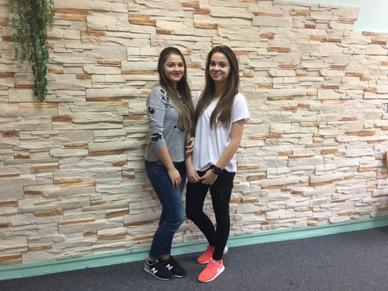

Our Volunteers
But, there are much more school volunteers!

Slide 6
Objectives of School Voluntary Club
Involvement of young people in conscious, voluntary and unpaid/non profit help, getting to know the idea of ​​volunteering
Developing the attitude of commitment to those in need, help, openness and sensitivity to the needs of others, kindness and selflessness.
Active actions in the area of ​​peer support, cultural life and protection of the environment
Developing a system of young people's involvement in the activities of a voluntary work and using their skills and enthusiasm to work for school and the school environment

Slide 7

Objectives of School Voluntary Club
Preparation of lower secondary school students to take voluntary action for the environment and the local schools
Supporting interesting initiatives
The promotion of volunteering in the school
School Voluntary Club is also engaged in supporting certain charity events for example Easter charity collection.

Slide 8
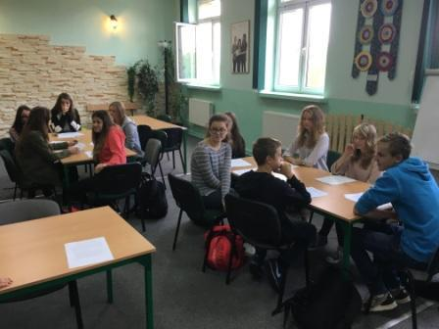

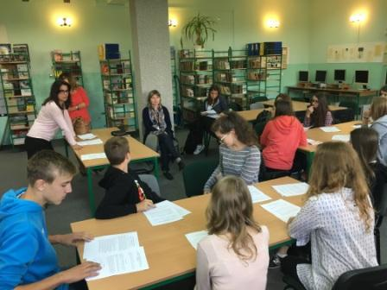
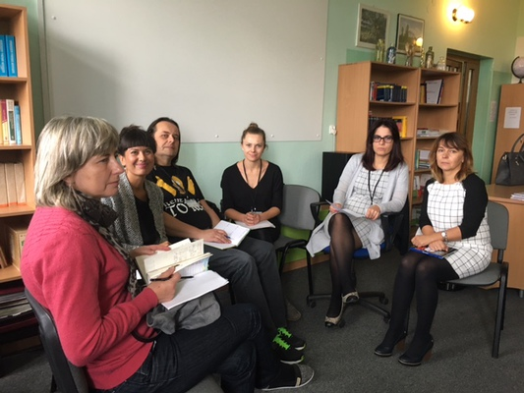


Some Photos From Our 1st Meeting

Slide 9

The Activity of School Voluntary Club
The activity of the volunteers participating in the project is focused on two main areas: the school, environment and the local environment (external). It includes:
Peer education
Collecting food and clothing for the poor people
Helping in the Orphanage.
Helping in Social Assistance Centre.
Helping in animals shelters.
Street money collections

Slide 10

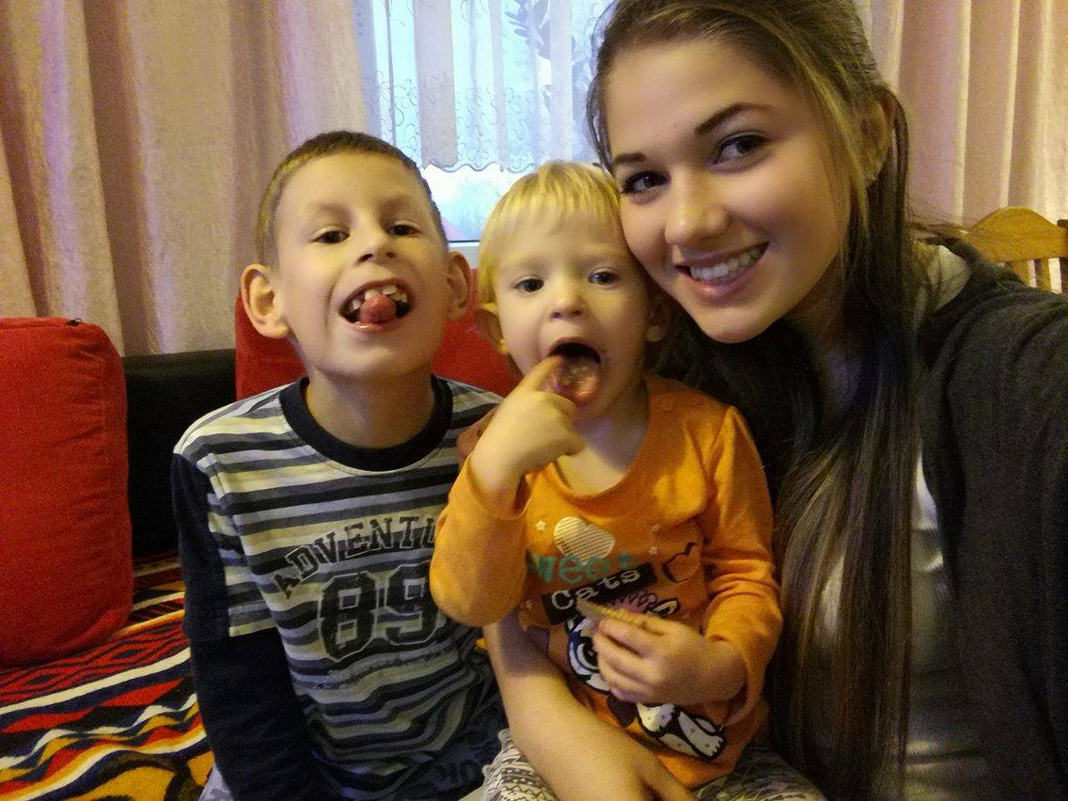
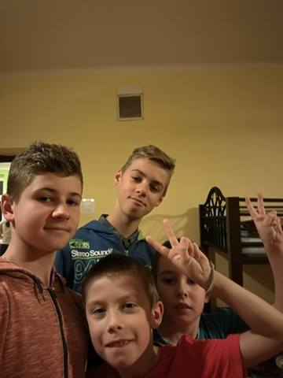

Actions
Playing and taking care of kids in orphanage

Slide 11

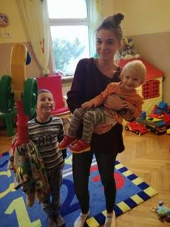
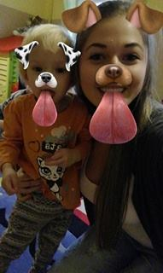
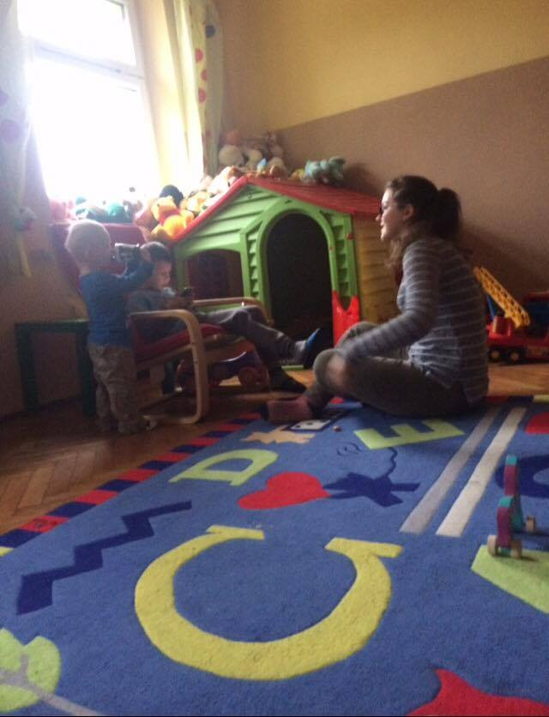

Actions

Slide 12
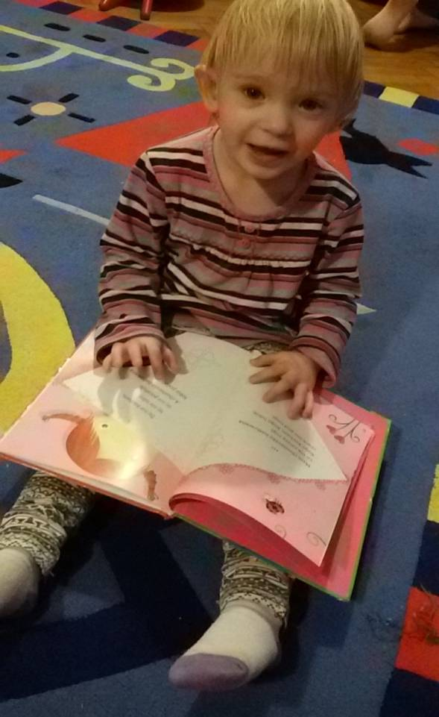
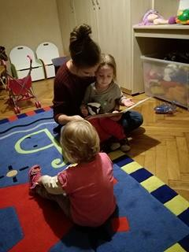
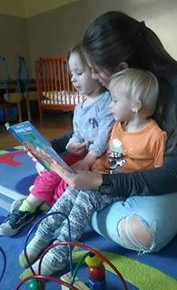

Actions

Slide 13

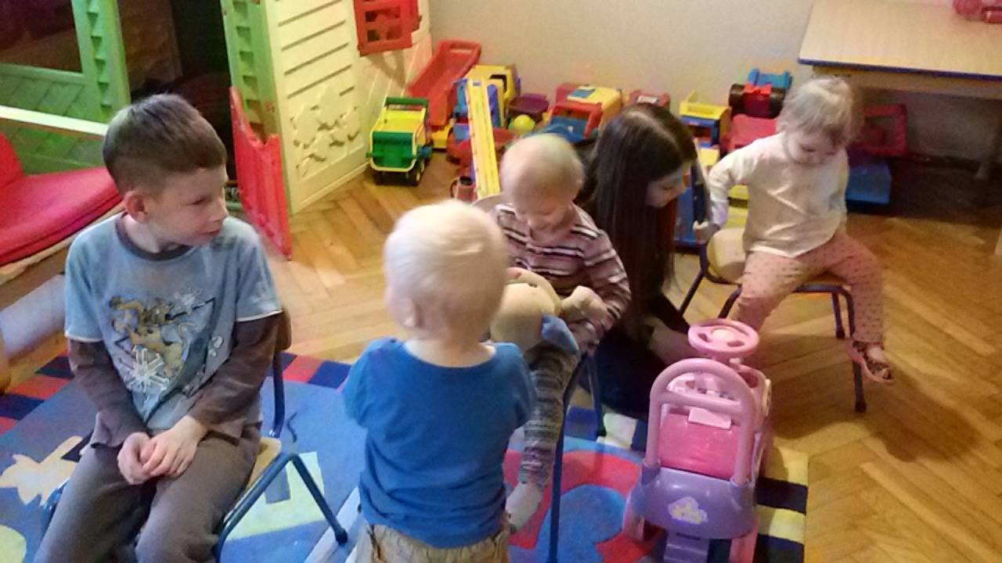
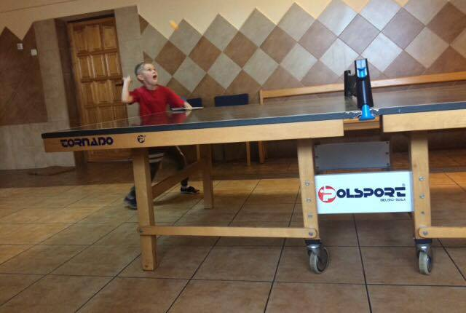
Actions

Slide 14
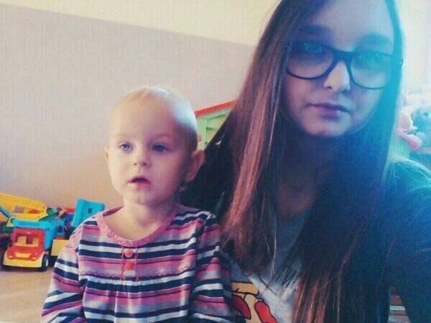

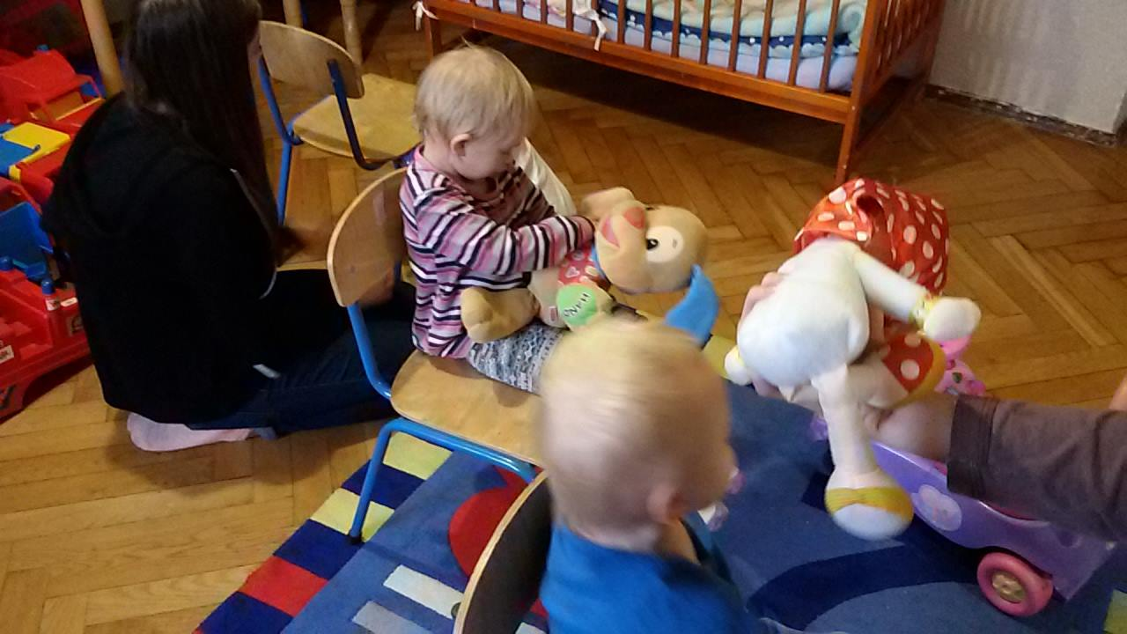

Actions

Slide 15
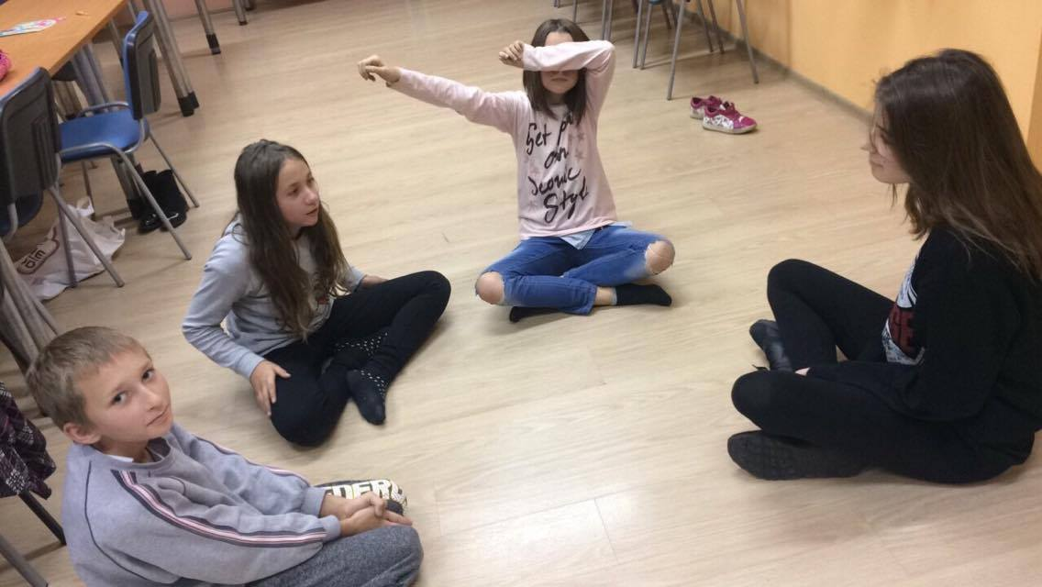
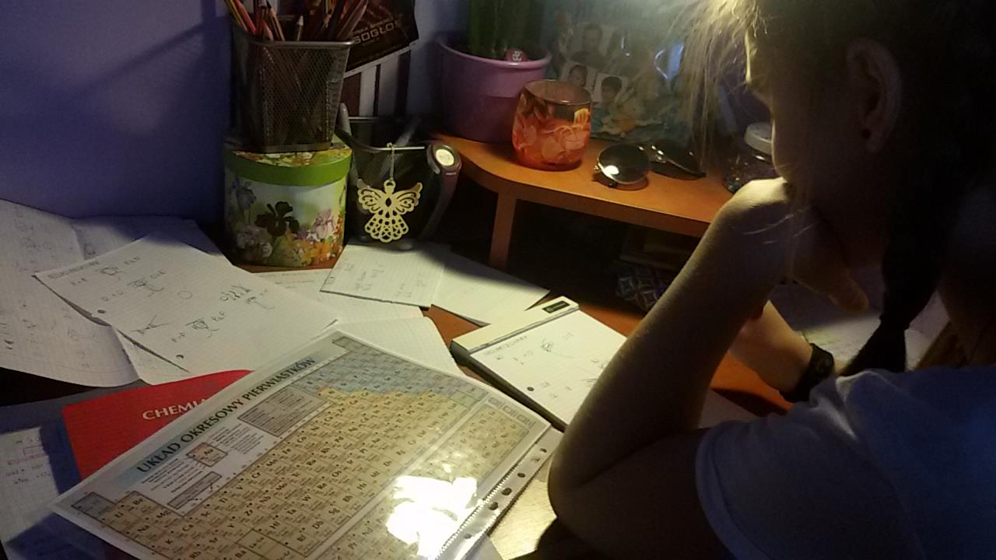
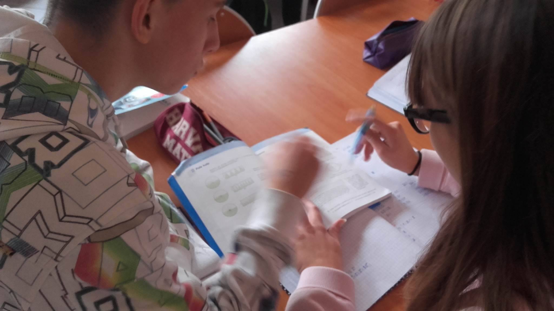
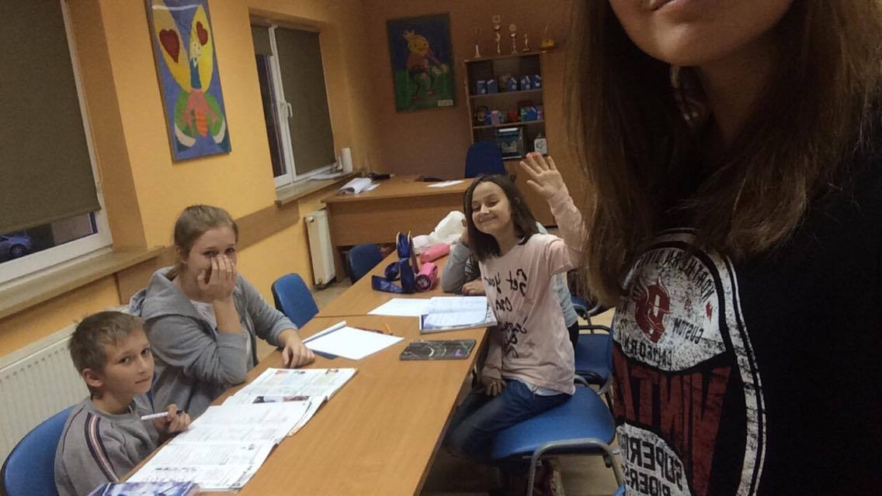
Actions
Helping other students with learning

Slide 16
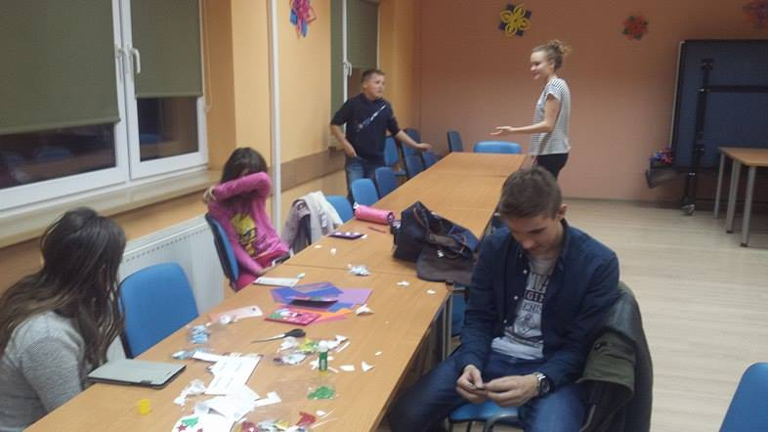

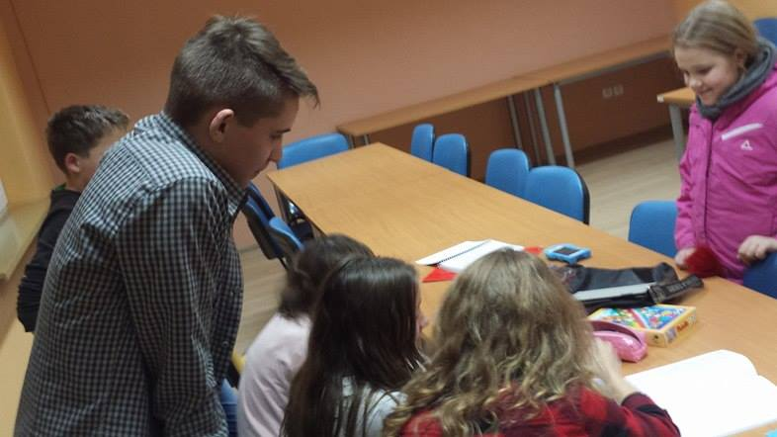

Actions
Helping younger kids with homework in the local Help Centre

Slide 17

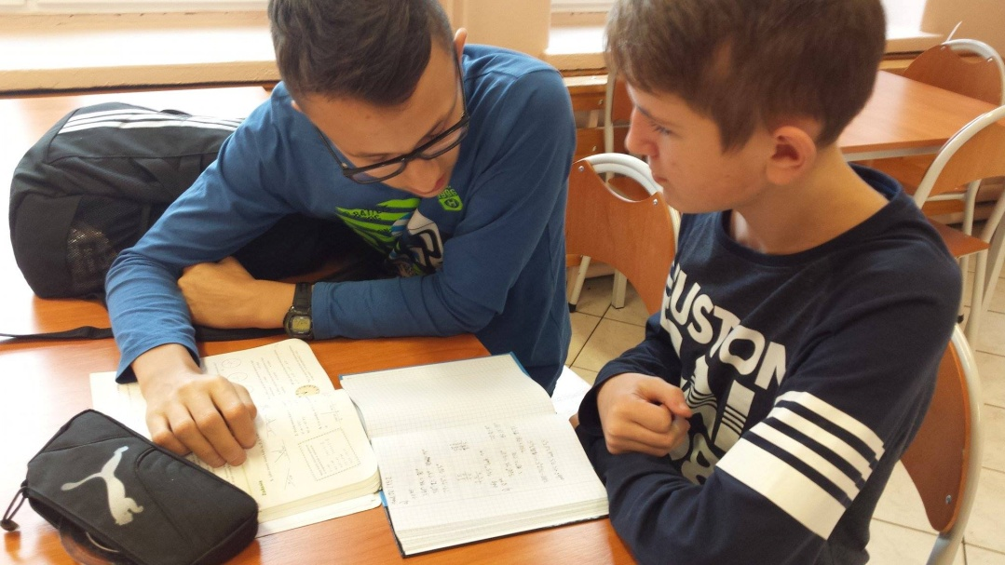
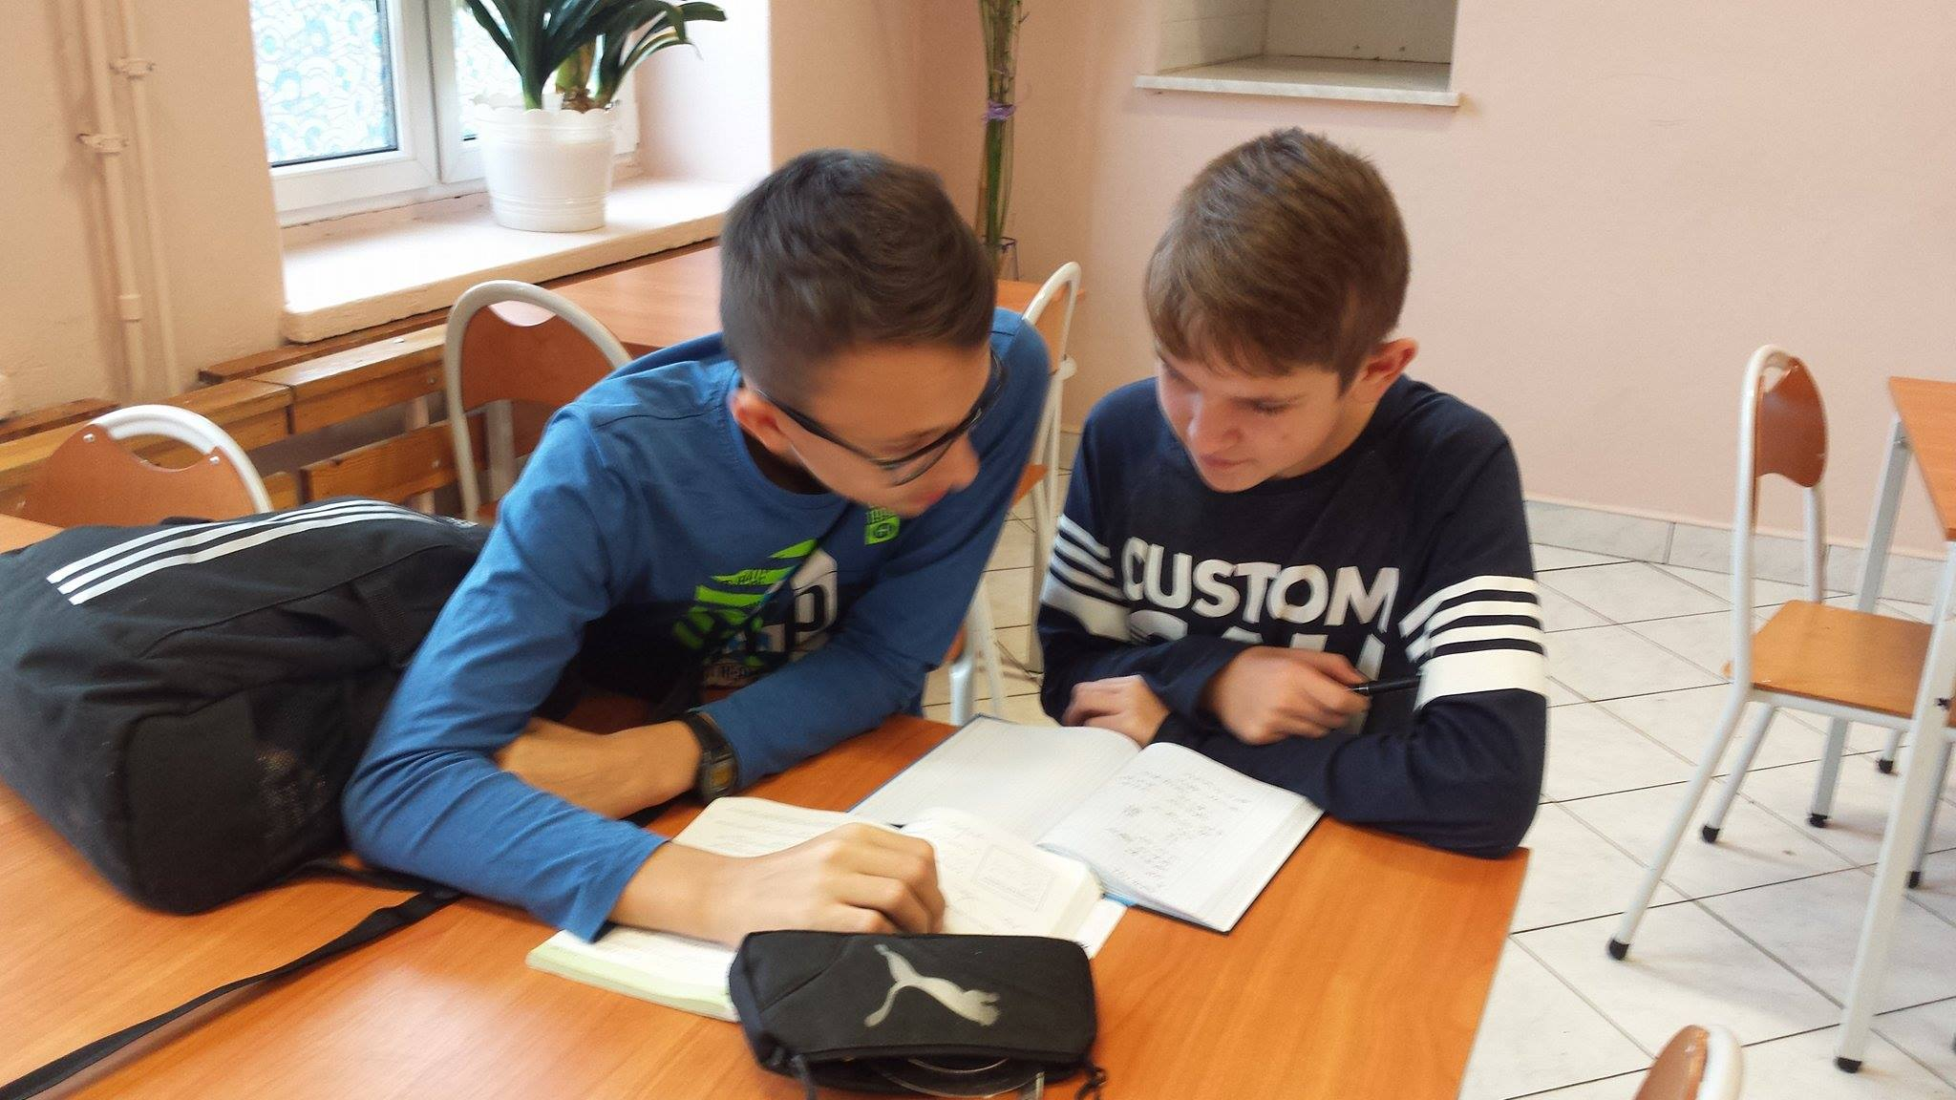


Actions
Peer – education at school
Notes:
17

Slide 18

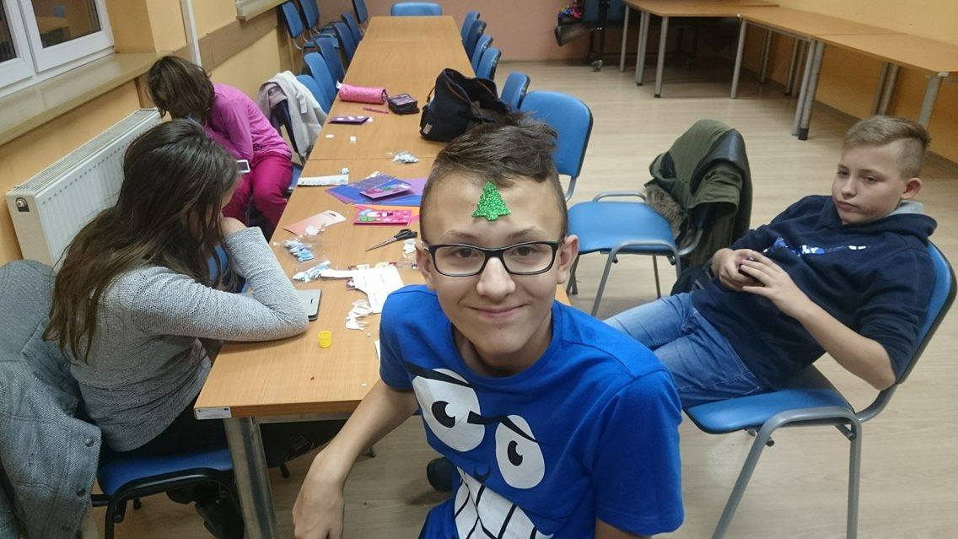
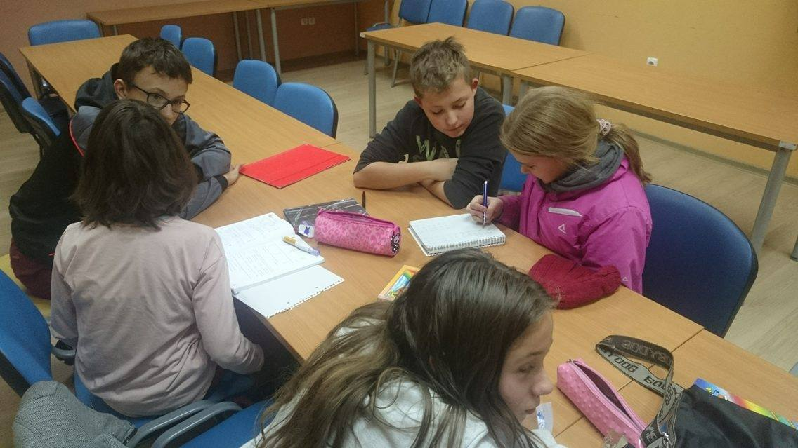

Actions

Slide 19

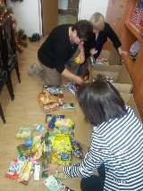


Actions
Presently we are collecting food for the poor

Slide 20
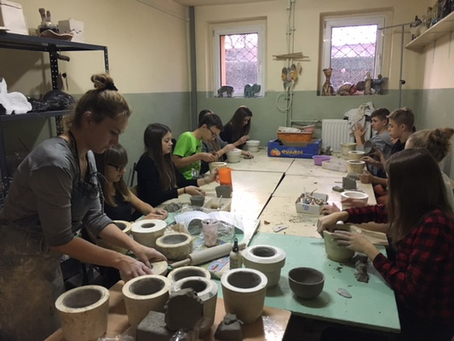


Ceramics Workshops
Making handcrafts for the market

Slide 21
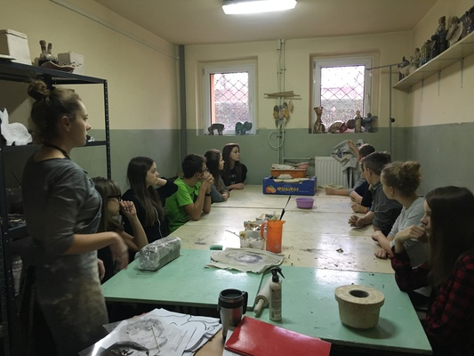
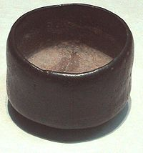
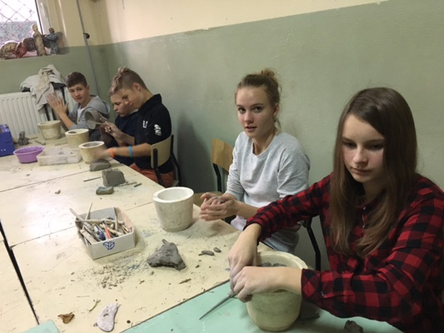
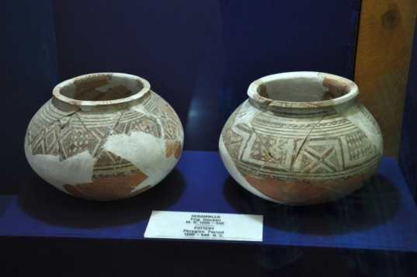
Ceramics Workshops

Slide 22

Our Planns
We want to visit the animals shelter
We will continue visiting children from the orphanage
We will continue helping students with schoolwork and homework

Slide 23
Thanks for watching ☺
REALIZATION:
JULIA CIEMIĘGA
AND
WERONIKA BOCHENEK
POLAND

