Slide 2
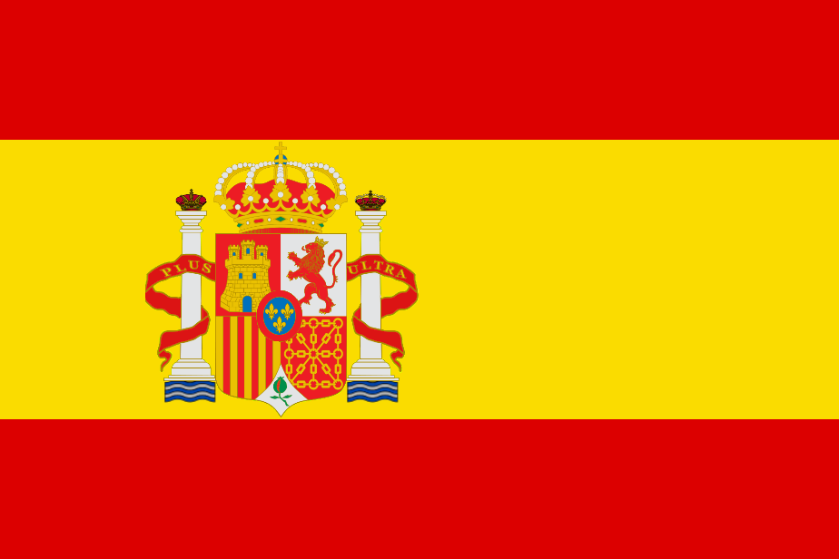
MEDITERRANEAN DIET & QUIXOTE CUISINE FROM LA MANCHA
Eating habits of Spaniards:
Our healthy nutrition proposal

Slide 3
Mediterranean diet
A heart-healthy eating plan
Flavorful olive oil
Red wine
Eating primarily plant-based foods: fruits and vegetables, whole grains, legumes and nuts
Replacing butter with healthy fats such as olive oil and canola oil
Using herbs and spices instead of salt to flavor foods
Limiting red meat to no more than a few times a month
Eating fish and poultry at least twice a week
Enjoying meals with family and friends
Drinking red wine in moderation (optional)
Getting plenty of exercise
The heart-healthy Mediterranean diet is a healthy eating plan based on typical foods and recipes of Mediterranean-style cooking
The Mediterranean diet emphasizes:

Slide 4
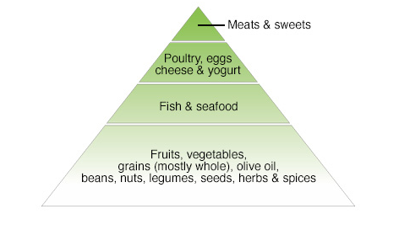

Slide 5
4 Benefits of the traditional Mediterranean diet
Reduces the risk of heart disease
The diet has been associated with a lower level of oxidized low-density lipoprotein (LDL) cholesterol ("bad" cholesterol) that's more likely to build up deposits in your arteries
Reduced incidence of cancer, and Parkinson's and Alzheimer's diseases
Women who eat a Mediterranean diet supplemented with extra-virgin olive oil and mixed nuts may have a reduced risk of breast cancer.

Slide 6
Specific steps to switch to Mediterranean diet
Eat your veggies and fruits — and switch to whole grains bread and cereal, and begin to eat more whole-gain rice and pasta products.
Go nuts. Keep almonds, cashews, pistachios and walnuts on hand for a quick snack.
Pass on the butter. Try olive or canola oil as a healthy replacement for butter or margarine.
Spice it up. Season your meals with herbs and spices rather than salt.
Go fish. Eat fish once or twice a week.
Rein in the red meat. Substitute fish and poultry for red meat.
Choose low-fat dairy. Switch to skim milk, fat-free yogurt and low-fat cheese.
Raise a glass of wine to healthy eating

Slide 7
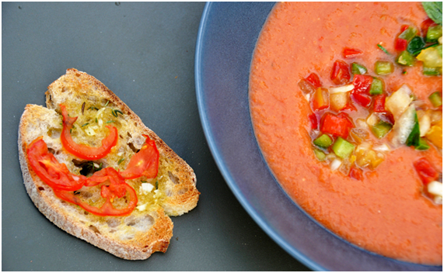
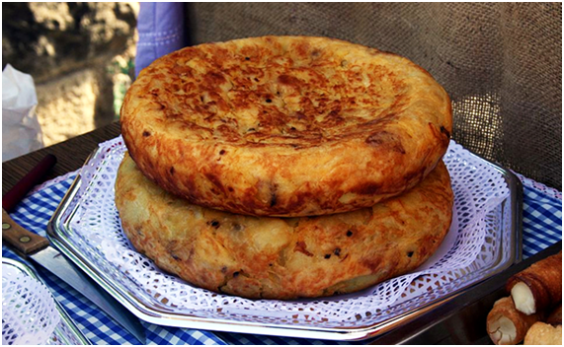
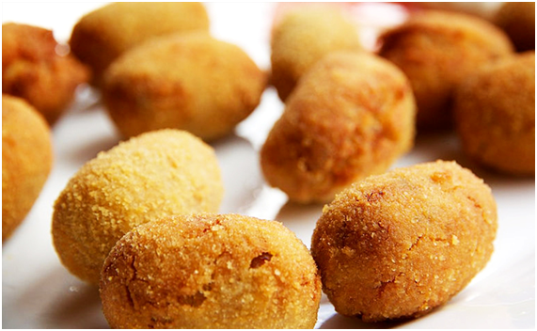
Some examples of Mediterranean dishes:
Top Spanish foods you have to try
Tortilla Espanola or Spanish omlette.It's a great starter (or meal) for breakfast, lunch and dinner. The best ones come from slow-cooking caramalised onion and potato in olive oil, which later creates a soft-sweet centre once egg is added and it is cooked into a thick omelette, almost like a cake. A tasty Spanish snack you'll see around is a wedge of omelette squeezed between bread to make a bocadillo (sandwich)
Gazpacho or salmorejo
Refreshing Spanish gazpacho is made with full-flavoured Spanish tomatoes. Usually eaten as an appetizer – and sometimes drunken straight from a bowl or glass – this thick soup is made from blending a whole heap of fresh tomatoes, green peppers, cucumbers, garlic, onions, vinegar and herbs.
Croquettes: Combining ingredients such as jamon (cured ham) or bacalao (Atlantic cod fish) with béchamel sauce, which is then breaded and fried, or try the croquettes of local sweet-spiced black sausage (morcilla) or Spanish blue cheese (queso de Cabrales)

Slide 8
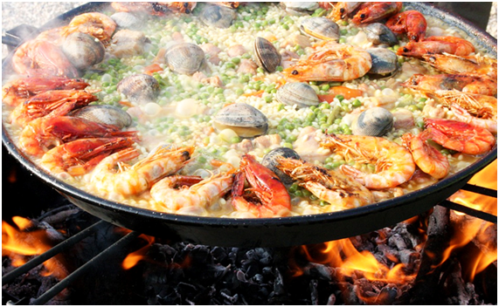
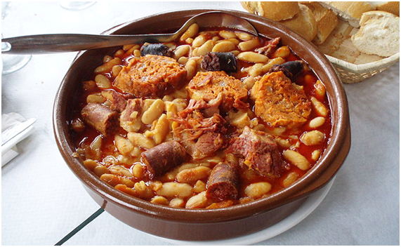
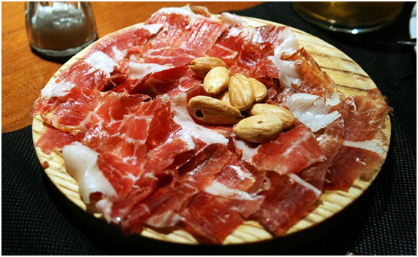
Spain's famous bean stews – and salads
Around Spain you can find many regional bean stews known as fabada, which involve cooking the beans slowly with a mixture of meats – such as chorizo pancetta, black sausage and so on – depending on the region, commonly eaten in winter.
A twist on this is Madrid's cocido, which adds vegetables and cabbage to a tasty mix of sausages and chic peas (garbanzos).
Salads; just drizzle on olive oil, lemon, vinegar and salt to taste, alongside a hearty helping of diced garlic, tomato, onion and green and red peppers.
Cured meats – jamon, chorizo, salchichón
Cured legs of pork.
Chorizo: a cured sausage with sweet and spicy flavours, identified by its red smoked-pepper colouring.
Salchichón.
Paella
Rice-based dish. Some consider this a national dish of Spain, but many consider it a Valencia dish.The most traditional Valencian paella is a mixture of chicken or rabbit (or both), white and green beans and other vegetables, but seafood is also common, where you can find an array of seafood suprises among the flavoursome rice, such as calamari, mussels, clams, prawns, scampi or fish

Slide 9
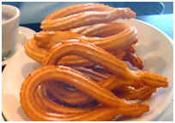
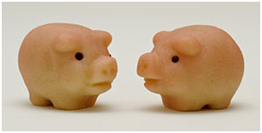
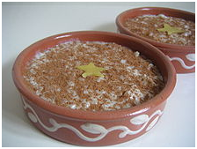
Yummy desserts
Torrijas
Spanish dessert is torrijas, a mix between french toast and bread pudding, where large slices of bread are soaked in milk and sugar, and then lightly fried in a pan and topped with sugar and cinnamon or honey
Churros
Serve with a thick Spanish hot chocolate. Churros consist on a thin long donut-type pastry that you can dip in your hot drink; the thicker, less-sweet version, porras, go great with coffe
Turrón
If you visit at Christmas time, the must-eat sweet is turrón, a Spanish-style almond nougat.
Marzipan is a confection consisting primarily of sugar or honey and almond meal (ground almonds), sometimes augmented with almond oil or extract. It is often made into sweets; common uses are chocolate-covered marzipan and small marzipan imitations of fruits and vegetables.Christmas cakes
Rice pudding is a dish made from rice mixed with water or milk and other ingredients such as cinnamon and raisins

Slide 10
Quixote cuisine from La Mancha
Refers to the typical dishes and ingredients in the cuisine of Castilla–La Mancha region of Spain.
These include pisto (a vegetable stew with tomato sauce), gazpacho manchego, Manchego (a type of cheese), the white wine of La Mancha, and the red wine
The dishes and specialties of the region are generally sober and sensible, reflecting a modest, rural origin. They contain a limited number of ingredients, those most easily accessible by the locals.
Dishes tend to be high in calories, ideal for the diets of laborers, farmers, and shepherds.
The cuisine of this area was popularized by Cervantes in his Don Quixote de la Mancha, where a number of traditional dishes are mentioned.
Entrées:

Slide 11
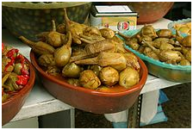
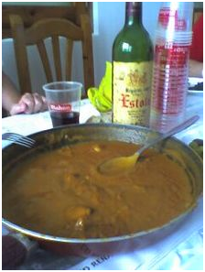
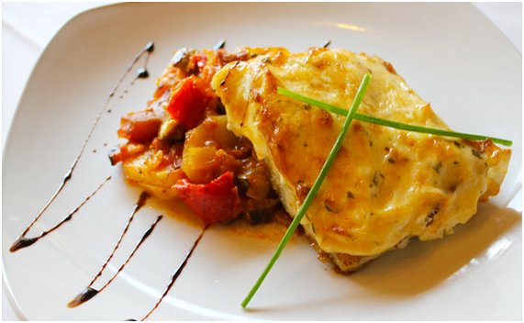
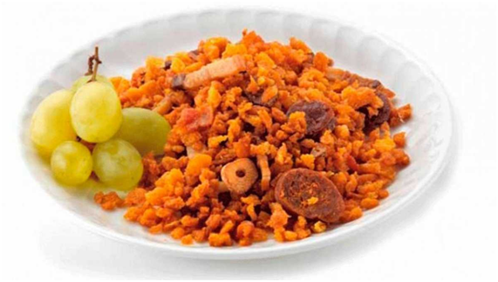
Staples. Local traditional staples in La Mancha were gachas de almorta, made with grass pea (Lathirus sativus) flour, and flat bread that is the base for the "gazpachos", an elaborate dish appearing in El Quixote under the name of "galianos". Nowadays bread is much more widespread.
Pisto. Spanish ratatouille
Vegetarian top Spanish dish, eaten in Spain as a tapa, appetiser, a side dish to meats, or even as a meal with a fried egg on top or chorizo. It's a Spanish ratatouille of tomatoes, peppers, zucchini, onions, garlic, and of course, olive oil.
There are not many purely vegetarian dishes in the region. The berenjenas de Almagro are a variety of small aubergines that are grown in Almagro, Ciudad Real. These are seasoned and pickled according to a traditional recipe and usually eaten as a snack or side dish. A common ingredient found in almost all local dishes is garlic.
Manchego migas: Migas is a traditional dish in Spanish cuisine. Migas includes chorizo and bacon, and is often served with grapes.

Slide 12
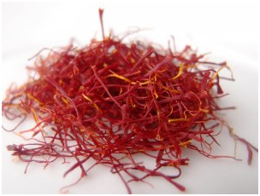
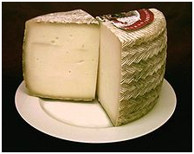
Manchego cheese
Queso manchego, or "cheese from La Mancha", is the best-known cheese from the area. Made from the milk of local sheep found in the pastures year-round. The cheese is hard, with a strong taste, mild bite, and greasy texture.
Saffron
Crocus sativus is the botanical name of a crocus that originally came from Asia Minor, where it has been cultivated since ancient times. The Moors brought with them the spice az-zafaran during their invasion of Spain over a thousand years ago, Today over 70% of the world's production is grown on the high Castilian plateau known as La Mancha.
Saffron is a deeply rooted condiment, both economically and culturally, in Castile-La Mancha. It should not be considered just another agricultural product, rather part of the historic and cultural patrimony of the region that must be protected and preserved.
...and ever- present local wine

Slide 13
Do it yourself!
Churros Recipe
Ingredients
1 large cup of white flour
1 large cup of water
1 teaspoon of oil
pinch of salt
olive oil
sugar
Directions
In a saucepan, heat up the water, salt, and a spoonful of olive oil. When it comes to a boil, add the flour and stir rapidly until it forms a smooth, thick mixture. Wait a few minutes for it to cool and then place the mixture in the donut maker. Shape the dough and fry them in ample hot oil until they turn golden. Now and while hot, sprinkle them with sugar, cinnamon, or just dunk them in thick hot chocolate. Enjoy!

Slide 14
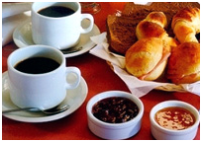
Eating Habits of The Spaniards
Spanish Eating Customs: Meals
A normal day's breakfast- or desayuno- typically consists merely of a cup of coffee, although it's also commonplace to accompany your steaming café con leche with a croissant or other pastry.
Spaniards eat their lunch, or comida, between 2:00 and 4:00 in the afternoon. Serving as the day's main meal, it is traditionally quite a bit larger than the dinner meal, or cena. A typical lunch will have several courses. The first course is the lighter part of the meal, usually consisting of a salad or soup, while the second course is normally your typical fish or meat dish. A dessert can be a simple piece of fruit, a typical Spanish flan, or a sweet pastry or cake.
The Spanish dinner (cena) is traditionally much smaller than the midday comida. It often consisting of something lighter like a salad, a sandwich, or a selection of tapas. Spaniards eat late for this final meal of the day- even more so on weekends and during the summer- sitting down to eat anytime from 9:00 until 11:00 in the evening.

Slide 15
SOME CURIOUS FACTS
Bread
A piece of bread is the third cutlery utensil after the knife and fork in Spain. Spaniards will eat bread with anything and everything, including heavy carbohydrate dishes like pasta and rice, even with dessert on some occasions. Spaniards just don't eat without bread.
Water / Agua del Tiempo / Mixing water
The Spanish do not eat without water. Juice, orange squash, coke, beer etc, are aperitifs in Spain - they don't appear at the dinner table.The most you will find beyond water is a bottle of wine, but almost certainly not beer. Water is always still, and mostly from the tap too, but it is always, always served. When you order water at a bar in Spain, you'll be asked "Fria" (cold) or "Del tiempo" (literally 'of the weather', actually meaning 'ambient temperature'). Many Spaniards don't like their water too cold, so don't want it straight out of the fridge.
Sobremesa
The sobremesa (the period after eating where you stay at the table for an extended chat) is sacred. When Spaniards finish eating, they don’t like to get up and carry on with their day, they need at least 15 minutes of rest.
Tapas
A tradition begun long ago in the southern city of Seville, Spaniards have since perfected the art of snacking. Going out for tapas consists of travelling from bar to bar and sharing plates of the bars' specialties with a small group of friends.

Slide 16
History of Spanish Food
Spanish food is often recognised as one of the top cuisines in the world, and some traditional Spanish dishes and recipes date hundreds of years.
The succession of cultures that one-by-one set foot on the Iberian peninsula have each left a lasting mark on every facet of Spain's culture: language, music, art, architecture and, of course, food. In fact, many people are surprised to learn just how much of a delicious melting pot Spain really is.
Geography of Spanish Food
The basis of the history of Spanish food of course has to do with its geographical situation. First of all, the country is located on the Iberian peninsula and is therefore almost entirely surrounded by the waters. Naturally, due to this fortunate location, seafood forms one of the pillars of Spain's gastronomy and categorizes the country as having a Mediterranean diet. The rest of Spain is a diverse terrain made up of mountain ranges, lush pastures, fertile farm grounds, extensive coastlines and more, which together provide quite the variety of fresh products. For example, Spain's famous hams are cured high in the mountains, vineyards and olive groves sprawl across expanses of land, and fresh fruits and vegetables hail from throughout the country.

Slide 17
Cultures Throughout the History of Spanish Food
Endless cultures, as they passed through or settled in Spain, have influenced the history of Spanish food. The Phoenicians left their sauces, the Greeks introduced Spain to the wonders of olive oil, and Romans, Carthaginians, and Jews integrated elements of their own cooking into that of Spain. However it was the Moors who, during their centuries of reign, most impacted Spanish gastronomy. They introduced fruits and light seasonings into the Iberian diet, as well as combinations of fruits and nuts with meats and fish. Rice- a genuine staple of Spanish gastronomy- and therefore Spain's vast array of rice dishes, come straight from the Moors, as does the use of saffron, cinnamon, and nutmeg. As you eat gazpacho on a hot summer day, thank this clearly gastronomically talented Moorish culture, as it too comes straight from them. Conclusion? Ironically enough, the foods we consider to be "typically Spanish" would either not exist or would be extremely different without the intervention of so many cultures into the history of Spanish food.
The Americas' Impact on the History of Spanish Food
Along with its obvious historical impact, the discovery of the Americas with Christopher Columbus' famous 1492 voyage resulted in the addition of more important elements to the history of Spanish food. As of 1520, foods from the new lands arrived in Spain and immediately began to integrate themselves into the Spanish diet. Amongst the many products that crossed the Atlantic and arrived on Spanish turf, tomatoes, vanilla, chocolate, various beans, and potatoes - which surprisingly arrived in Spain before arriving in Ireland- are all staples of today's Spanish kitchen.

