Slide 2
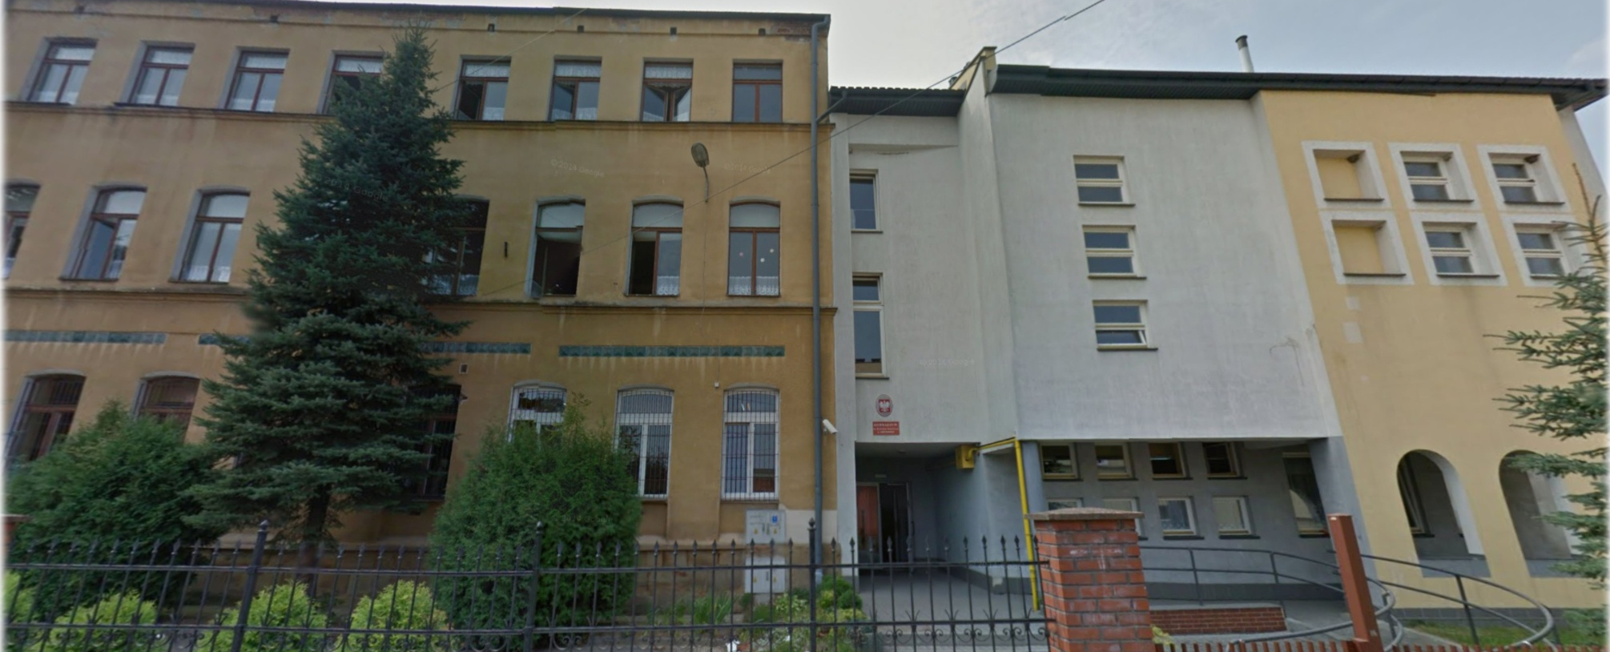
Welcome in our school

Slide 3
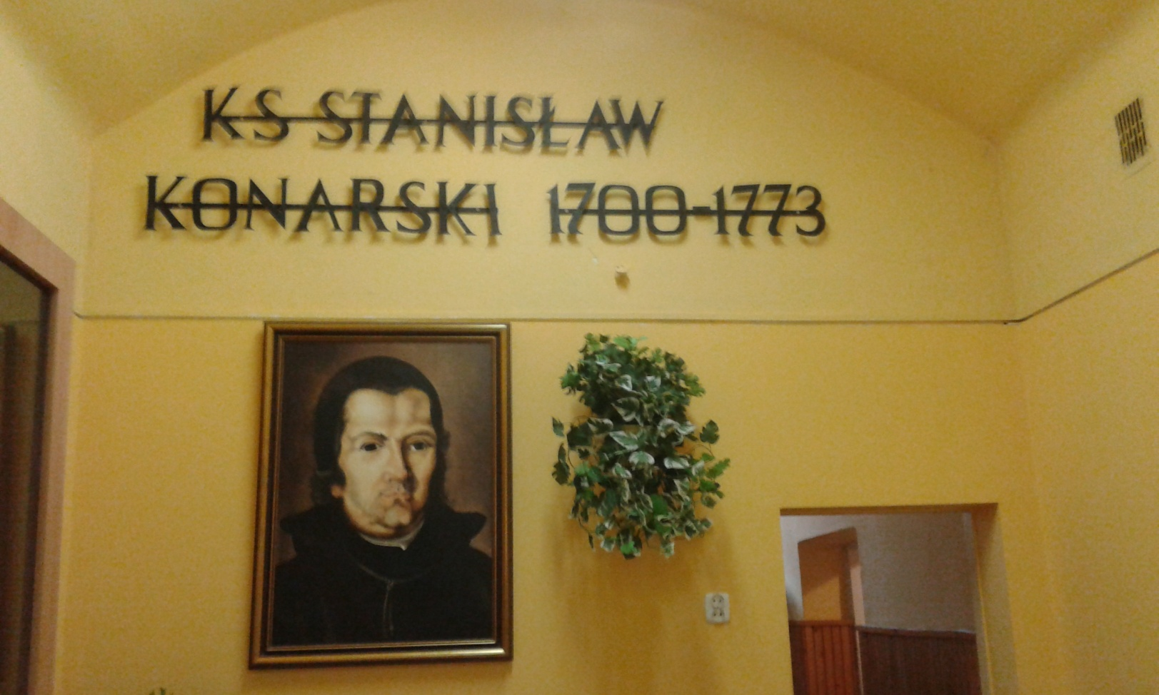
Patron of our school – priest Stanislaw Konarski
founder of the Collegium Nobilium
and great mecenas of education in Poland

Slide 4
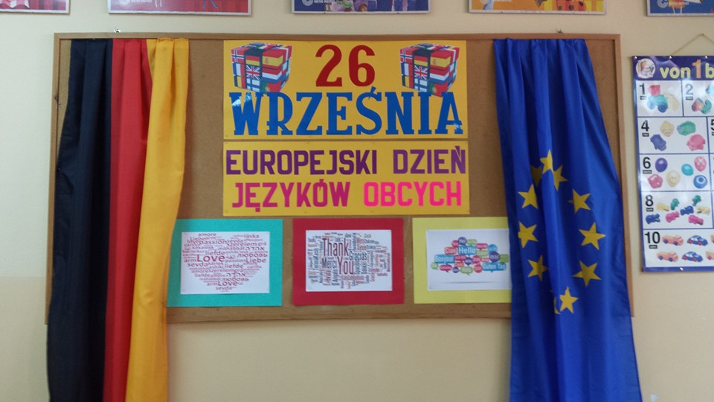
Pin board promoting foreign languages in German classroom

Slide 5
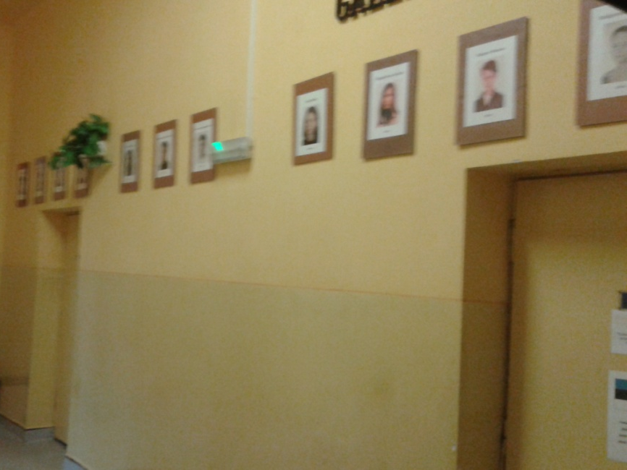
Last year project - Comenius
Gallery of best students of the year
Photos of different instrument types
in music classrom

Slide 6
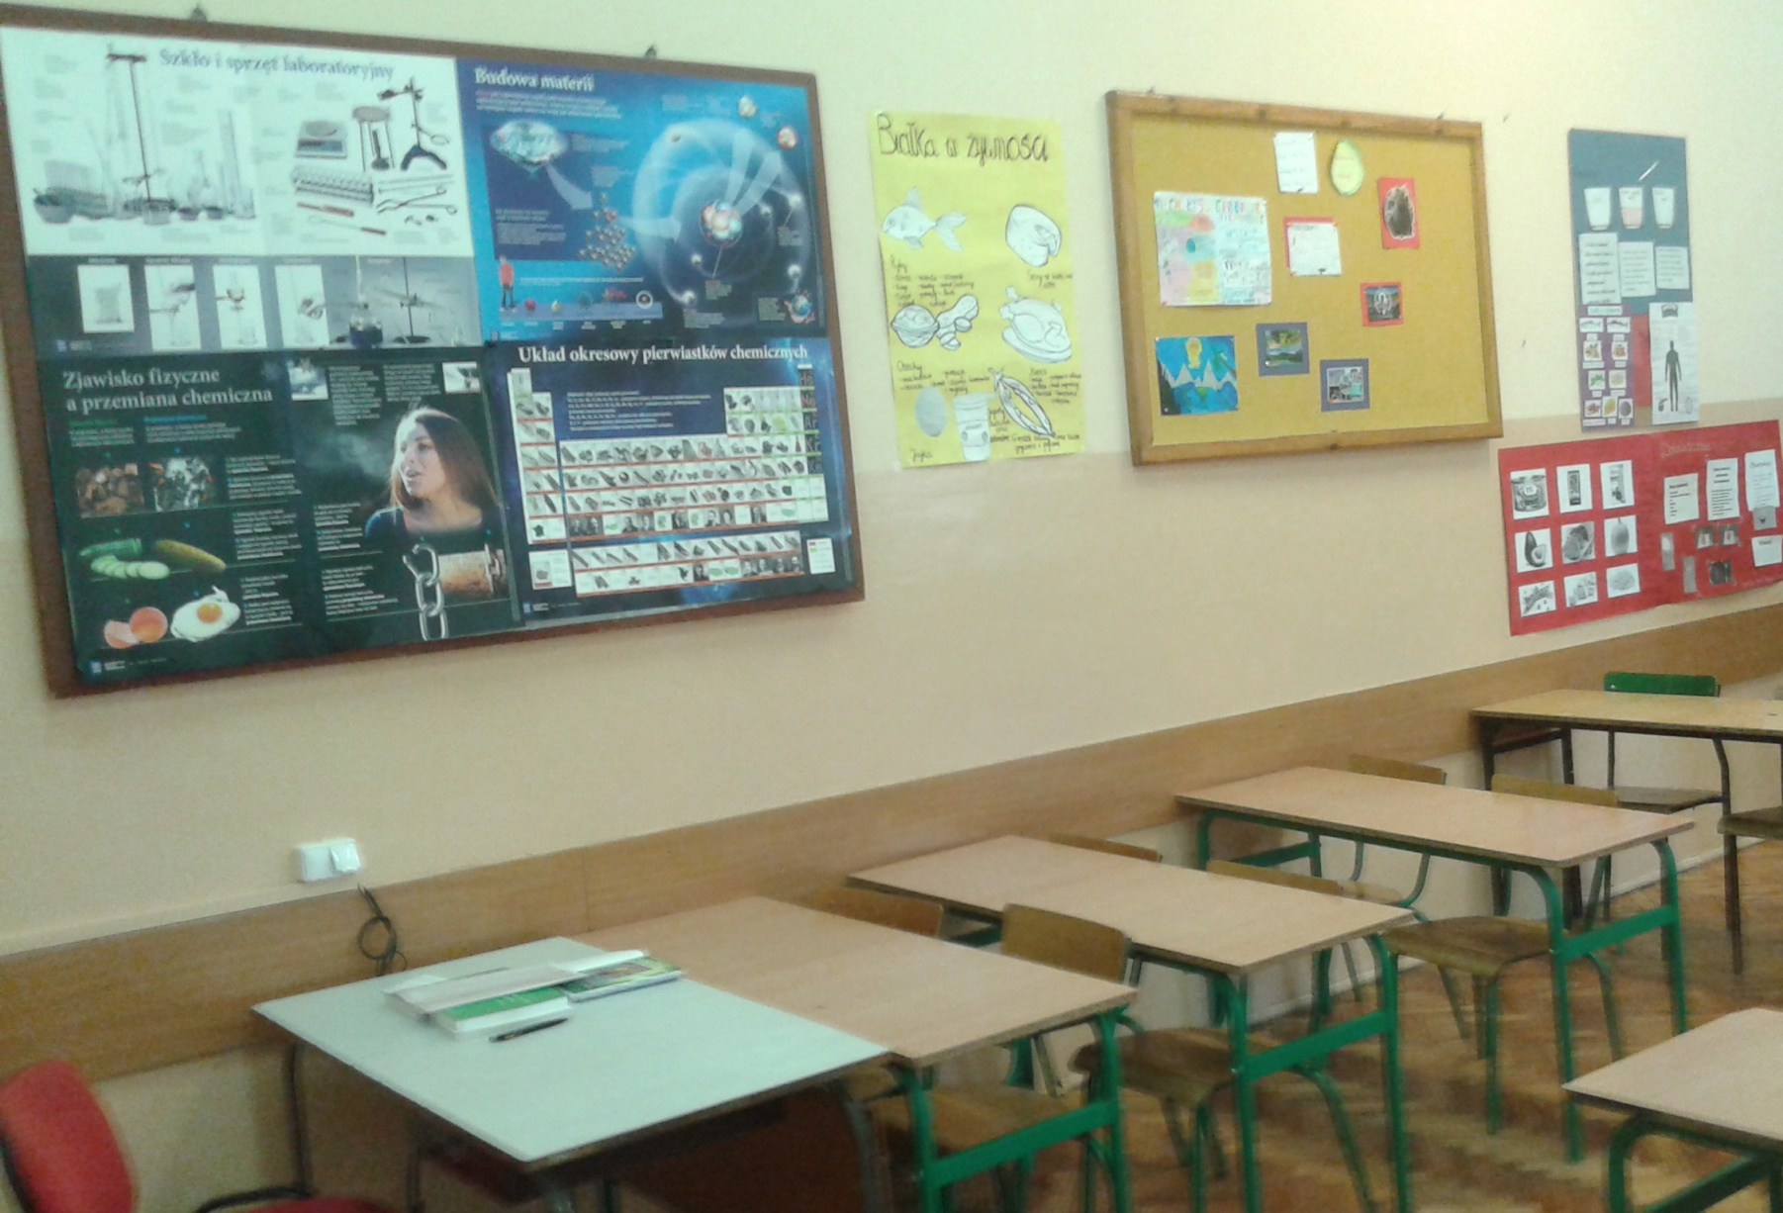
Pin boards promoting Biology and Chemistry

Slide 7
By
Kacper Obrzut

