Slide 1

Erasmus+ with Mathmatics Through life 2016-2018
Zağnospaşa Secondary School Balıkesir
TURKEY
My school

Slide 2
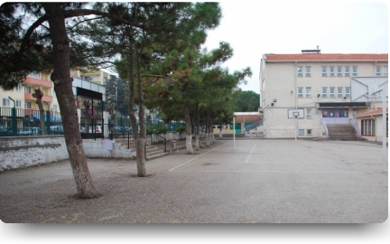
OUR SCHOOL
OUR SCHOOL

Slide 3
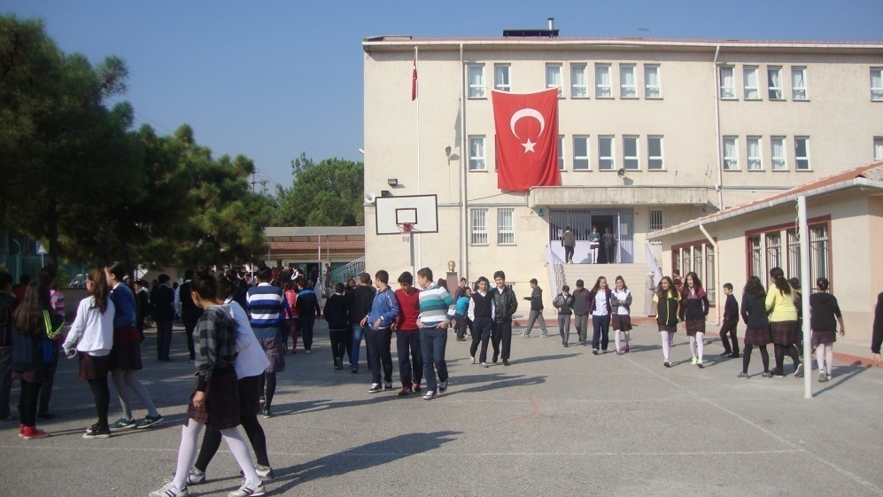
SCHOOL GARDEN
SCHOOL GARDEN

Slide 4
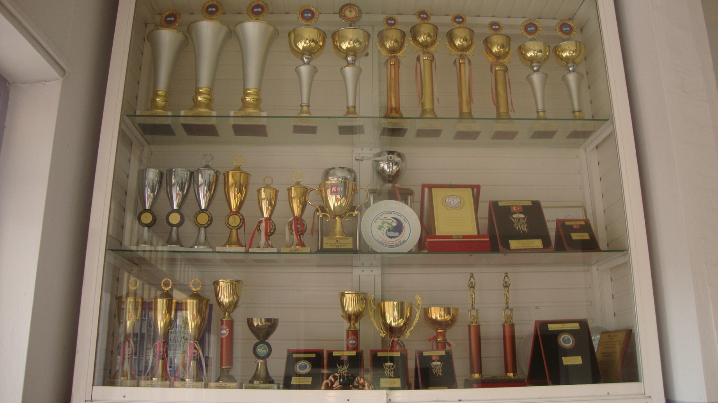
OUR AWARDS

Slide 5
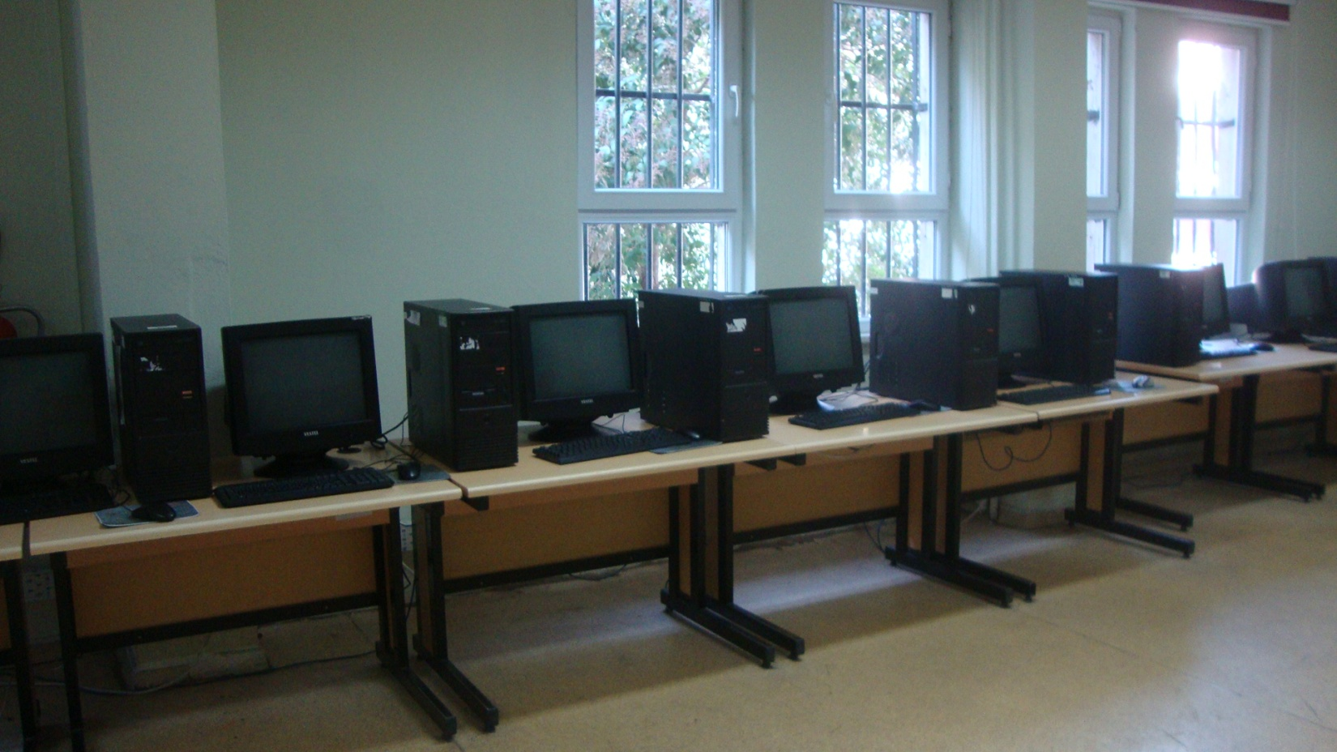
COMPUTER LABORATORY

Slide 6
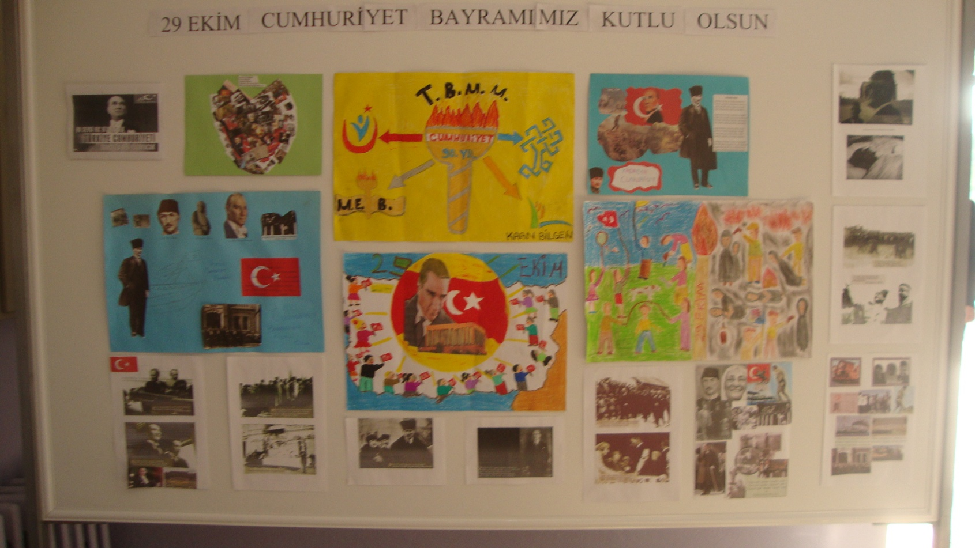
Republic day documents

Slide 7
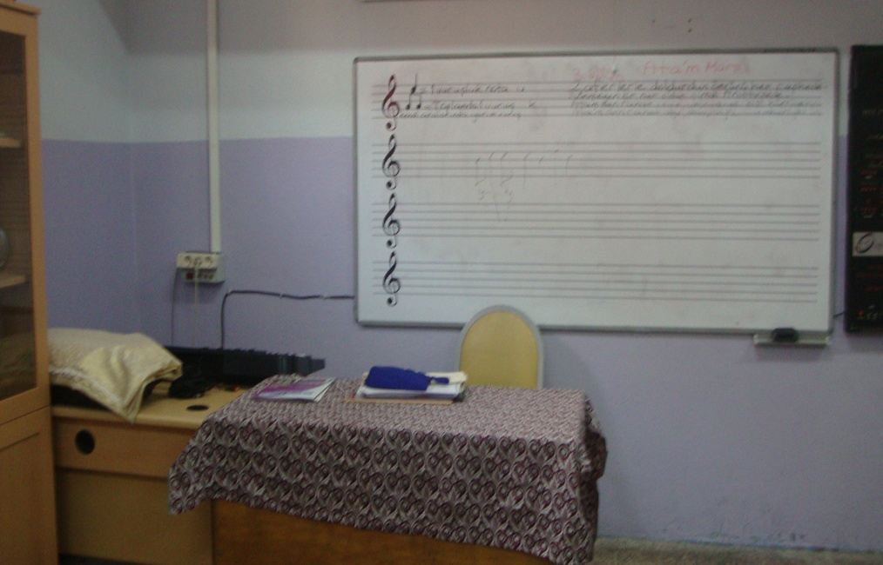
MUSIC CLASSROOM

Slide 8
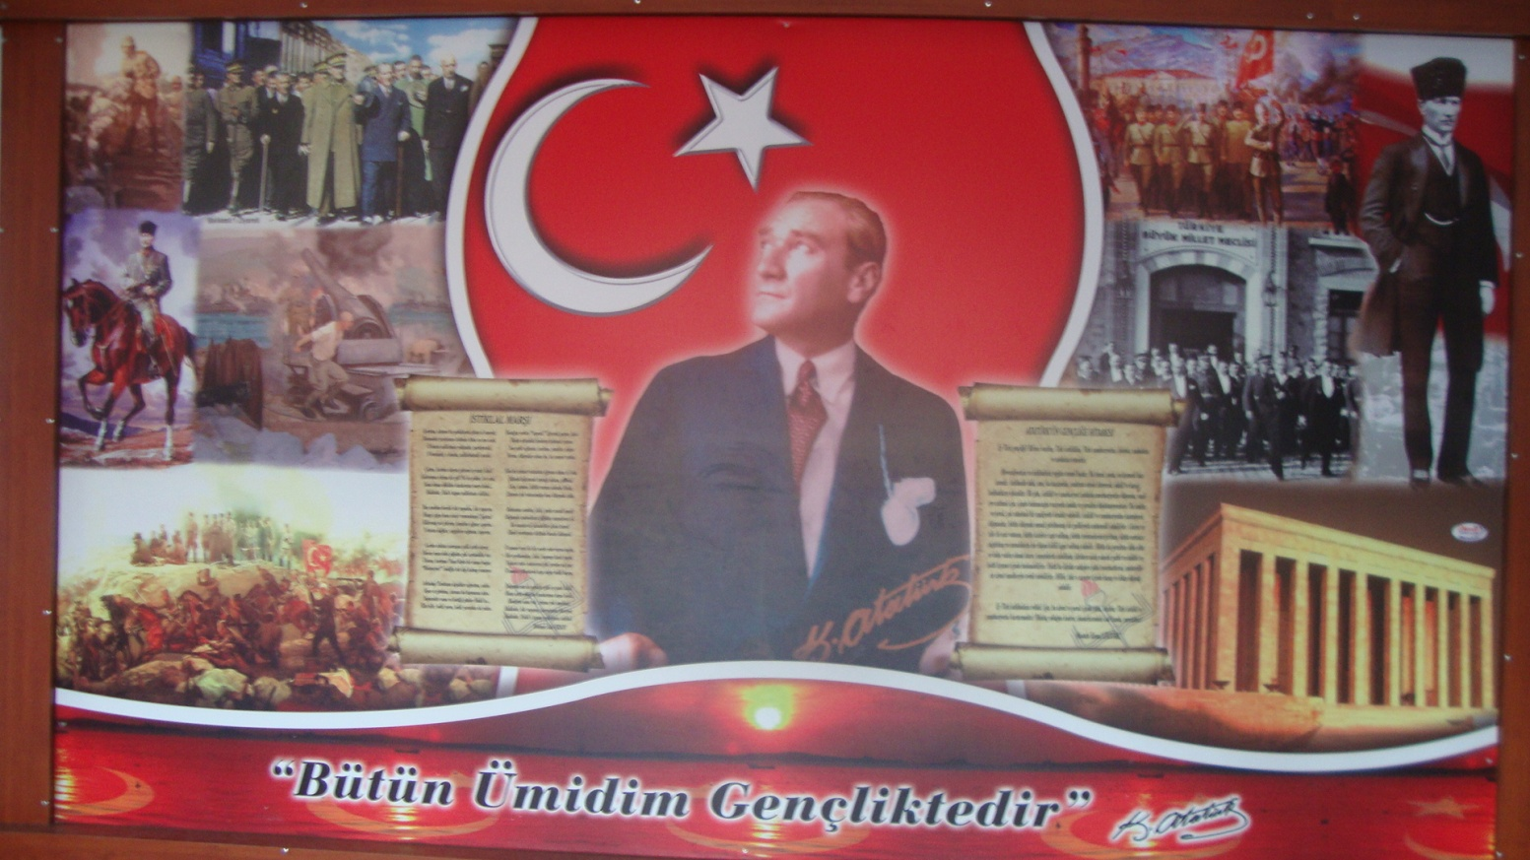
Mustafa kemal Atatürk
Founder of Turkey

