Slide 1
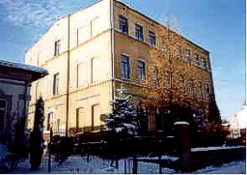

Slide 2
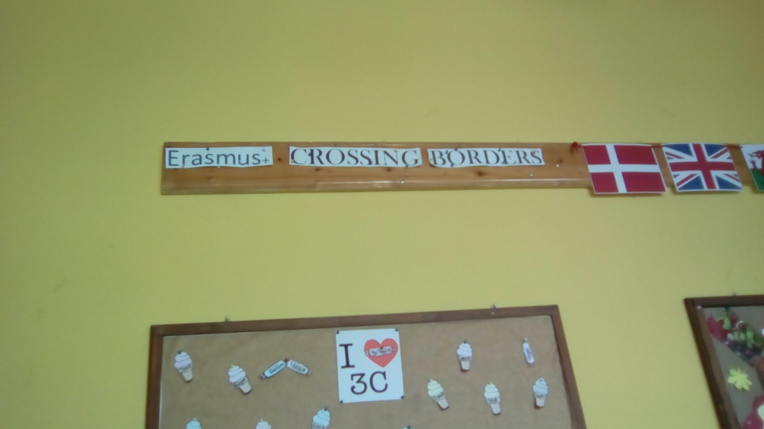
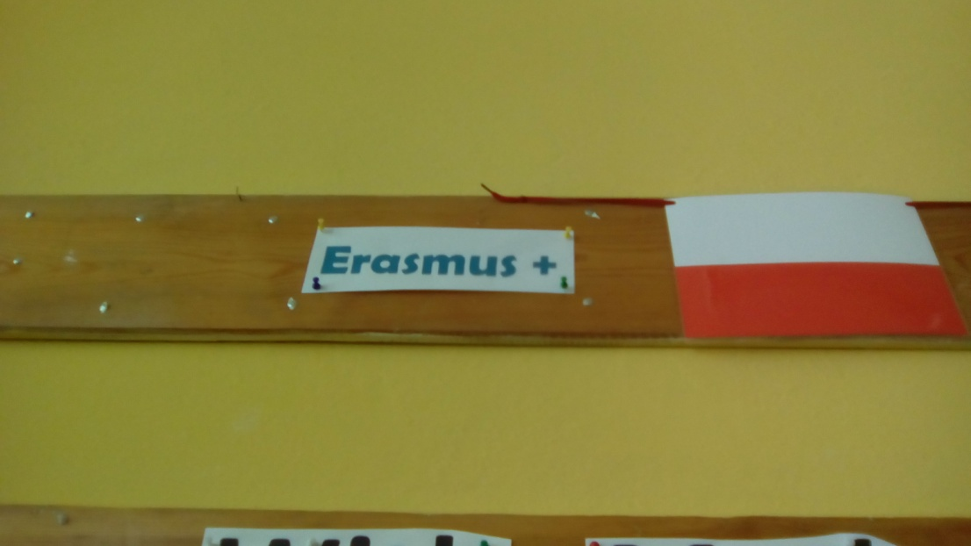
My: English classroom

Slide 3
Gym

Slide 4
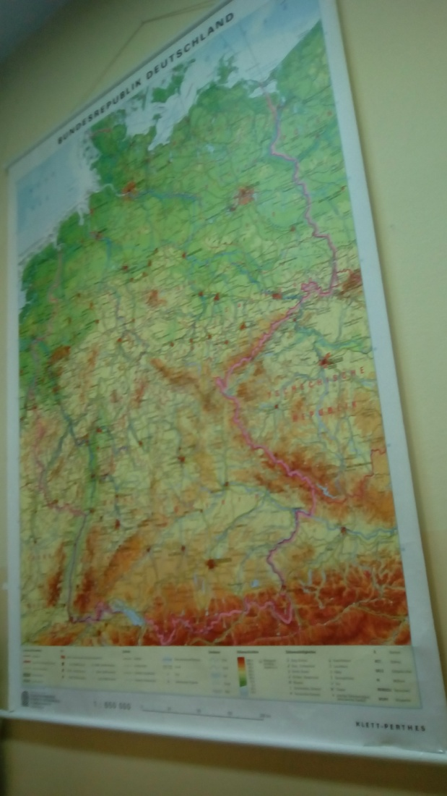
German classroom

Slide 5
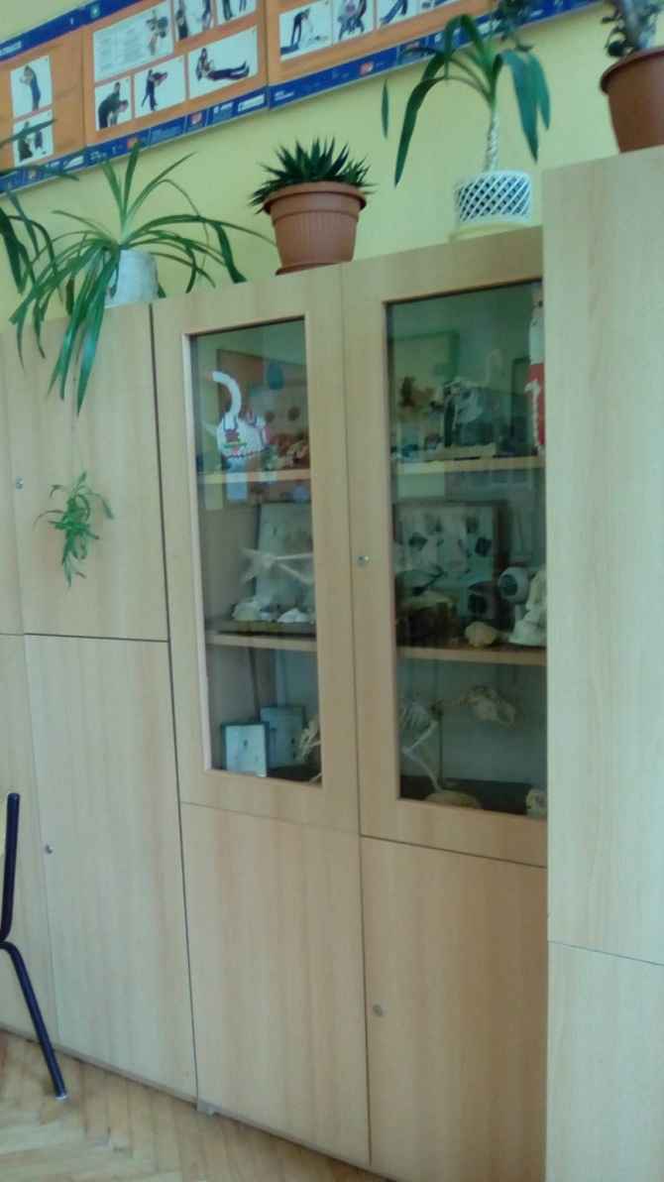
Chemistry classroom

Slide 6
Polish classroom

Slide 7
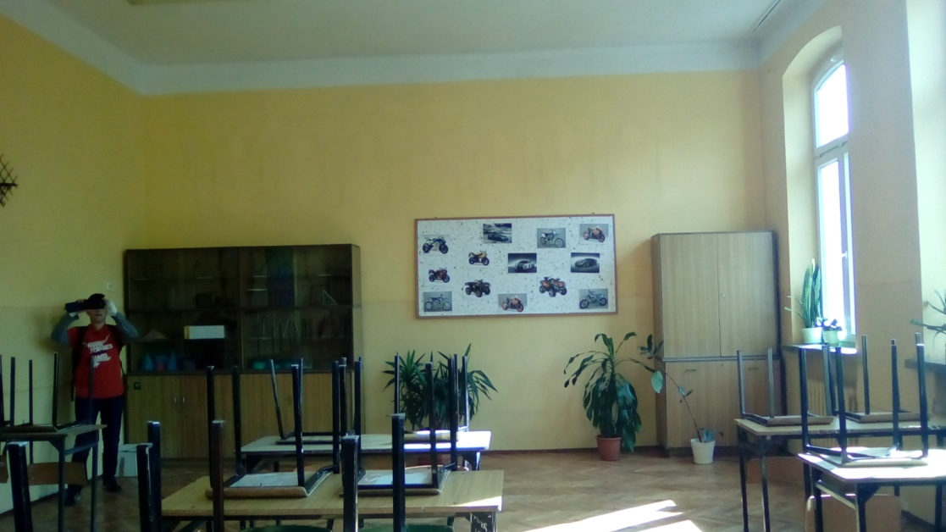
Maths classroom

Slide 8
Geography classroom

Slide 9
Corridor

Slide 10
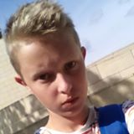
FINISH
I think our school is beautiful and our teachers are great
Jan Szczepanik kl Ib

