Slide 1
Middle School in Grybów
There is a secondary school in Grybów,
where students are treated really well. ;)

Slide 2
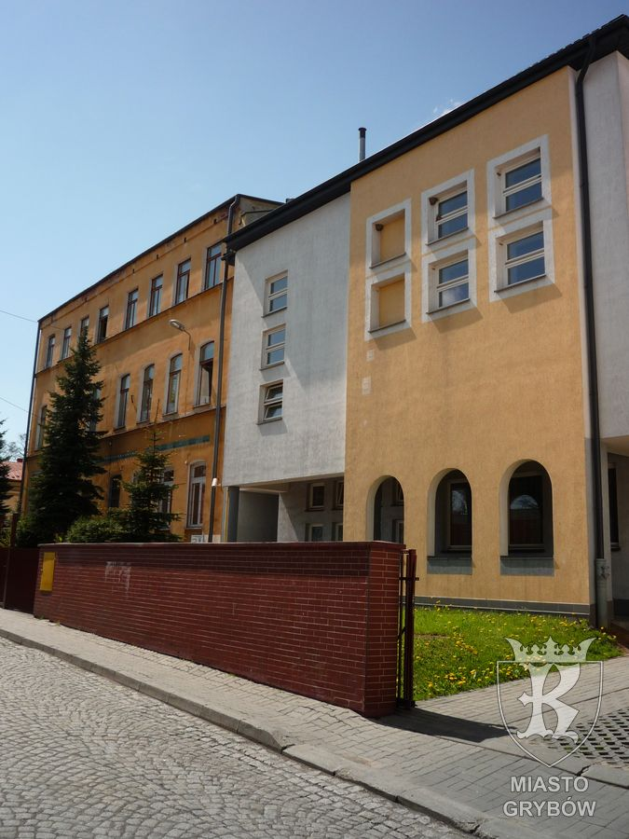
It looks like our school outdoor

Slide 3
SCHOOL PATRON
Patron of these school is Stanisław Konarski. He was poet, translator, editor, teacher and founder of the Collegium Nobilium.

Slide 4
ERASMUS+
It looks like a signboard for Erasmus+, is it looks nice? :)

Slide 5
PEOPLE IN MY CLASS
This is my class. Welcome to class 1A.
I really like my class, they are funny and cool people ;)

Slide 6
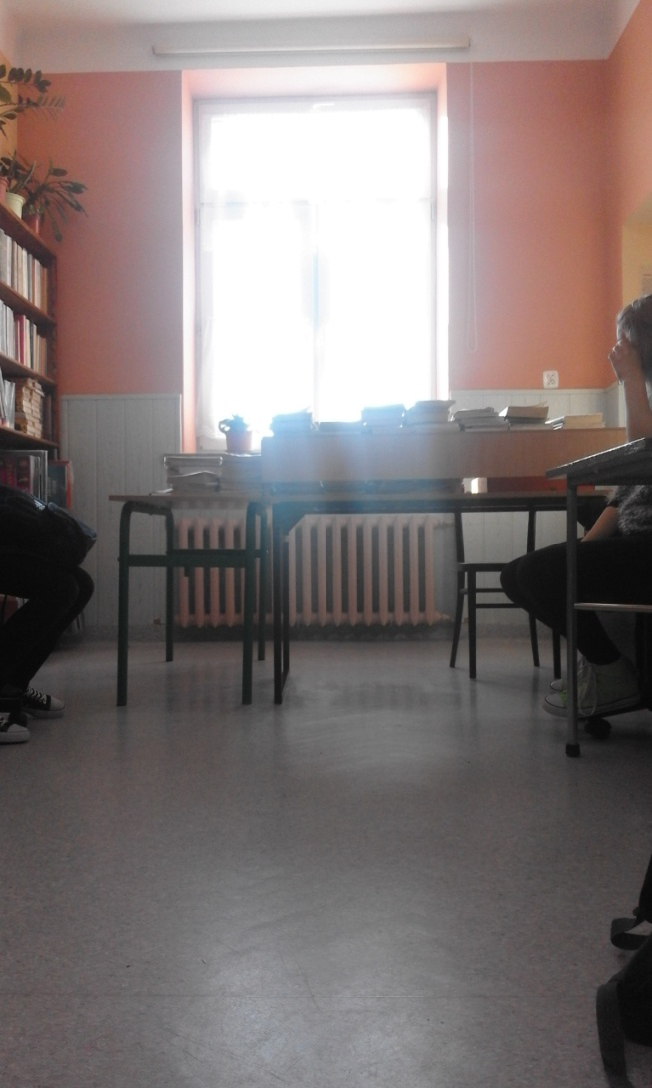
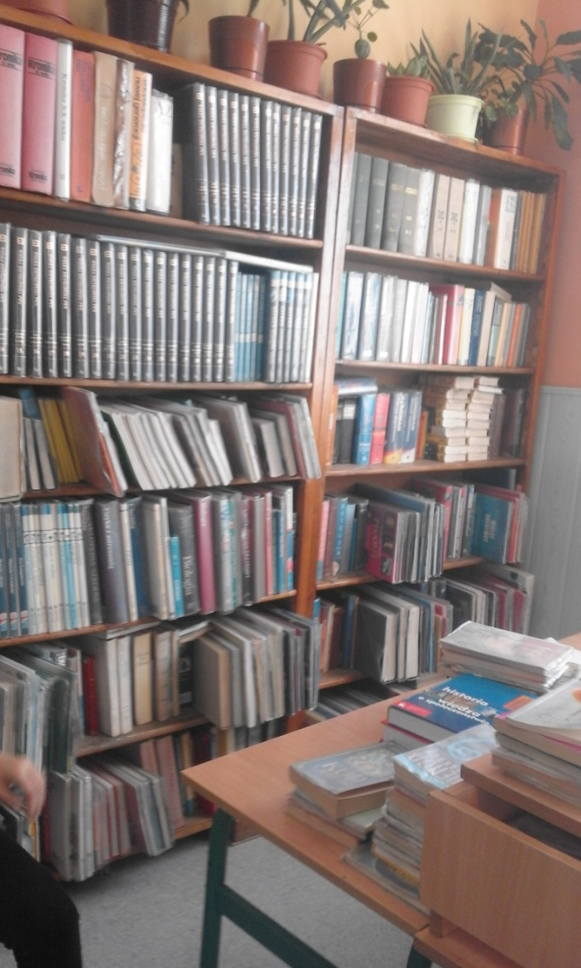
OUR LIBRARY
This is the place, where we can always find books and check our knowledge.

Slide 7
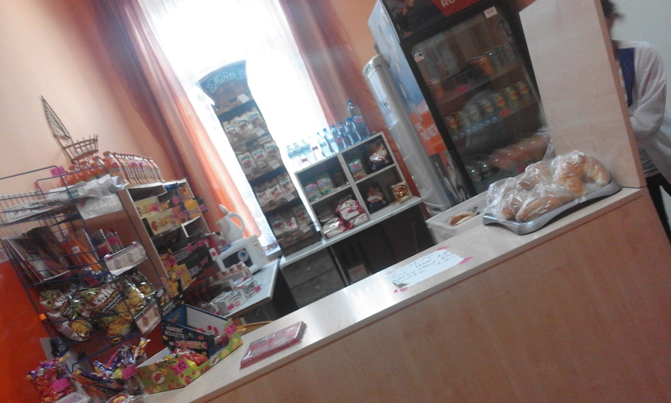
Shop in school
It looks like our shop in school. Here you can eat weel.
Here are the only delicious things ! ;)

Slide 8
OUR ARCHIEVEMENTS IN SPORT
Some girls in our school playing volleyball in school team ISKRY.
This girls are playing volleyball really great and they have archievements in Poland.
Trainer our school team is Mr Jerzy Udziela

Slide 9
GYM IN SCHOOL
It looks gym in our school. It is even large.
Here we are practicing our bodys and muscles :)
Teachers of Physical Education: Mrs Elżbieta Cygnarowicz,
Mr Marek Zagórski, Mr Jerzy Udziela

Slide 10
IT
Here we are studing about a computer.
Teacher of Informatics : Mr Tomasz Skrabski, Mr Marceli Stanisz

Slide 11
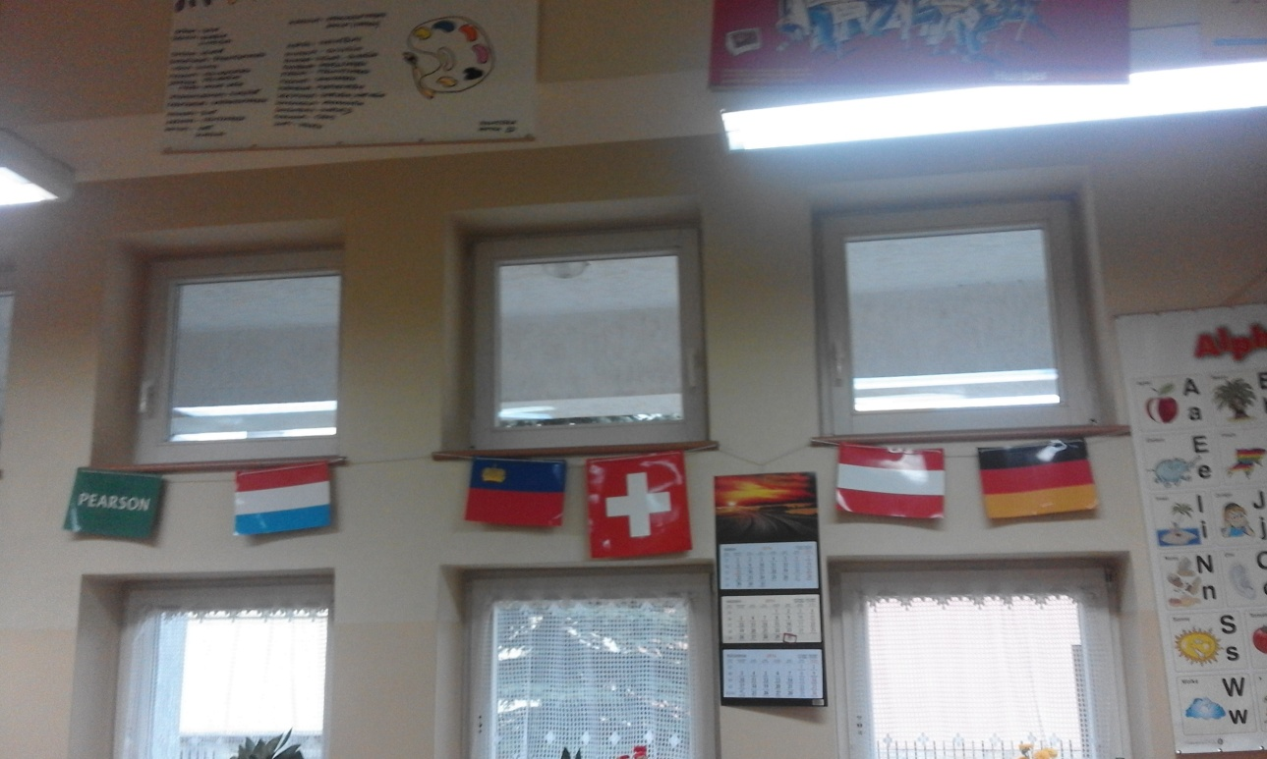
LANGUAGE CLASS
It looks like our language class.
In the class we are studing German language.
Teacher of German language: Adrianna Holender

Slide 12
LANGUAGE CLASS
This is our second language class. We are studing English here.
Teacher of English language – Mordarska Maria, Janusz Magdalena

Slide 13
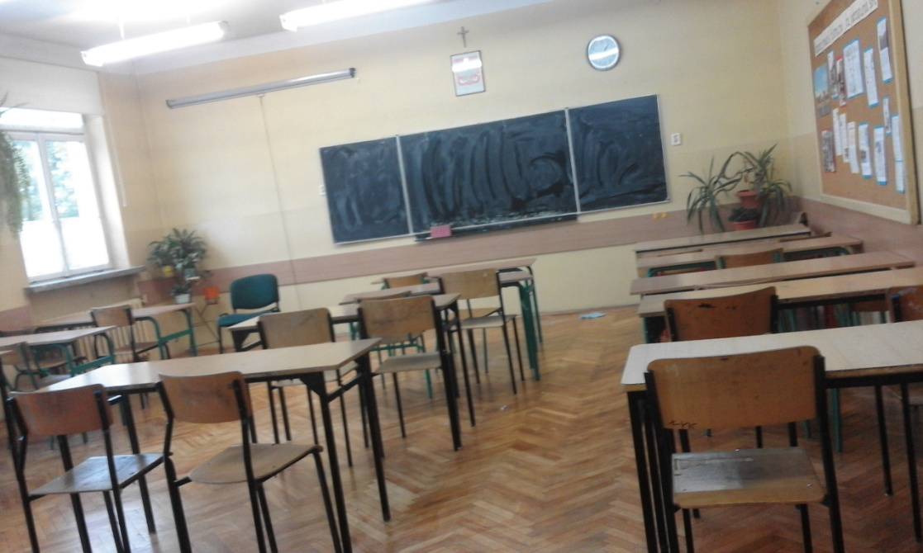
LANGUAGE CLASS
This is Polishs’ language class.
Teacher of Polish Language – Mrs Aneta Święs, Mrs Marta Michalik, Mrs Bogusława Nowak, Mr Łukasz Stelmach

Slide 14
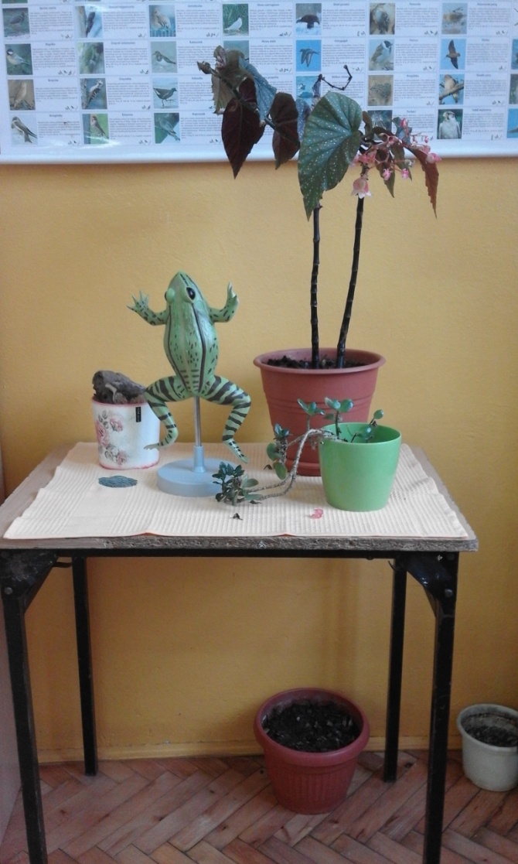
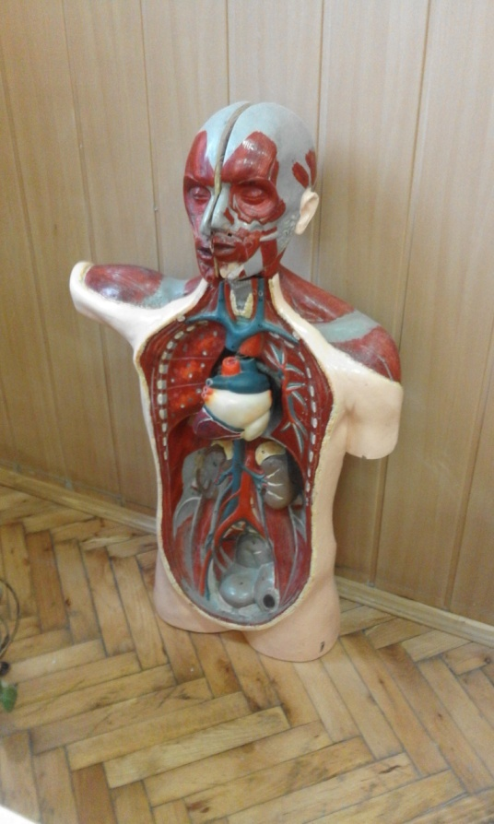
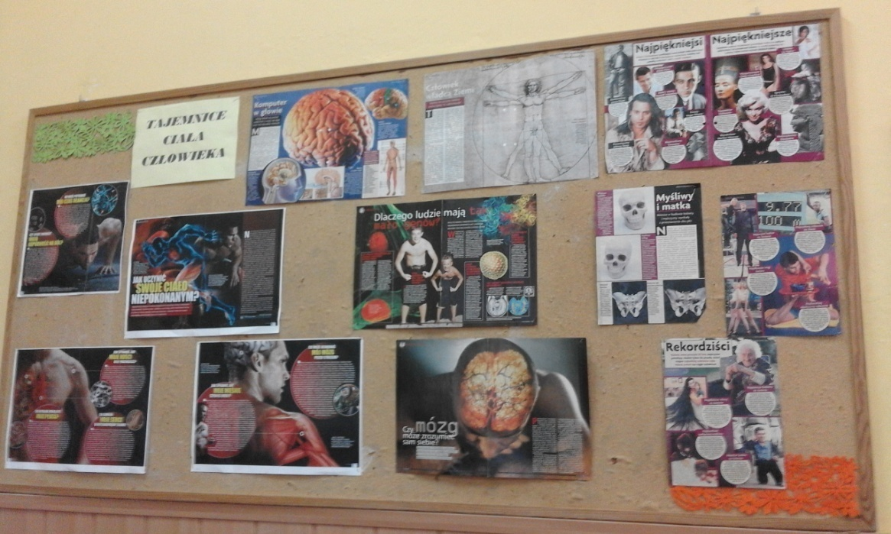
Biological class
In the class we have biology lessons.
Teacher of biology – Mrs. Alina Polańska, Mrs. Katarzyna Kusiak-Matusik

Slide 15
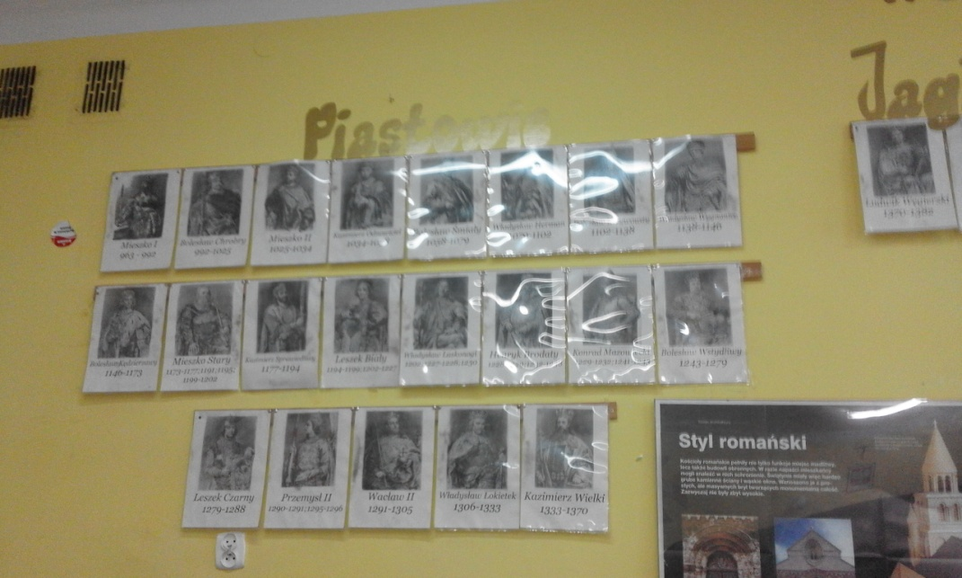
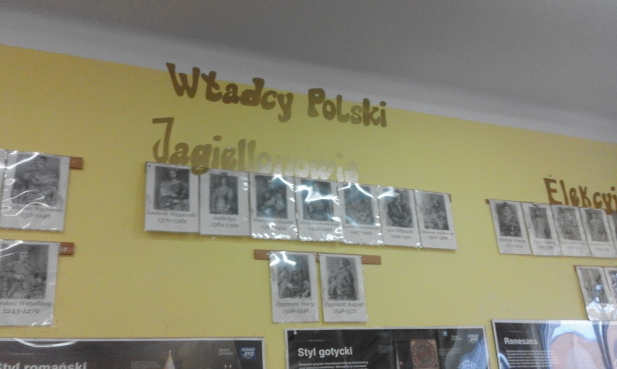
Historical class
In the class we are studing History and Knowledge About our Country.
Mrs Grażyna Blicharz, Mrs Barbara Glińska, Mrs Janina Skraba, Mr Tomasz Skrabski

Slide 16
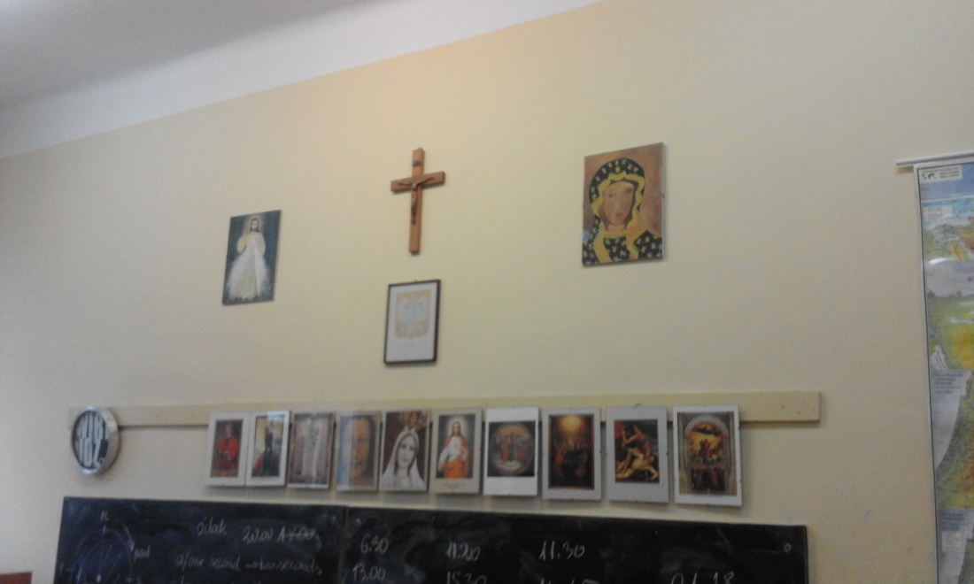
Class of Religion Education and Music
Here we studing about our creed and study music
Teacher of Music –Albina Gambal
Teacher of Religion: Albina Gambal, ks. Janusz Szpilowski, ks. Janusz Mąka

Slide 17
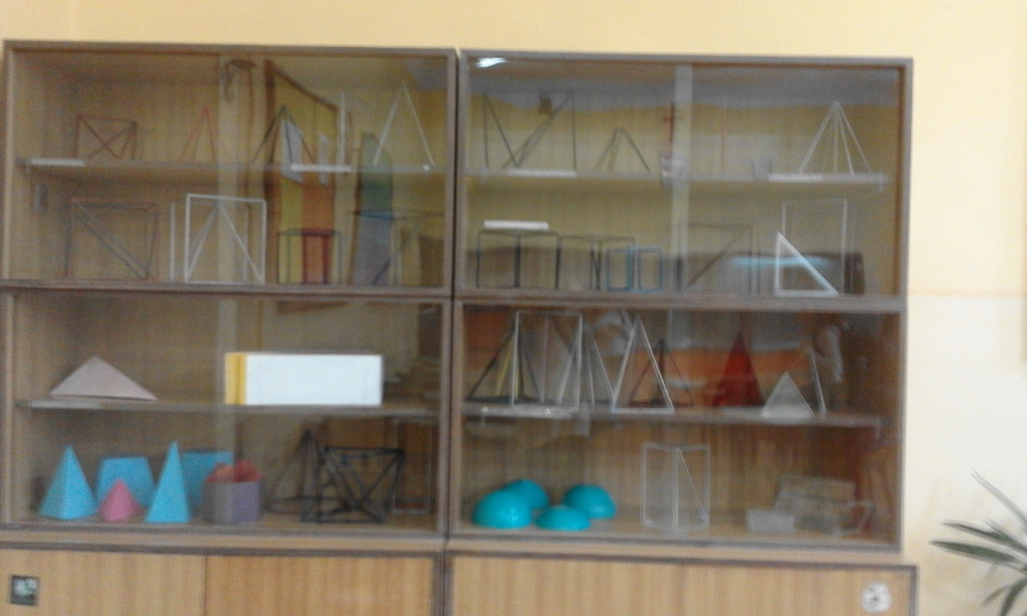
MATEMATICAL
Who likes Maths? ;)
Teacher of Maths : Mr Marceli Stanisz, Mrs. Albina Gambal, Mrs Lucyna Brońska, Mr Jerzy Udziela, Mrs. Katarzyna Wiatr, Mrs Agnieszka Skrabska

Slide 18
GEOGRAPHICAL CLASS
Here we are studing about world.
Teacher of Geography – Mrs. Alicja Blicharz

Slide 19
CHEMICAL AND PHYSICAL
Teacher of Physics: Mrs Gertruda Mitoraj
Teacher of Chemistry : Mrs Katarzyna Kusiak-Matusik

Slide 20
THANK YOU VERY MUCH ! ☺
Anna Gomułka 1A

