Slide 1
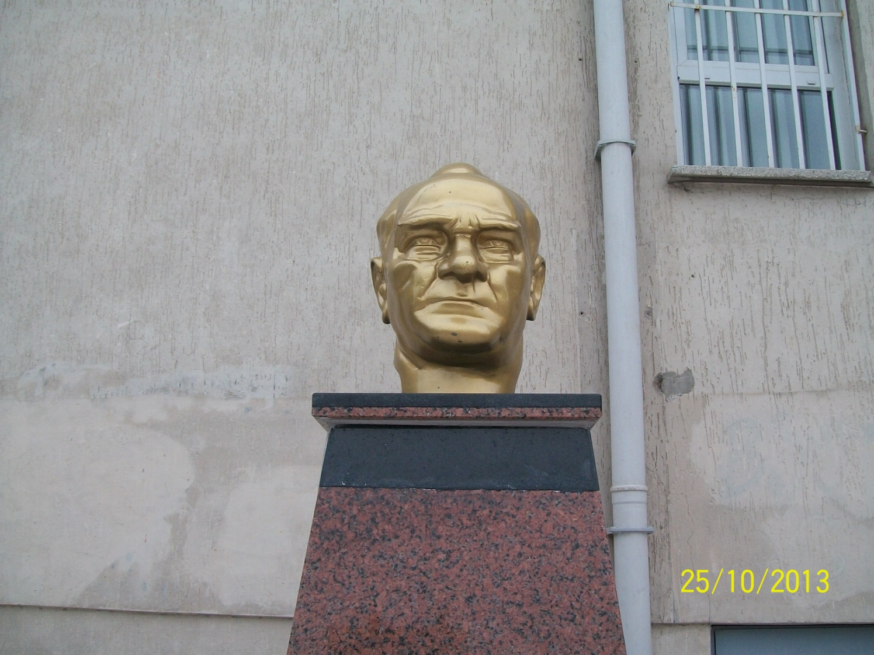
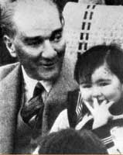
ATATÜRK’S CORNER

Slide 2
THIS IS MY CLASROOM

Slide 3
THİS IS MY MUSIC CLASROOM

Slide 4
THIS IS MY COMPUTER CLASROOM

Slide 5
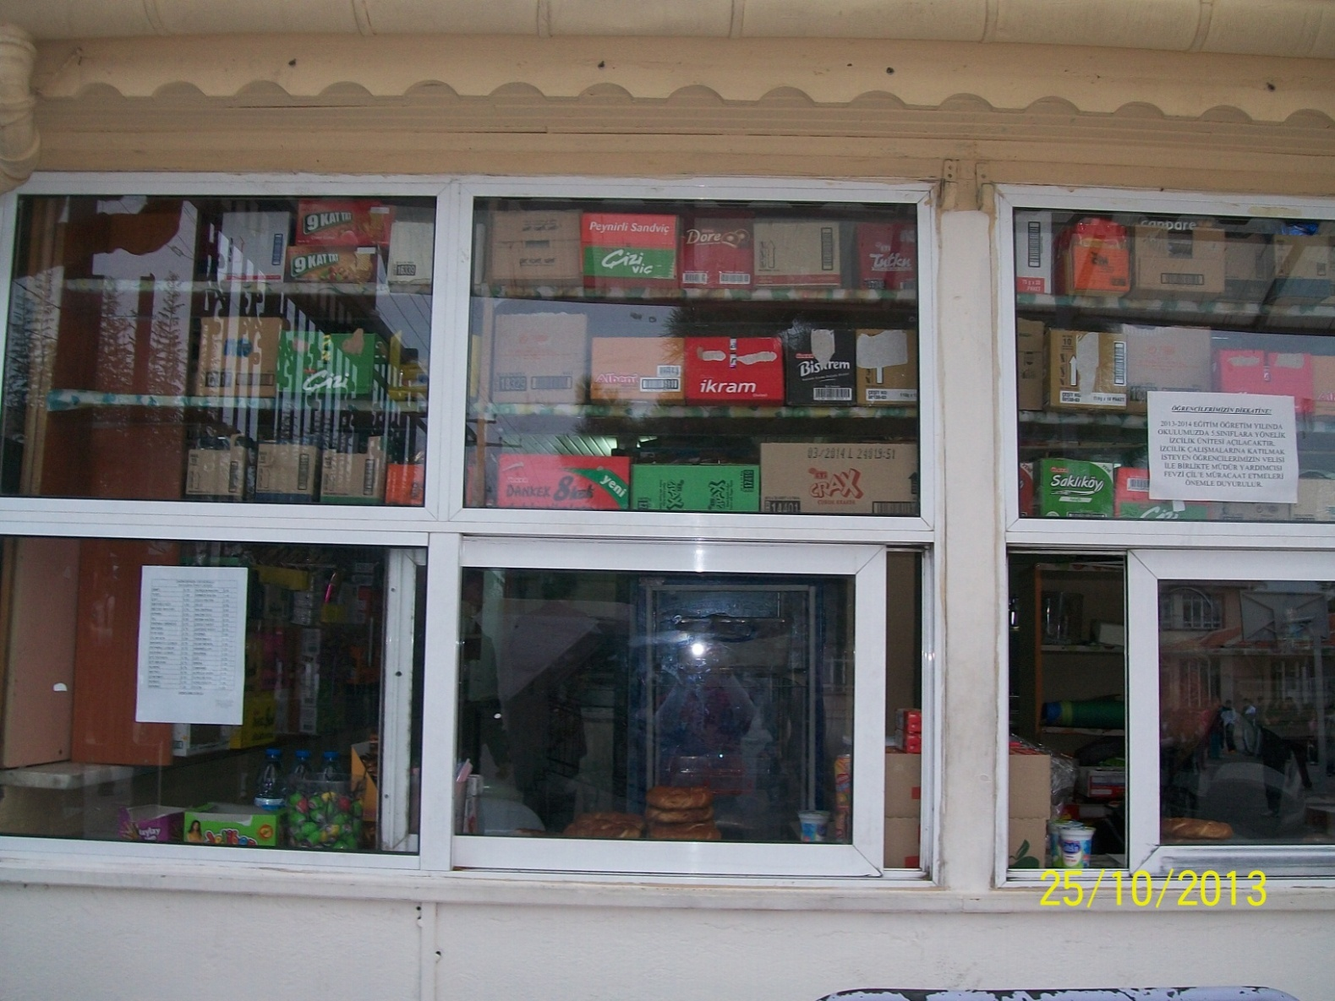
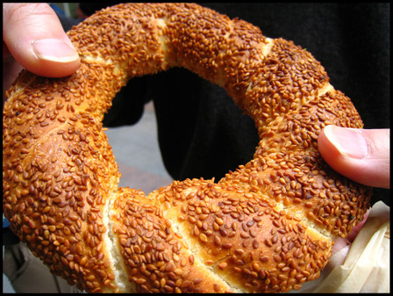
THIS IS CANTEEN

Slide 6
NECATİ ÇETİN
6/F 412

