Slide 1
Erasmus+ with Mathmatics Through life
2016-2018
Zağnospaşa Secondary School Balıkesir
TURKEY

Slide 2
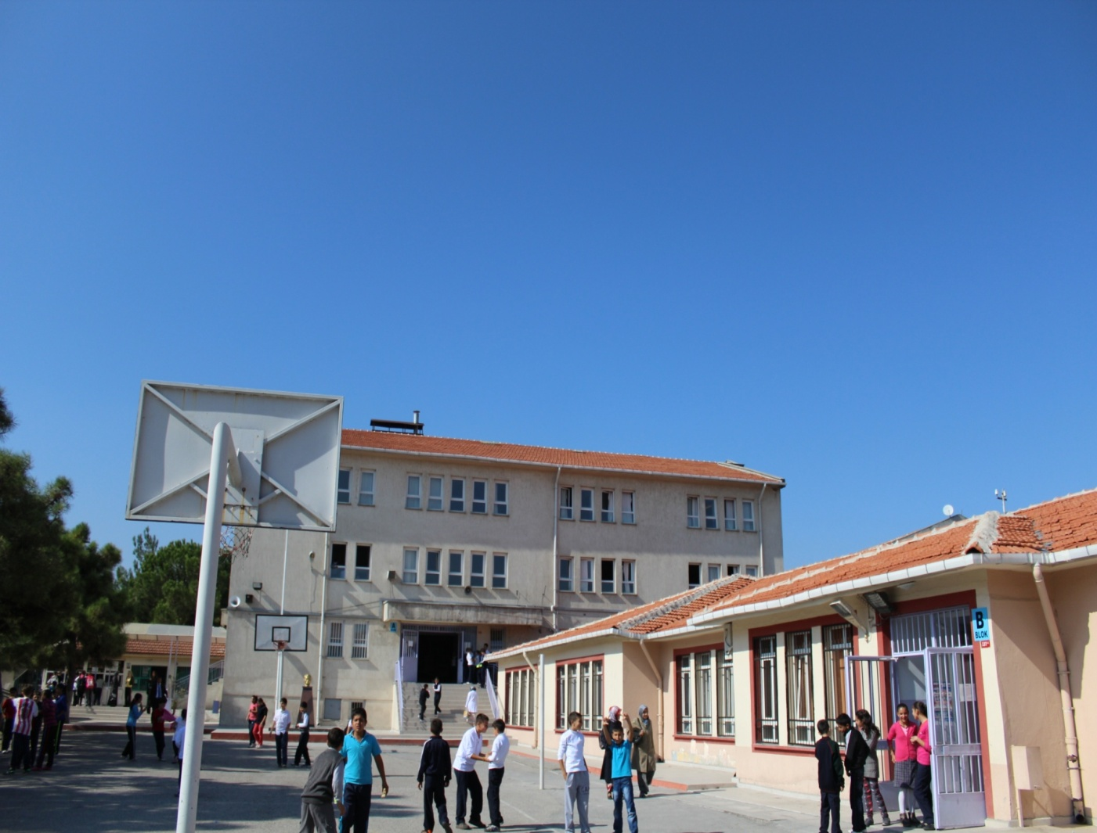
THIS IS MY SCHOOL

Slide 3
THIS IS MY CLASROOM

Slide 4
THIS IS THE COMPUTER ROOM

Slide 5
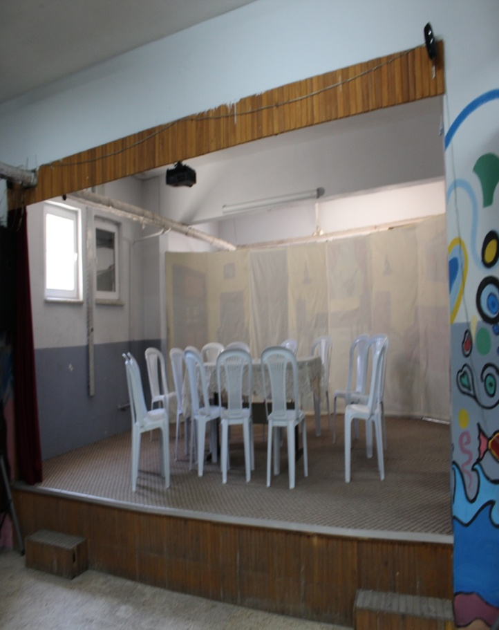
THIS IS OUR MEETING ROOM

Slide 6
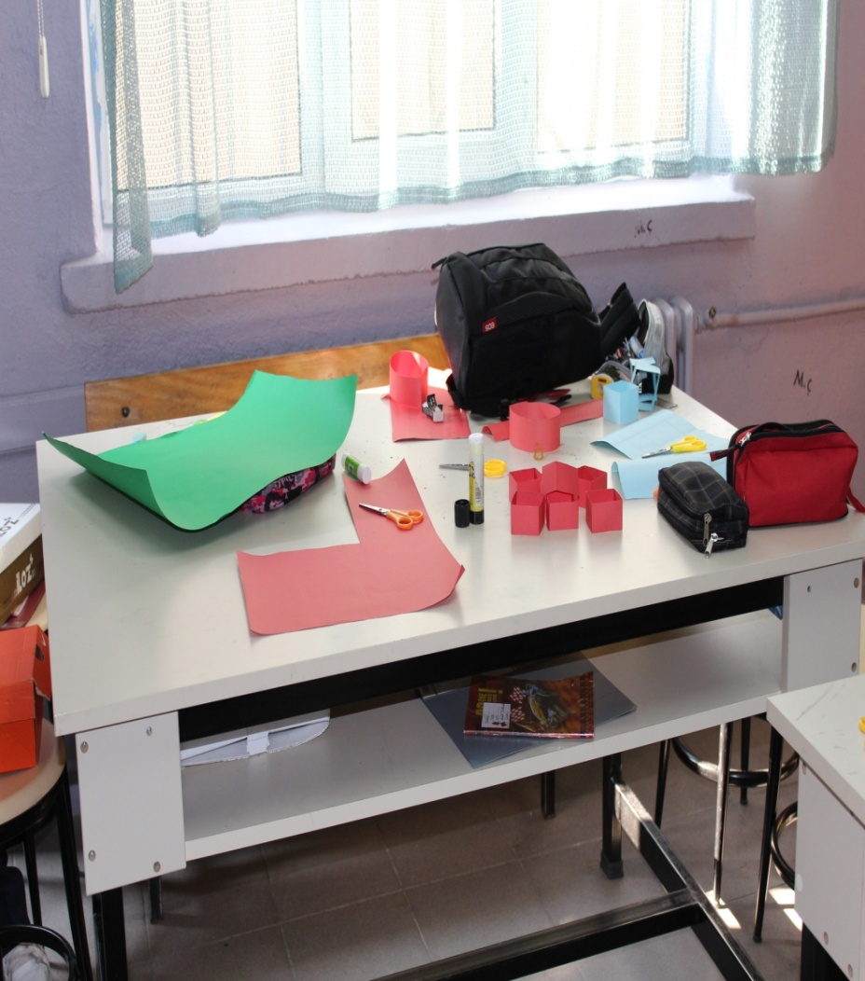
THIS IS OUR WORKSHOP

Slide 7
AWARDS

Slide 8
CANTEEN

Slide 9
SCHOOL GARDEN

Slide 10
THIS IS A BUST OF ATATÜRK

Slide 11
SENA TEZCAN
SENA TEZCAN 6-A

