Slide 1

Erasmus+ with Mathmatics Through life 2016-2018
Zağnospaşa Secondary School Balıkesir
TURKEY
        MY SCHOOL

Slide 2
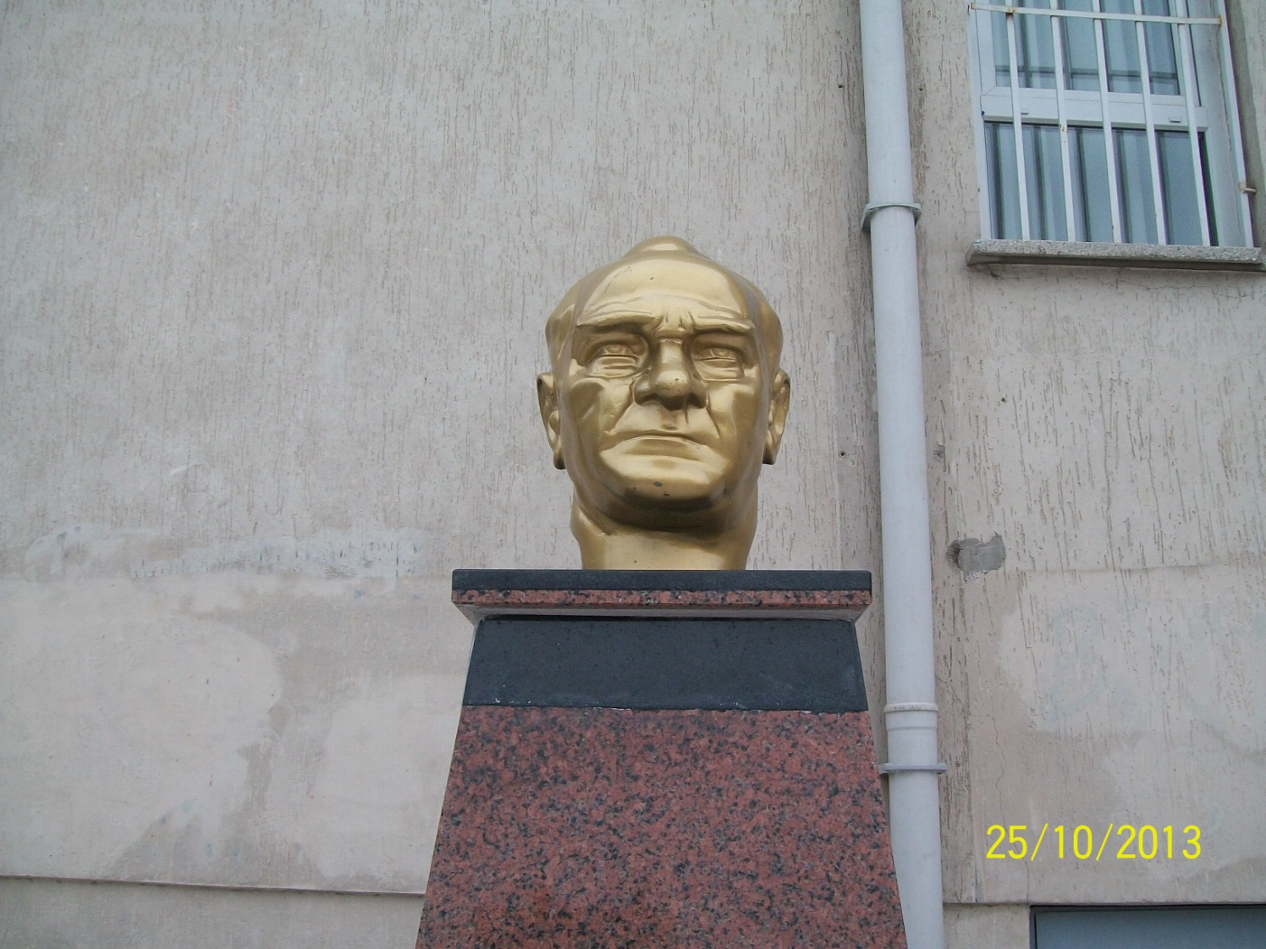
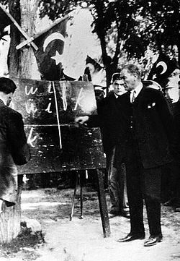
Atatürk`s Corner

Slide 3
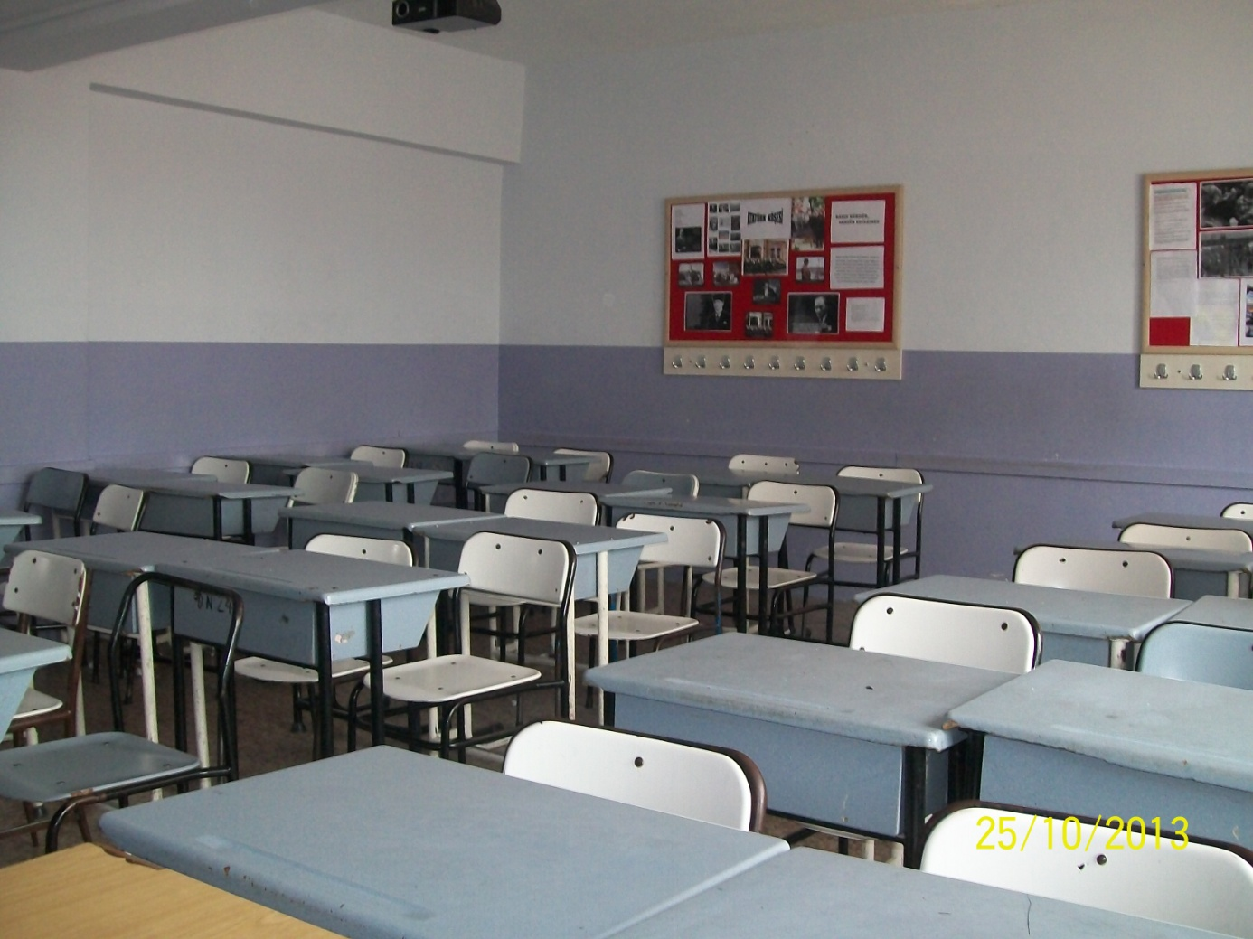
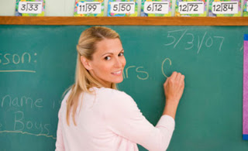
My Class room

Slide 4
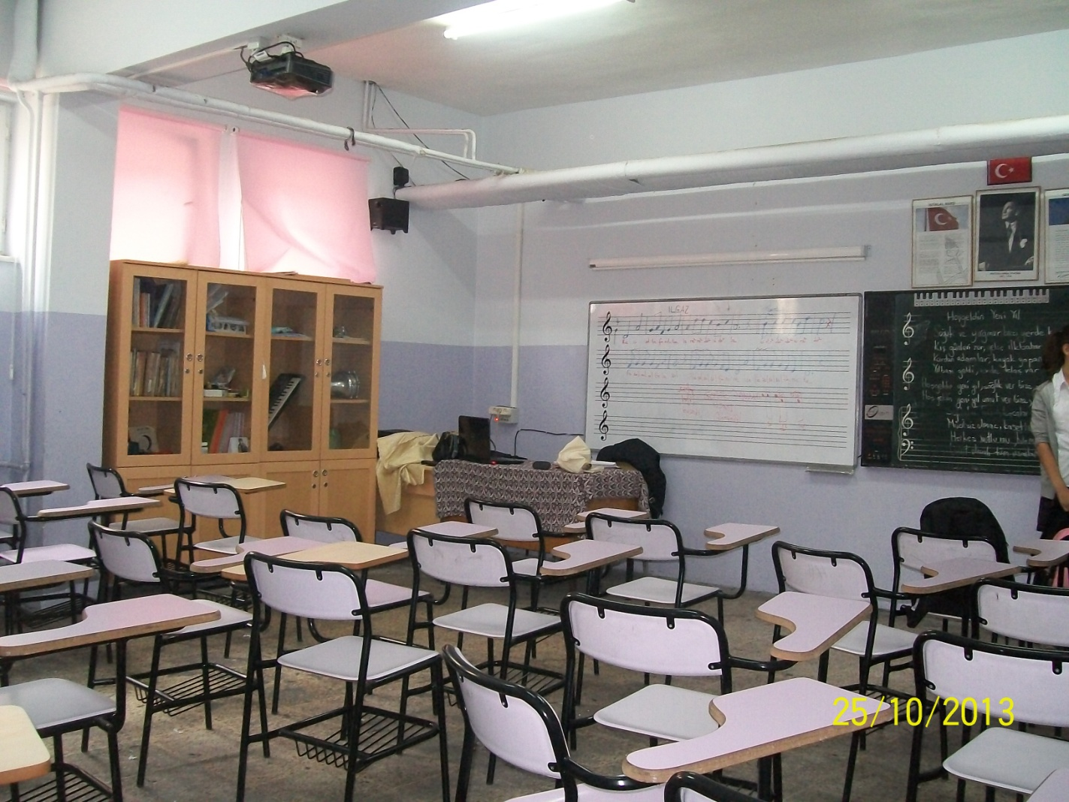

Music Class

Slide 5
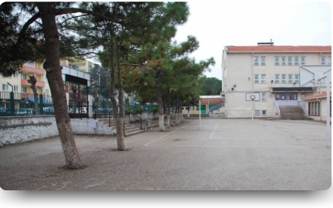

Garden

Slide 6
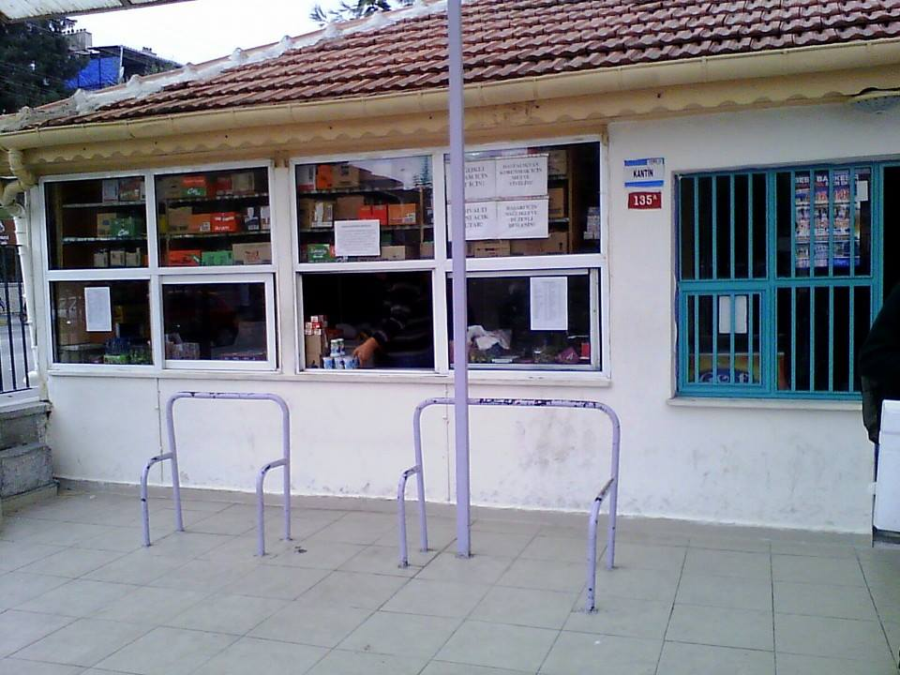
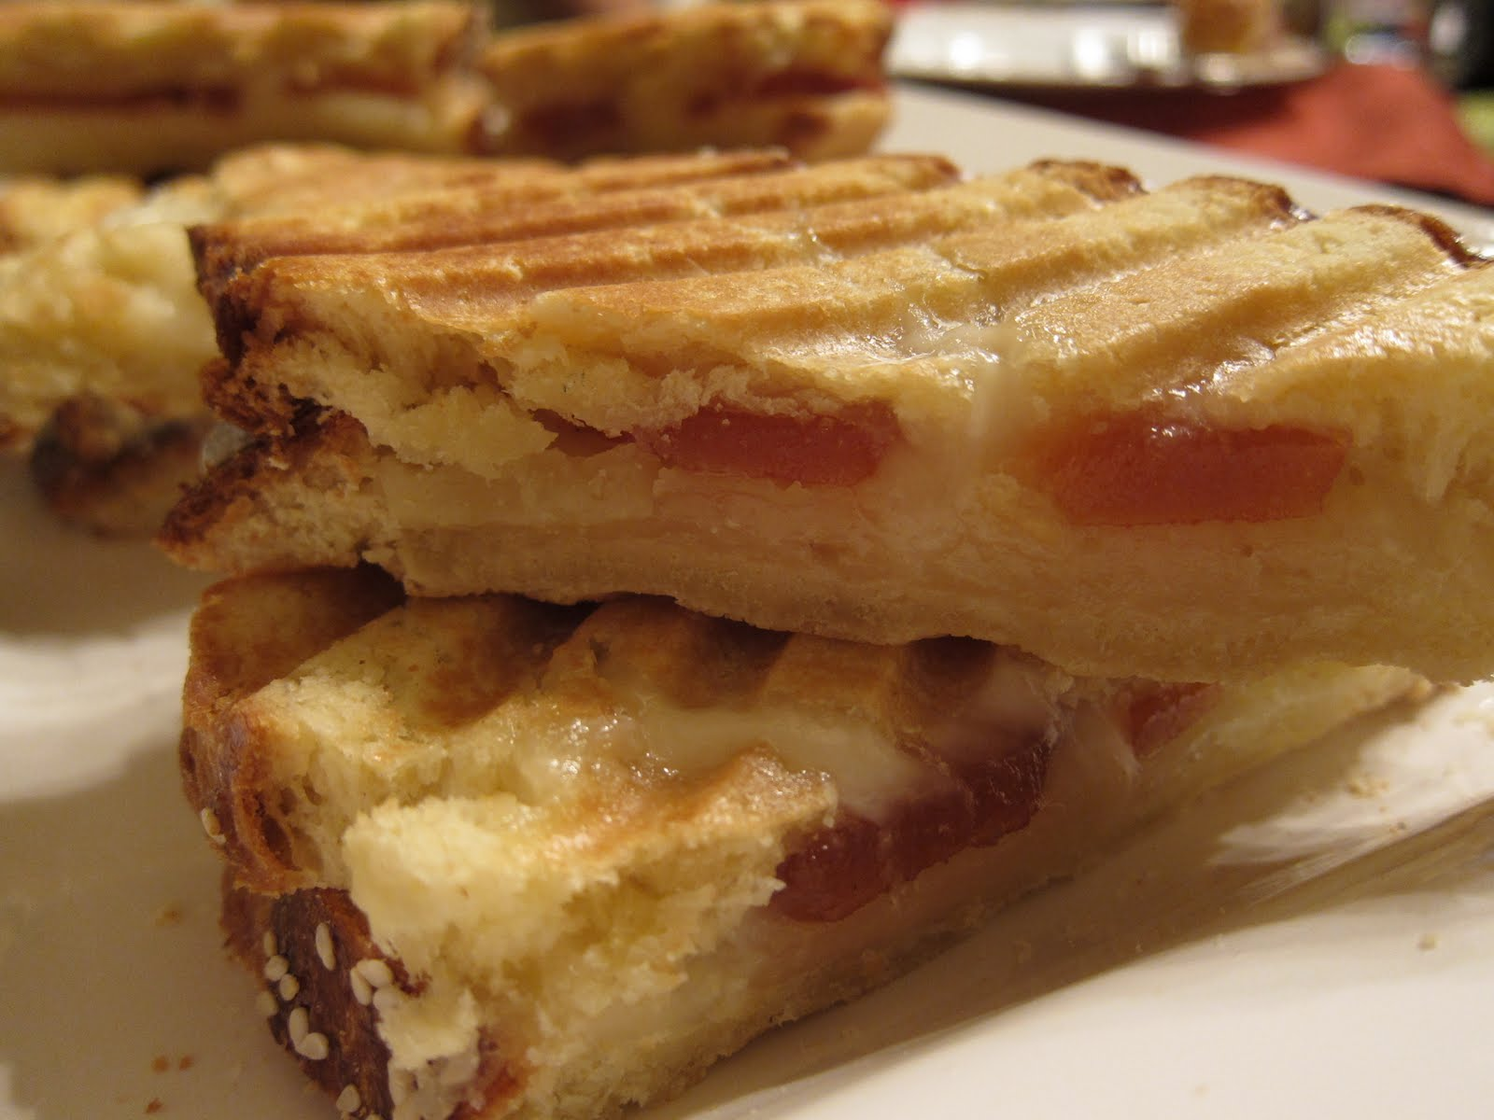
Canteen

Slide 7
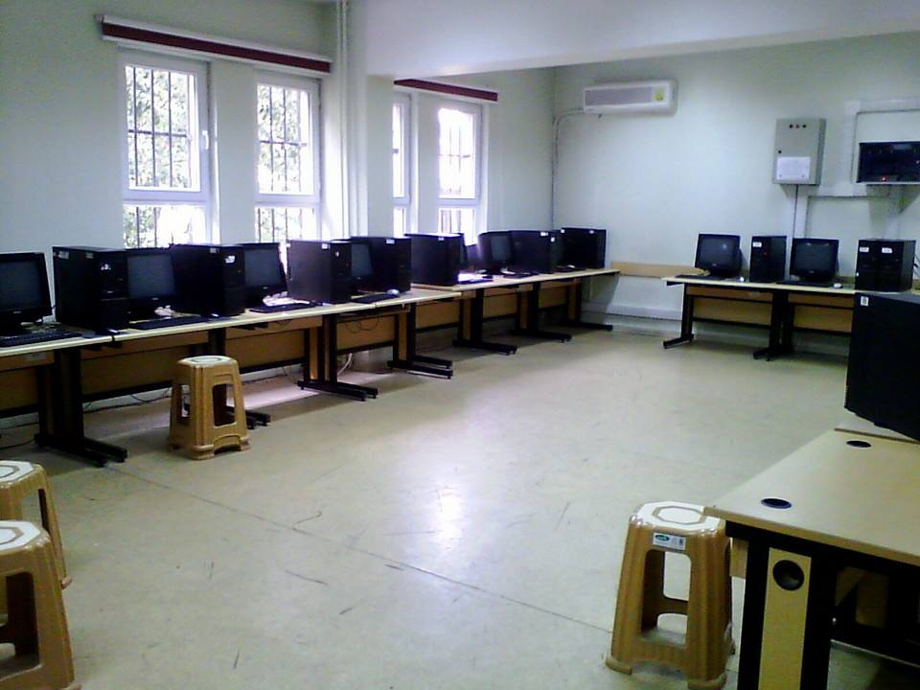
o
Computer Laboratorio

Slide 8
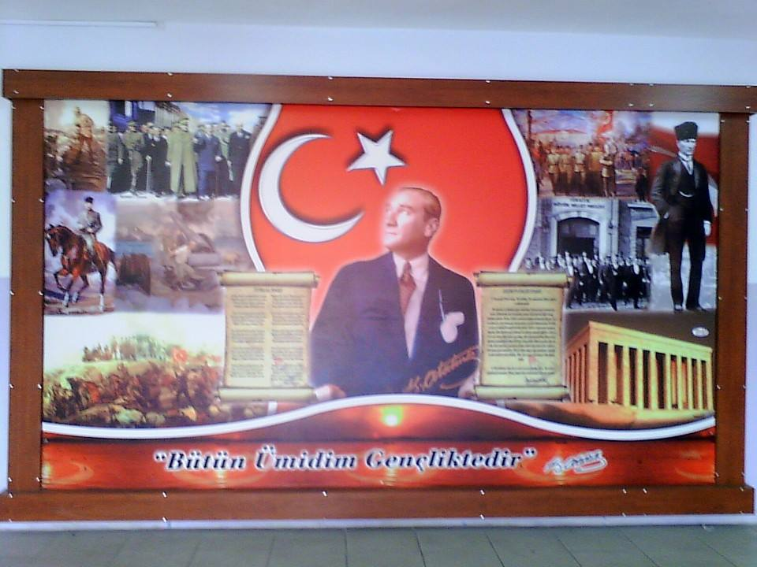
Atatürk Board

Slide 9
SEFA ÖZTÜRK
6/B 271

