Slide 1

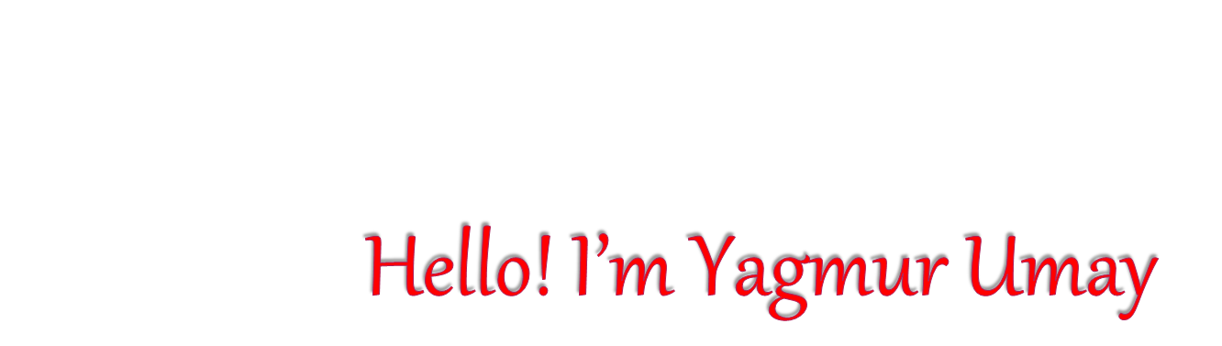
Hello! I’m Yagmur Umay
I am 11 years old.I’m Turkish.
My favorite free time activity is go shopping with my mom.I hate playing soccer.
Erasmus+ with Mathmatics Through life 2016-2018
Zağnospaşa Secondary School Balıkesir
TURKEY

Slide 2
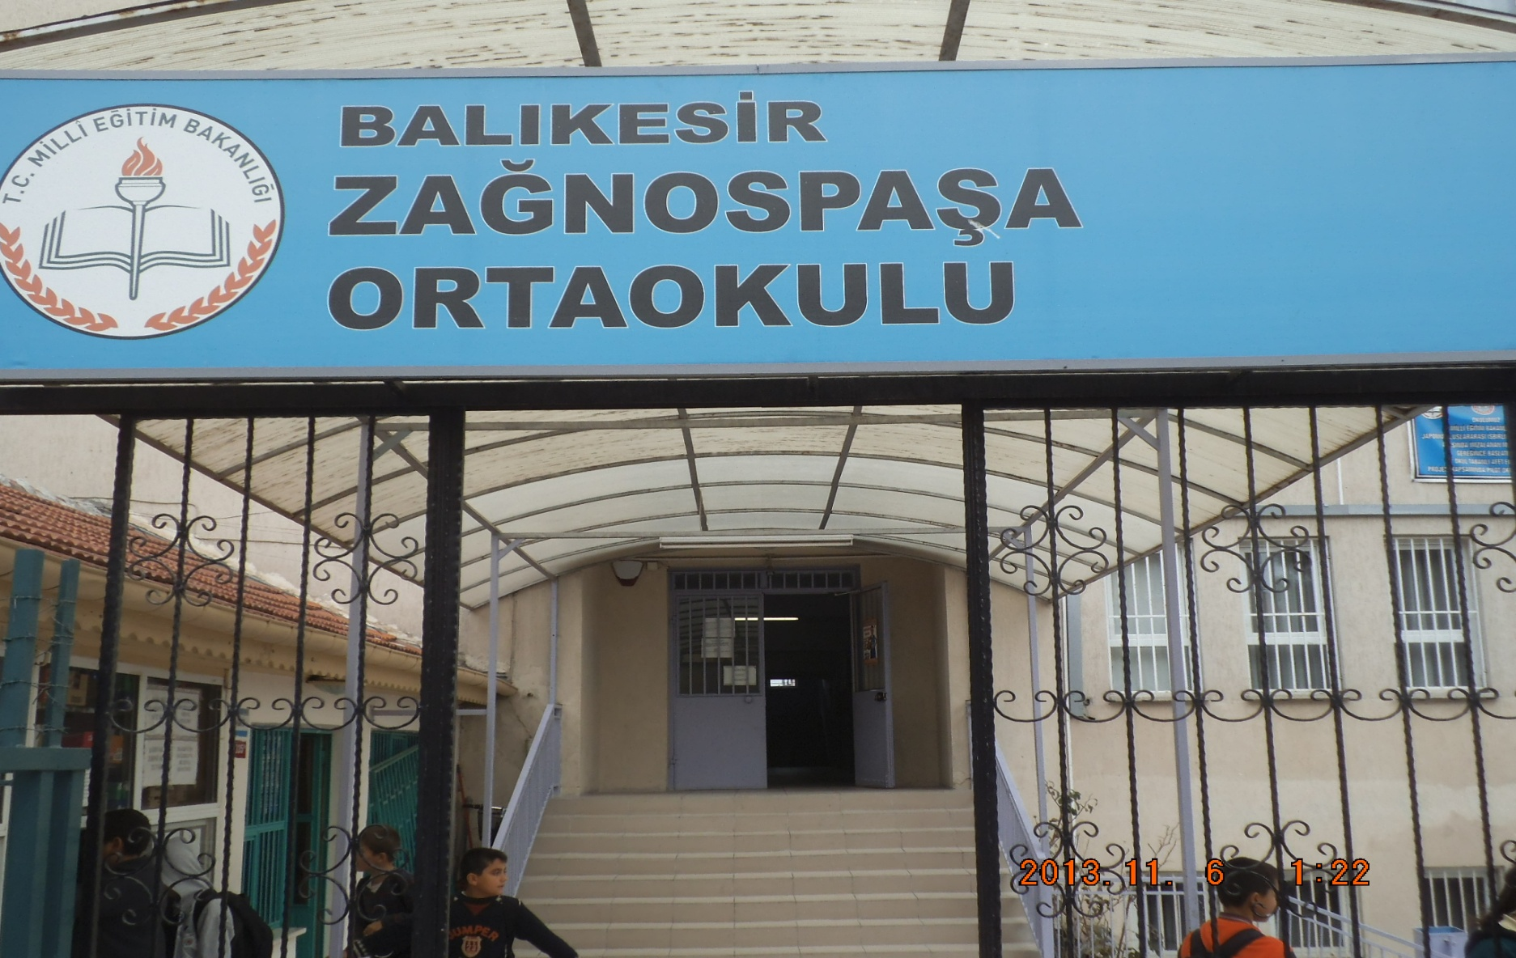


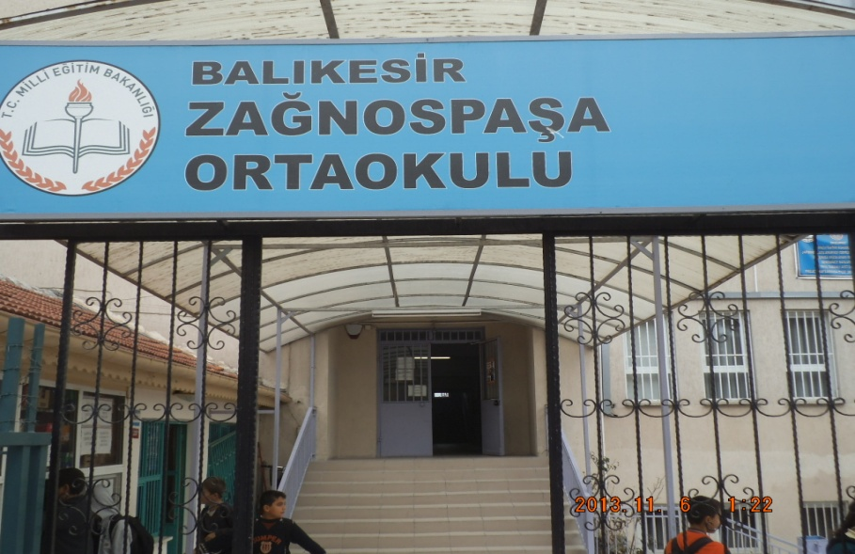
Here is my school’s entrance. It is a big school.

Slide 3
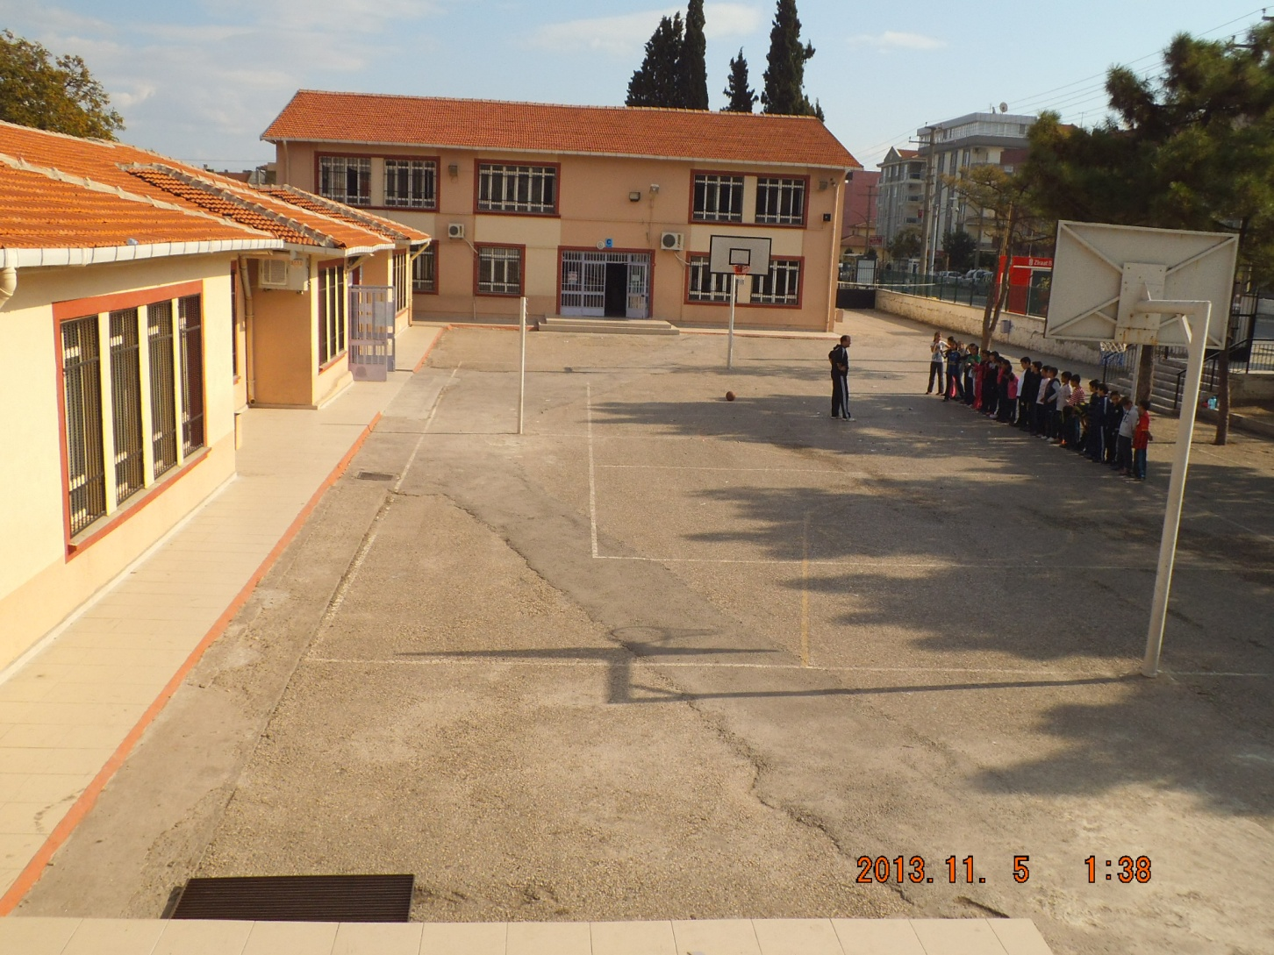
Here is my school’s garden

Slide 4
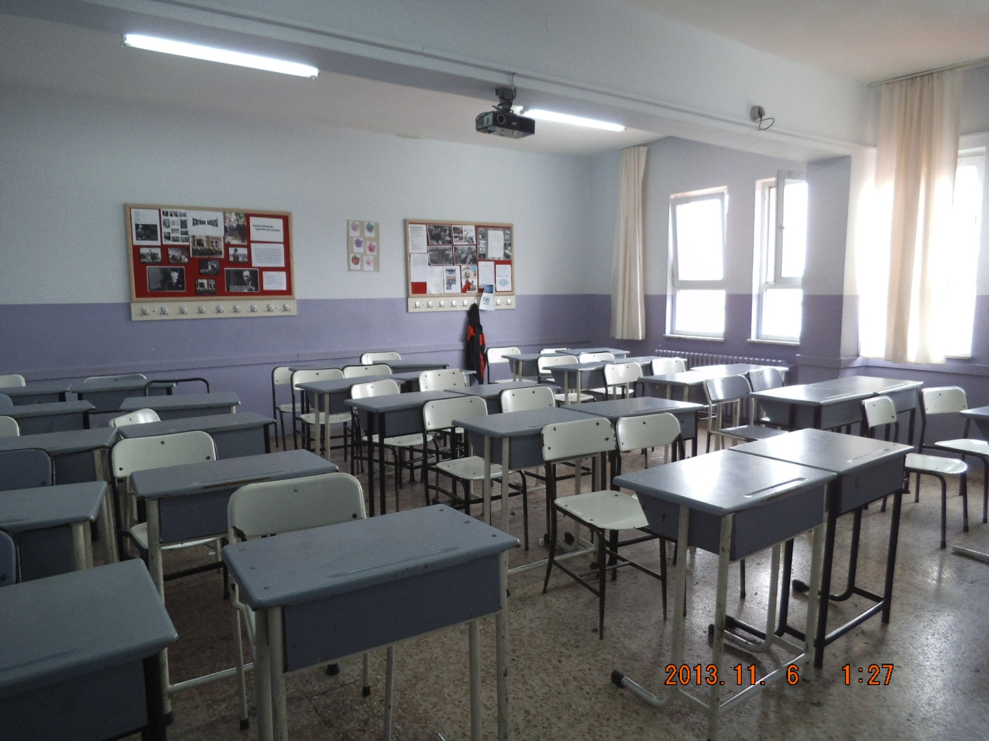
Here is my class.

Slide 5
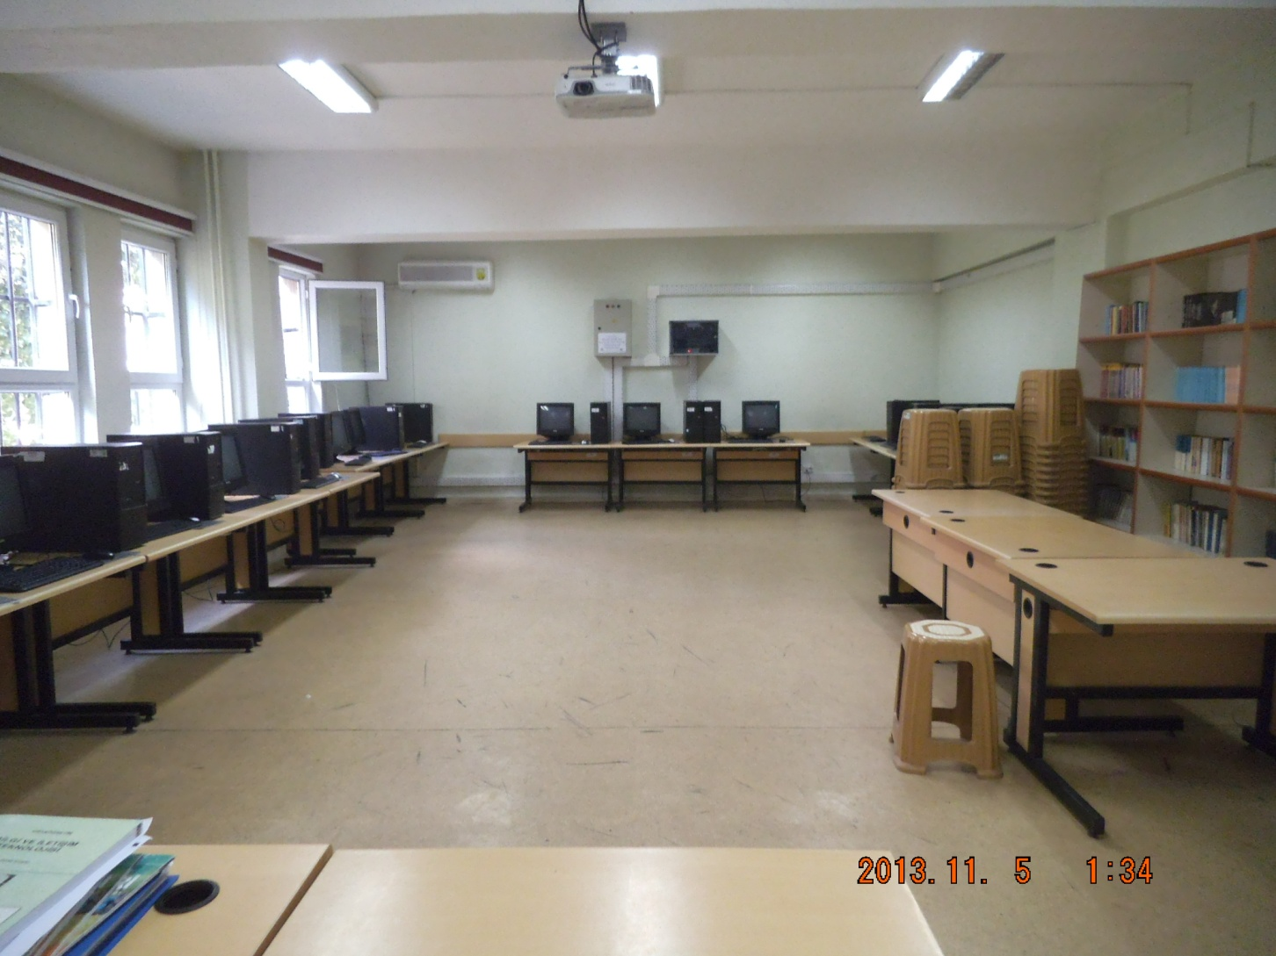
Here is my school’s ICT class.

Slide 6
THANKS FOR WATCHNG.
I love my school
Very much.

