Slide 1
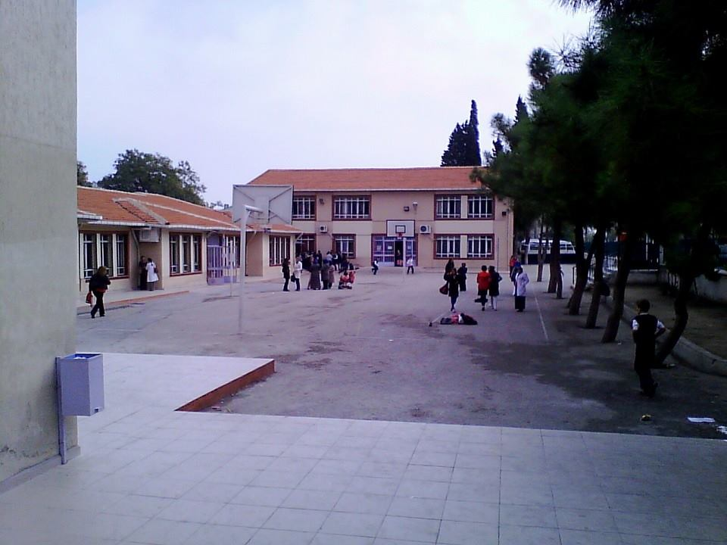
Erasmus+ with Mathmatics Through life 2016-2018
Zağnospaşa Secondary School Balıkesir
TURKEY
ZAĞNOSPAŞA SECONDARY SCHOOL

Slide 2
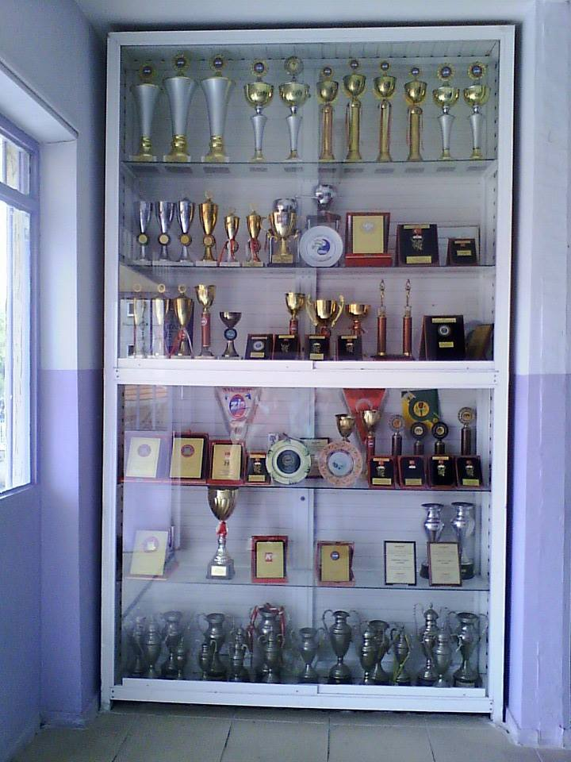
Our Awards

Slide 3
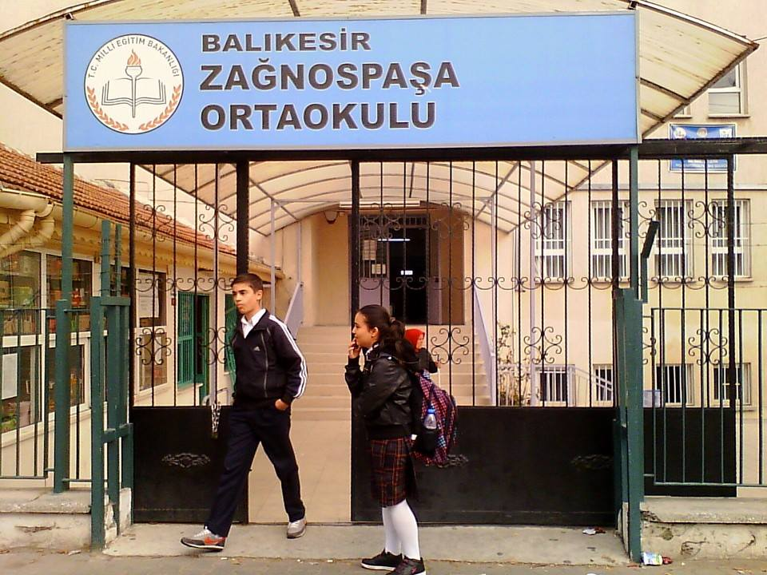
This İs My School

Slide 4
School Garden

Slide 5
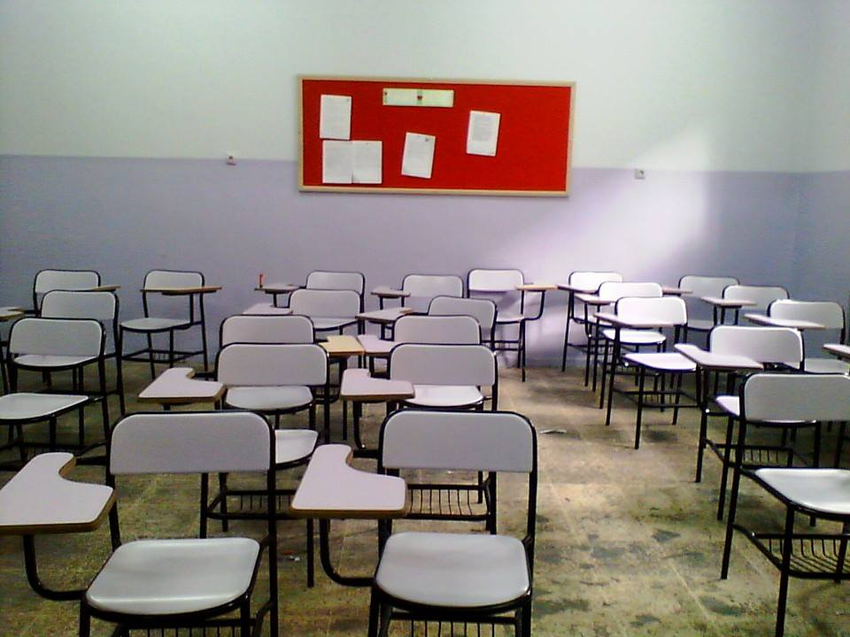
Music Clasroom

Slide 6
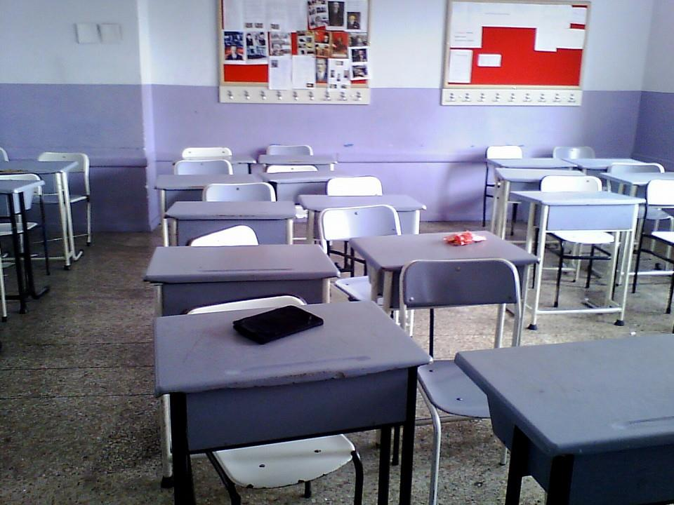
classroom

Slide 7
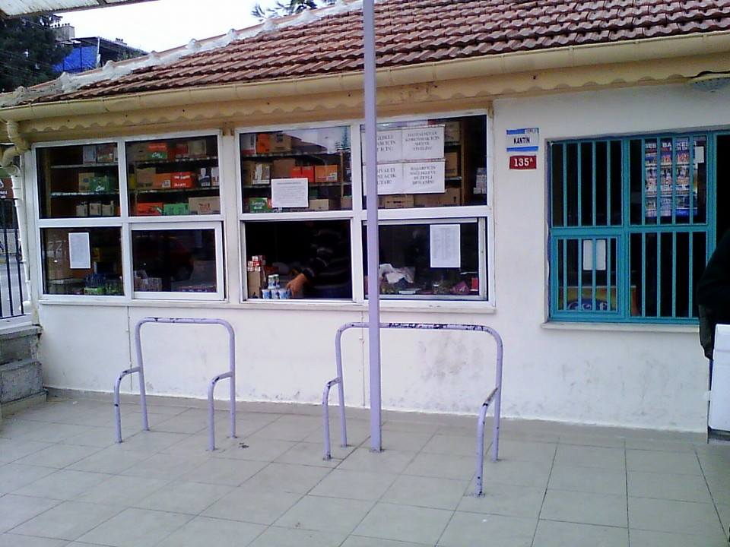
Canteen

Slide 8
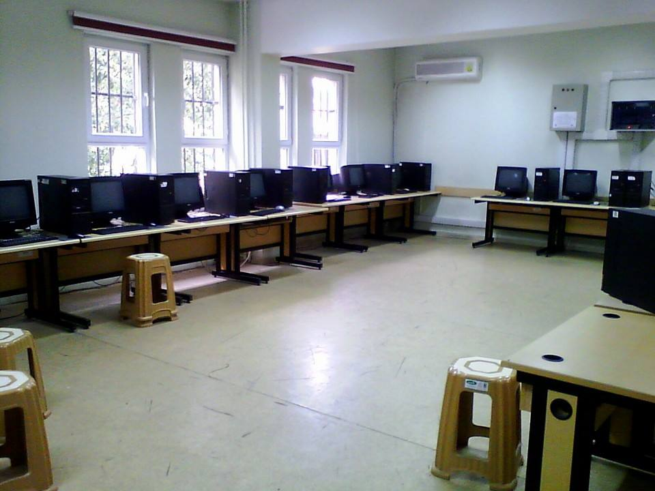
Computer Laboratory

Slide 9
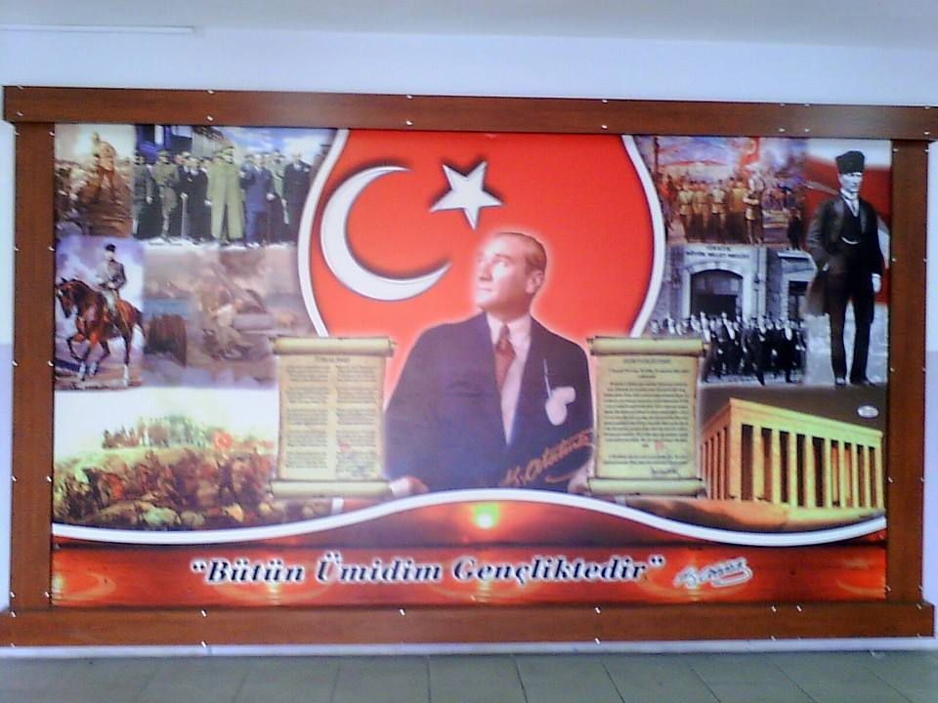
Atatürk Board

Slide 10
Sena Akça

