Slide 1
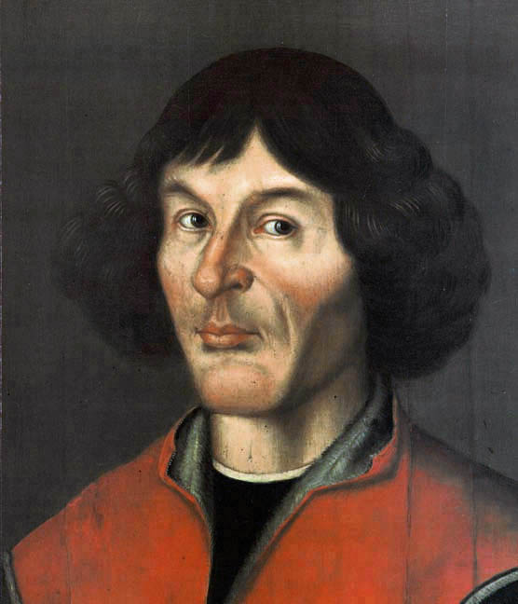
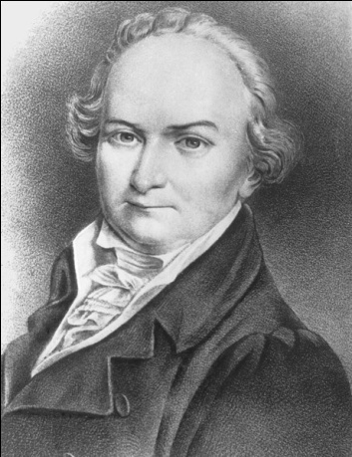
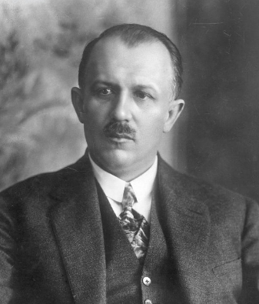
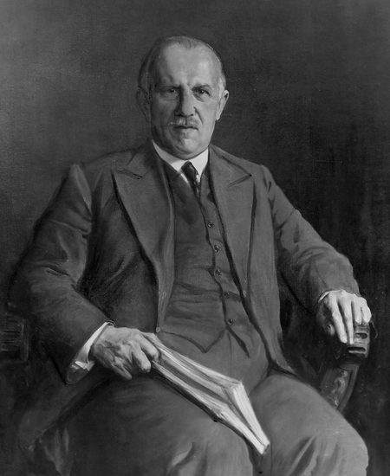
THE MOST POPULAR POLISH MATHEMATICIANS

Slide 2
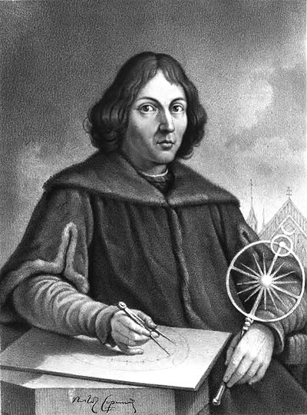
Mikołaj kopernik
(19 February 1473 – 24 May 1543)
Mikołaj was a Renaissance mathematician and astronomer who formulated a model of the universe.
Kopernik was a polyglot and polymath who obtained a doctorate in canon law and also practiced as a physician, classics scholar, translator, governor, diplomat and economist. In 1517 he derived a quantity theory of money – a key concept in economics – and in 1519 he formulated a version of what later became known as Gresham's law.
Copernicus is postulated to have spoken Latin and German with equal fluency. He also spoke Polish, Greek and Italian. The vast majority of Copernicus's surviving works are in Latin, which in his lifetime was the language of academia in Europe.

Slide 3
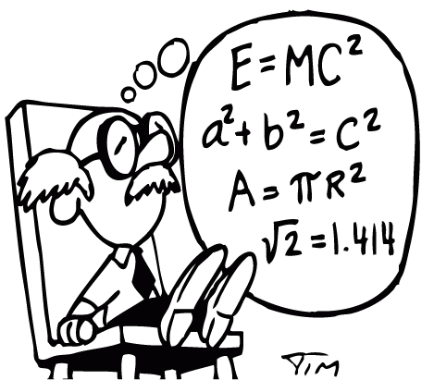
Jan śniadecki
(29 August 1756 – 9 November 1830)
He was a Polish mathematician, philosopher and astronomer at the turn of the 18th and 19th centuries.
Born in Żnin, Śniadecki studied at Cracow University and in Paris. He was rector of the Imperial University of Vilnius, a member of the Commission of National Education and director of astronomical observatories at Cracow and Vilnius.
He died at Jašiūnai Manor near Vilnius.
Śniadecki published many works, including his observations on recently discovered planetoids. His ,,O rachunku losów” (On the Calculation of Chance, 1817) was a work in probability.

Slide 4
Kazimierz Bartel
(3 March 1882 – 26 July 1941)
Kazimierz was a Polish mathematician, scholar, diplomat and politician who served as Prime Minister of Poland three times between 1926 and 1930 and the Senator of Poland from 1937 until the outbreak of World War II.
In 1930 upon giving up politics, he returned to the university as professor of mathematics. In 1930 he became rector of the Lwów Polytechnic and was soon awarded an honorary doctorate and membership in the Polish Mathematical Association.
He was decorated with, among others, the Order of the White Eagle (1932) for outstanding achievements, the French Legion of Honour (class I), the Cross of Valour, the Cross of Independence and the Silver Cross of the Virtuti Militari (1922).

Slide 5
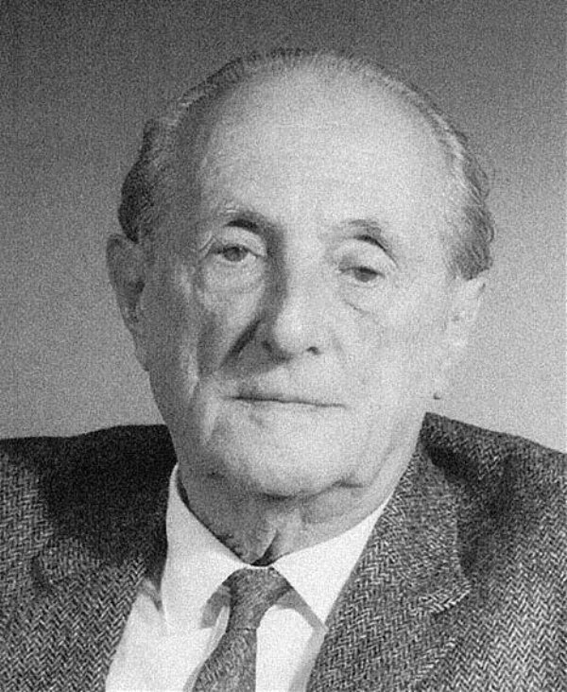
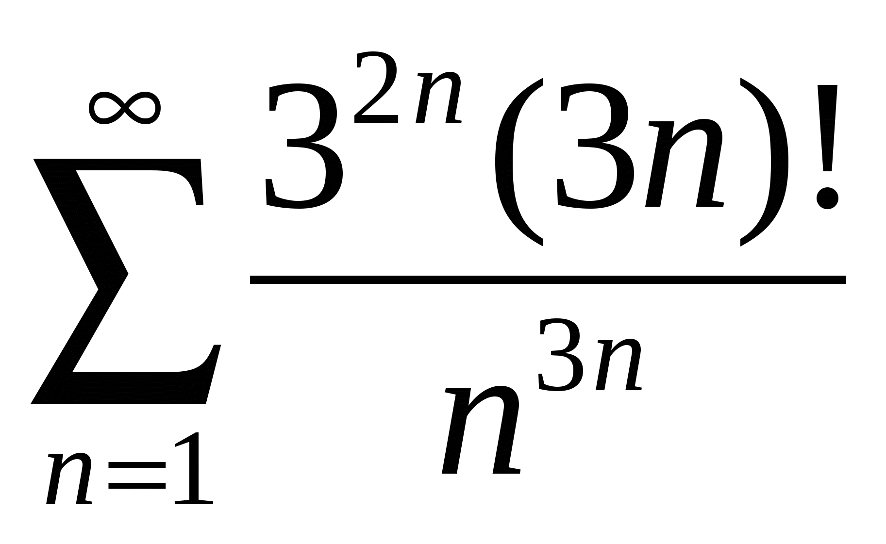
HUGO DIONIZY STEINHAUS
(14 January 1887 – 25 February 1972)
Hugo was a Polish mathematician and educator. Steinhaus obtained his PhD under David Hilbert at Göttingen University in 1911 and later became a professor at the Jan Kazimierz University in Lwów, where he helped establish what later became known as the Lwów School of Mathematics.
Author of around 170 scientific articles and books. Steinhaus has left his legacy and contribution in many branches of mathematics, such as functional analysis, geometry, mathematical logic and trigonometry. Notably he is regarded as one of the early founders of game theory and probability theory which led to later development of more comprehensive approaches by other scholars.

Slide 6
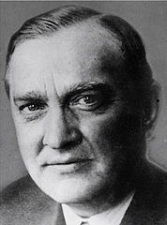
STEFAN BANACH
(30 March 1892 – 31 August 1945)
He was a Polish mathematician who is generally considered one of the world's most important and influential 20th-century mathematicians. He was one of the founders of modern functional analysis and an original member of the Lwów School of Mathematics. His major work was the 1932 book, Théorie des opérations linéaires (Theory of Linear Operations), the first monograph on the general theory of functional analysis.
Some of the notable mathematical concepts that bear Banach's name include Banach spaces, Banach algebras, the Banach–Tarski paradox, the Hahn–Banach theorem, the Banach–Steinhaus theorem, the Banach-Mazur game, the Banach–Alaoglu theorem, and the Banach fixed-point theorem.

Slide 7
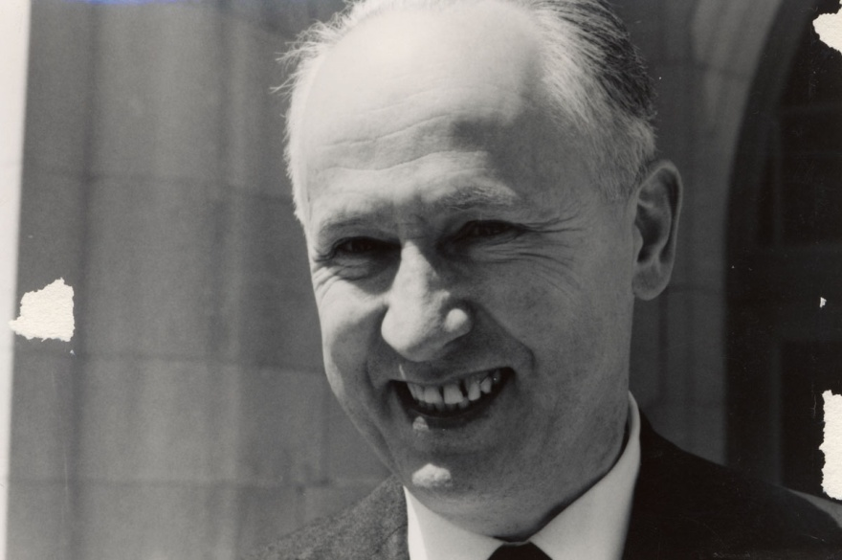
KAROL BORSUK
(8 May 1905 – 24 January 1982)
He was a Polish mathematician. His main interest was topology.
Borsuk received his master's degree and doctorate from Warsaw University in 1927 and 1930, respectively; his Ph.D. thesis advisor was Stefan Mazurkiewicz. He was a member of the Polish Academy of Sciences from 1952. Borsuk's students included Samuel Eilenberg, Jan Jaworowski, Krystyna Kuperberg, Włodzimierz Kuperberg and Andrzej Trybulec.
His topological and geometric conjectures and themes stimulated research for more than half a century.

Slide 8
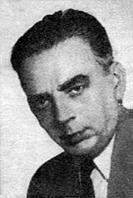
STANISŁAW MAZUR
(1 January 1905 – 5 November 1981)
He was a Polish mathematician and a member of the Polish Academy of Sciences.
Mazur made important contributions to geometrical methods in linear, nonlinear functional analysis and to the study of Banach algebras. He was also interested in summability theory, infinite games and computable functions.
Mazur was a close collaborator with Banach at Lwów and was a member of the Lwów School of Mathematics, where he participated in the mathematical activities at the Scottish Café. On 6 November 1936, he posed the "basis problem" of determining whether every Banach space has a Schauder basis, with Mazur promising a "live goose" as a reward: Thirty-seven years later, a live goose was awarded by Mazur to Per Enflo in a ceremony that was broadcast throughout Poland.

Slide 9
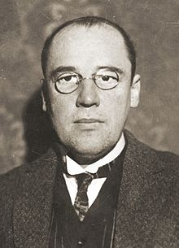
WŁADYSŁAW SIERPIŃSKI
(14 March 1882 – 21 October 1969)
He was a Polish mathematician.
Władysław was known for outstanding contributions to set theory (research on the axiom of choice and the continuum hypothesis), number theory, theory of functions and topology. He published over 700 papers and 50 books.
Three well-known fractals are named after him (the Sierpinski triangle, the Sierpinski carpet and the Sierpinski curve), as are Sierpinski numbers and the associated Sierpiński problem.

Slide 10
I hope you enjoyed
my presentation ☺
Thank you for watching
!!!

Slide 11
The presentation was made by
Weronika Furtak

