Slide 1
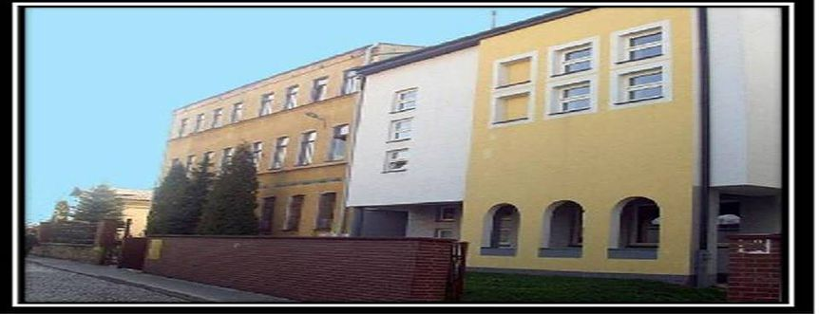
My School
Made by:
Bartosz Wysowski

Slide 2
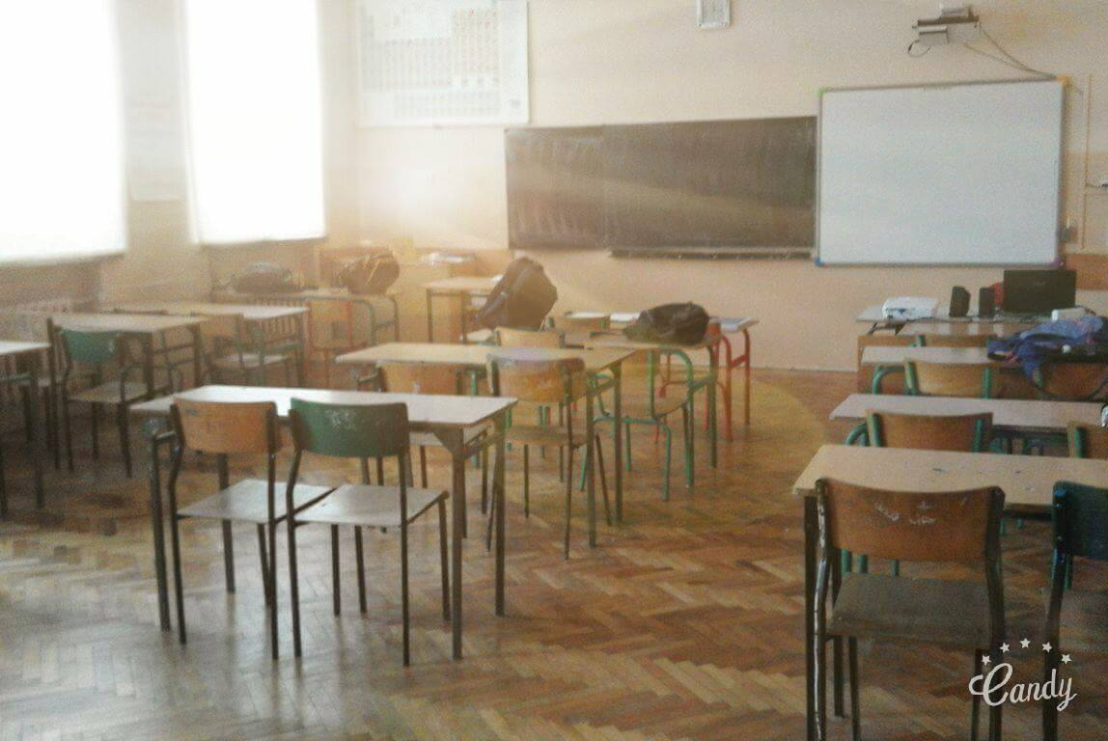
Chemical Classroom

Slide 3
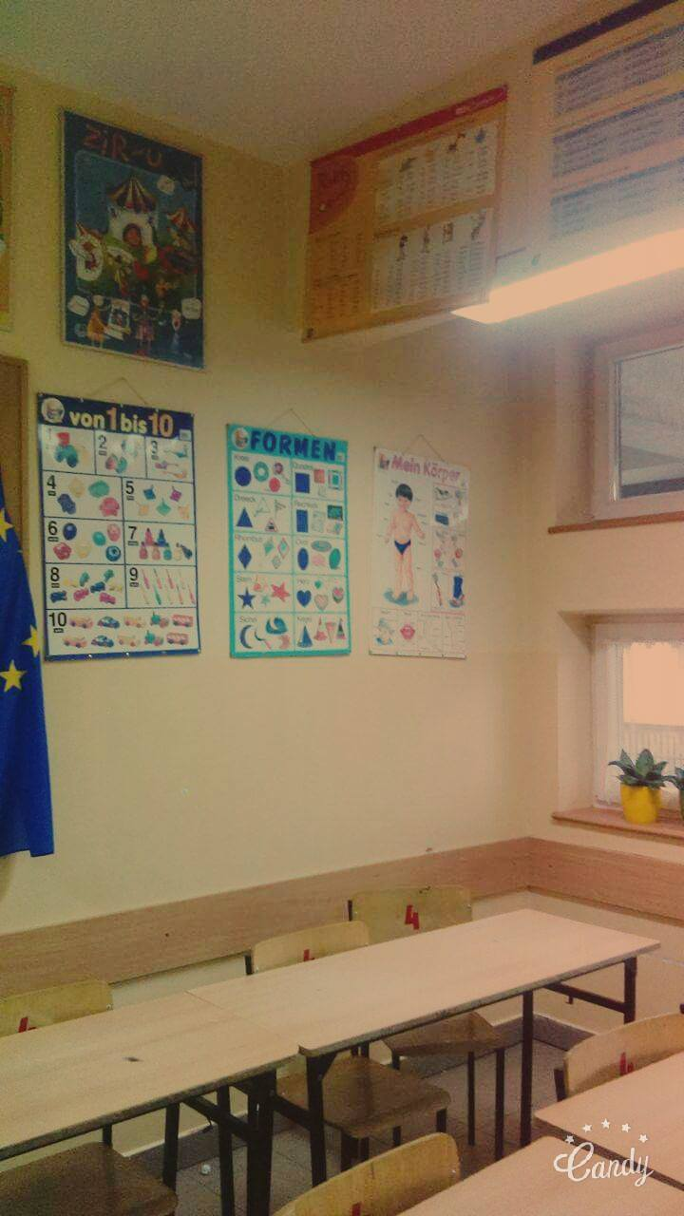
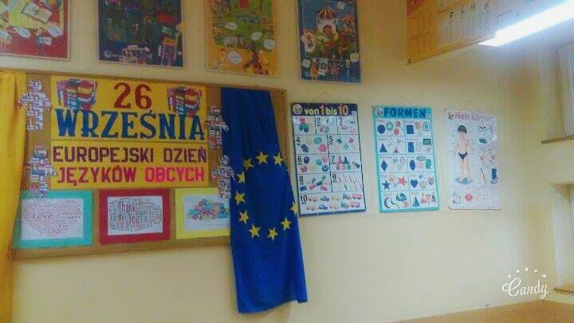
German Classroom

Slide 4
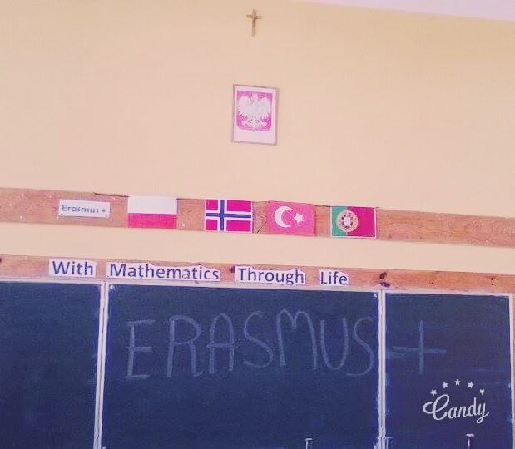
Englisch Classroom

Slide 5
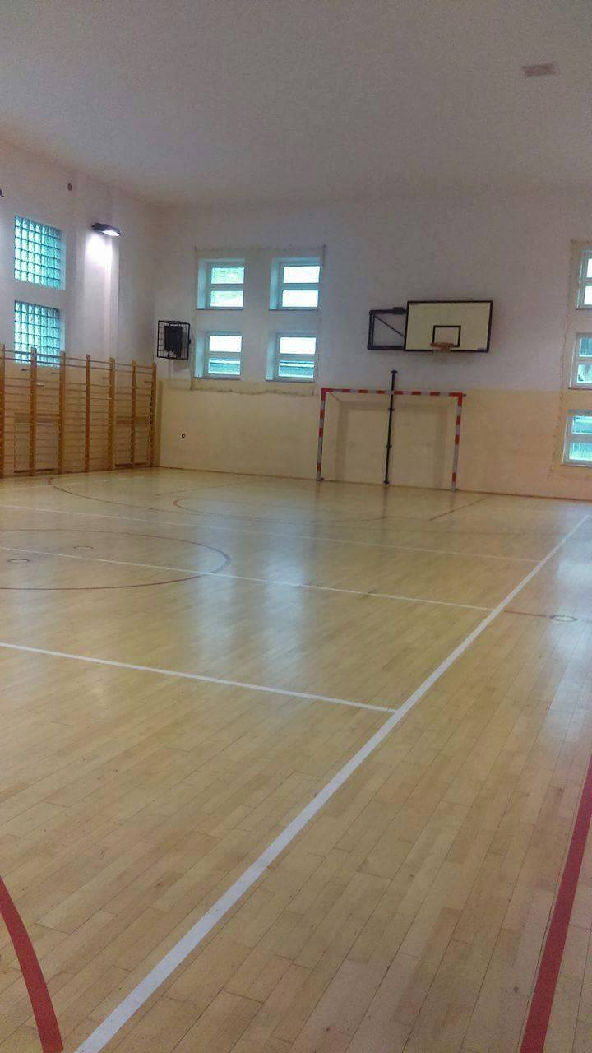
GYM

Slide 6
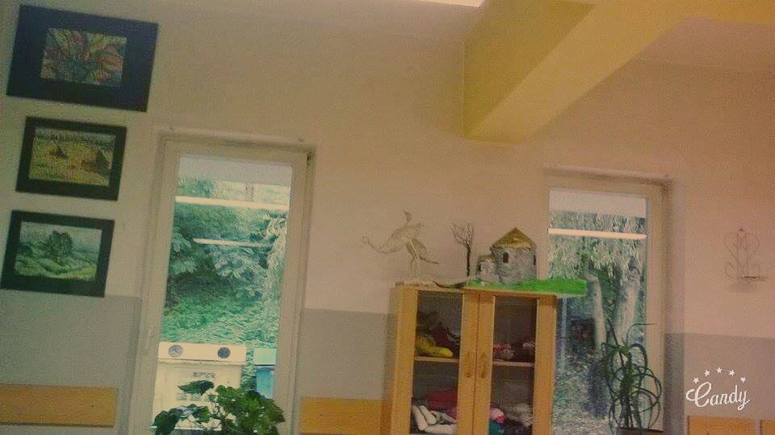
Art Classroom

Slide 7
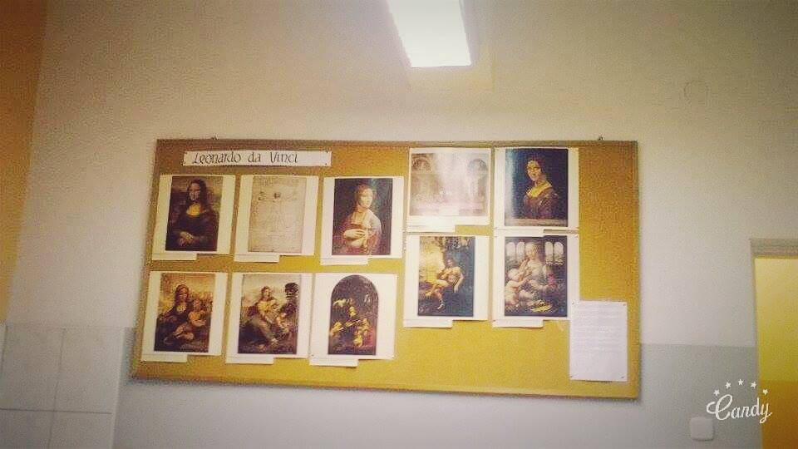
And next photo witch
art classroom ☹

Slide 8
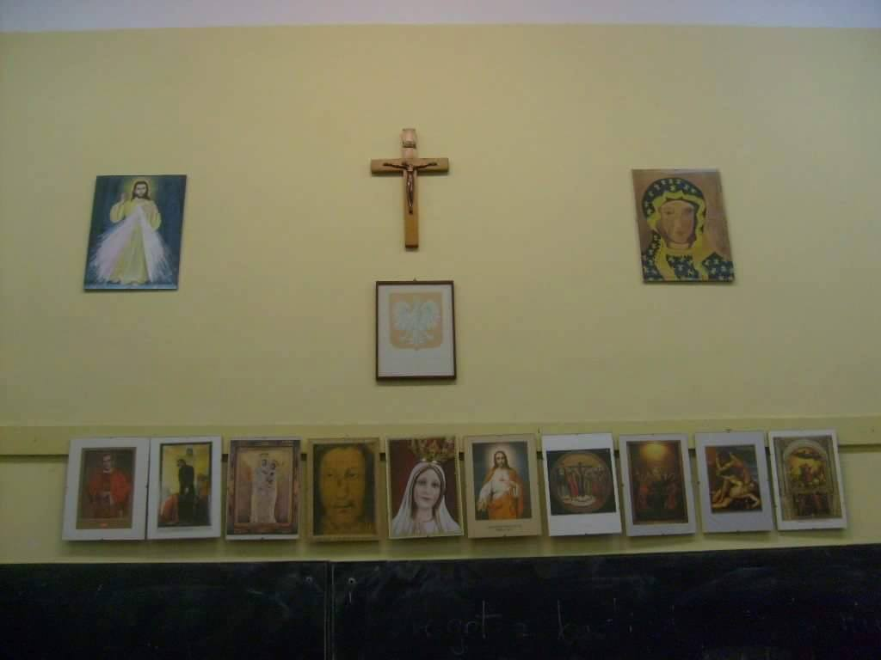
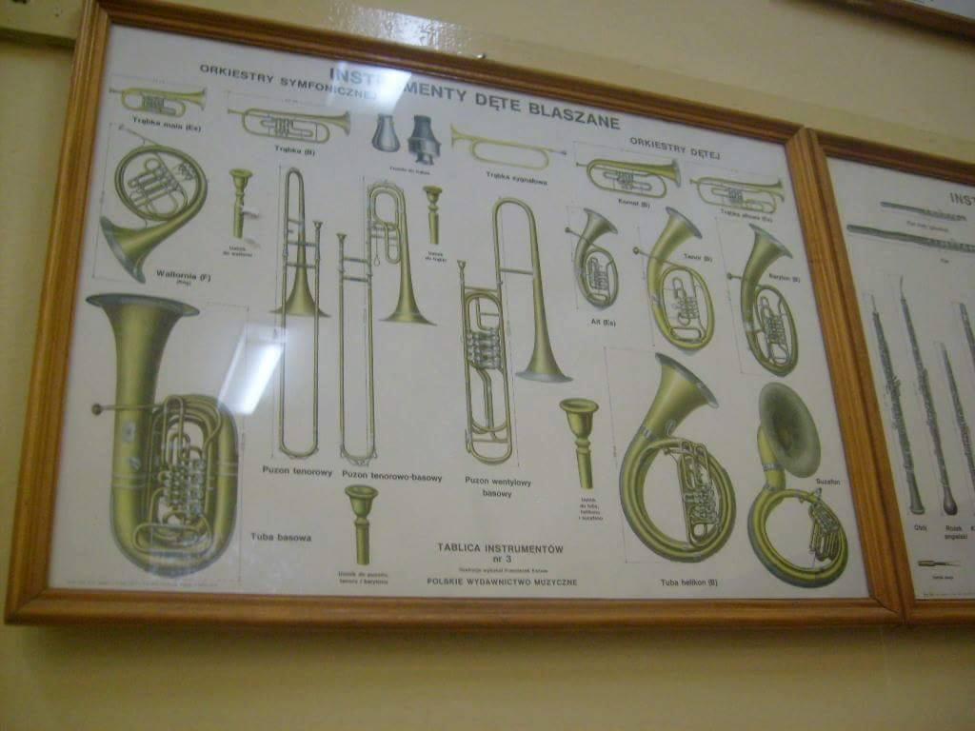
Religion and Music Classroom

Slide 9
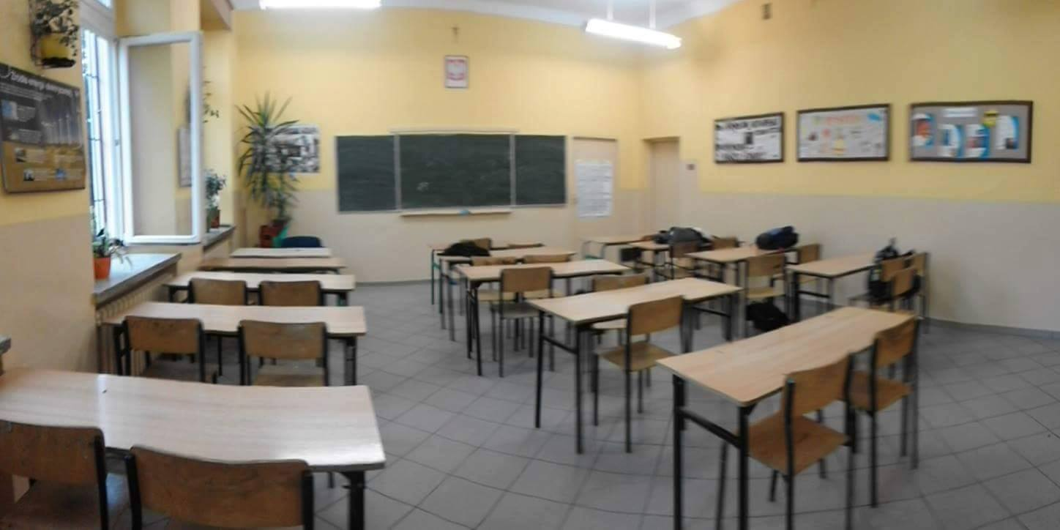
Psysics Classroom

Slide 10
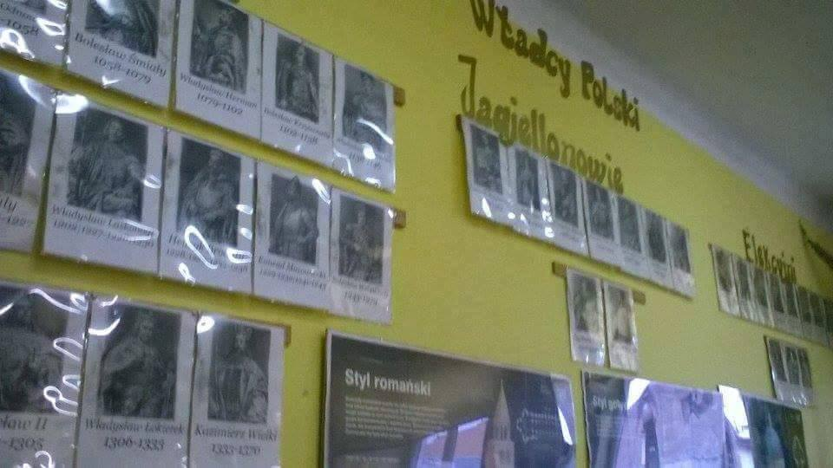
Historic Classroom

Slide 11
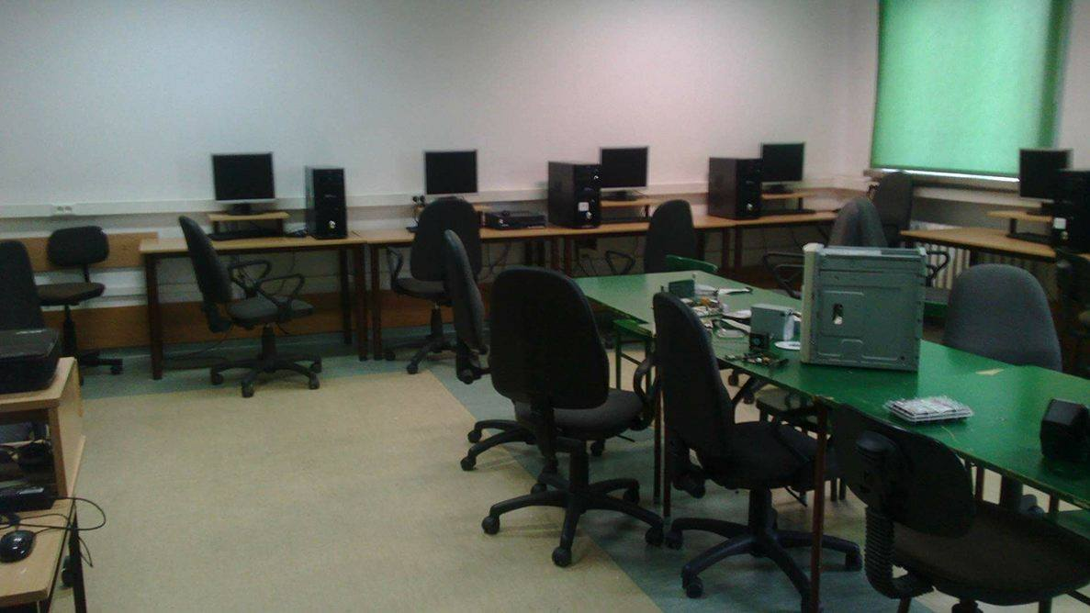
Informatic Classroom

Slide 12
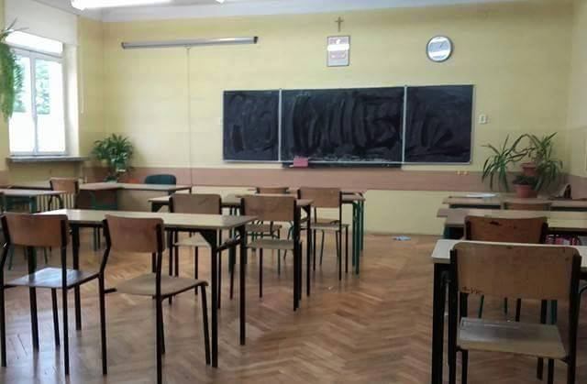
Polisch Classroom

Slide 13
And that is the END of my project.
If you read this its mean you survive this boring journey about my school but…
THANKS FOR READ :D
P.S
Special thanks for my friends who send me this photos . Thank you guys !

