Slide 1
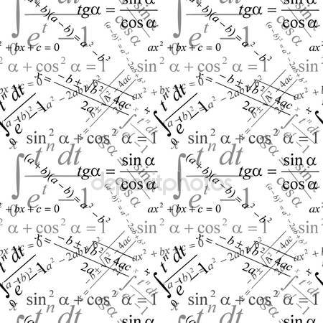
Polish Mathematicians

Slide 2
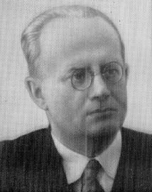
LEON CHWISTEK
He was born is June 13, 1884 in Cracow.
Parents: Bronisław i Emilia Mazowieccy
Wife: Olga Steinhaus
He was Polish painter, philosopher, mathematician, art theoretician, logician.

Slide 3
He was a professor at Lwowski University. During his life he mainly took up logic. Since 1922 he lectured on mathematics at Jagielloński University where he habilitated in mathematical logic in 1928. He taught mathematical analysis.

Slide 4
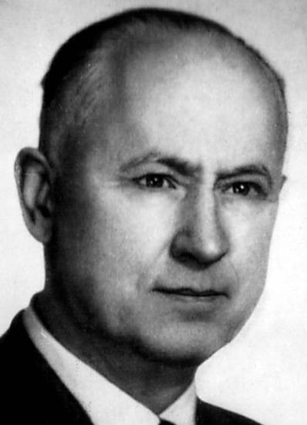
KAROL BORSUK
He was born in May 05, 1905 in Warsaw.
Parents: Marcin i Zofia z Maciejewskich
Daughter: Magdalena Białynicka-Birule
He was Polish mathematician.
He died in January 24, 1982 in Warsaw.

Slide 5
He lectured in 60 mathematical centres around the world. He was a member of Polish Mathematical Society and editorial committee of Bulletin "PAN" which concerned mathematics, physics and astronomy.
He was an outstanding specialist in a field of topology. He wrote and published over 170 research works. Many of them had an influence on topology. 133 of his chosen publications were published as "Collected Works".
He wrote several academic textbooks as well.

Slide 6
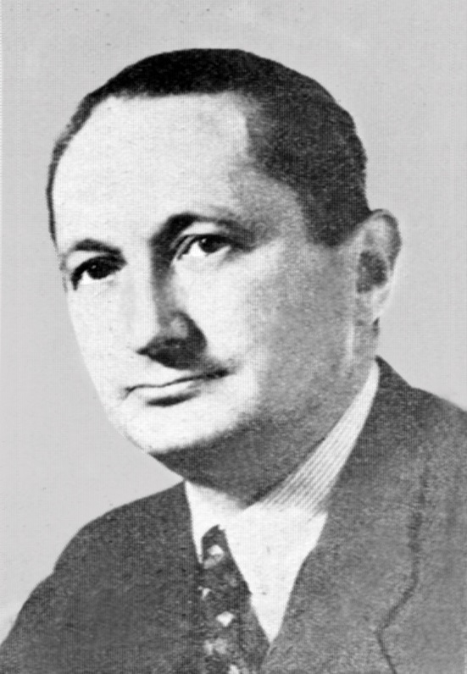
Kazimierz Kuratowski
He was born is February 02, 1896 in Warsaw.
Parents: Marek Kuratow i Róża Karzewska.
Daughter: Zofia
He was Polish mathematician.
He died in June 18, 1980 in Warsaw.

Slide 7
He was Professor of the Polytechnic Institute of forensic and Warsaw University. From his hands came a lot of work, mainly in the area of topology and set theory. During the SECOND world war, taught at a secret University in Warsaw, and after graduation got a job at the University of Warsaw. He was Chairman of the Polish Mathematical Society, the Director of the Mathematical Institute of the Polish Academy of Sciences, which was established on his initiative. Is the author of popularnonaukowej "a half century of Polish mathematics", and textbooks: Theory of sets introduction to set theory and topology, lectures differential calculus and one variable.

