Slide 1
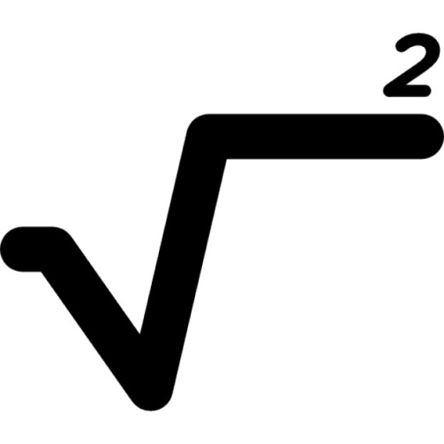
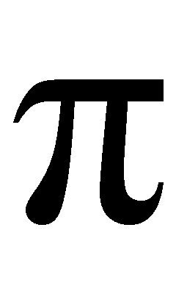
Polish mathematicians

Slide 2
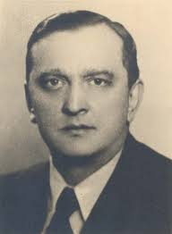
Stefan Banach
One of the most outstanding Polish mathematicians, self-taught, lecturer at the Institute of Technology in Lviv (since 1919) and Lviv University (since 1922), 1927 prof. ordinary mathematics at the University of Lvov, a member of the Polish Academy of Sciences and the Academy of Sciences of the Ukrainian SSR. One of the founders of the so-called. Lvov school of mathematics. Winner of Grand Prize PAU in 1939 was the beginning of modern functional analysis, made an important contribution to the development of the theory of topological vector spaces, moreover, he dealt with the theory of real numbers, and orthogonal series. During the German occupation was lice in Lviv Research Institute typhus R. Weigl. He died before repatriation. The most important work of Banach is considered Théorie des opérations linéaires (theory of linear operations, 1932). He was one of the initiators of publications and studies Mathematica Mathematical Monographs

Slide 3
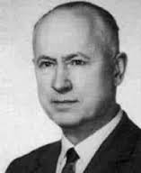
Karol Borsuk
One of the greatest topologists, creator of the theory of retracts and the theory of shape. Professor at the University of Warsaw. After World War II revived with K.Kuratowskim Warsaw mathematics center. He was the secretary, and in 1980-1982 he was editor in chief of Polish mathematical journal "Fundamenta Mathematicae".
Karol Borsuk created and developed the theory of retracts; introduced by him so. absolute retracts that are generalizations simplex and so. absolute retracts of surroundings, which are generalizations of polyhedra, proved to be important classes of topological spaces.
Badger was also the creator of the theory of shape, which gives the strict sense intuitions associated with the concept of the shape of the space.
Introduced to algebraic topology group kohomotopii space, also called groups of Borsuk-Spanier. Author approx. 200 scientific publications.

Slide 4
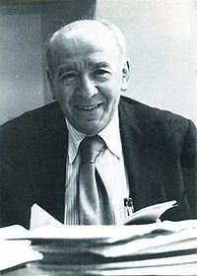
Mark Kac
Mark Kac (b. August 3, 1914 in Krzemieniec - d. October 26, 1984 in the US) - Polish mathematician working primarily in the United States.
1938 was the representative of the Lvov school of mathematics, since 1939 until 1961 he was a professor at Cornell University. He was a member of the American Academy of Arts in Boston and the National Academy of Sciences in Washington, DC;
His work mainly related to the theory of probability, but also dealt with other disciplines of natural, mainly physics and technology.

Slide 5
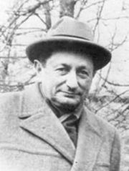
Kazimierz Kuratowski
Since 1927 Professor of Lviv Polytechnic, and since 1934 Warsaw University of Technology.
From 1945 member of the Polish Academy of Sciences, since 1952 a member of the Polish Academy of Sciences (in the years 1957 to 1968 - Vice President).
Since 1948 the director of the Institute of Mathematics (one of its founders), a longtime president of the Polish Mathematical Society and vice president of the International Mathematical Union.
Doctor honoris causa of many universities,
The author of numerous works in the field of topology (including basic monograph "Topologies" 1934), set theory and mathematical logic.
In the 1951 State Award.

