Slide 1
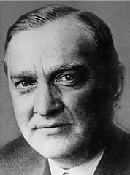
Stefan Banach

Slide 2
Who was Stefan Banach ?
Stefan Banach 30 March 1892 – 31 August 1945 was a Polish mathematician who is generally considered one of the world's most important and influential 20th-century mathematicians. He was one of the founders of modern functional analysis, and an original member of the Lwów School of Mathematics. His major work was the in 1932 book, Théorie des opérations linéaires (Theory of Linear Operations), the first monograph on the general theory of functional analysis.

Slide 3
Early life
Stefan Banach was born on 30 March 1892 at St. Lazarus General Hospital in Kraków, then part of the Austro-Hungarian Empire. Banach's parents were Stefan Greczek and Katarzyna Banach, both natives of the Podhale region. Greczek was a soldier in the Austro-Hungarian Army stationed in Kraków. Little is known about Banach's mother.
Unusually, Stefan's surname was that of his mother instead of his father, though he received his father's given name, Stefan. Since Stefan Greczek was a private and was prevented by military regulations from marrying, and the mother was too poor to support the child, the couple decided that he should be reared by family and friends. Stefan spent the first few years of his life with his grandmother, but when she took ill Greczek arranged for his son to be raised by Franciszka Płowa and her niece Maria Puchalska in Kraków. Young Stefan would regard Franciszka as his foster mother and Maria as his older sister. In his early years Banach was tutored by Juliusz Mien, a French intellectual and friend of the Płowa family, who had emigrated to Poland and supported himself with photography and translations of Polish literature into French. Mien taught Banach French and most likely encouraged him in his early mathematical pursuits.

Slide 4
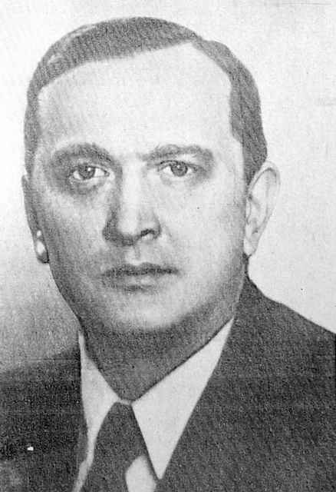
In 1902 Banach, aged 10, enrolled in Kraków's IV Gymnasium (also known as the Goetz Gymnasium). While the school specialized in the humanities, Banach and his best friend Witold Wiłkosz (also a future mathematician) spent most of their time working on mathematics problems during breaks and after school. Later in life Banach would credit Dr. Kamil Kraft, the mathematics and physics teacher at the gymnasium with kindling his interests in mathematics. While generally Banach was a diligent student he did on occasion receive low grades (he failed Greek during his first semester at the gymnasium) and would later speak critically of the school's math teachers.
After obtaining his matura (high school degree) at age 18 in 1910, Banach moved to Lwów with the intention of studying at the Lwów Polytechnic. He initially chose engineering as his field of study since at the time he was convinced that there was nothing new to discover in mathematics. At some point he also attended Jagiellonian University in Kraków on a part-time basis. As Banach had to earn money to support his studies it was not until 1914 that he finally, at age 22, passed his high school graduation exams.
When World War I broke out, Banach was excused from military service due to his left-handedness and poor vision. When the Russian Army opened its offensive toward Lwów, Banach left for Kraków, where he spent the rest of the war. He made his living as a tutor at the local gymnasiums, worked in a bookstore and as a foreman of road building crew. He attended some lectures at the Jagiellonian University at that time, including those of the famous Polish mathematicians Stanisław Zaremba and Kazimierz Żorawski, but little is known of that period of his life.

Slide 5
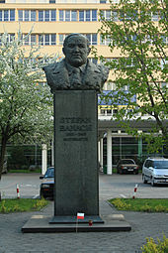
Scientific career
In 1916, in Kraków's Planty gardens, Banach encountered Professor Hugo Steinhaus, one of the renowned mathematicians of the time. According to Steinhaus, while he was strolling through the gardens he was surprised to overhear the term "Lebesgue integral" (Lebesgue integration was at the time still a fairly new idea in mathematics) and walked over to investigate. As a result, he met Banach, as well as Otto Nikodym.Steinhaus became fascinated with the self-taught young mathematician. The encounter resulted in a long-lasting collaboration and friendship. In fact, soon after the encounter Steinhaus invited Banach to solve some problems he had been working on but which had proven difficult. Banach solved them within a week and the two soon published their first joint work (On the Mean Convergence of Fourier Series). Steinhaus, Banach and Nikodym, along with several other Kraków mathematicians (Władysław Ślebodziński, Leon Chwistek, Alfred Rosenblatt and Włodzimierz Stożek) also established a mathematical society, which eventually became the Polish Mathematical Society.[The society was officially founded on April 2, 1919. It was also through Steinhaus that Banach met his future wife, Łucja Braus.

Slide 6
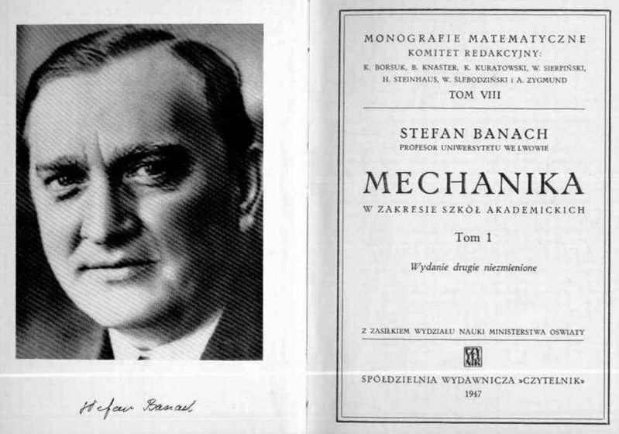
Professional achievements
He was a lecturer, author of Wielun textbooks, including textbooks for Mathematical High School.
The first works related ITS Ranks Fourier (first published work together with Steinhaus decided adversely problem of convergence of the average partial sums of Fourier series ), functions and Ranks orthogonal, Maxwell's equations, functions, derivatives, measurable functions, Theory of measure. The dissertation (published in 1922) AND monograph Théorie des opérations linéaires gave the first axiomatic definition of space, named later his name (Banach space), which he described as spaces of type B. cemented ultimately Basics extremely important in Modern applications of mathematics Analyses functional. He handed her the fundamental theorem, introduced IT terminologies, which accepted mathematicians worldwide.

Slide 7
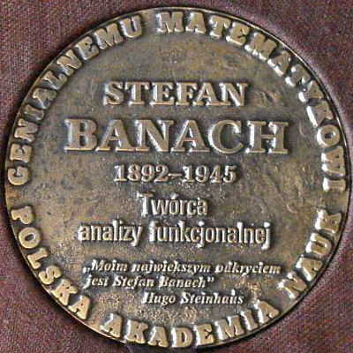
Death
After the re-occupation of Lvov by the Red Army (27 July 1944) continued his work at the University of Lviv as head of the department of mathematics. He also lectured at the Lviv Polytechnic Institute. He lived in a friend's family Lviv merchants Riedlów in the building at ul. Dwernickiego 12. The prepared his departure was fixed to Krakow, where he was to take lectures at the Jagiellonian University. In January 1945, however, he fell ill with lung cancer and the trip did not take place. He died on August 31, 1945, was buried in a tomb Riedlów the Lychakiv Cemetery in Lviv next to the grave of Maria Konopnicka. His funeral, which was attended by crowds of residents of Lviv, was a great manifestation of the Polish scientific community, which still remains in Lviv. At the cemetery Łyczakowski żegnało it 16 speakers.

Slide 8
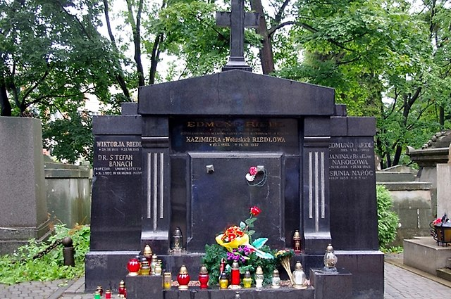
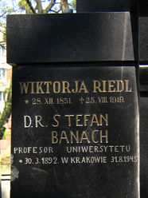
His grave

Slide 9
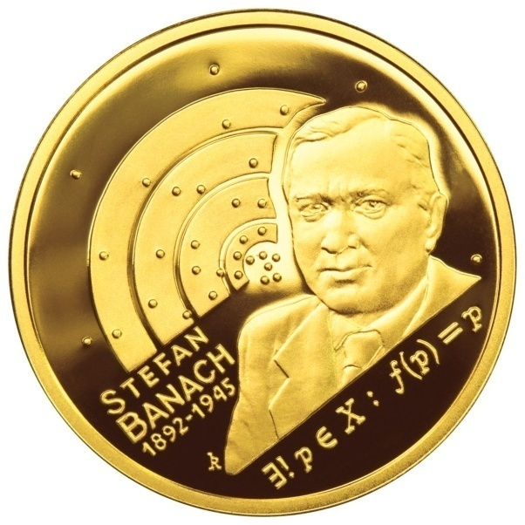
Commemoration
Polish Mathematical Society funded research award them. Banach (1946), his name streets in university towns, in 1972, created the International Center for Mathematical them. S. Banach at the Institute of Mathematics of the Polish Academy of Sciences, and in 1992 - the centenary of the birth - established Kill them. Banach Prize for outstanding achievements in the field of mathematical sciences . Since 2009 he is awarded the International Prize. Stefan Banach.
Since 2001, the asteroid number 16856 marked 1997YE8 named after Stefan Banach .
April 3, 2012, the National Bank of Polish commemorated Banach on the gold coin of 200 zł, 10 zł silver and 2 zł Nordic Gold. The coins were designed by Robert Kotowicz
October 14, 2016 year to Planty unveiled bench with figures of Stefan Banach and Otto Nikodym commemorating the 100 year anniversary of the conversation he held mathematicians, by the way you came to the meeting with Hugo Steinhaus .

Slide 10
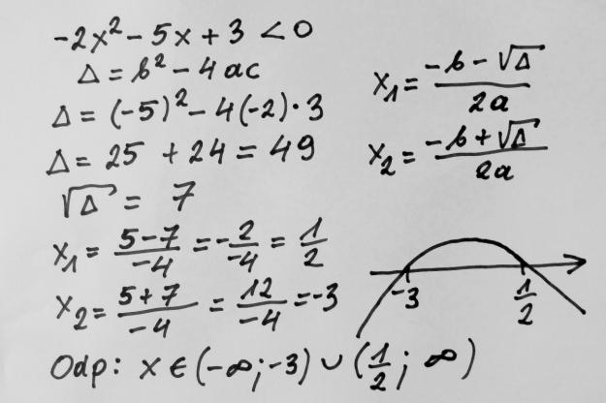
Other Polish Mathematicians

Slide 11
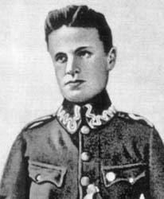
Zygmunt Janiszewski
Zygmunt Janiszewski (b. June 12 or July 12 [1] in 1888 in Warsaw, died. January 3, 1920 in Lviv) - Polish mathematician, organizer of science, one of the leading representatives of the Warsaw school of mathematics.
He studied in Zurich, Göttingen and Paris. Doctoral thesis Fri. Sur les continus irréductibles entre deux points, the promoter was Henri Lebesgue, defended in 1911. The examination committee consisted of mathematicians such as Henri Poincaré and Maurice Fréchet. In 1913 he published a fundamental work On cutting the plane by continua (O cutting the plane by continua) concerning topology of the plane.
In 1914-1915, a soldier of the Polish Legions. In 1918 he became professor at the University of Warsaw. In 1920, died at the age of 31 with the flu, the pandemic of 1918-1920 is known colloquially as the Spaniard. Inherited ancestral property and part of their income allocated for the purposes of educational and social.
His work mainly related to the topology, and therefore is considered one of the founders of the Warsaw school topology. As the author of the program for the development of Polish mathematics (which became the basis for the creation of Polish school of mathematics), he postulated the focus on set theory, topology and mathematical logic. He was a co-founder of the world's first specialized magazine mathematical "Fundamenta Mathematicae".

Slide 12
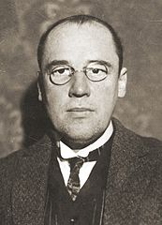
Wacław Sierpiński
Waclaw Sierpinski Francis (b March 14, 1882 in Warsaw, died October 21, 1969 r ..) - Polish mathematician, one of the leading representatives of the Warsaw school of mathematics and the founders of the Polish school of mathematics.
He left a huge scientific achievements, including, in addition to many books, 724 works and communications, 113 articles and 13 scripts. This included number theory, mathematical analysis, general and descriptive set theory, topology mnogościowej, measure theory and the theory of categories and functions of a real variable. Of particular importance are his works on the axiom of choice and the continuum hypothesis.
In 1906 he was awarded the degree of Doctor of Philosophy at the Faculty of Philosophy of the Jagiellonian University on the work of The summation of a series Σ + n2≤x f m2 (m2 + n2) (ITS promoter was botanist Edward JANCZEWSKI-Glinka). After returning to do warsaw taught in Polish schools Medium Private, Seminary Teachers weights Ursynowie and taught mathematics NA Higher Courses Scientific, equivalent unofficial Polish University in Warsaw.

Slide 13
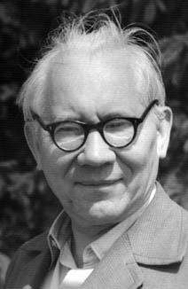
Władysław Orlicz
Wladyslaw Orlicz (b May 24, 1903 in Okocim, d August 9, 1990 in Poznan ..) - Polish mathematician, belonging to the so-called. Lvov School of Mathematics. He worked as a professor at the University of Poznan. His works are perpendicular series of functional analysis and foremost. Among his most important achievements was the development of the theory of some kind of functional spaces (Orlicz spaces and Musielak-Orlicz). He proved the theorem in the theory of Banach spaces called today say Orlicz-Pettisa.Studia polytechnic does not give him trouble. But they were not sufficient for him fascinating and when he decided to change the university. He began his studies at the Faculty of Philosophy (transformed into the Faculty of Mathematics and Natural Sciences) at the University of Lvov start exploring the secrets of mathematics.

Slide 14
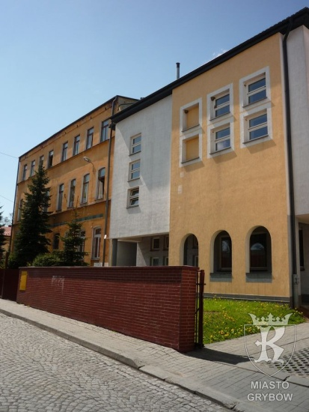
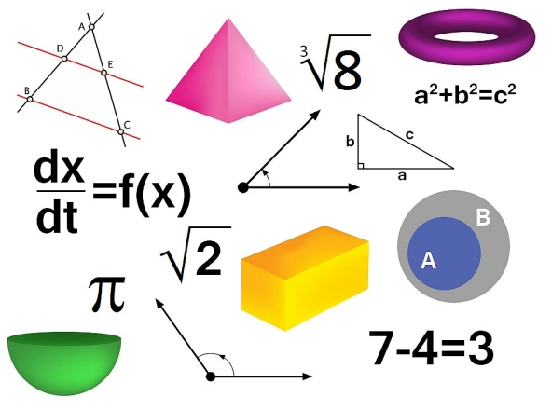
Thank you for watching my presentation of Polish mathematicians
BY KINGA GRUCA 2D

