Slide 1
MARIA SKŁODOWSKA-CURIE
Outstanding Polish chemist.

Slide 2
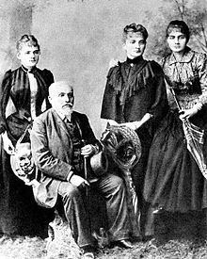
Childhood
Maria Skłodowska-Curie was born in Warsaw on November 7, 1867 year. She was the fifth and last child in the family Skłodowskich. When she was nine years died of her eldest sister Sophia. On the other hand, two years later, when Maria was 11 years old her mother died.
The photo shows part of the family Skłodowskich.

Slide 3
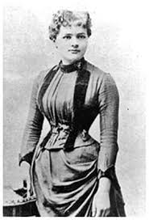
Youth
Maria Skłodowska began studying at the Sorbonne in November 1891 year. As a subject of study chose mathematics and physics. After graduating, Gabriel Lippmann helped Mary get scholarship on research related to the magnetic properties of different types of steel. At the same time Maria met with prof. Joseph Wierusza-Kowalskiego modest scientist - Pierre Curie

Slide 4
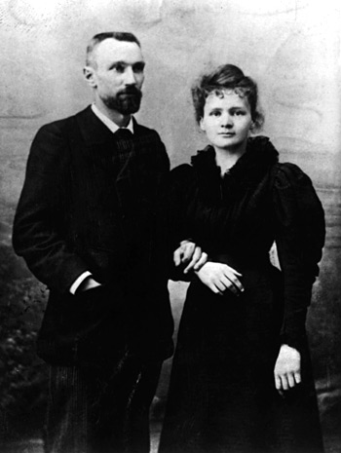
Marriage
Pierre Curie was interested in Chemistry, Physic, Mathematics. Maria and Pierre quickly found common topics of conversation. July 26, 1895, Maria Skłodowska and Pierre Curie entered into a legal marriage without a wedding ring and a priest. During the ceremony, accompanied by the only immediate family and a few friends. In the honeymoon they went on bicycles - a wedding gift from one of his friends
Wedding photo

Slide 5
Discoveries
Spouses Curie studied the radiation emitted by radium and polonium, stating, inter alia, that the compounds radioactive glow, radium salts give off heat, color the porcelain and glass, the radiation passes through the air and some of the body that can develop into molecular oxygen (O2) into ozone ( O3). Pierre Curie gave his arm several hours action of radium, and the resulting difficult wound healing observed and described. For his work spouses Curie were awarded numerous prizes, among others, Plante, Lacaze, Gegner, Osiris, Davy Medal. In 1903, Maria presented her thesis dissertation Fri. "Investigation of radioactive bodies." In August of this year she gave birth to a second daughter, who died after giving birth. W 1903 Maria and Pierre Curie received together with Becquerel the Nobel Prize in physics. December 6, 1904, Maria gave birth to a third daughter, Eve - a future biographer mother, pianist and peace activist.

Slide 6
The death of her husband
On Thursday, April 19, 1906 years Pierre Curie returning from meetings of the Association of Professors of the Faculties of Science died hit by a horse cart Cargo; when he was 47 years. Desperate Maria year led the so-called. "Official mourning," which described the pain, grief and emptiness which remained after the death of her beloved husband, a friend, a companion. In May 1906, the 38-year-old Maria got the chair of physics after her husband. The first lecture was conducted November 5, 1906 year. It was thus the first woman professor at the Sorbonne in Paris.

Slide 7
Further success
After the death of Pierre Maria gave herself entirely to: receive advice in the metallic state, developed and improved methods for isolating and obtaining new substances, said the definition of an international standard of radium. She also took an active part in international conferences and meetings, among others, Solvay conference. Together with a group of friends created a school where children were taught in an innovative way (in laboratories, museums, theaters). In 1911, Maria declared his candidacy for the French Academy of Sciences, but lost the vote. It should be emphasized that Mary was a Nobel laureate, three-time winner of the Academy of Sciences in Paris, held honorary doctorates universities including Edinburgh, Geneva, Manchester, was a member of the Academy of Sciences in St. Petersburg, Bologna, Prague, member of the Academy of Sciences in Krakow.

Slide 8
The death of a genius
In 1934, Maria began to feel worse and worse: she had a high temperature, chills appeared. Doctors diagnosed the flu, then tuberculous lesions in the lungs. They suggested a trip to the sanatorium. Maria and her daughter Eve as a nurse, she went to a sanatorium Sancellemoz in Passy. There is on-site doctors found the real cause of the weakening of Mary - pernicious anemia (also had radiation sickness caused by ionizing radiation) for fulminant course. Maria Skłodowska-Curie died there July 4, 1934 year. The funeral took place on July 6, 1934 in family and closest friends. Maria Pierre rested next to the cemetery in Sceaux. April 20, 1995, the remains of Pierre and Marie Curie were transferred to the Pantheon in Paris.

Slide 9
Thank you for watching the entire presentation.
Execution: Gabriela Główczyk

