Slide 1
Maria Skłodowska-Curie

Slide 2
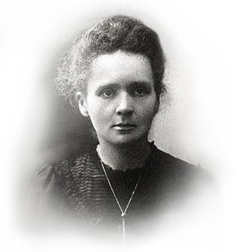
‘’Niczego w życiu nie należy się bać, należy to tylko zrozumieć.’’
Maria Skłodowska Curie

Slide 3
Maria Skłodowska- Curie was the first woman, who was awarded the Nobel Prize in Physics in 1902.

Slide 4
Maria Skłodowska- Curie was the first woman, who was awarded the Nobel Prize in Physics in 1902. Maria Skłodowska- Curie was the first woman, who was awarded the Nobel Prize in Physics in 1902. She got it together with her husband and Henri Becquerel for the discovery of radioactivity. She worked in Paris, together with her husband- Pierre Curie. In 1906 she got a job as a lecturer at the Sorbonne University. She was the woman lecturing there. In 1911 Skłodowska was once again awarded the Nobel Prize- this time in chemistry. She managed to discover and isolate two chemical components- radium and pollen. Up till now, no one else was awarded the Nobel Prize twice. To make things more unbelievable, her daughter- Irene Joliot- Curie, also got the Nobel Prize in Chemistry in 1935. Skłodowska is remembered as very wise, hard-working and extremely successful in her work person.

Slide 5
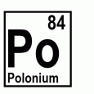
chemical components- radium and pollen

Slide 6
On 4 July 1934 Maria Skłodowska-Curie died for leukaemia in Sabaudia.She was decorated with a Legia Honorowa medal.

Slide 7
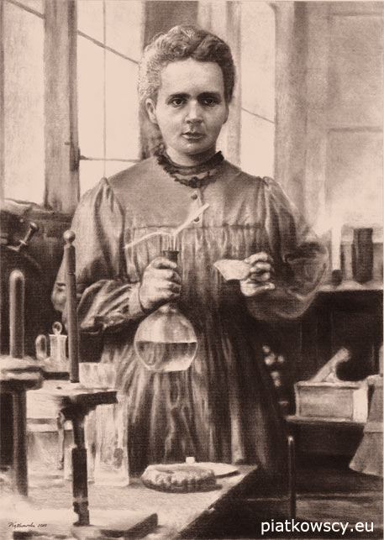
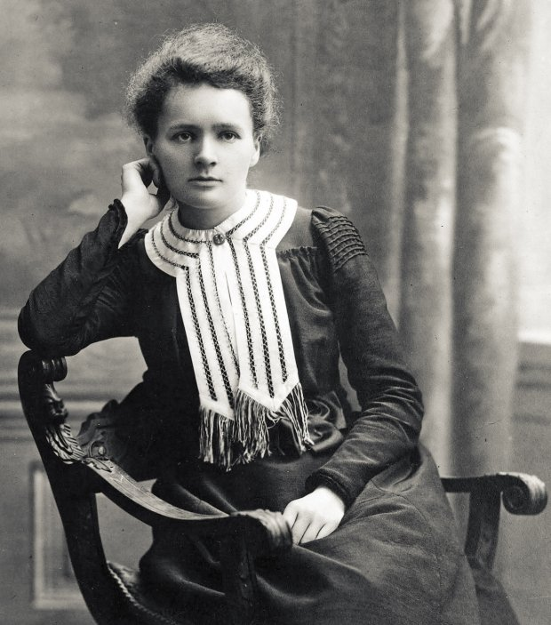

Slide 8
Thanks for watching ;)

Slide 9
Paulina Dyl
Class 2,,d’’

