Slide 1

Erasmus+ with Mathmatics Through life
2016-2018
Zağnospaşa Secondary School Balıkesir
TURKEY
MY SCHOOL

Slide 2
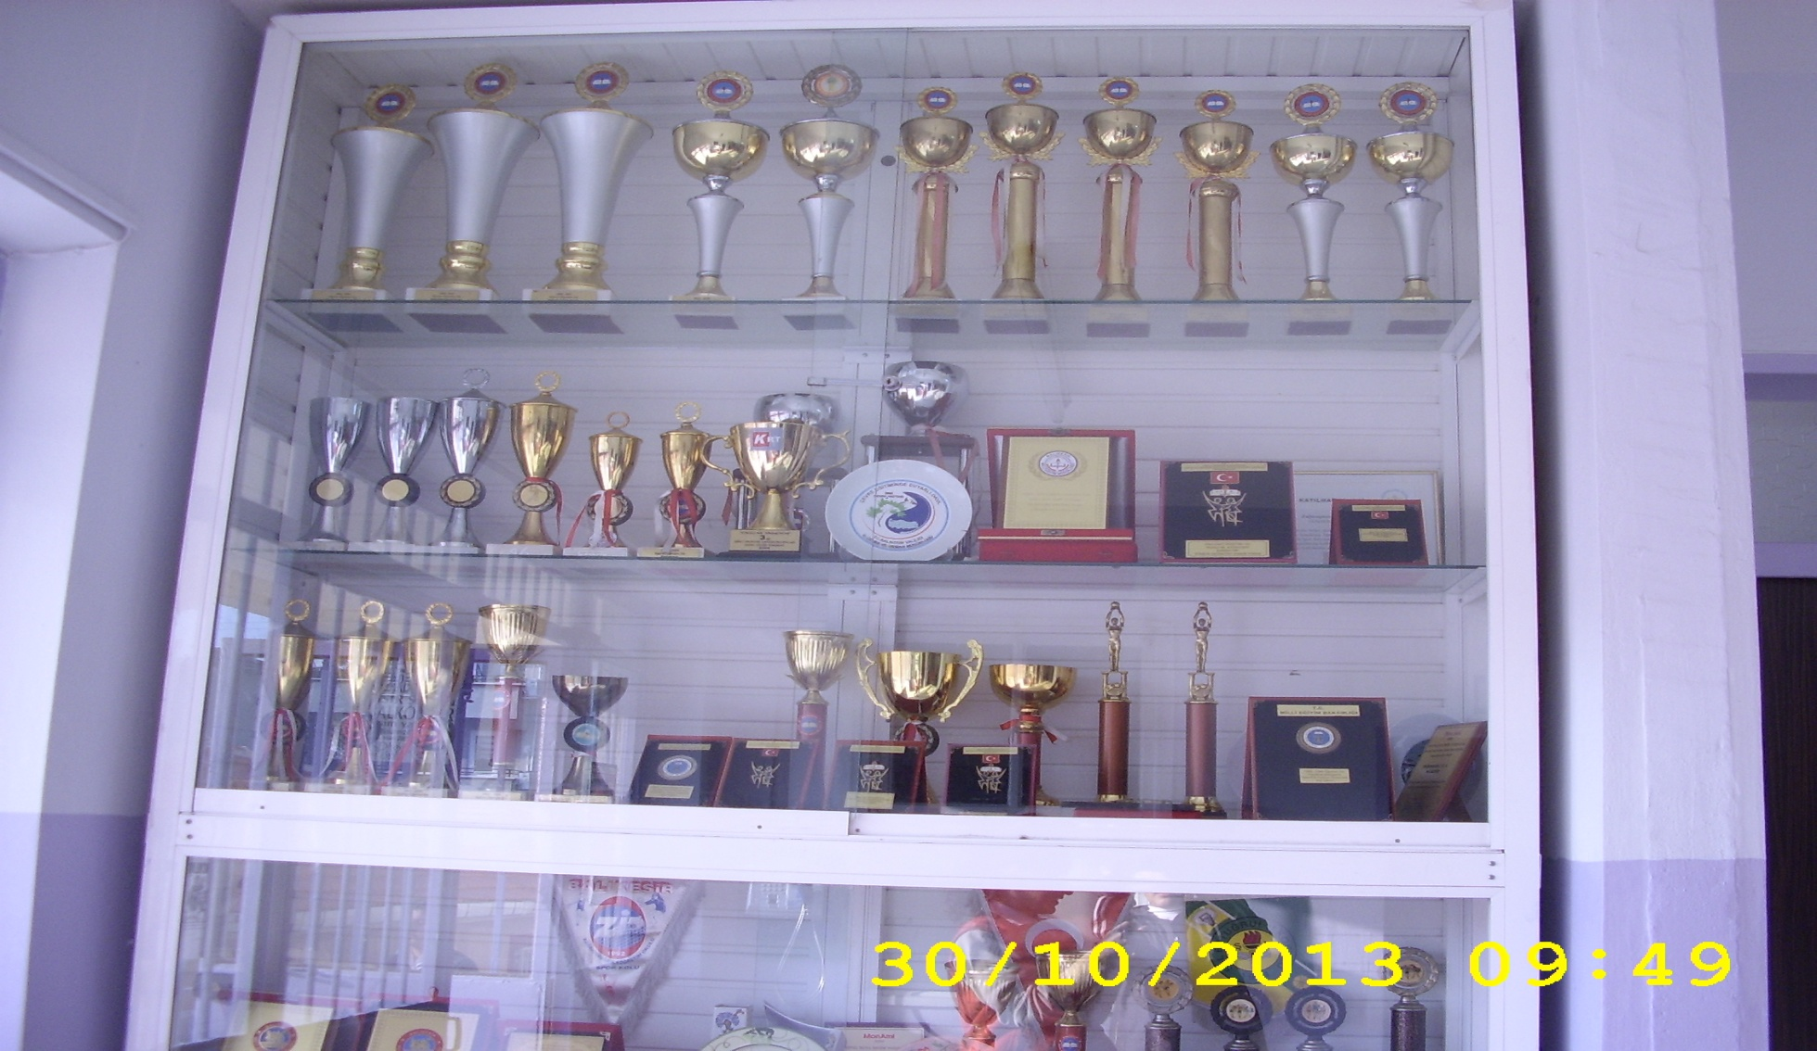
THIS IS OUR SCHOOL’S awaRds

Slide 3
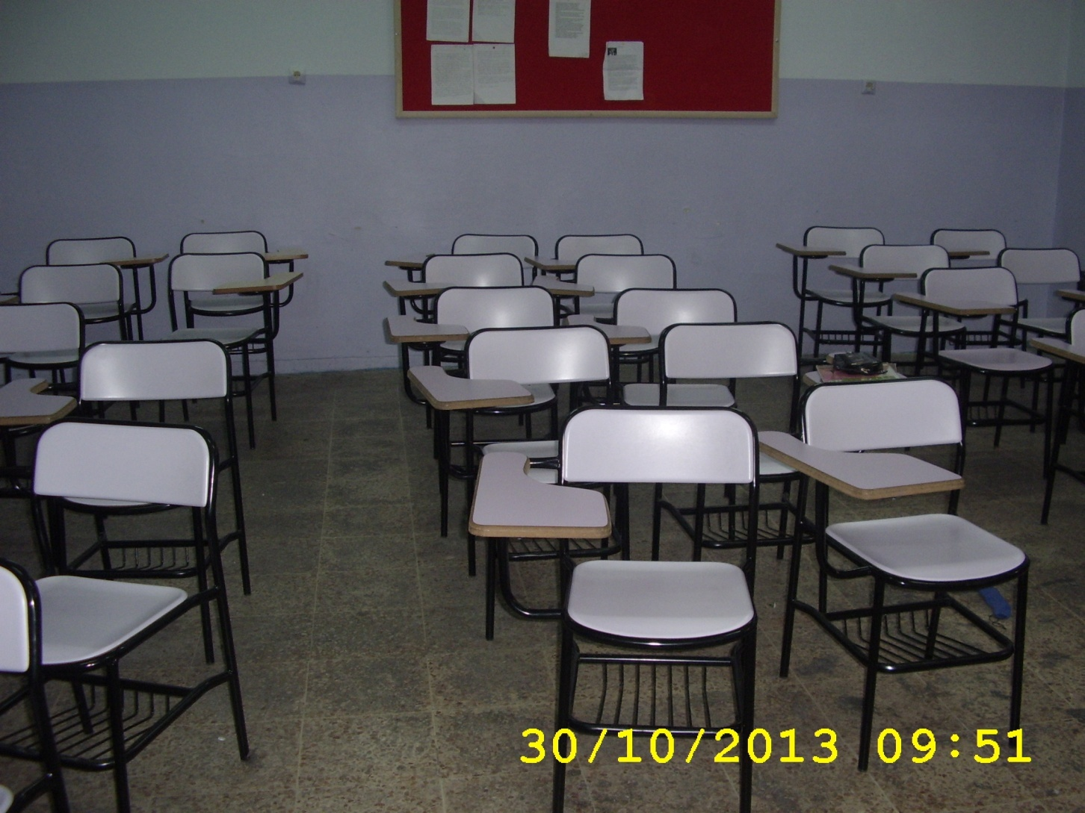
THIS IS OUR CLASS

Slide 4
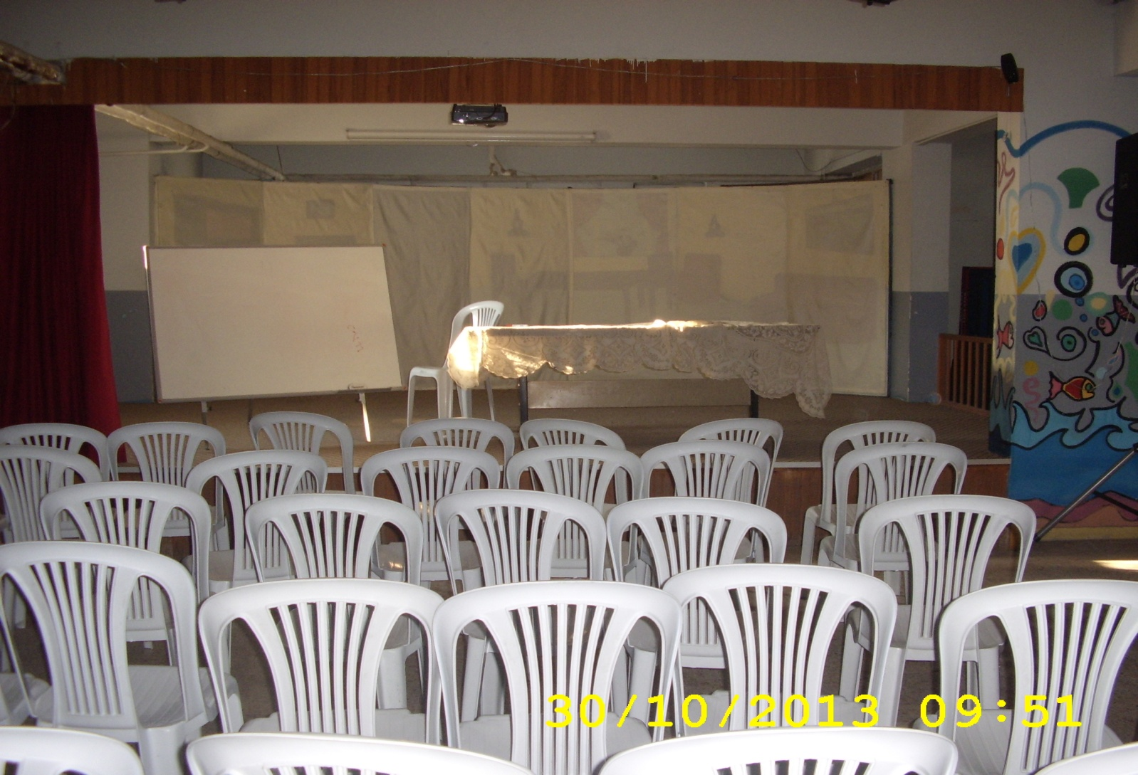
THIS IS OUR theatre

Slide 5
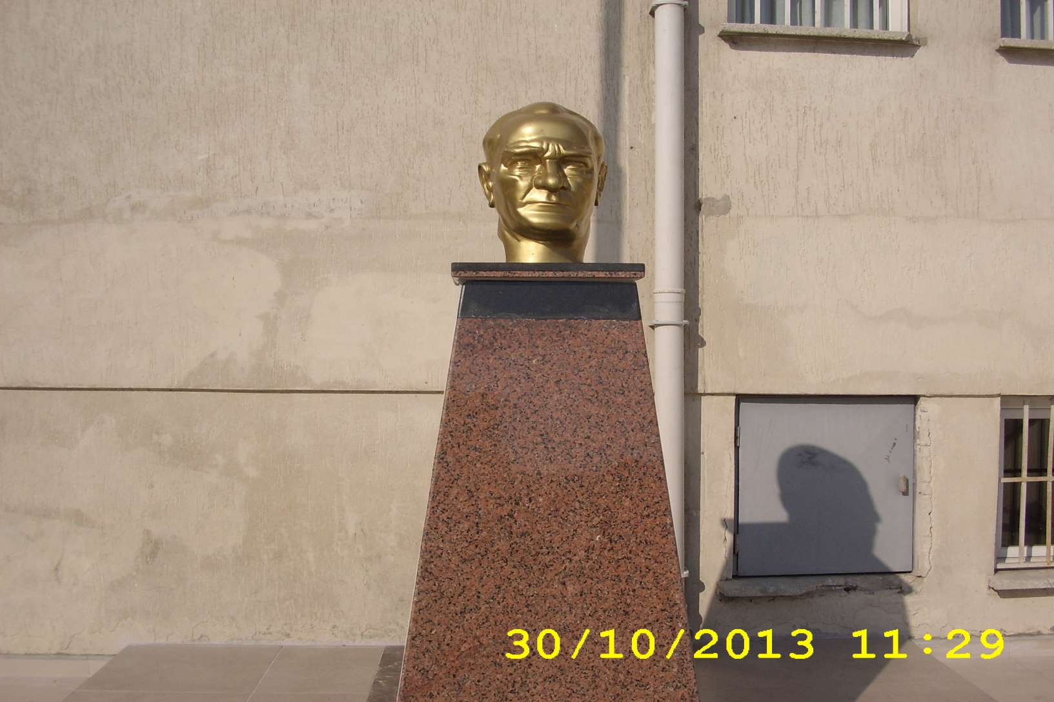
ATATÜRK’S BUST

Slide 6
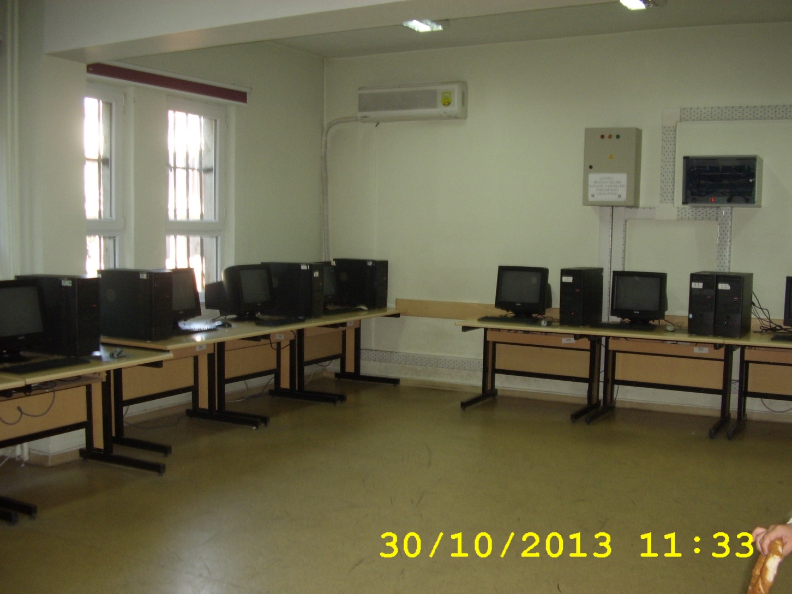
THIS IS OUR COMPUTER CLASSROOM

Slide 7
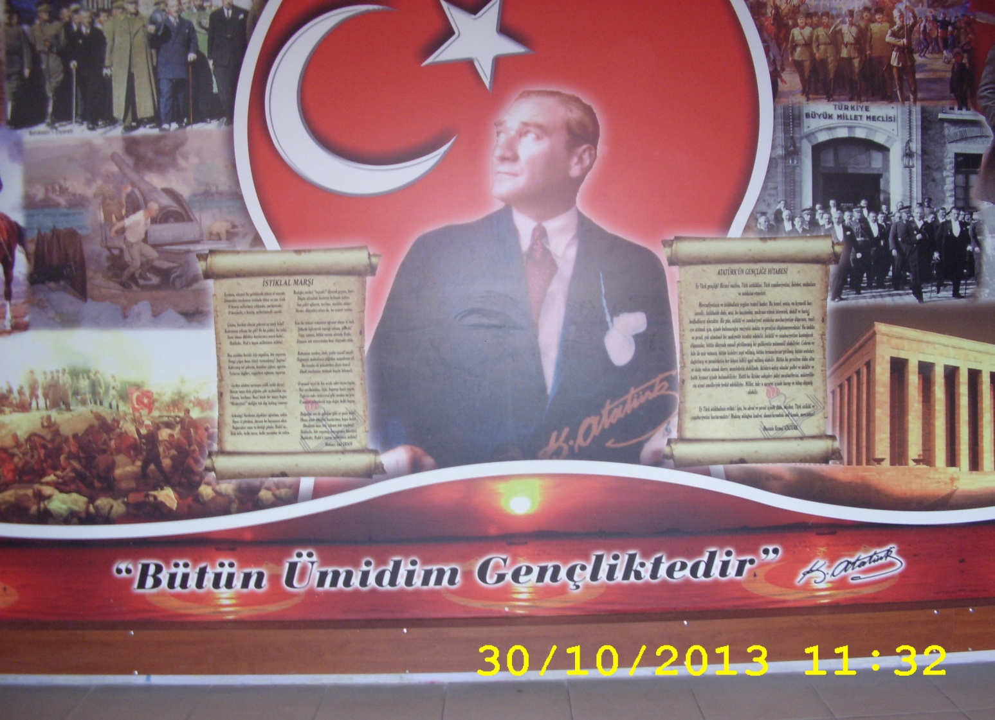
ATATÜRK’s Corner

Slide 8
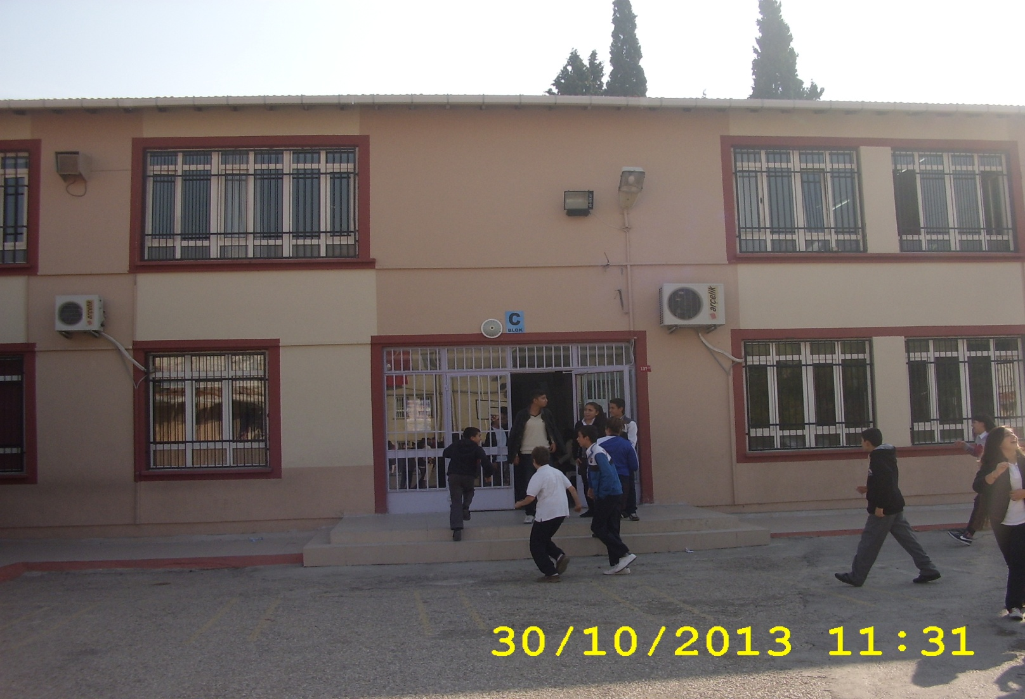
C BLOCK (school BuIldIng)

Slide 9
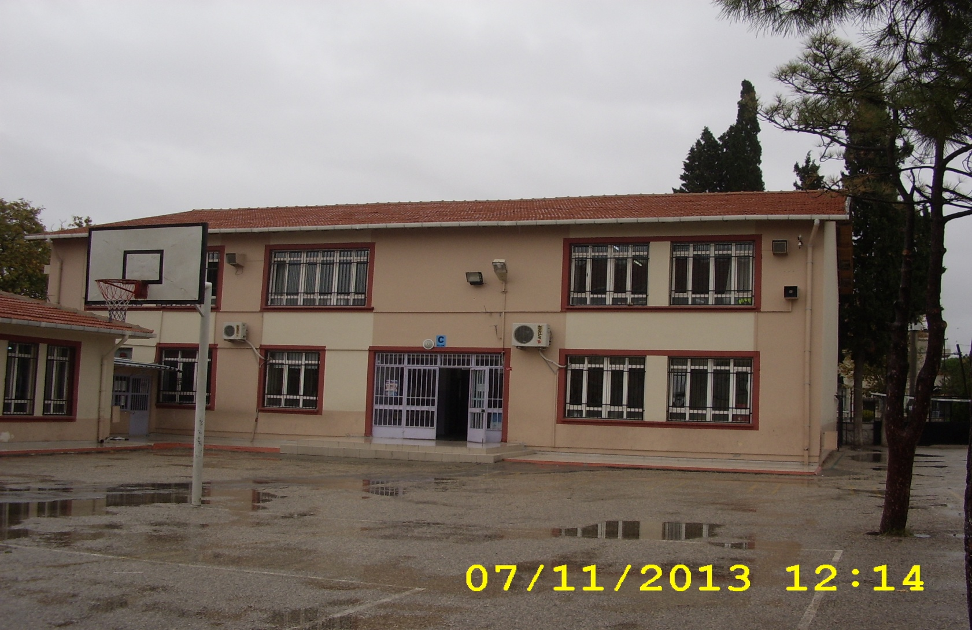
b BLOCK (school BuIldIng)

Slide 10
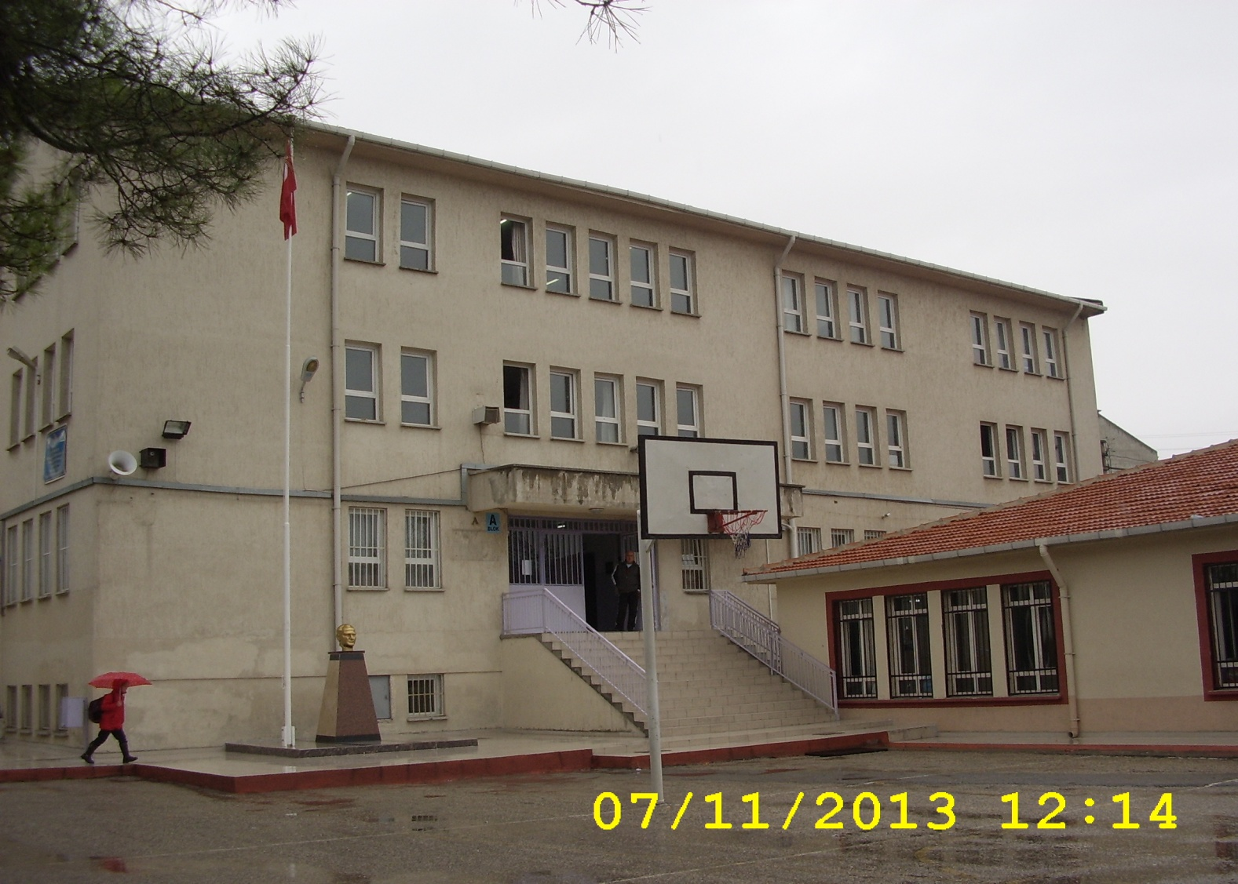
a BLOCK (school BuIldIng)

Slide 11
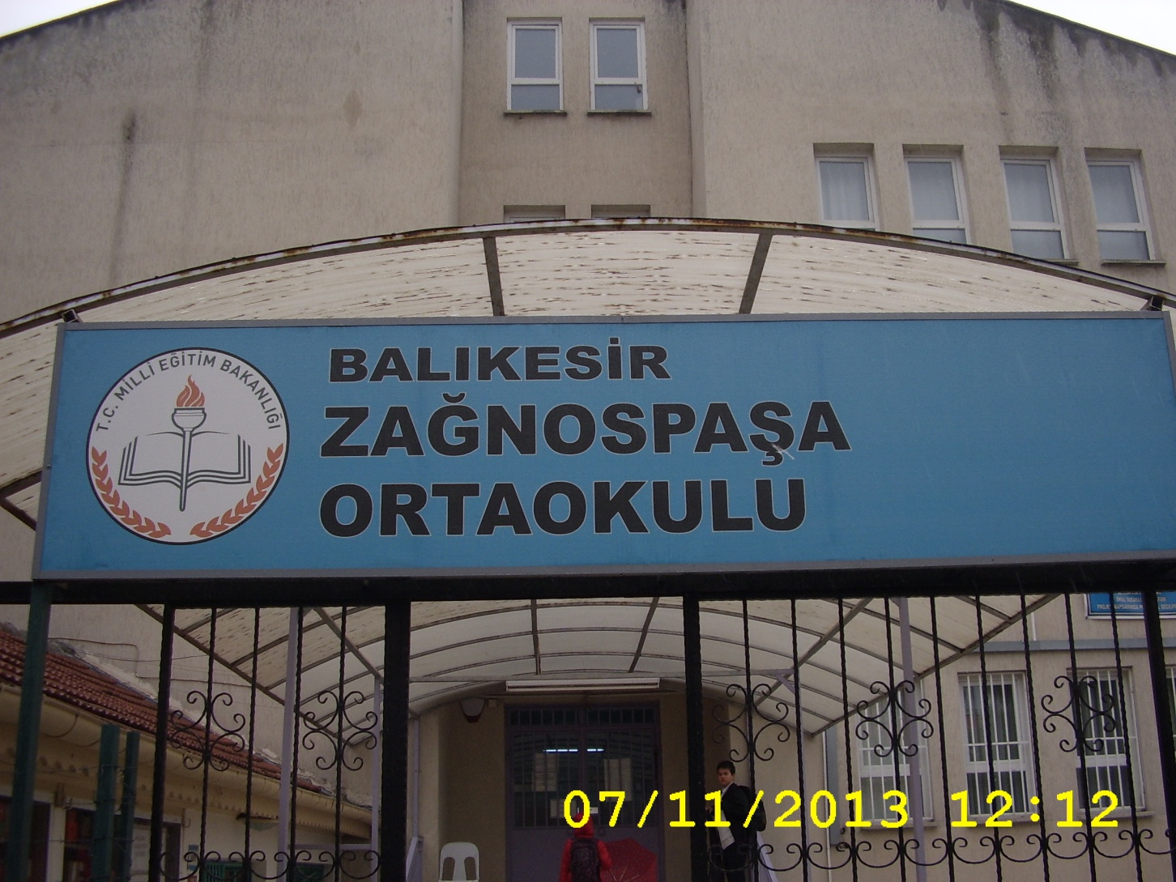
Gate of the school

Slide 12
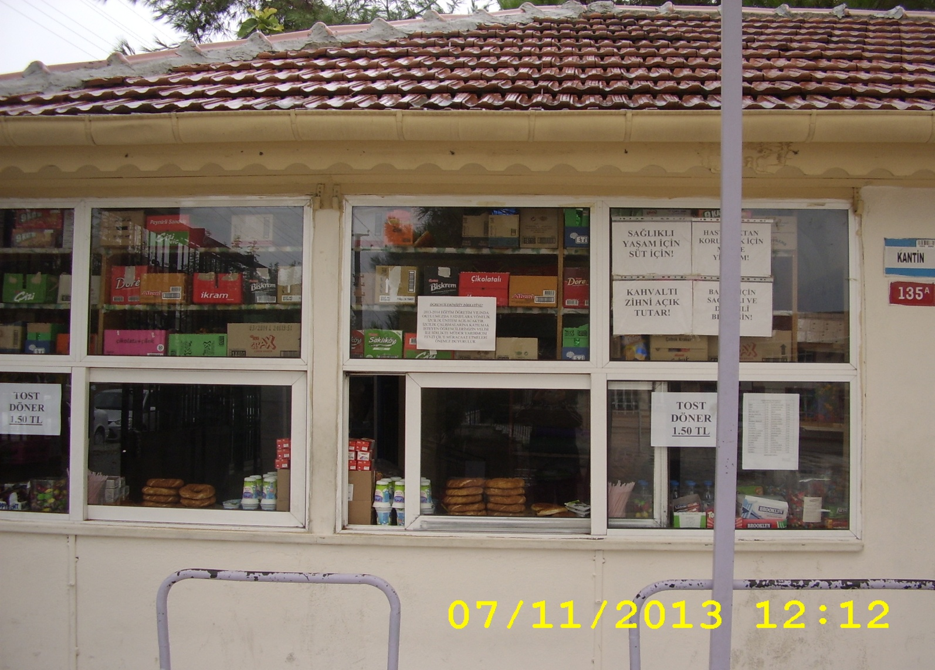
canteen

Slide 13
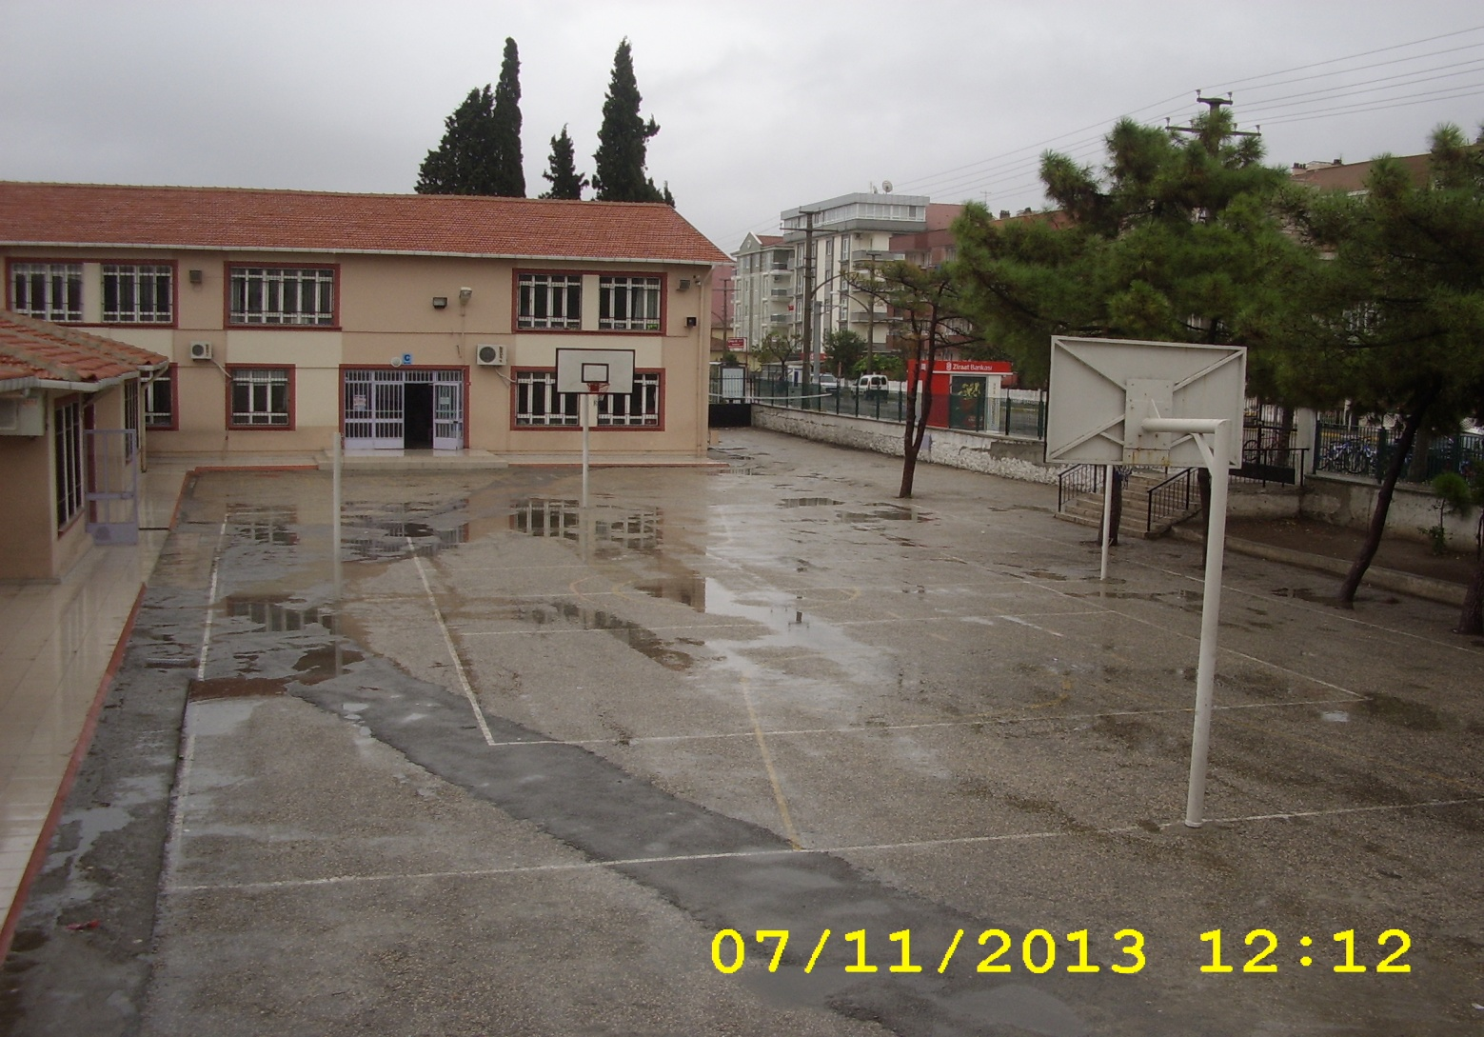
garden

Slide 14
PREPARED BY KÜBRA İREM EROĞLU

