Slide 1
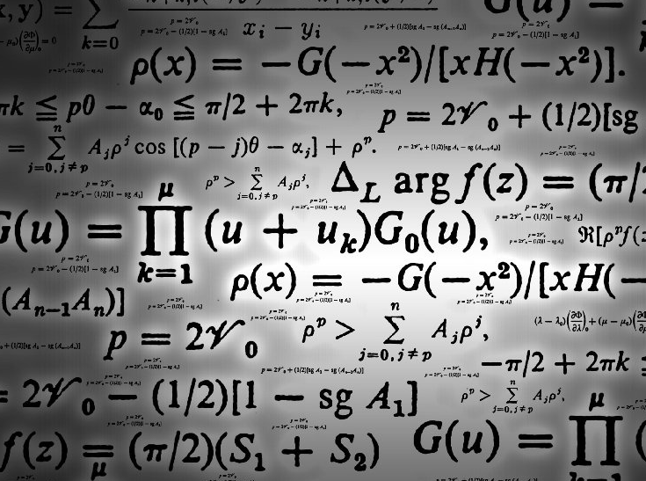
Polish
mathematicians

Slide 2
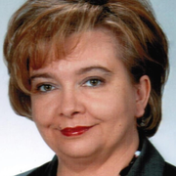
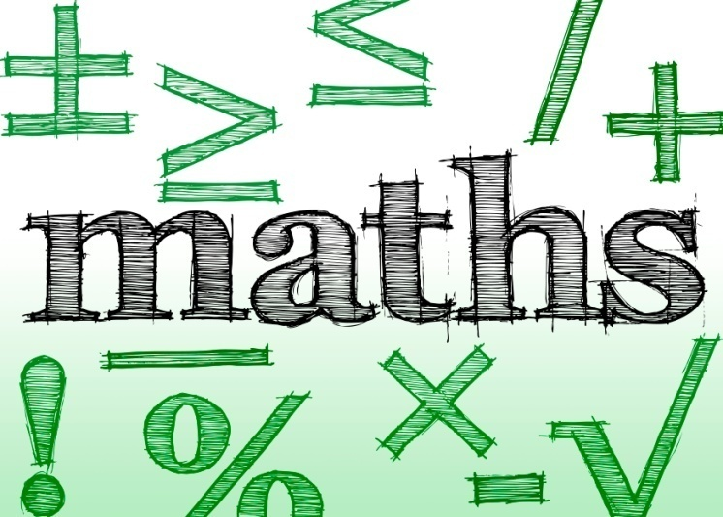
Aldona Dutkiewicz
Aldona Dutkiewicz - Polish mathematician.
Member of the Polish Mathematical Society.
Habilitation in 2014 on the basis of scientific achievements and work
Topological properties of sets of solutions of nonlinear integral equations
with kernel weakly singular differential equations and integral-higher orders.

Slide 3
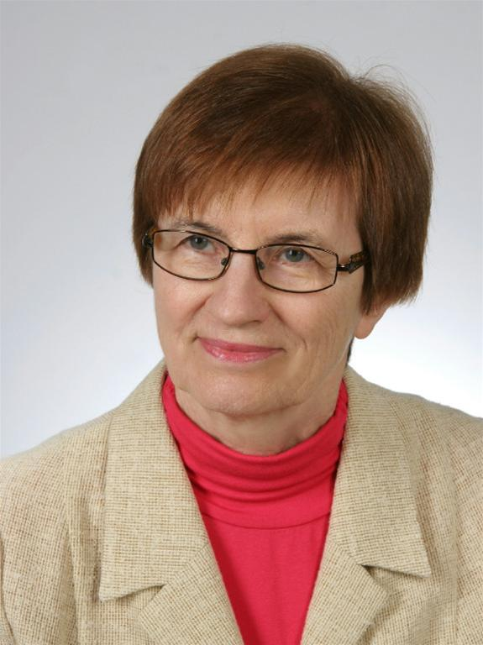
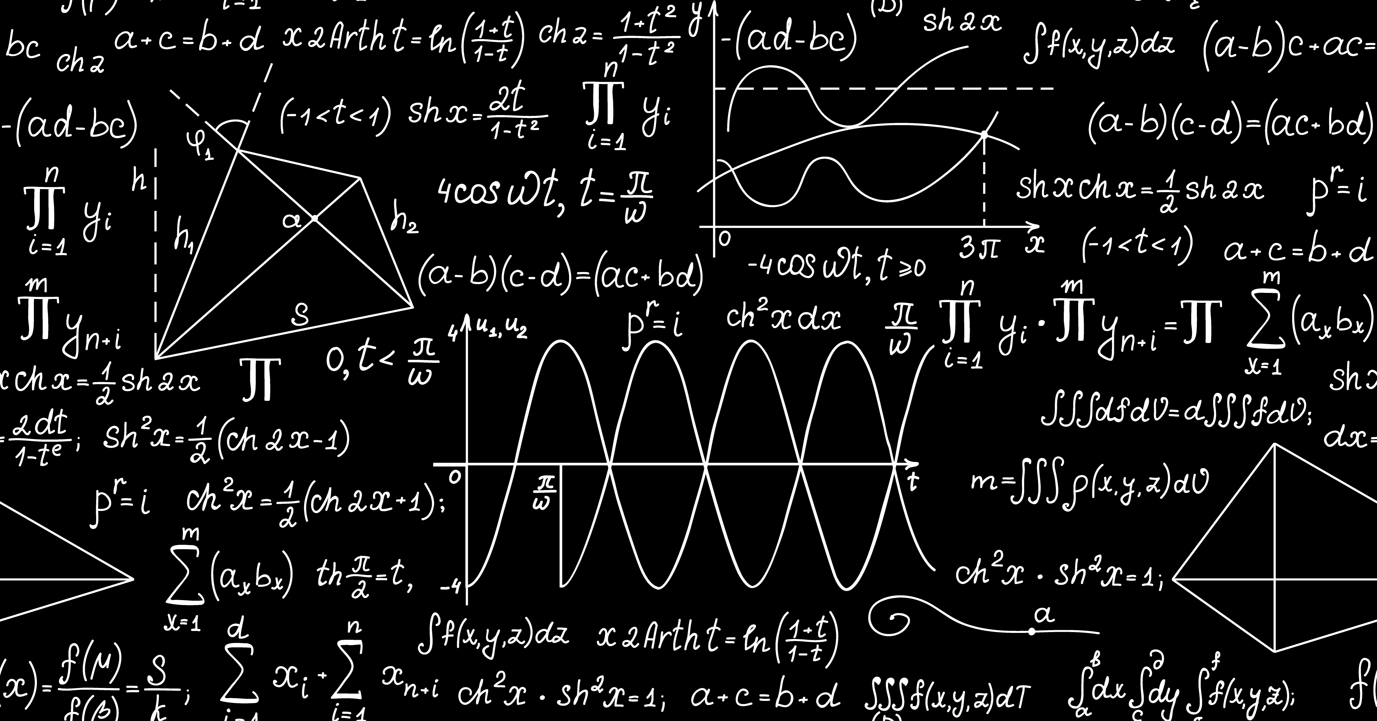
Magdalena
Jaroszewska
Magdalena Jaroszewska - Polish mathematician.
She worked as an extraordinary professor in the
Department of Real Function Theory WMiI UAM.
In 2013, she was a candidate for the prize in the competition "Science Populariser"
in recognition of the work of outstanding mathematicians.
She wrote the textbook "Mathematical Analysis" with Julian Musielak.

Slide 4
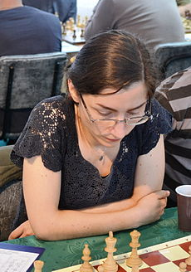
Małgorzata
Bednarska-Bzdęga
She was born on 4 October 1972 in Łódź.
She is Polish chess player,
champion of FIDE since 1992,
a professional mathematician.

Slide 5
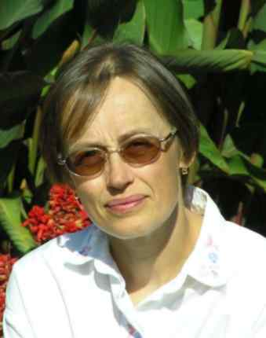
Ewa
Damek
She was born 9 August 1958 in Wroclaw.
In 1999 she was awarded the prestigious competition
of the Foundation for Polish Science for the stipends for scholars.
She is the author or co-author of more than 20 extensive scientific
papers published in mathematical journals of international scope.

Slide 6
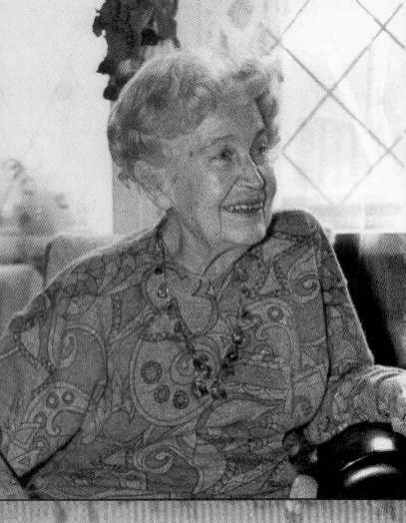
Helena Rasiowa
Helena Rasiowa was born 20 June 1917,
died 9 August 1994
was a Polish mathematician.
She worked in the foundations of
mathematics and algebraic logic.
Helena Rasiowa worked in the Polish
Mathematical Society in 1955-1957.
She was his secretary, and in the
years 1958-1959 vice-chairman.V

Slide 7
Thank you for
watching ☺
By Aleksandra Kaflińska

