Slide 1
Famous Polish Mathematicians
Kinga Sekuła kl. 2d
Poland

Slide 2
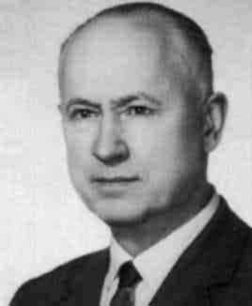
Karol Borsuk (1905 - 1982)
One of the most prominent topologists, creator of the theory of retract sand the theory of the shape. Professor Of The University Of Warsaw. After World War II, reactivated along with k. Kuratowskim the mathematical Centre in Warsaw. He was Secretary, and in the years 1980-1982, the editor-in-Chief of the Polish Journal Fundamenta math. Karol Borsuk has created and developed the theory of retract; made by him. retracts absolute, that are generalizations model spaces. absolute retracts of surroundings that are generalizations Polyhedra, have proved to be important classes of topological spaces. Badger was also the theory of shape, in which suitable strict meaning of the term related intuition the shape of space. Introduced to algebraic topology group kohomotopii space, also known as Badger groups-Spaniera. The author of the ok. 200 scientific publications.

Slide 3
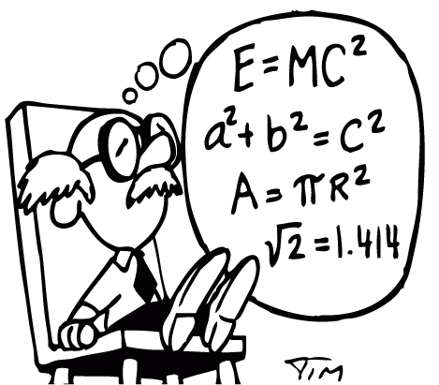
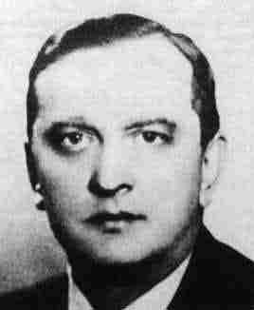
Stefan Banach (1892 - 1945)
One of the most outstanding Polish mathematicians, self- taught, lecturer at the Institute of Technology in Lviv (since 1919) and Lviv University (since 1922), 1927 prof. Ordinary mathematics at the University of Lvov, a member of the Polish Academy of Sciences and the Academy of Sciences of the Ukrainian SSR. One of the founders of the so- called. Lvov school of matematics. Winner of Grand Prize PAU in 1939 was the beginning of modern functional analysis, made an important contribution to the development of the teory of topological vector spaces, moreover, he dealt with the teory of real numbers, and orthogonal series. During the German occupation was lice in Lviv Research Institute typhus R. Weigl. He died before repatriation. The most important work of Banach is considered Theorie des operations lineaires( theory of linear operations, 1932). He was one of the initiators of publications and studies Mathematica Mathematicial Monographs.

Slide 4
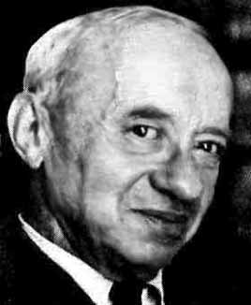
Alfred Tarski (1901-1983)
Alfred Tarski (actually Alfred Teitelbaum)- Polish mathematician origin of Jewish, one of the gratest logicians of all time. Alfred Teitelbaum was born on 14 January 1901 year in Warsaw. He underwnet a thorough education- m. In studied Russian, German, French, Greek and Latin.
He was also a visiting professor at universities in Mexico, Los Angeles, Chile, London and the Sorbonne. Alfred Tarski worked in many areas of matematics m.in. set theory, algebra, mathemathematics, as well as logic and philosophy. With many achievements Tarski, the most famous is called. The paradox of Banach- Tarski, co- authored by Polish mathematician Stefan Banach. This is not actually a paradox, but paradoxically sounding assertion, saying that
(assuming the axiom of choice), the ball can be broken down into parts, which can lodge two balls of the same diameter as the original. The assertion ordered many mathematicians cautious approach to the axiom of choice, which seems tobe a seemingly intuitively.

Slide 5
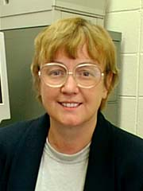
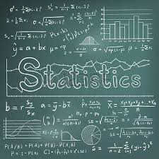
Krystyna M.Trybulec-Kuperberg (1944 )
Krystyna Kuperberg, great American mathematician Polish, considered by journalists for herself then closely watched modern amazements of the world, was born in 1944 in Tarnów as Krystyna Trybulec. Her parents were pharmacists. At the age of 15 she moved with his family to Gdańsk. In 1962, she joined the University of Warsaw, where she met her future husband (also a student), also an eminent mathematician Vladimir. They have two children: son Greg Kuperberg is also a Professor of mathematics, the daughter of Anna (here you can see her gorgeous work) K. Kuperberg mainly occupied with topology, devoting his attention also discrete geometry. In 1987 she solved a former very difficult problem Knaster. In the late 1980s took the issue of fixed points and topological aspects of dynamic systems. In 1993 she obtained a counter-example. assumption (hypothesis) Seifert (on some properties of vector fields on the surface of the sphere), eliminating them; This was considered an extraordinary achievement. This work continued jointly with his son. Since 1993, had more than 50 lectures on this topic, including highly Honorable AMS Plenary Lecture in 1995, and MAA Plenary Lecture in 1996. In 1995, k. Kuperberg received the prestigious award. The Alfred Jurzykowski Prize. In 1996 she received the Research Excellence Award from the College of Sciences and Mathematics of Auburn University. It is also extremely active in the American Mathematical environment.

Slide 6
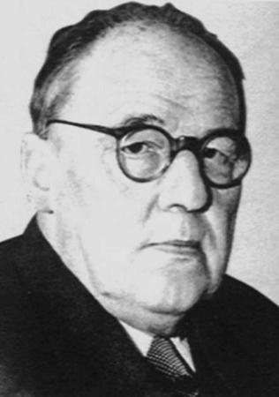
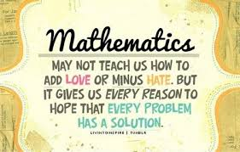
He was born March 14, 1882 in Warsaw into the family of Konstanty, a doctor, and Louise Lapinska. In 1900, he graduated from the gymnasium in Warsaw, and in the same year he began his studies at the Faculty of physical and Mathematical of the Imperial University of Warsaw. In 1904 he finished his studies, obtaining the degree of candidate of Sciences and the gold medal for his work on the theory of numbers on given by Prof. g. f. Woronoja, and from the fall, he was appointed teacher of mathematics and physics at the high school. He participated in the school strike in 1905, left his job and moved to Kraków, where he continued his studies at the Faculty of Philosophy of the Jagiellonian University. He retired from the Institute and the University in the 1960s. All those years was very active. The number of universities where he taught, rose to 47; He was awarded many national and foreign decorations; He received numerous honorary membership of national and foreign scientific institutions membership societies. He was a member of the real PAN (from 1952) and its Vice-President (1957), a member of the International Academy of the philosophy of science in Brussels and its Vice President (1962-1965), as well as a member of the international Accademia dei Lincei in Rome, the Academy of Sciences in Lima and Paris and the Academy: Bulgarian, Czechoslovakian, Dutch, Yugoslav, German, the Pope, Romanian and Serbianand and member of many more organizations. He left behind a huge scientific, covering, in addition to the many books, 724 work and messages, 113 articles and 13 scripts. This work focused on number theory, mathematical analysis, General and descriptive mnogościowej topology, set theory, measure theory and category theory variable actual. Of particular significance are his works on axiom choice and continuum hypothesis. He was one of the founders of the Polish school of mathematics. Died on 21 October 1969 in Warsaw.
Wacław Franciszek Sierpiński (1882-1969)

Slide 7
Thank you for watching ☺
Kinga Sekuła kl. 2d

