Slide 3
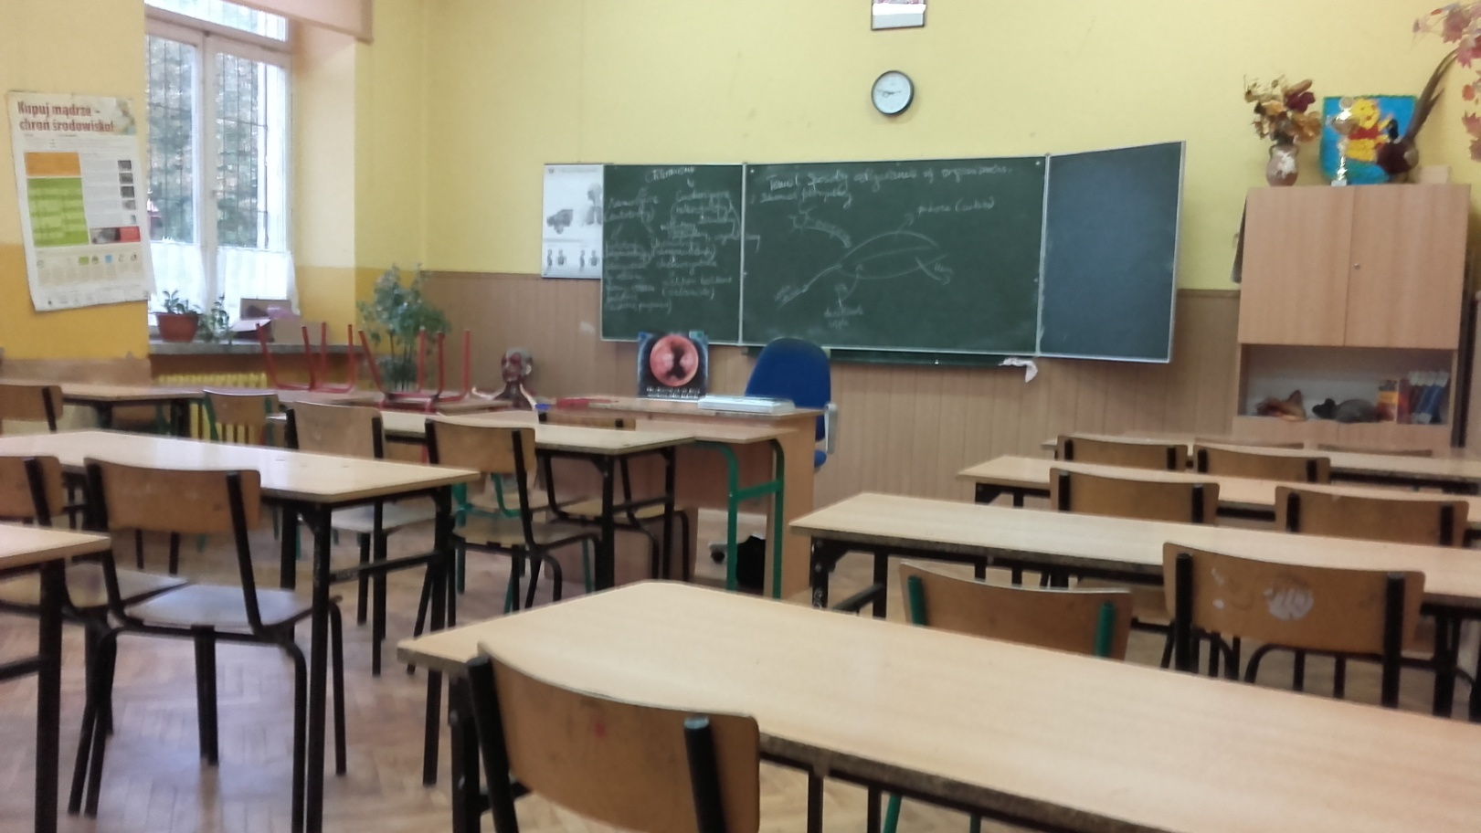
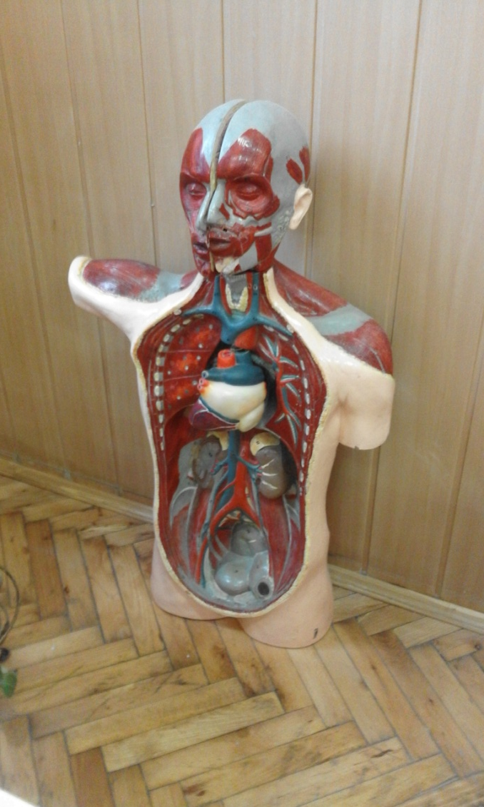
BIOLOGICAL CLASSROOM

Slide 4
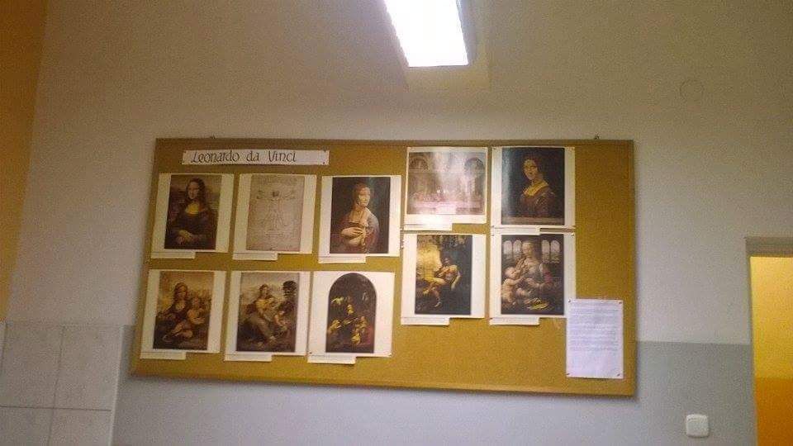
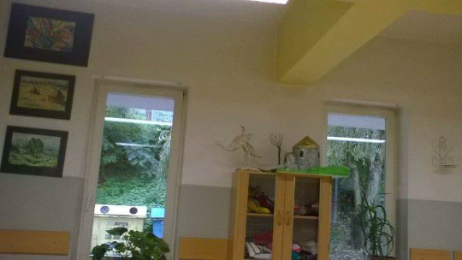
ART CLASSROOM

Slide 5
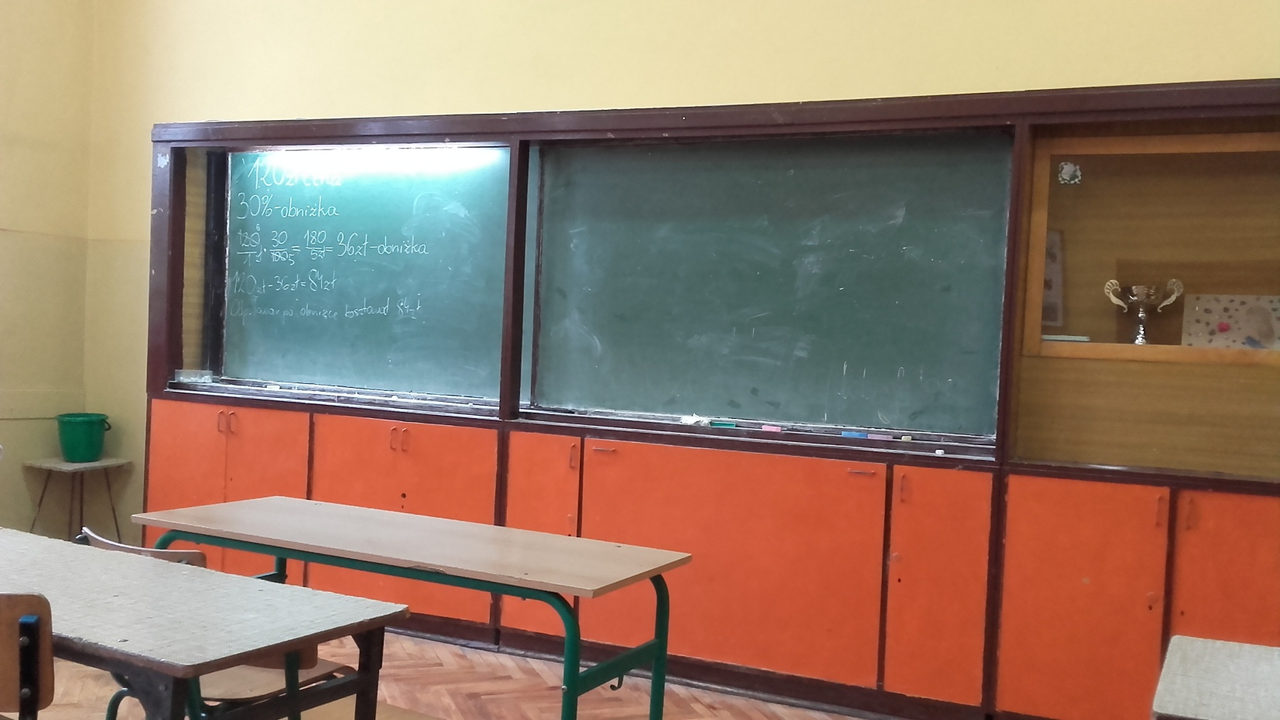
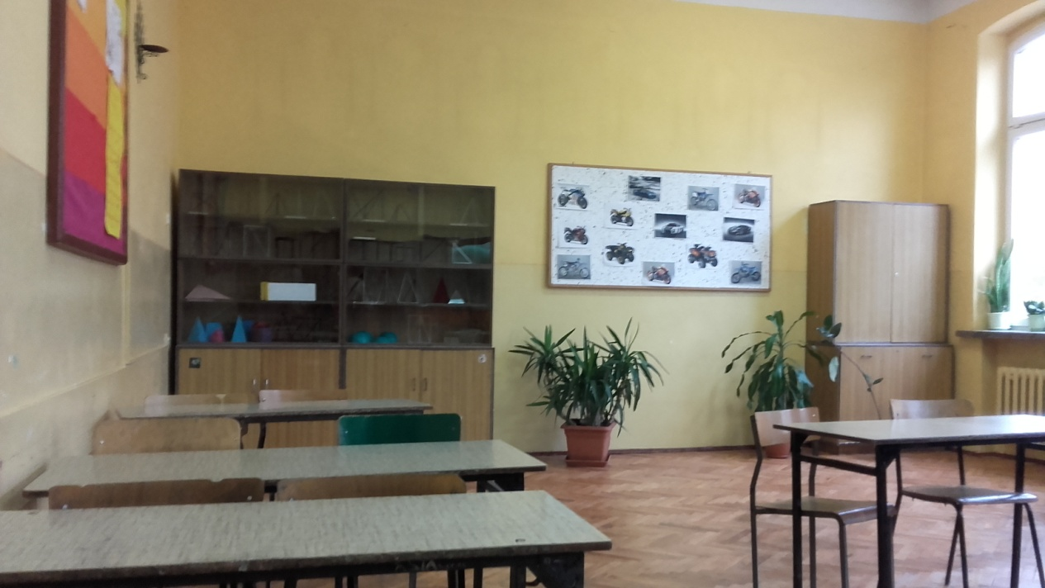
MATHEMATICAL CLASSROOM

Slide 6
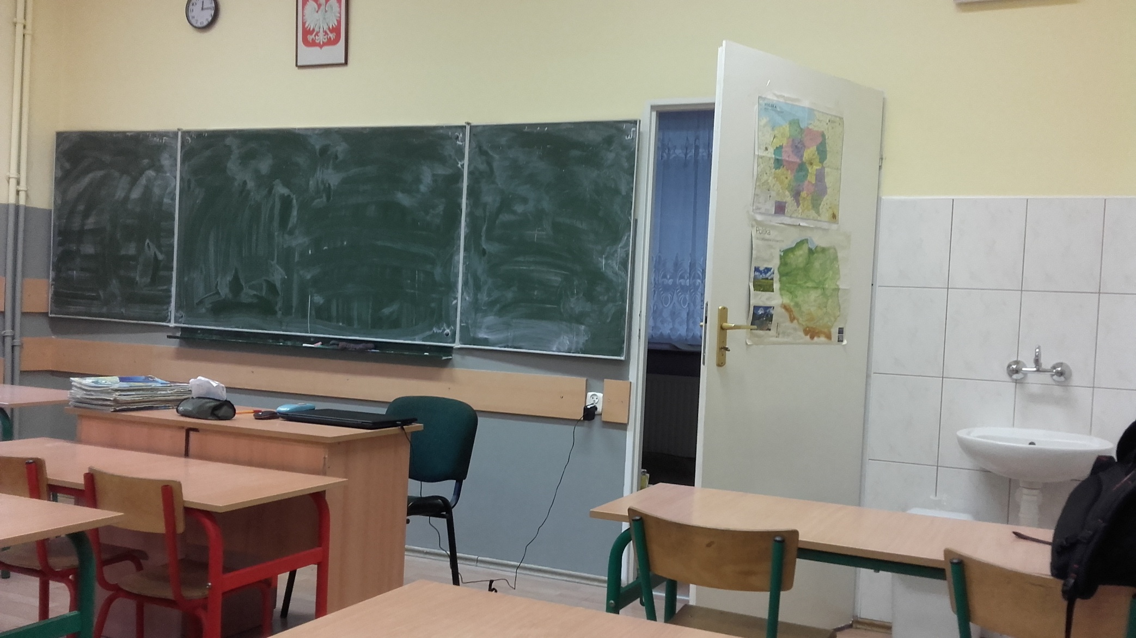
GEOGRAPHIC CLASSROOM

Slide 7
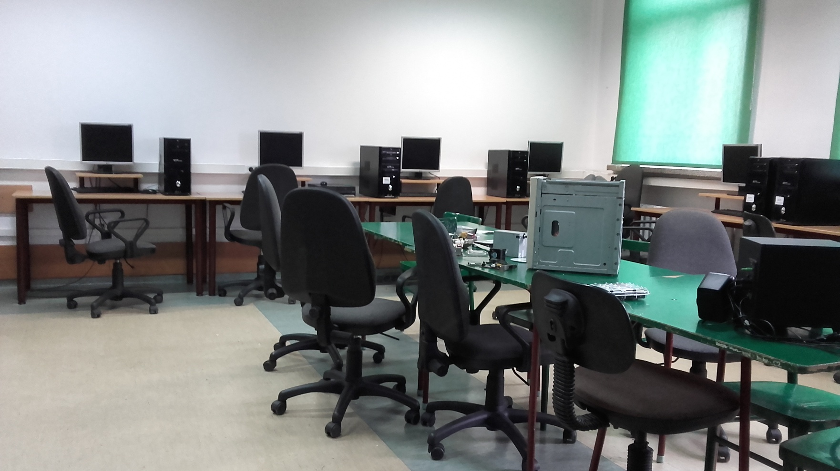
INFORMATION CLASSROOM

Slide 8
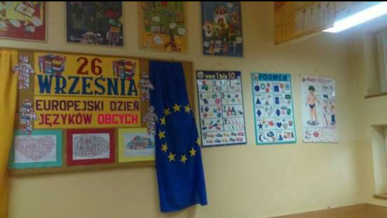
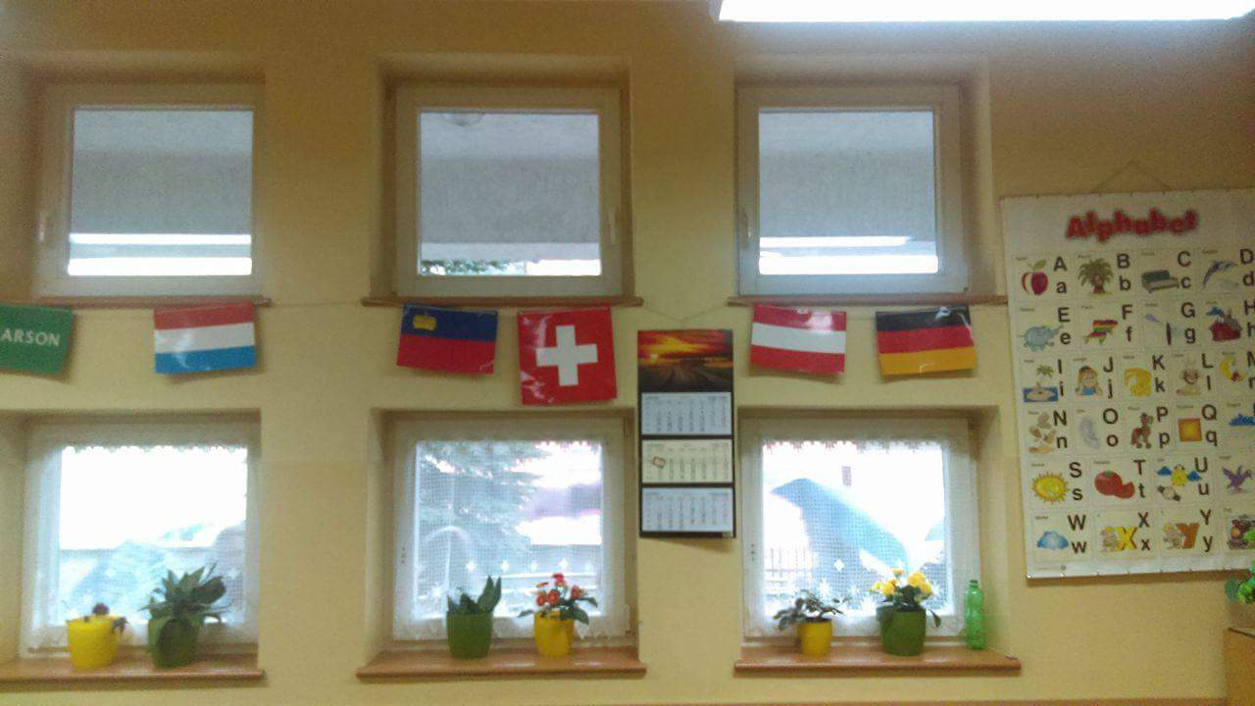
GERMAN CLASSROOM

Slide 9
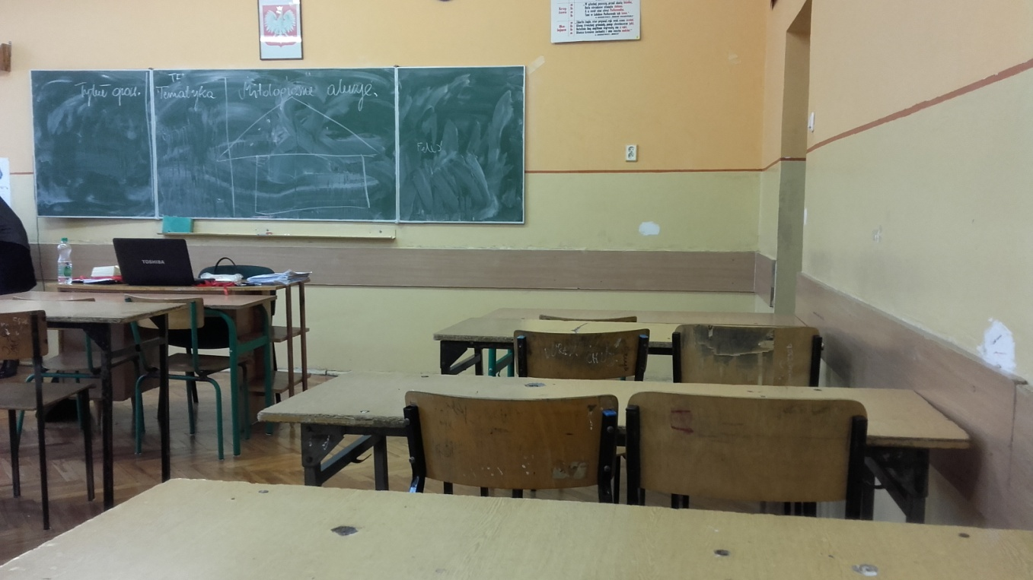
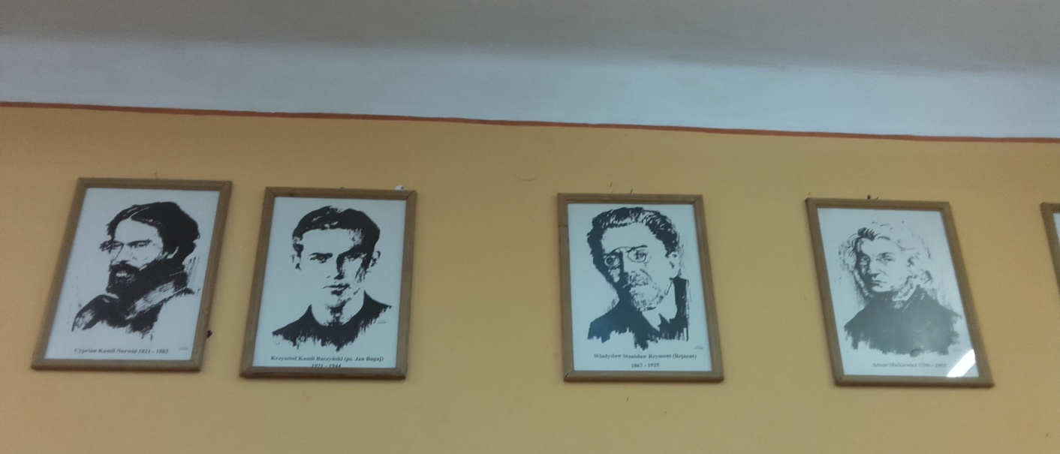
POLISH CLASSROOM

Slide 10
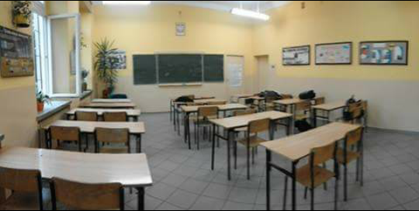
PHYSICAL CLASSROOM

Slide 11
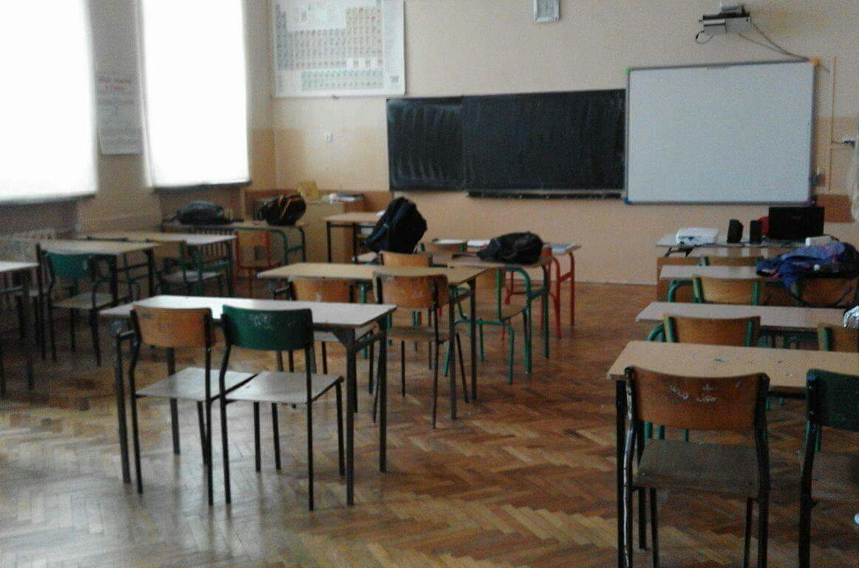
CHEMICAL AND HISTORIC
CLASSROOM

Slide 12
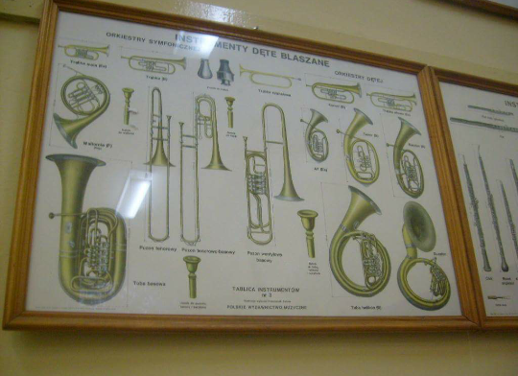
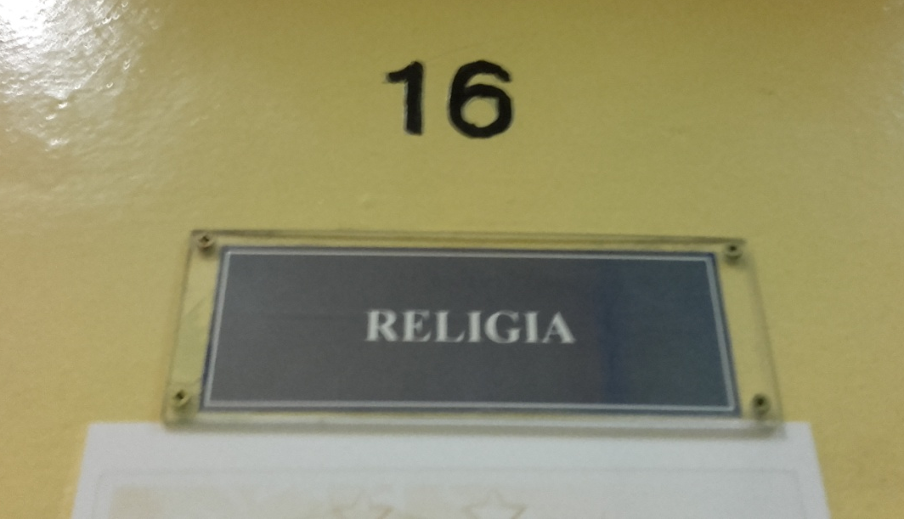
RELIGIOUS AND MUSICAL CLASSROOM

Slide 13
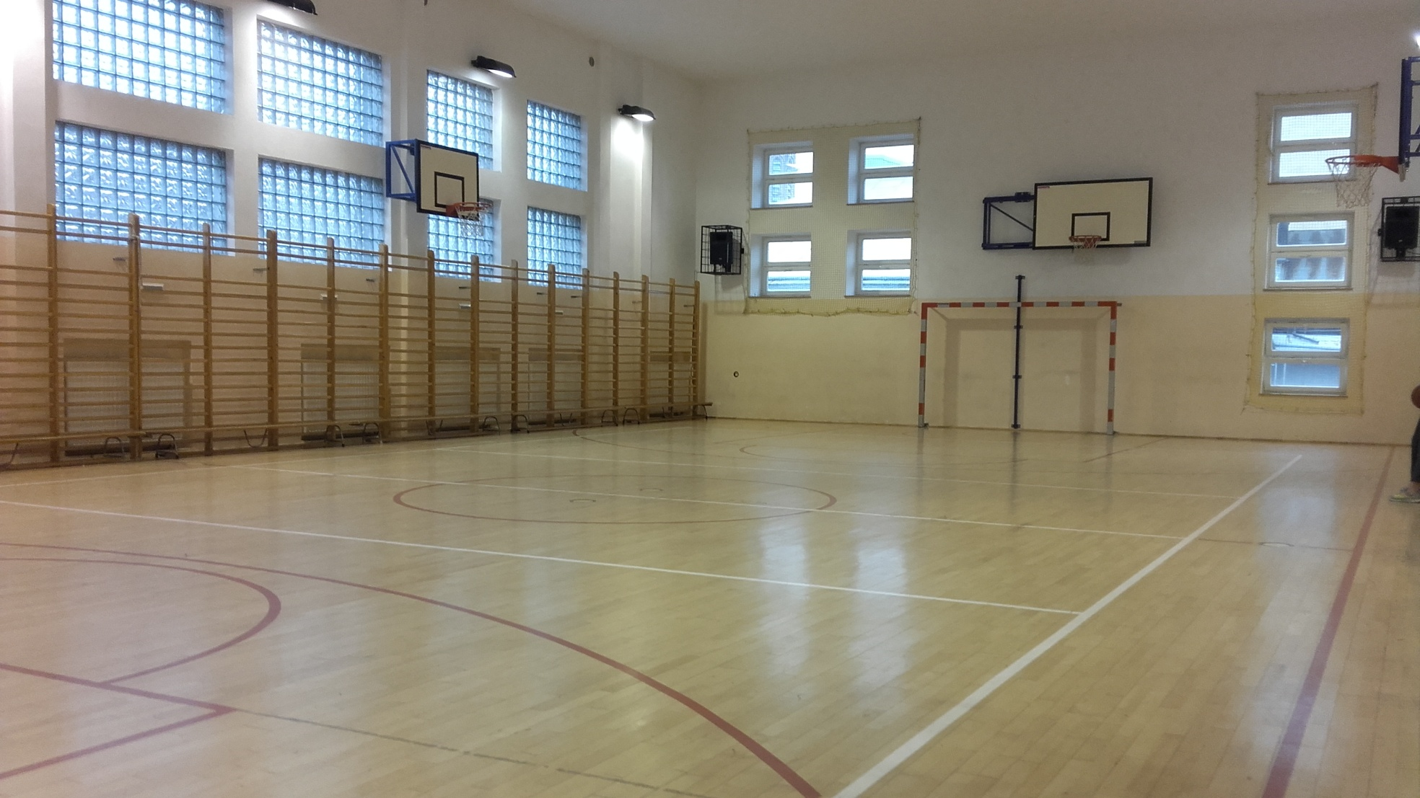
GYM

Slide 14
ENGLISH CLASSROOM

Slide 15
KNOWLEDGE ABOUT SOCIETY CLASSROOM

Slide 16
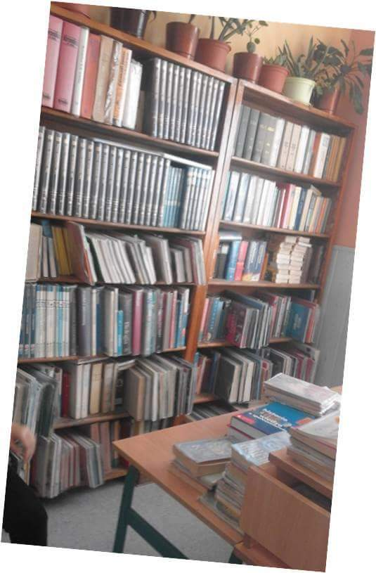
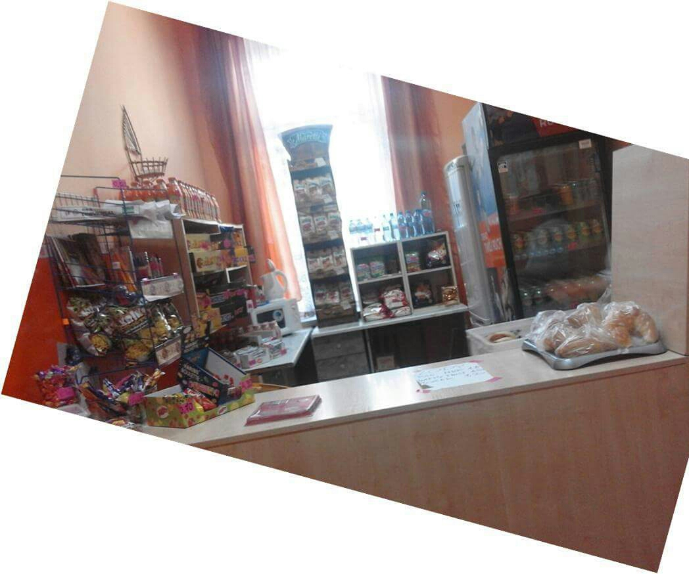
LIBRARY AND SCHOOL SHOP

Slide 17
THANK YOU FOR YOUR ATTENTION
NAME: MARTA
SURNAME: KOSZYK
KLASS: 1A

