Slide 1
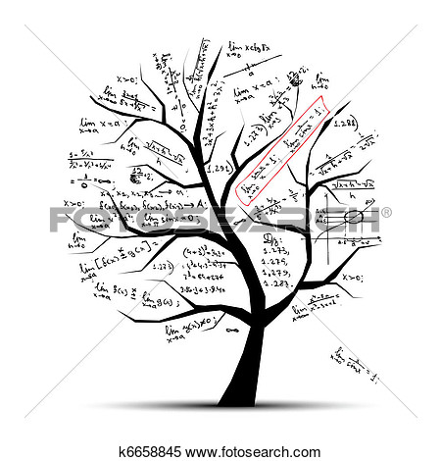
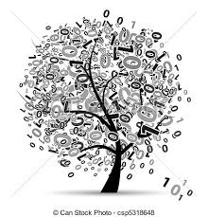
Famous mathematicians

Slide 2
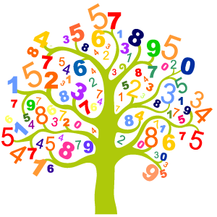
This presentation will be about famous mathematicians such as:
♦ Pitagoras
♦ Archimedes
♦ Pascal
♦ Galileusz
♦ Newton

Slide 3
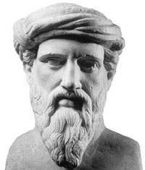
Pitagoras
Pitagoras was born in 572 p.n.e. in the Samnos. His parents was Mnesaechus and Pythais . He had three siblings : Eunomus, Themistocleia and Tvrrhenus. He was a
Mathematician and philozopher. He had
developed theory about sum angles in trianngle.
He was dead in 496 year.

Slide 4
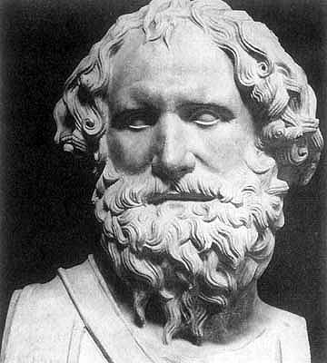
Archimedes
He was born in 287r p.n.e. in Syrakuz. He was a Greek philosopher and
mathematician . He was a son
of astronomer Fidiasz. Roman killed him in 212 year.

Slide 5
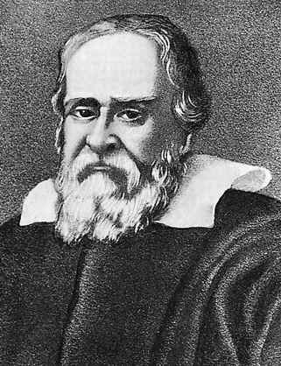
Galileusz
He was born in 1564 in Piza .He was an Italian astronomer, astrologer, mathematician, physicist and philosopher. He discovered rings of Saturn and geometric and military compass. He was dead in 1642 in Arcetri. He is buried in Santa Croce church.

Slide 6
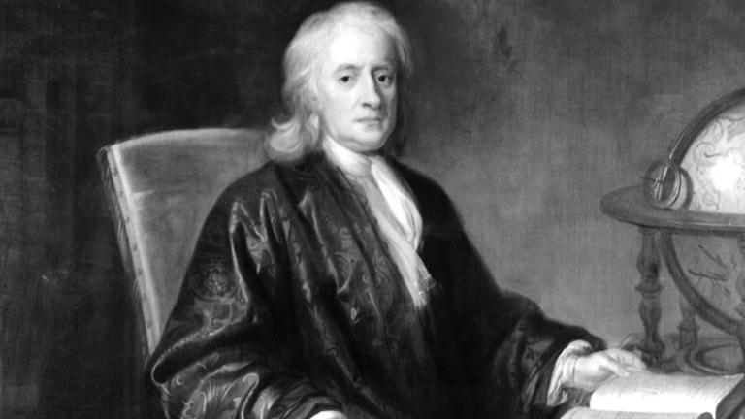
Newton
Isaac Newton was born in 1643 in Woolsthorpe. He was english
physicist, mathematician, astronomer, philosopher, historian and alchemists. In his famous work he was write about law of gravity. He was dead in 1721 in Kensington.

Slide 7
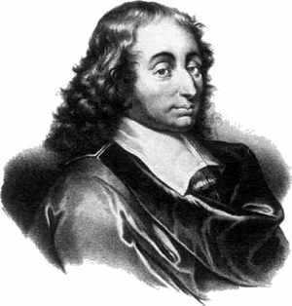
Pascal
Blaise Pascal was born in 19 June 1623 in Clermont-Ferrand. Since the age of sixteen he was
interested in mathematics . He was a french mathematician, physicist
and philosopher of religion . He was help to construction of mechanical
calculators and fluid mechanics.
In all his studies he defended the scientific method.
He was dead in 19 September 1662.

Slide 8
Thank you for your attention
Karolina Michalik
1c

